Slide 1
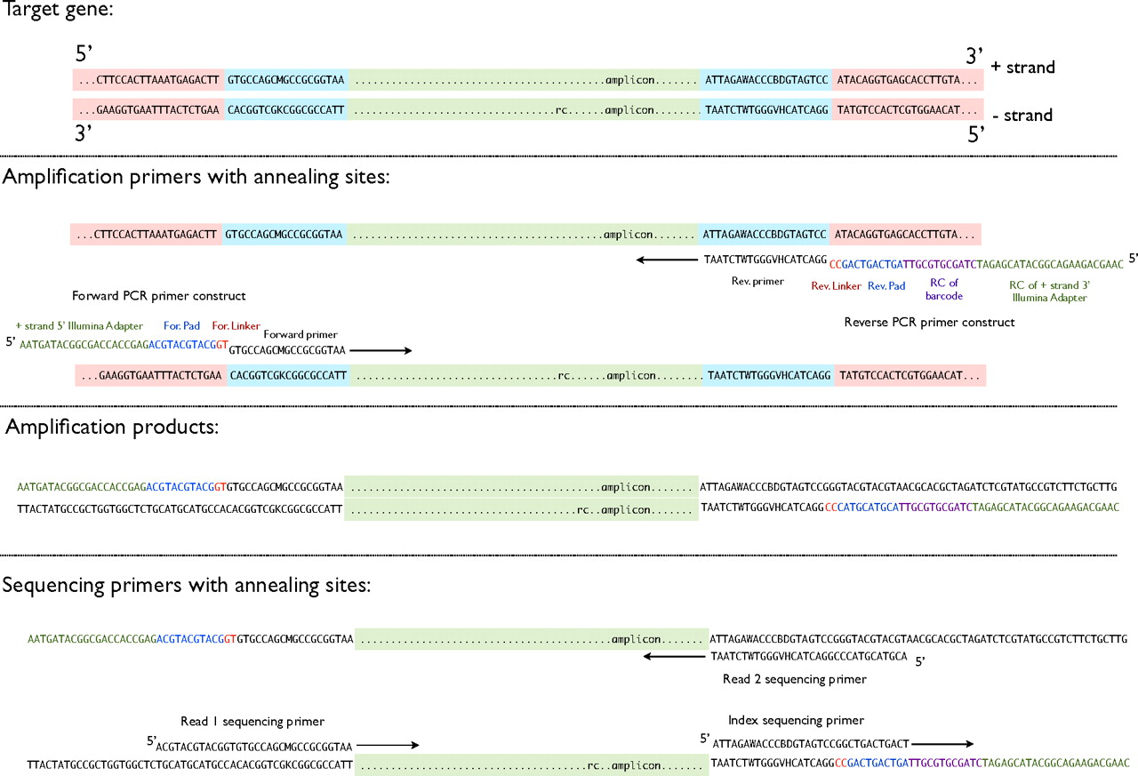
Protocol for barcoded Illumina pyrosequencing.
J. Gregory Caporaso et al. PNAS 2011;108:4516-4522
©2011 by National Academy of Sciences
Notes:
Protocol for barcoded Illumina pyrosequencing. First, conserved regions within the target gene (in this case, 16S rRNA) are identified (blue), together with an amplicon that clipping studies along the lines of ref. 15 indicate are especially good for community sequence analysis (green). Second, PCR amplifications are performed, using primers that include a linker sequence not homologous to any 16S rRNA sequence at the corresponding positions, the barcode, and the Illumina adaptor. Thus, the match between the primer and the template sequence ends at the end of the black region of the primer, and the linker and adaptors (shown in color) do not match the template. This procedure yields a library of amplification products that contain the barcode and Illumina adaptors. Finally, three separate primers are used to yield the 5′ read, the 3′ read, and the index read (that yields the barcode sequence).

