Slide 1
Shipboard ADCPs :
Software tools to view velocity profiles
using calibration as example

Slide 2
Outline:
    (briefly) introduce three ways
    to view ADCP data
    check out one with example data:
          “pretty”, cal idea, similar ADCP setup
    summarize cal needs and approach
    three methods to (check) calibration
    quiz: identify these two cal issues

Slide 3
Two ADCPs: - TRDI Pinnacle 45kHz
- Simrad EC150
Three tools for Pinnacle:
- VMDAS (TRDI’s acquisition software)
- WinADCP (TRDI “userexit” program)
- CODAS (U. Hawaii )

Slide 4
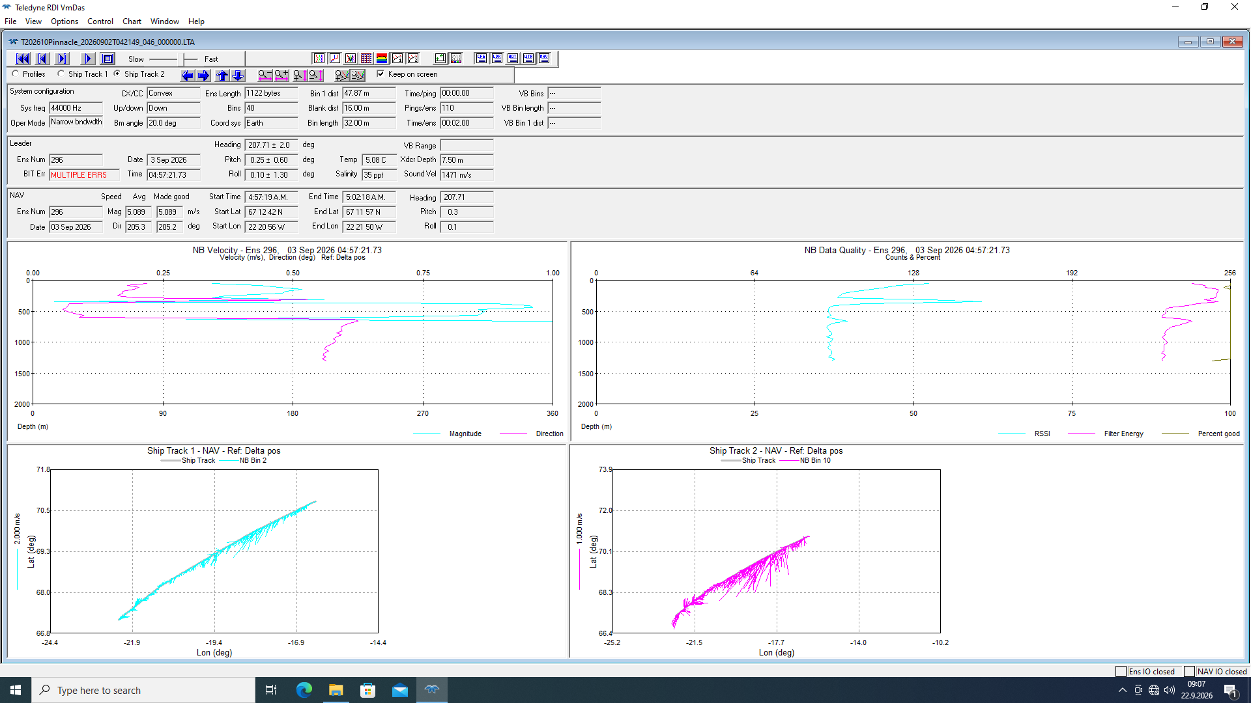

Slide 5
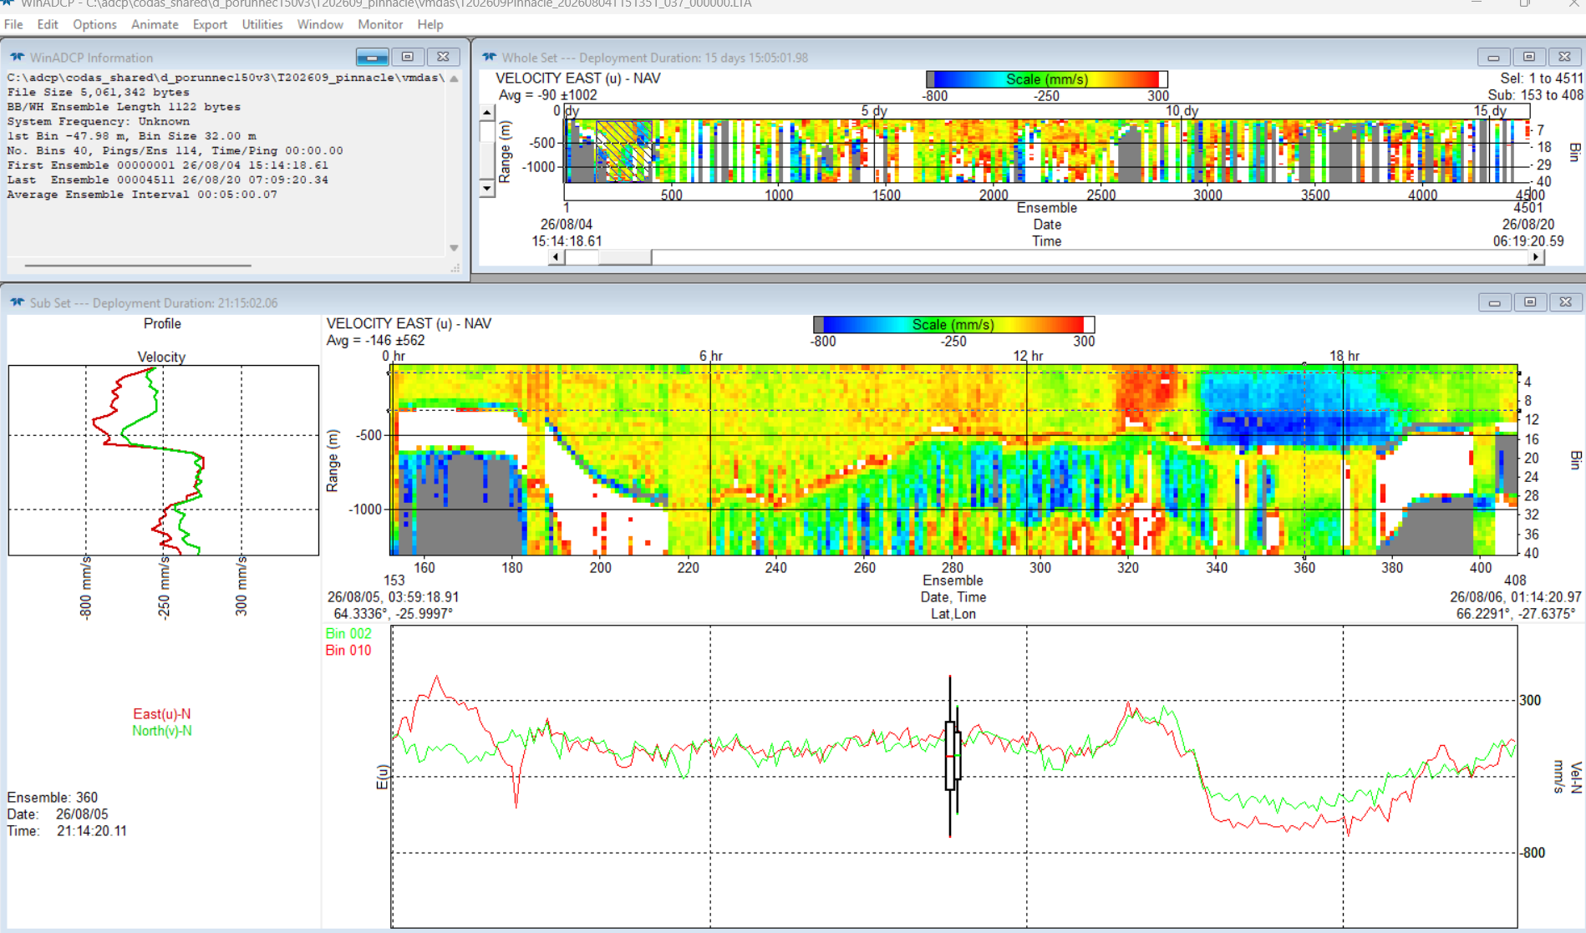

Slide 6
Two ADCPs: - TRDI Pinnacle 45kHz
- Simrad EC150
Three tools for Pinnacle:
- VMDAS (TRDI’s acquisition software)
- WinADCP (TRDI “userexit” program)
- CODAS (U. Hawaii )

Slide 7
CODAS:
- from University of Hawaii:
https://currents.soest.hawaii.edu
- native for linux and Mac
via conda package manager
- Windows and Mac:
VirtualBox plus .ova => linux

Slide 8
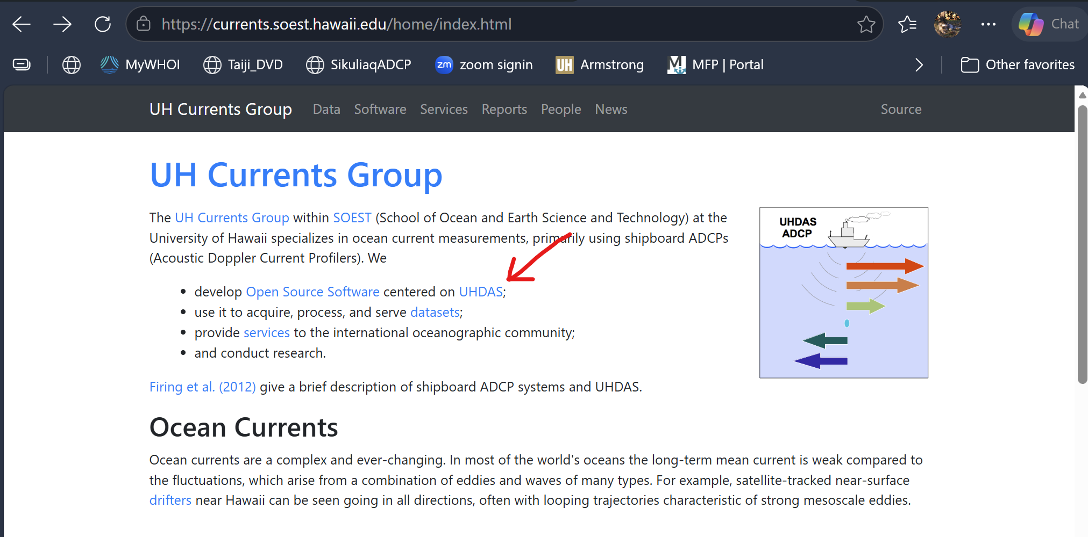
“words”: CODAS vs. UHDAS
- in short:
UHDAS = data acquisition + CODAS processing

Slide 9
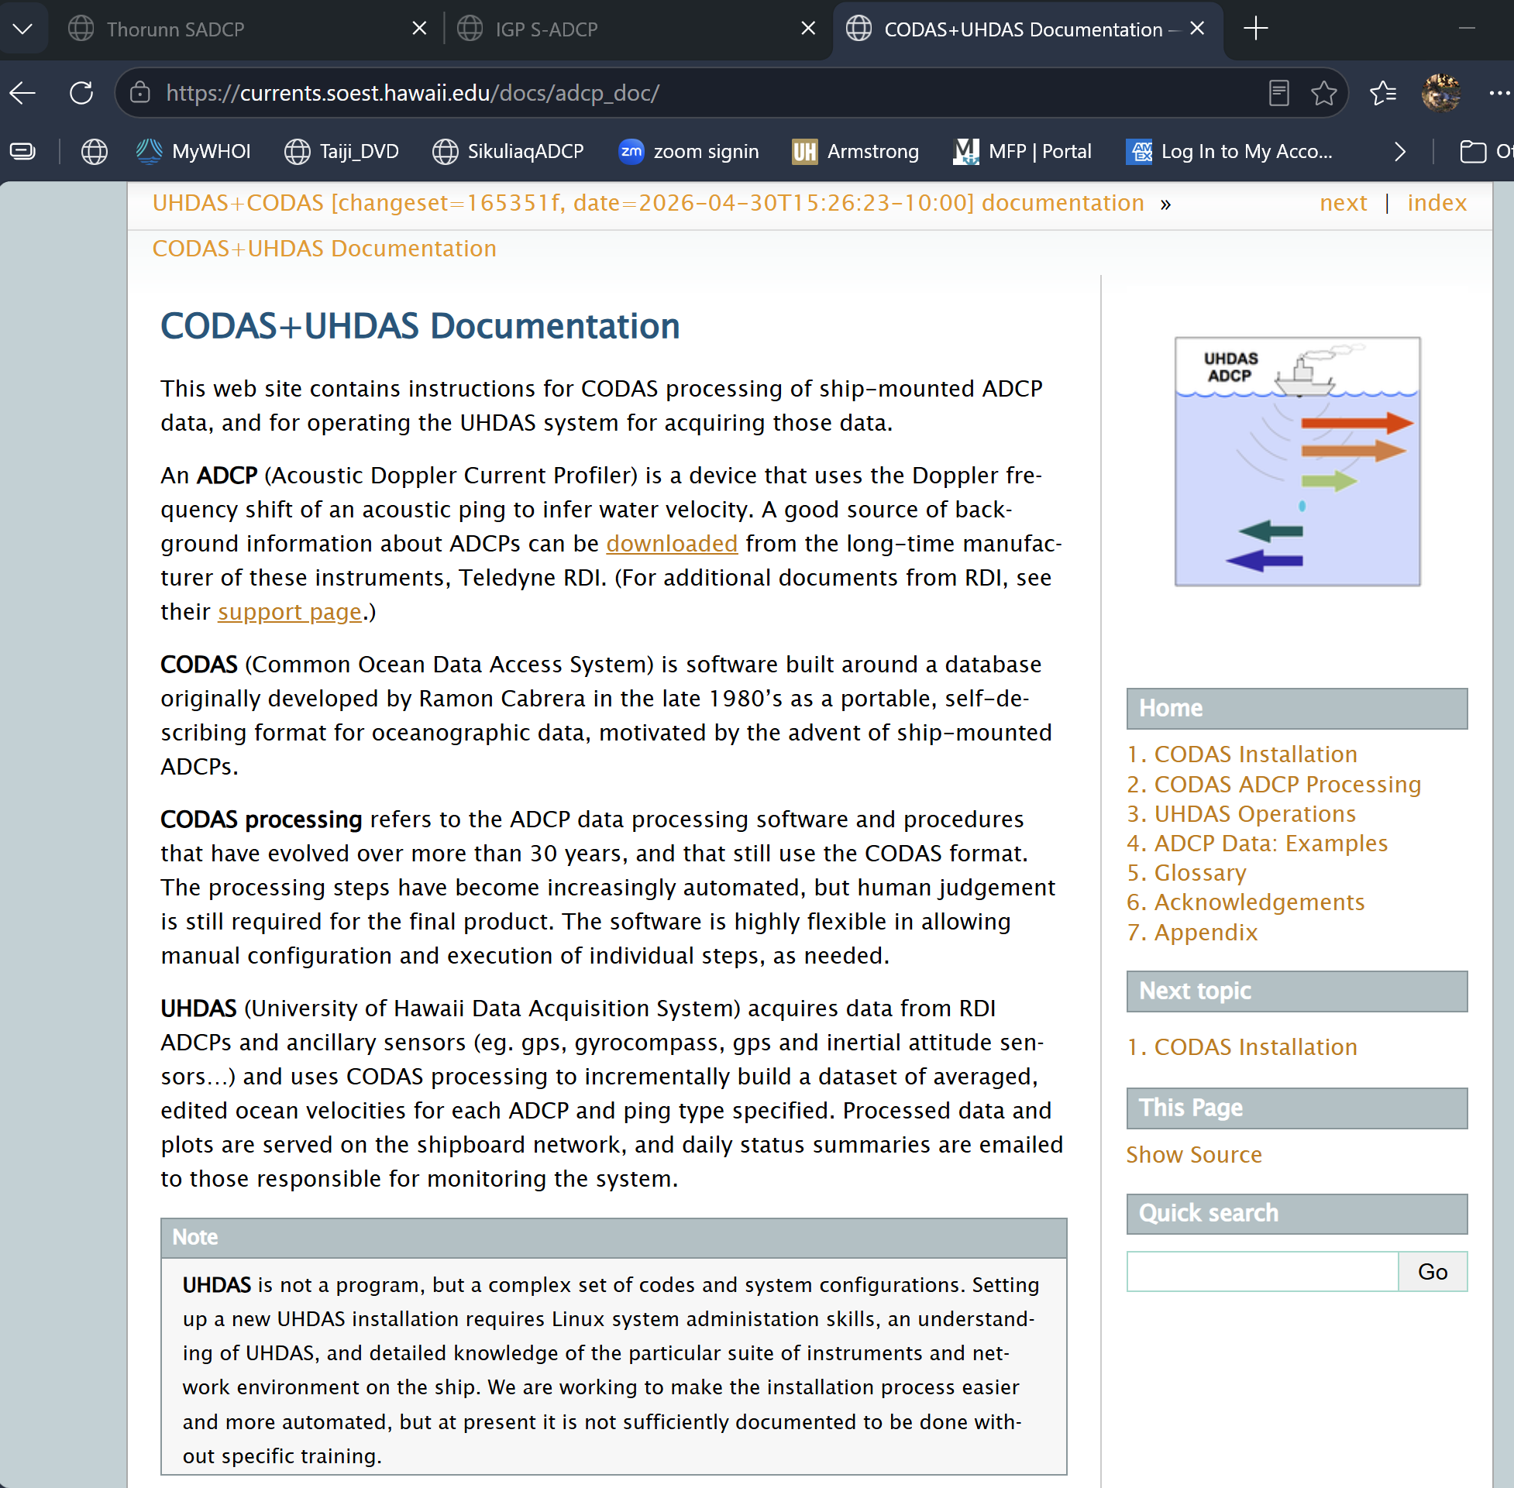

Slide 10
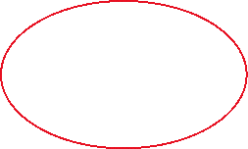

Slide 11
Examples:
- AR72a 96.65 0.6 pretty Gulf Stream meander
/media/sf_codas_shared/ar72a/adcp/proc/os38nb
AR45_1 182.9 0.6 reciprocal current off W Greenland; relevant for calibration
JS2542 246.1 0.6 bins 70 75 deep overflow;
similar setup but OS75nb
/media/sf_adcp_b/codas_shared/all_faroe/2025cruises/js2542/os75nb_ENR

Slide 12
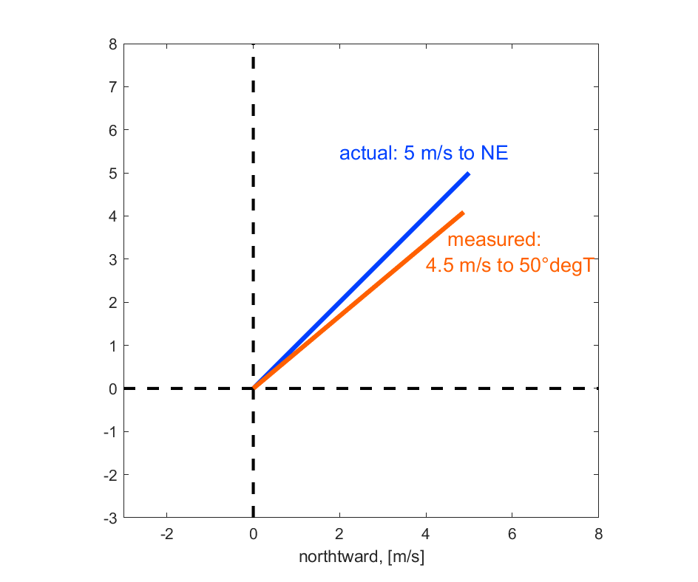
Back to calibrations:
Q: what to calibrate?
  Take a look at the ADCP system:

Slide 13
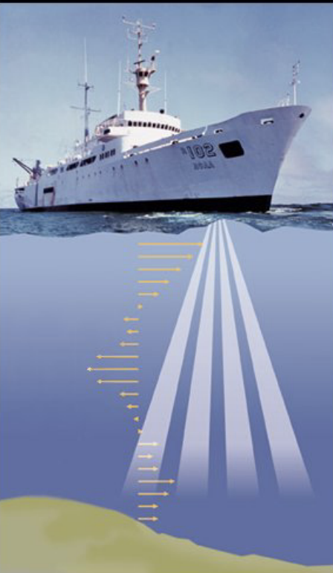
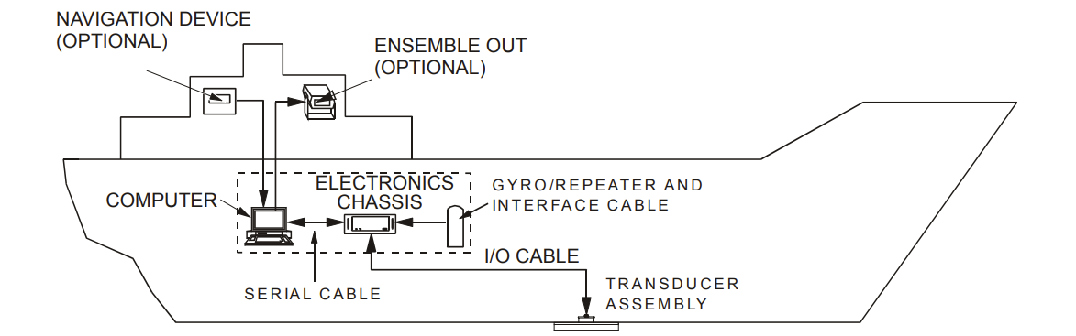
Calibrate:
- basic ADCP measurement:
accurate along-beam speed: => amplitude
- alignment:
correct orientation of transducer/heading device combination => rotation

Slide 14
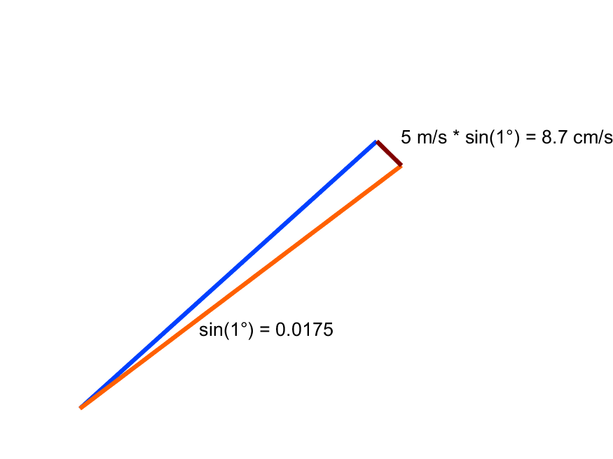
Problem: ship velocity is large
compared to ocean velocity
1 degree rotation => error ~2% of ship speed
10 knots => ~ 10 cm/s error per degree!
10 knots for 5 min: 5 m/s * 300 s = 1500m; 1 degree error: 1500m*0.02 = 30m; ¼ ship length. 30m/300s = 10 cm/s

Slide 15
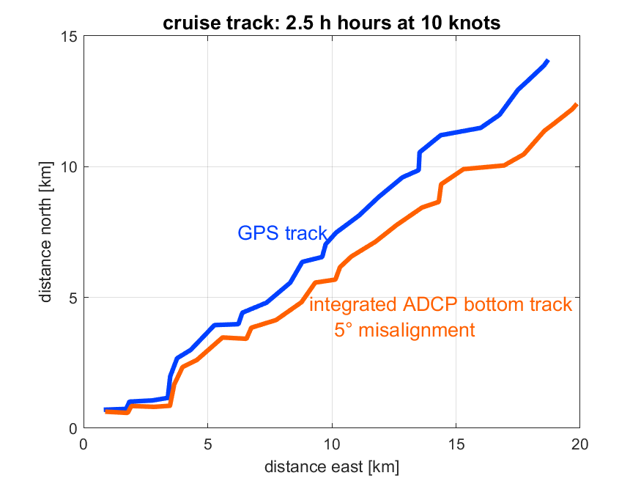
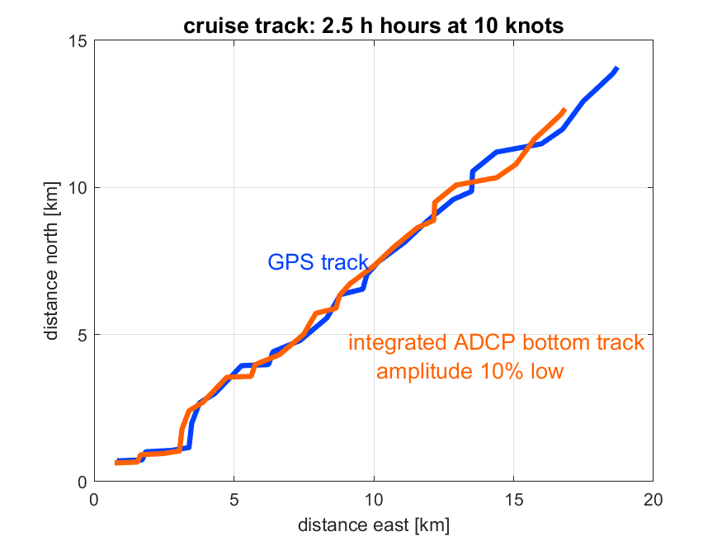
1. bottom track:
compare GPS track to
integrated (apparent) sea floor velocity

Slide 16
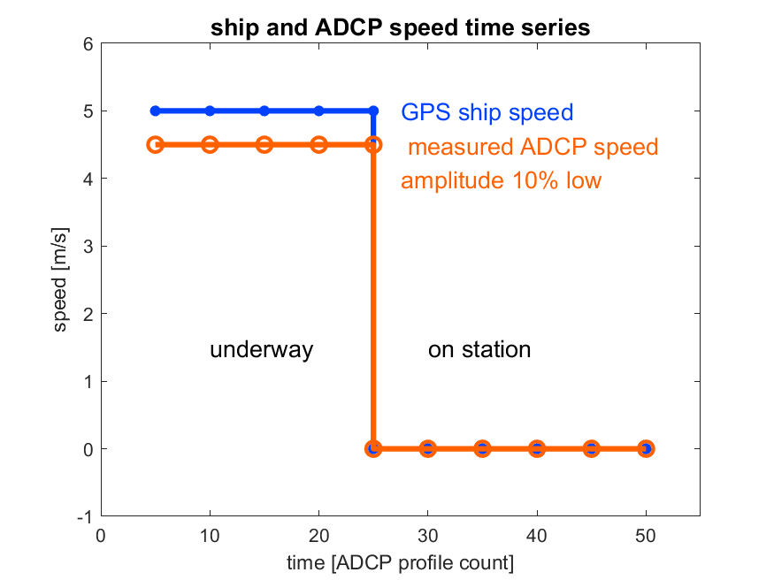
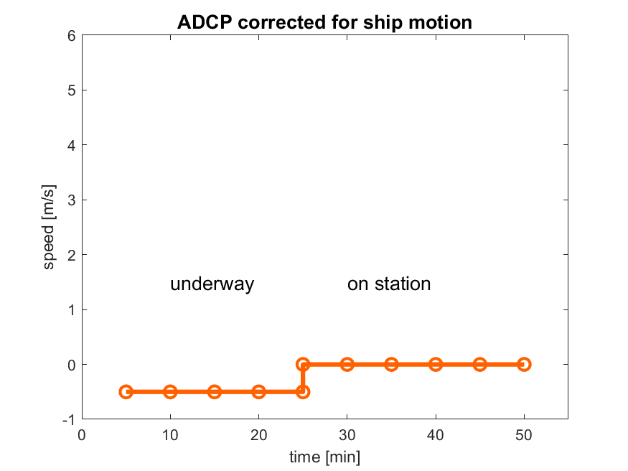
2. water track:
compare ADCP velocity before
and after ship velocity change
(station arrival/departure, sharp course change)

Slide 17
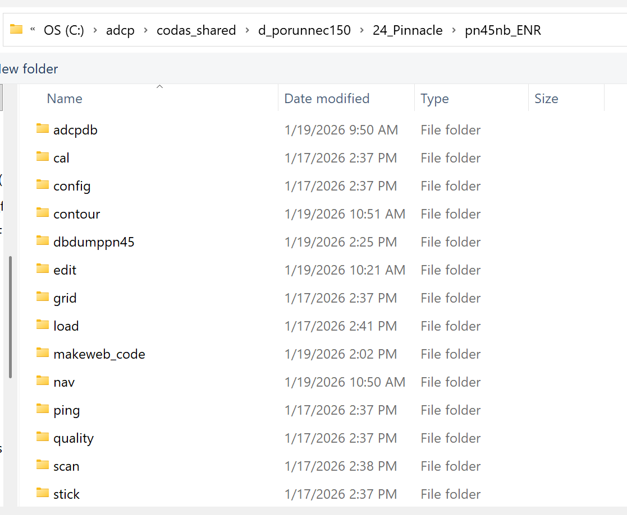
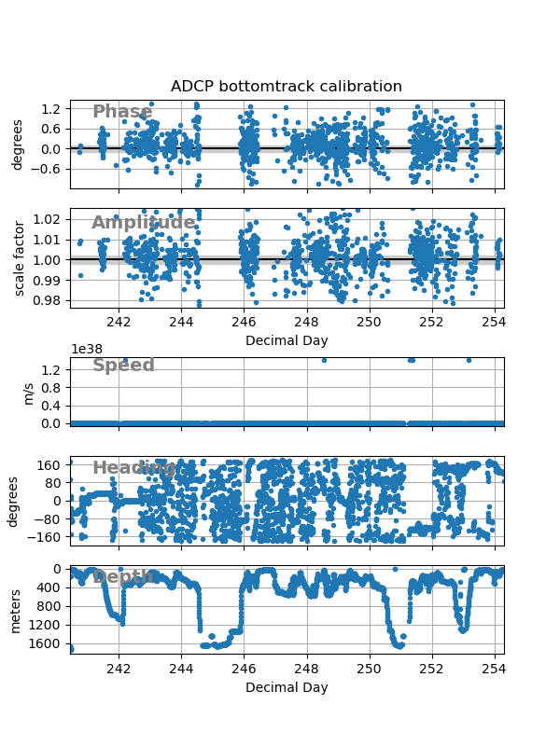
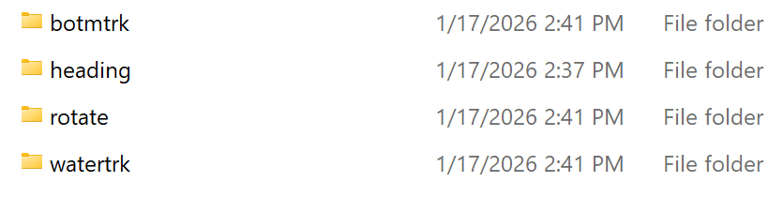
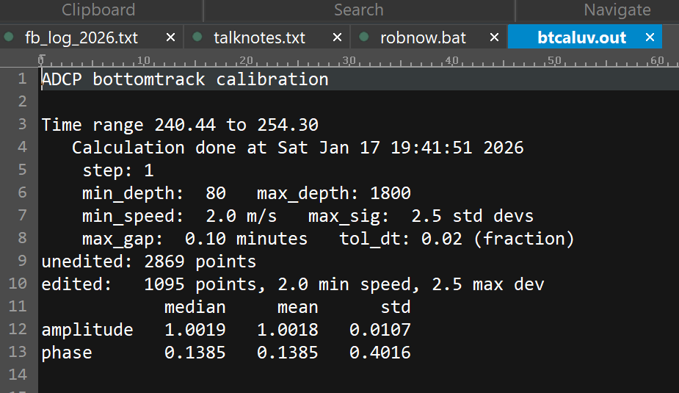



Slide 18
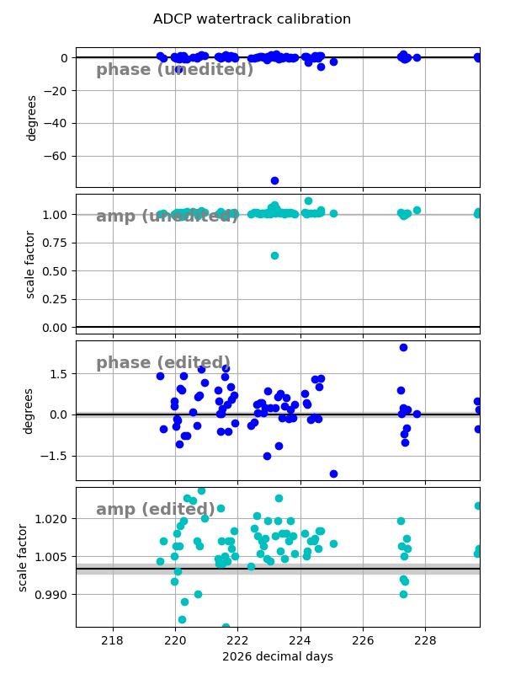
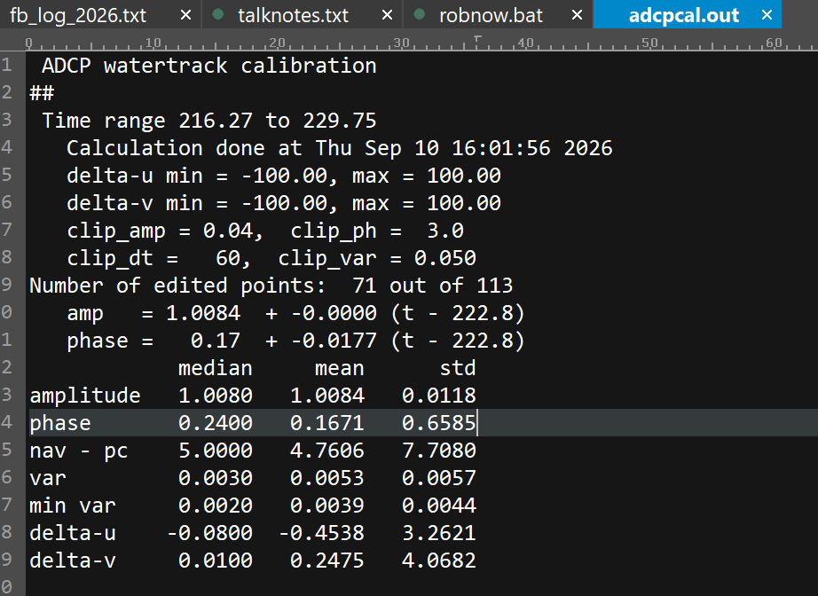



Slide 19
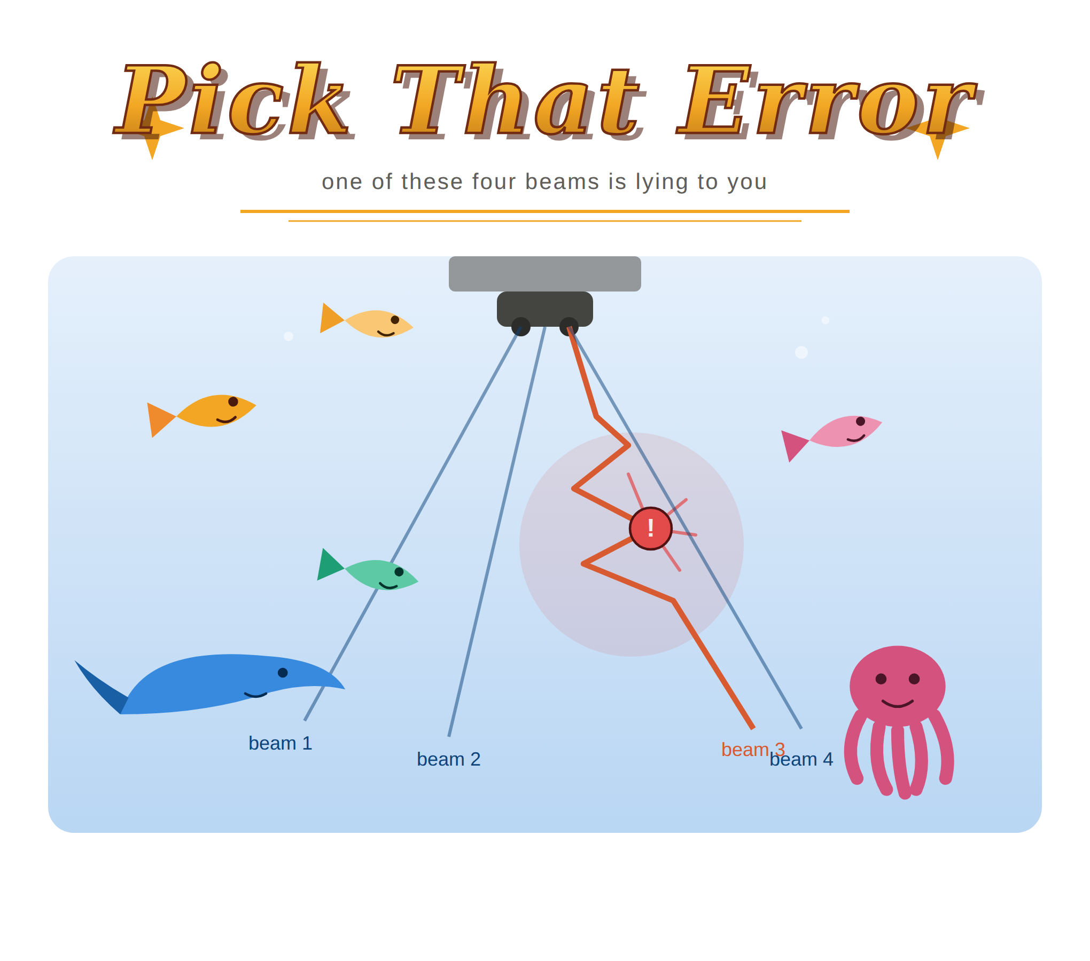
Quiz:
T202609 Pinnacle data were modified to simulate misalignment and low amplitude, respectively
quick_adcp.py --steps2rerun rotate:navsteps:calib --rotateangle -1 --auto
quick_adcp.py --steps2rerun rotate:navsteps:calib --rotate_amplitude 0.983 --auto

Slide 20
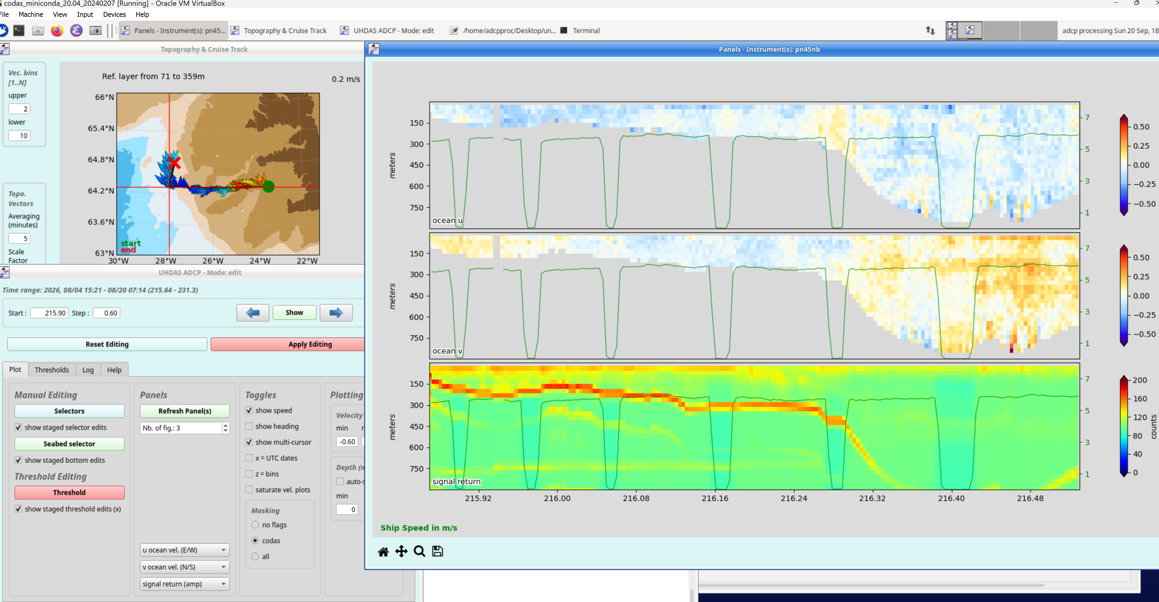

Slide 21
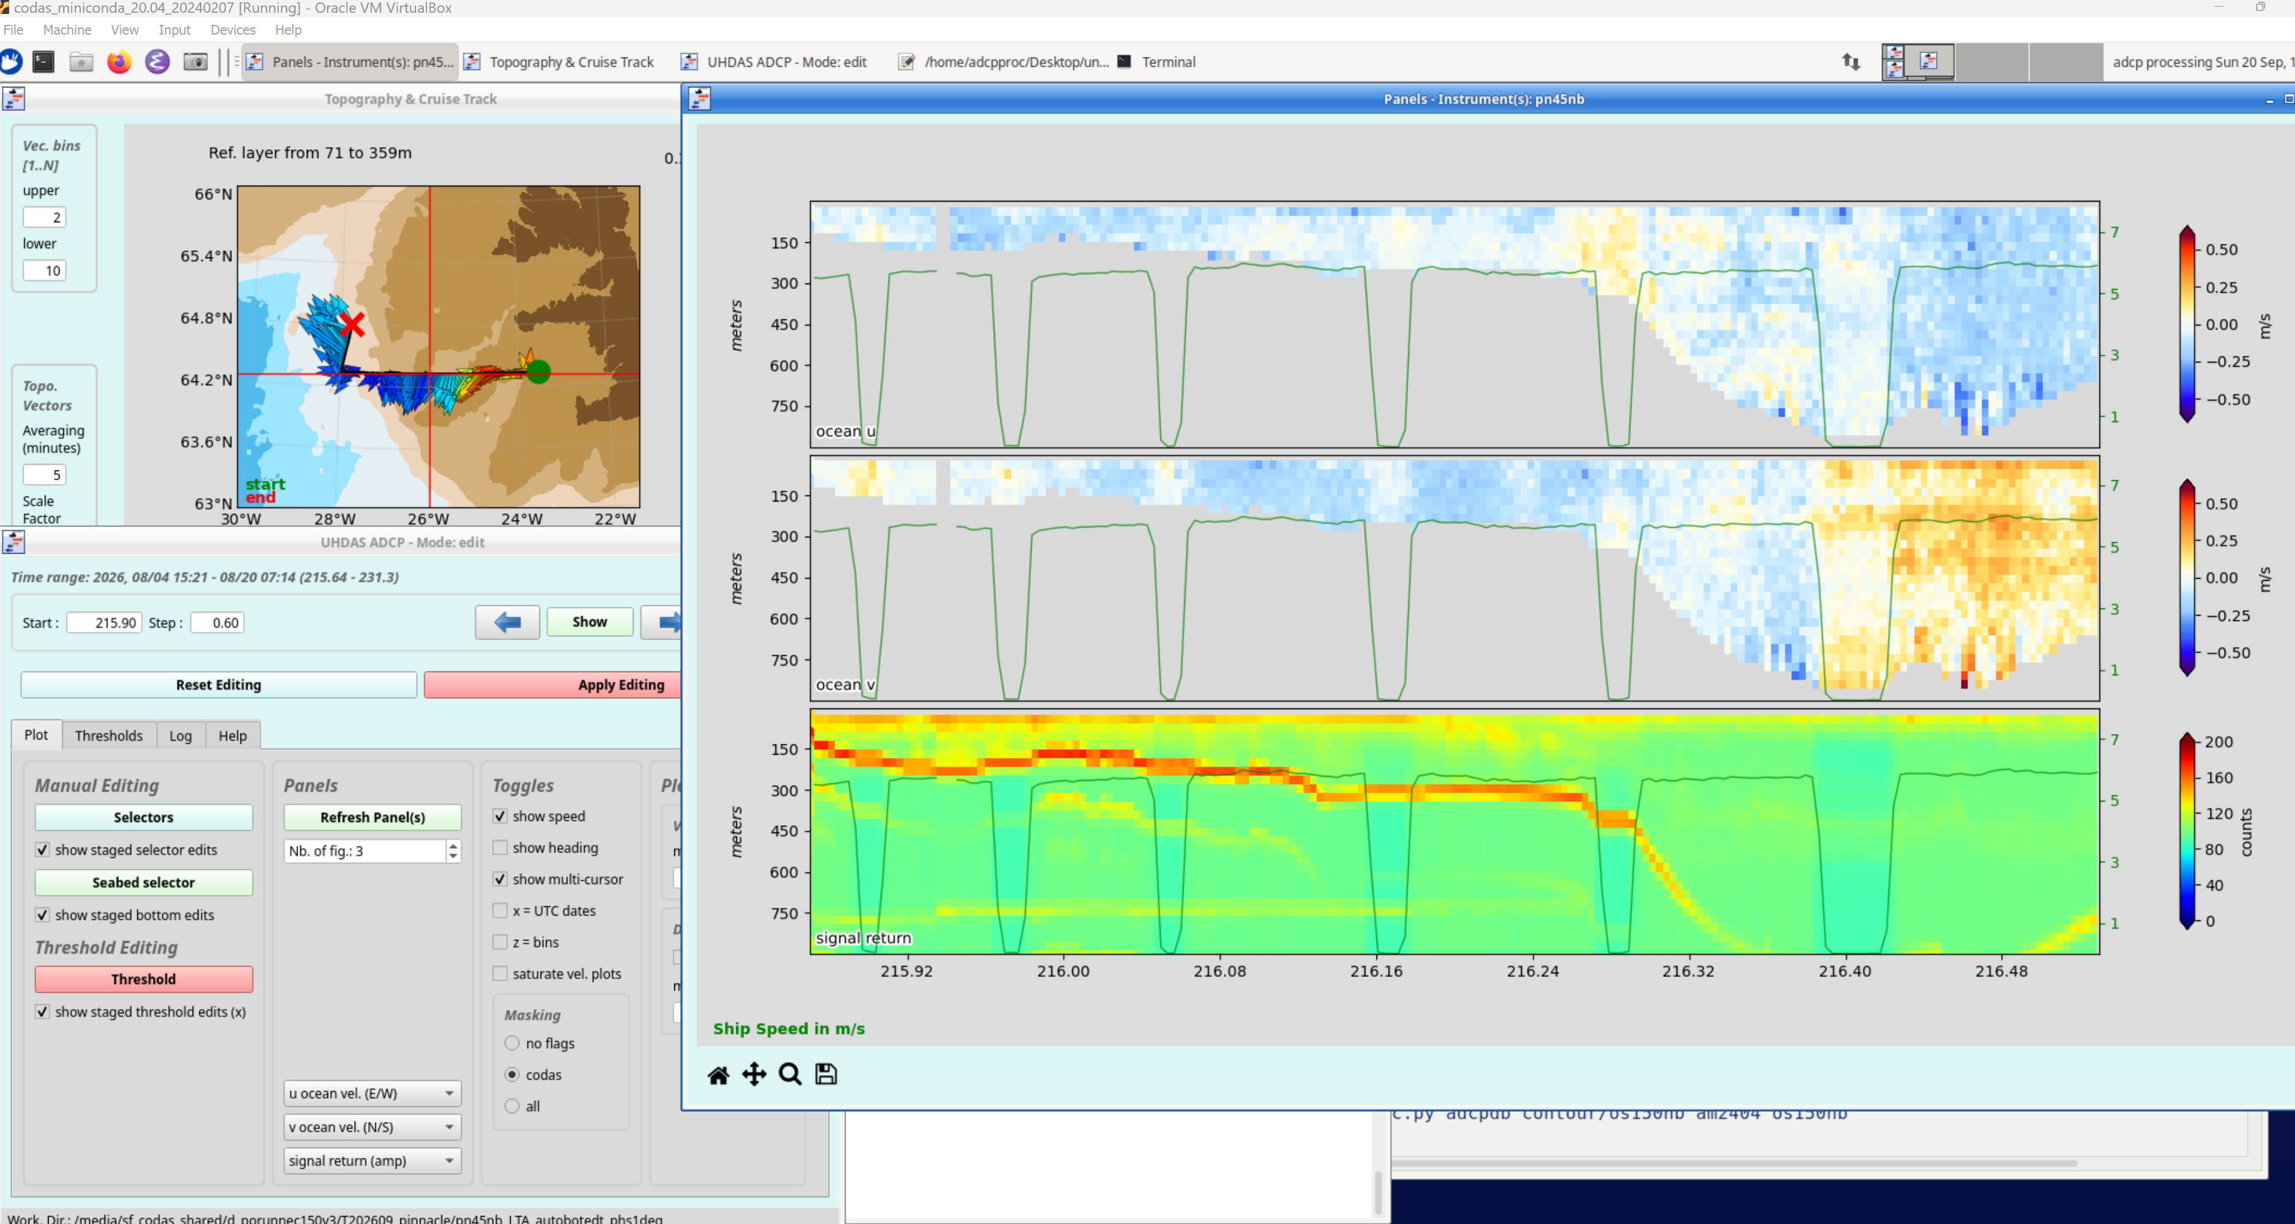

Slide 22
