Slide 1
DiabetesAI
Charis Xiong & Teresa Zhou
Notes:
Today, we’ll be talking bout our project, which deals with diabetes. Essentially, we watn to create a model DiabetesAI in whcih we can help people with diabetes manage their conditions whether that be early diagnosis / health suggestions

Slide 2
Table of Contents
01
04
02
05
03
06
Background
Models
Hypothesis
Results
Data Pre-Processing
Resources

Slide 3
Background Information
Diabetes: chronic disease that occurs when body has trouble regulating blood sugar levels (Cleveland Clinic)
In 2021, 38.4 million people in the US had diabetes (11.6%) with 8.7 million undiagnosed (3.4%) (CDC)
An estimated 97.6 million Americans had pre-diabetes (CDC)
Over time, high blood glucose levels can have long-term complications: risks of heart attacks, strokes, etc. (Cleveland Clinic)
Early diagnosis can lead to lifestyle changes and more effective treatments, allowing for predictive models for diabetes risks crucial for public health
Notes:
Diabetes is among the most prevalent chronic diseases in the United States, impacting millions of Americans each year. Because there are so many complications associated with consistent high blood sugar levels, it’s important to diagnose earlier [for lifestyle changes and more effective treatments]→ which is why we wanted to focus our model on this critical issue.
Diabetes - condition in which your body has trouble regulating your blood sugar (glucose) levels → resulting in too high of glucose levels
This results in blood sugar levels becoming too high because (either can’t produce enough insulin / can’t effectively use the insulin it produces /both). Needed to help cells absorb glucose from bloodstream (otherwise builds in blood)
This can become a problem as over time, consisitent high blood sugar levels can lead to serious health complications like risks of heart disease, nerve damage, kidney disease, etc. thats why it’s important to diagnose early so people can manage diabetes more effectively to prevent serious health complications like what we’ve previously mentioned.
In terms of statistics, how relevant it is to us in the US, in 2021 about 38.4 million people in the US had diabetes (11.6% of the population) with about 8.7 million being undiagnosed. The CDC further estimates that about 97.6 million Americans had pre-diabetes. These high levels
These high statistics really reinforce how relevant this issue is and the need for early diagnosis,which is why we wanted to focus our project on this issue →
so we can help individuals make the needed lifestyle changes / start the needed, more effective treatments early

Slide 4
With our model, you can…
Diabetes prediction
Suggestions for health
Notes:
Essentially with our model, we want to see if we can predict if a person has diabetes based on features but also see if we can make suggestions for health (people w diabetes)
We’ll get more into that in the further slides

Slide 5
03
Data Pre-Processing

Slide 6
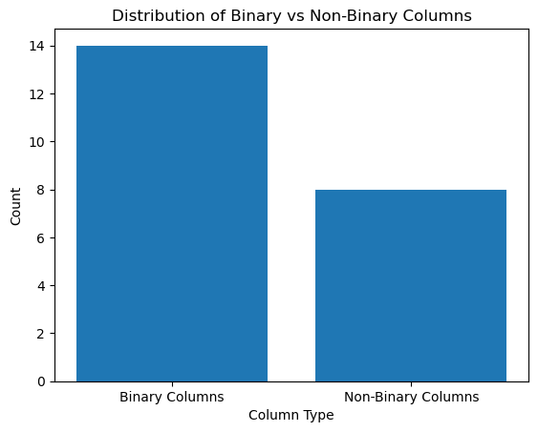
Dataset Overview
253,680 survey responses to CDC’s BRFSS2015
No missing values / categorical values
Features: HighChol, PhysAct, Fruits, Smoker, BMI
Binary features 14/22
Target feature (indicator of diabetes)
0 → no diabetes / only during pregnancy
1 → prediabetes
2 → diabetes
Notes:
The cdc sent out a survey system that collected data on health conditions, health-related risk behaviors, etc. so we have features like HighChol, BMI, MntlHealth, Fruits, etc. In our dataset, it’s relatively clean already – no missing values, no categorical variables – but we did have to do some other pre-processing b4 using our models, which we’ll talk about in the next couple slides/
BRFSS2015 is a telephone survey system that collects data on health-related risk behaviors, chronic health conditions, and health care access and use in the United States
Conformity bias - Specifically, lifestyle choices that are “bad” or “unhealthy” (like drinking, smoking, expressions of negative emotions, or other negative habits) may be misrepresented.

Slide 7
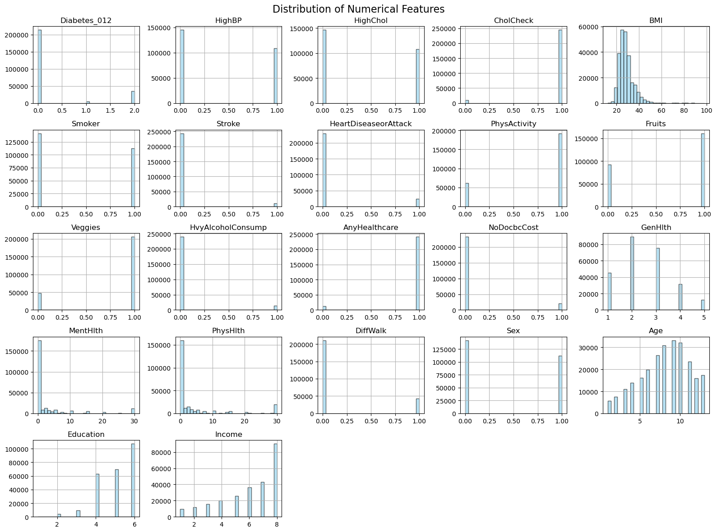
Imbalanced features
Diabetes_012 (target feature)
CholCheck
Stroke
HvyAlcoholConsump
AnyHealthcare
NoDocbcCost
Most correlated features
Most important features
Notes:
CholCheck → whether done cholesterol check in 5 years or not
hvyAlcConsumption → adult men (>14 drinks per week), adult women (>7 drinkers per week)
NoDocbcCost → past 12 months, you needed to see doctor but couldn’t bc of cost

Slide 8
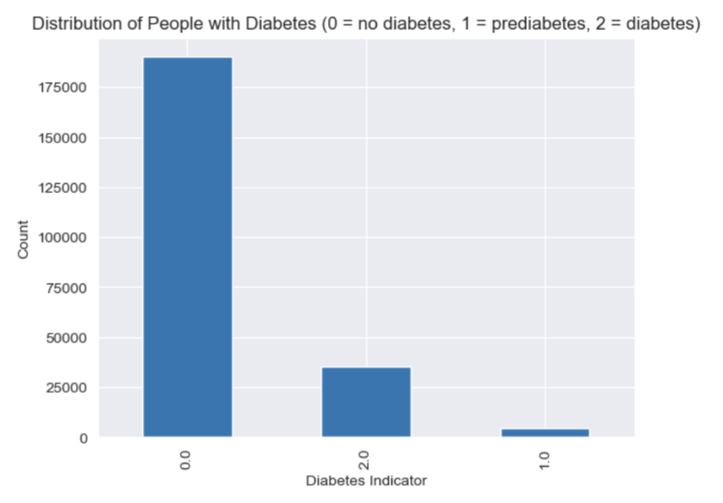
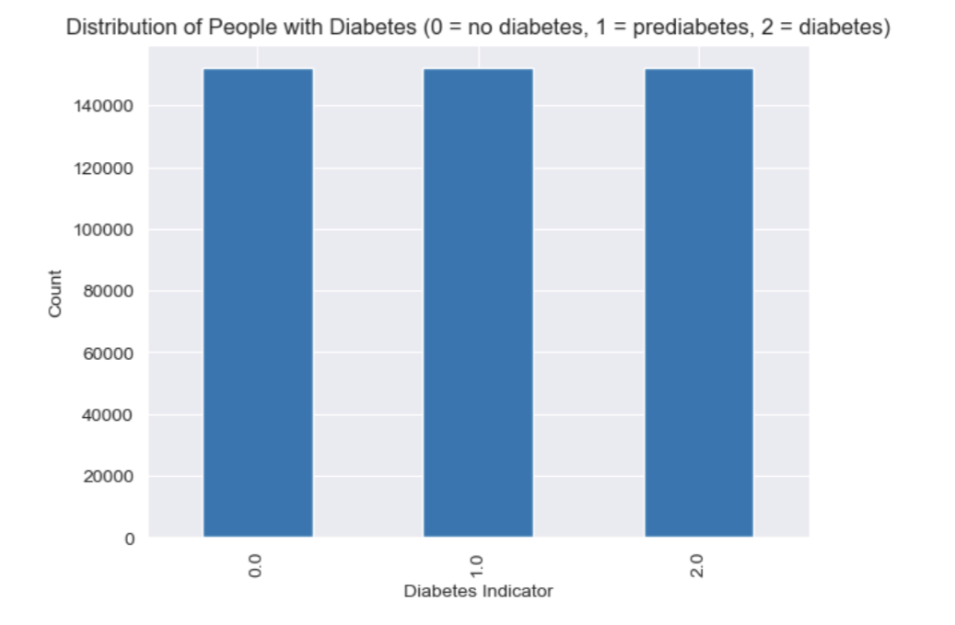
Imbalanced Features
Notes:
As you can see from the picture alone, we have a clear imbalance in our dataset:
0 (no diabetes) has about 190,000 values, 1 (pre-diabetes) has about 35,000 values, and class 2 (diabetes) - only about 4,000 values. There is a clear imbalance of features, so
To address this issue, we used resampling (oversampling) to balance the dataset, so we could create equal amts of data points in each category for the model to train effectively with.
Before we resampled, we split the dataset into training and test sets so we can make sure the test set remains an accurate representation fo real-world data and preventing data leakage

Slide 9
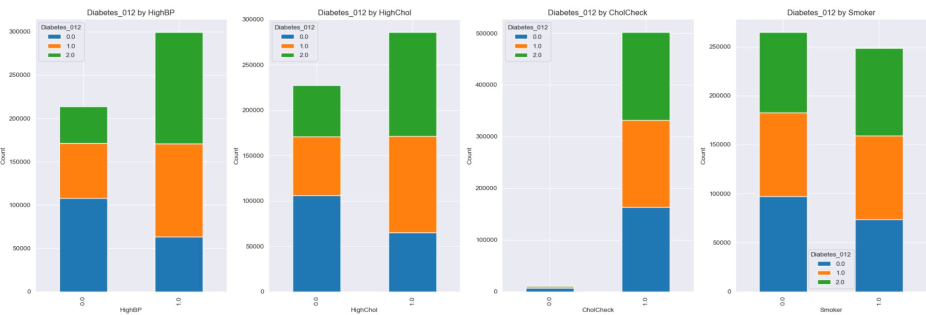
Visualizations
Notes:
We can see that across these four features HighBP, HIgh CHol, SMoker. CholCheck, the class 2/ green (diabetes) consistently occurs more often when people have high BP, high CHol, etc . This pattern indicates that maybe these health-related factors may be associated with an increased risk of diabetes.

Slide 10
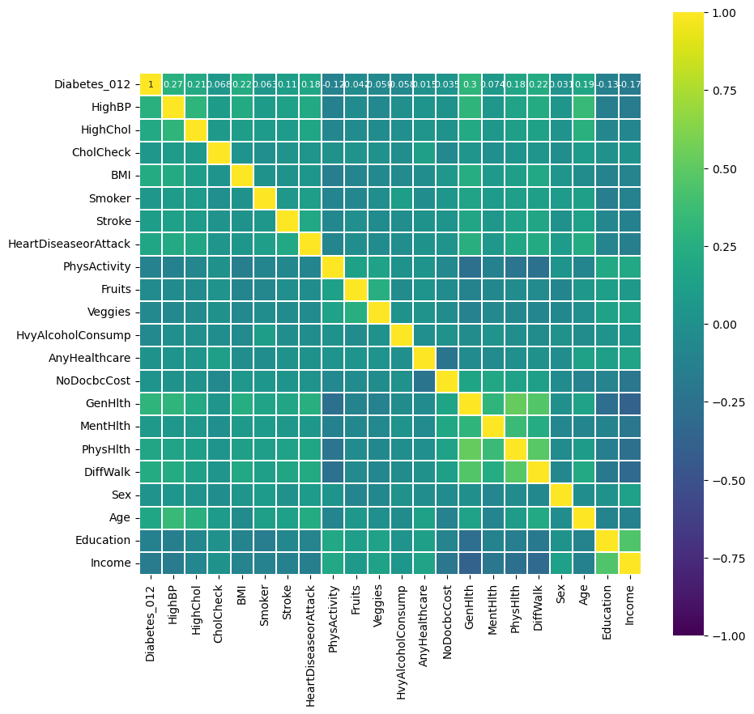
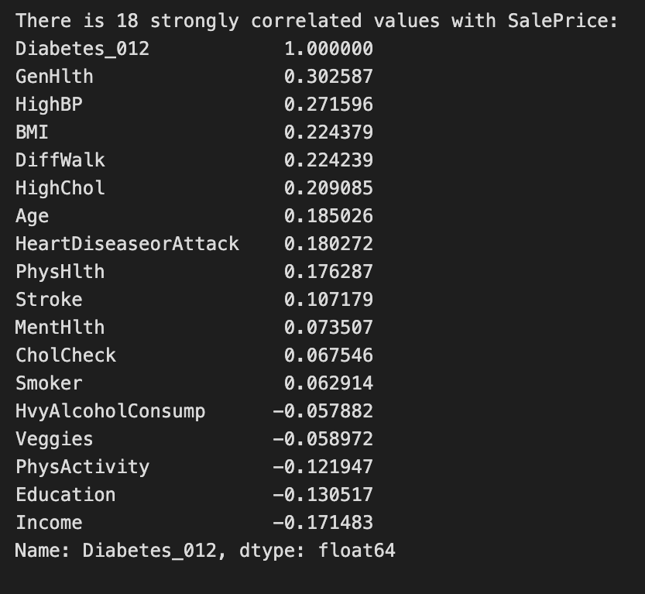
Correlation Analysis
Diabetes indicator → Diabetes_012
Most features are correlated with Diabetes_012
Apply a correlation threshold of 0.05
4 features excluded
5 features negatively related
13 features positively related
Notes:
We want to see how correlated the different features are with Diabetes_012;
5 features negatively related (PhysActivity → less physical activity - higher chance of health risks like obesity and diabtes;), 13 features positively related (genHlth, HighBP, BMI; BMI - strongly correlated with various health risks like diabetes (higher BMI - overweight) are at a higher risk of developing diabetes, cardiovascular disease, and other health conditions)

Slide 11
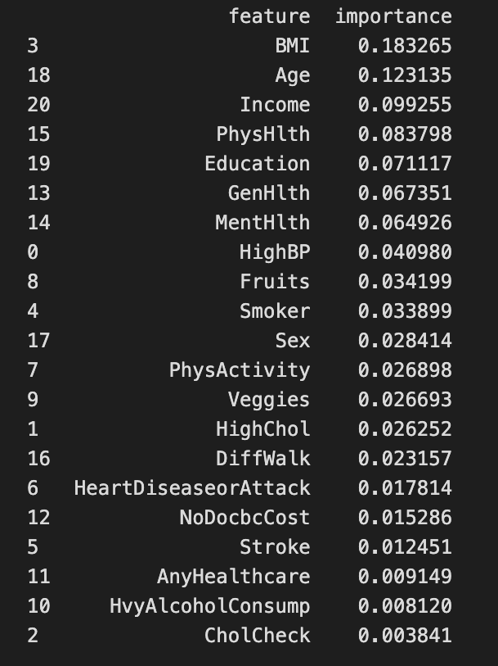
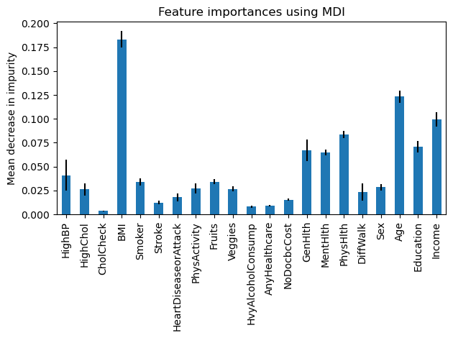
Feature Importance
Train and test on RandomForest
Obtain the importance level of each feature by “model.feature_importances_”
Feature selection based on model performance
Notes:
We train the randomforstclassifier, then obtain importantance level of each feature by using model.feature_importances_.
Then we can select certain features based off the model’s performance
Essentially, we are using machine learning models to select the more important features and train them based on that

Slide 12
Methods & Results

Slide 13
Model Design
DiabetesAI
Our general model
Diabetes Prediction
Health Suggestion
Predict if a patient has diabetes or not
Advice for patients with diabetes
Notes:
This is the overall model design. So our model, DiabetesAI, has two parts → whether we can predict if a patient has diabetes or not based on features like BMI, GenHealth, etc.
But also a health suggestion component to see if we can help people with diabetes improve their health.

Slide 14
Diabetes Prediction
Use Case:
Input: patients’ answers for selected features
Output: 0/2 → whether this patient has diabetes
Models to Compare:
Logistic Regression
Support Vector Machine
Random Forest
Notes:
We want to use patients’ information for selected features in order to predict if this patient has diabetes or not. For this problem, we are planning to implement logistic regression (as a baseline - we don’t expect the relationship between features and the output to be exactly linear), SVM (handles non-linear decision boundaries), random forest (handles complex, non-linear relationships)
BRFSS2015 is a telephone survey system that collects data on health-related risk behaviors, chronic health conditions, and health care access and use in the United States

Slide 15
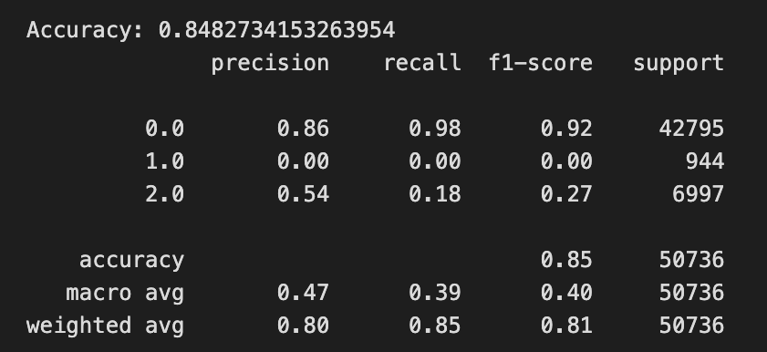
Results so far
Before resampling:
Predicts well for non-diabetes group
No correct prediction for prediabetes
Low precision score for diabetes
Notes:
Basically in this slide, we just wanted to see how the models [this one is logistic regression] performed if we did not resample so we can have a comparison (in our dataset, we have a clear, drastic imbalance of features of non-diabetic versus pre-diabetic and diabetic). As you can see we have a good accuracy, it predicts well for non-diabetic peopl (which makes sense as if majority of data is nondiabetic → if you just guess nondiabetic, you’ll get it right most of the time). And diabetes, we have a pretty low precision score
For predibates, nothing was correctly predicted at all → which was something that we had to do something abt
54% of the patients predicted to have diabetes actually have it. identifies only 18% of the patients who actually have diabetes.

Slide 16
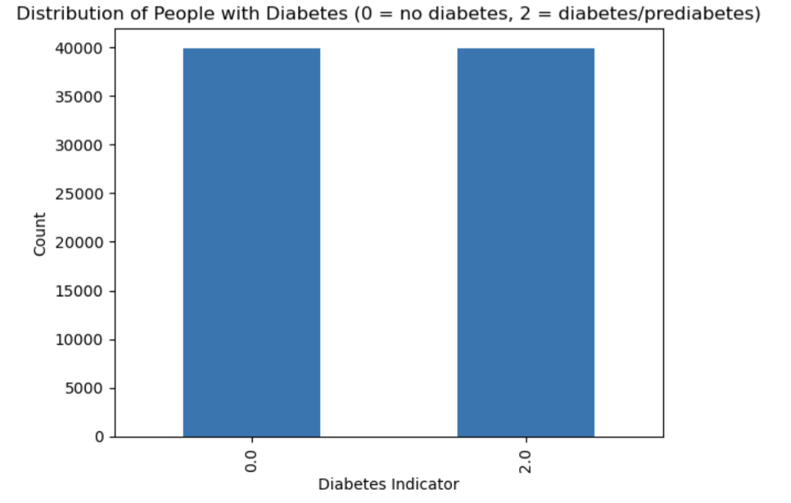
Data Pre-Processing
Pre-diabetes combined with diabetes
Split into test and training set
Match the size of non-diabetes with diabetes in training set
Downsampling
Scale Features
Notes:
As mentioned before, because prediabetes was not able to be accurately predicted → we combined prediabetes and diabetes together (so we can find the risk of diabetes)
We had to split our dataset into test and training b4 we had to deal with the imbalance data.
Essentially, we had to match the size of non-diabetes with diabetes in the training set and we did so by downsampling

Slide 17
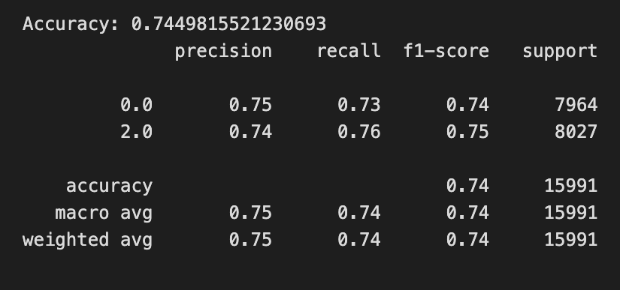
Results so far
Best model so far:
Logistic Regression
Feature selection
Average coefficient for each feature
Filter out Smoker/Fruits/Veggies/PhysActivity/AnyHealthcare/Stroke
After resampling:
RandomForest & SVM
Feature selection
Tree based embedded importance
RFECV (Recursive Feature Elimination with Cross-Validation)
Precision score not improved much
Notes:
Next thing we wanted to do is, for our models, we wanted to select the more important features to train with, so for random forest, we used the tree-based embedded importance
[contributes to reducing impurity (e.g., Gini impurity or entropy) across all trees] and for SVM we used RFECV (where we starts with all features and iteratively remove the least important ones].
Logistic regression - [provides coefficients for each feature, representing their contribution to predicting the target variable, then average to see which features have been consistently influential]
73% of the patients predicted to have diabetes actually have it. identifies only 76% of the patients who actually have diabetes.

Slide 18
Health Suggestion
Dataset
patients without diabetes
Separate training dataset for predicting highly relevant features to diabetes (BMI/GenHlth)
Features filtered out: CholCheck/HvyAlcoholConsump/AnyHealthcare/Stroke
Input: patients’ answers for selected features
Output: predicted value of (BMI/GenHlth) for the patient → suggestion on how to improve
Notes:
BRFSS2015 is a telephone survey system that collects data on health-related risk behaviors, chronic health conditions, and health care access and use in the United States

Slide 19
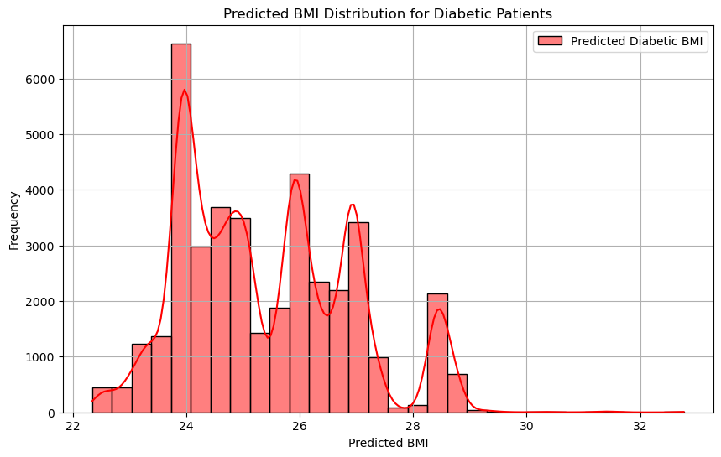
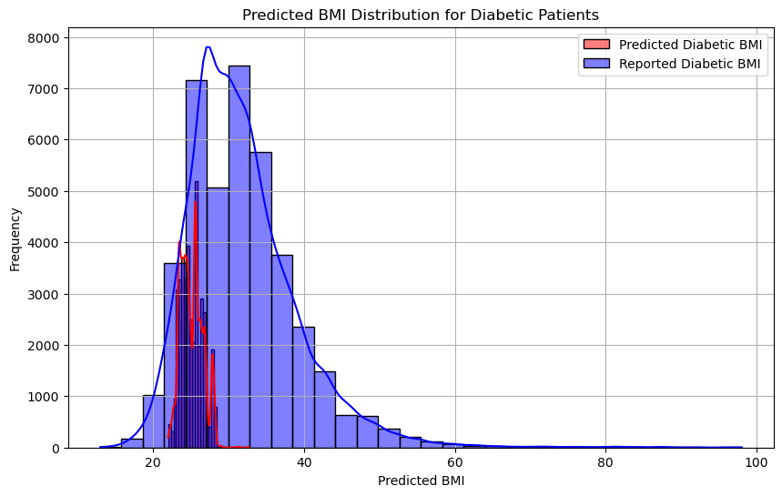
Results so far (BMI)
BMI
body mass index
a person's body weight divided by the square of their height
Random Forest Regressor
Train on all healthy subjects (39977)
Test set MSE 37.17
Predict on all the diabetic patients
Suggested score centered around 25
Notes:
Took more important features to train new model (with bmi as y) on non diabetic people
When we took our model and implemented it on diabetic patients → score centered around 25 (around average bmi)

Slide 20
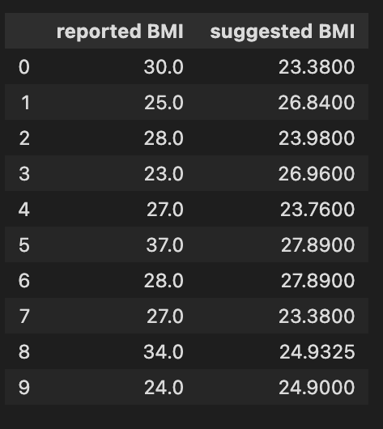
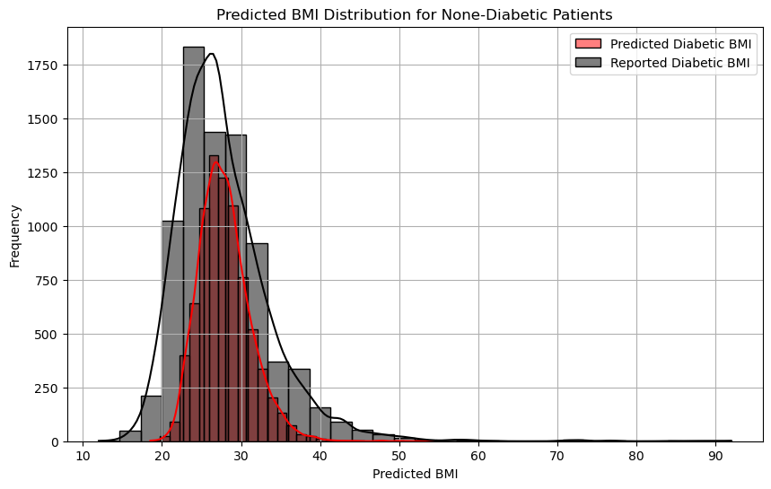
Problem & Reflection:
Model for BMI prediction needs improvement
Distribution captured
6 units deviated

Slide 21
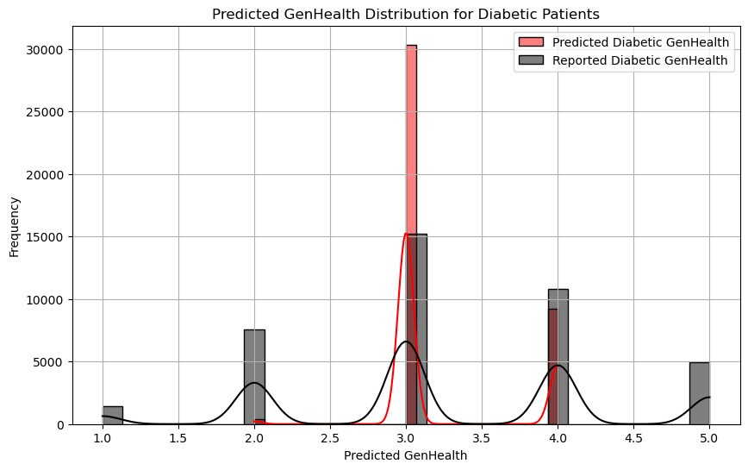
Results so far (GenHealth)
GenHealth score
scale 1-5
1 = excellent; 2 = very good; 3 = good; 4 = fair; 5 = poor
Random Forest Classifier
Train on all healthy subjects
Testset MSE 0.89
Testset R^2 score 0.16
Predict on all the diabetic patients
Suggested score → 3

Slide 22
Problem & Reflection:
General health score too vague
Need more specific quantification or qualification of health conditions

Slide 23
Model Design
DiabetesAI
Our general model
Diabetes Prediction
Health Suggestion
Predict if a patient has diabetes or not
Help patient get healthy again

Slide 24
Reflection
Can survey questions like this provide accurate predictions of whether an individual has diabetes?
In general, yes (0.74 precision)
Need more data from patients with diabetes
What factor is most related with the presence of diabetes?
BMI
GenHealth
MenHealth
During future collection, what kind of data should be focused on specifically?
Health conditions → related disease/physiological features
Stroke gets filtered out during feature selection
Need more data from patients with diabetes

Slide 25
Suggestions for Improvement
Addressing Imbalanced Classes
SMOTE, class weighting, combination
Hyperparameter Tuning
Ensemble Learning
Combine multiple models for better generalization on imbalanced data
Notes:
directly affects how the model learns patterns from the data and prioritizes different classes.
SMOTE: Generates synthetic data to increase minority class samples, adding variability instead of duplicating data.
Class Weighting: Assigns higher penalties for misclassifying the minority class to balance training.
hyperparameter tuning - optimize performance
Maybe using Boosting Algorithms: Methods like XGBoost handle imbalanced datasets effectively by focusing on hard-to-classify samples.
Class-weight for bagging algorithms

Slide 26
05
Evaluation Metrics

Slide 27
05
Results

Slide 28
Evaluation Metrics
Precision, recall & F-1 score
Confusion matrix (TP/FP)
ROC-AUC curve
Notes:
Precision → data is not completely balanced

Slide 29
Resources
CDC. “National Diabetes Statistics Report.” Diabetes, 15 May 2024,
www.cdc.gov/diabetes/php/data-research/index.html.
Dataset: https://www.kaggle.com/datasets/alexteboul/diabetes-health-indicators-dataset
‌

Slide 30
Q&A

