Slide 1
3rd / DATE : 12.0.2021
Detection of intracranial bleeding using an effective neural network
Karthikeyan 311117106030
Sanjay Roy 311117106047
Suriya Kumar 311117106051
Teressa Alphonsa Dominic 311117106053
Supervisor
Dr. K Kunaraj
Associate professor, ECE, LICET
“ Detection of intracranial bleeding using an effective neural network ”, Group Name : “Kingsmen”

Slide 2
Objective
To detect and classify various types of Intracranial Bleeding using neural networks.
PROBLEM STATEMENT:
Intracranial bleeding that occurs inside the Cranium, is a serious health problem requiring rapid and often intensive medical treatment and diagnosis of this is often time consuming. The diagnosis can be done by using neural networks that can detect the bleeding in the CT scan and predict the type of the hemorrhage thereby reducing the time needed for the detection of intracranial hemorrhages in normal cases.
“ Detection of intracranial bleeding using an effective neural network ”, Group Name : “kingsmen”

Slide 3
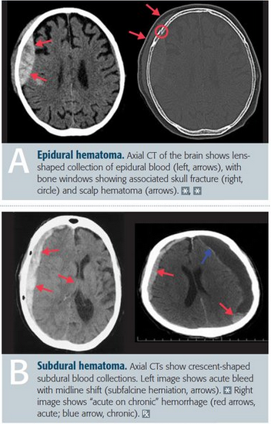
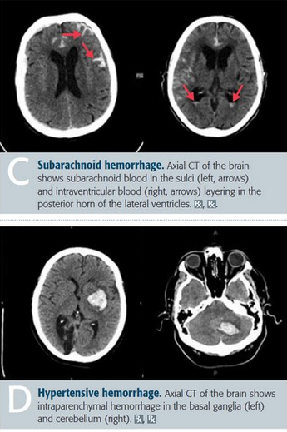
Types of Intracranial Bleeding
Source: https://www.grepmed.com

Slide 4
Proposed Solution
System with much better accuracy for detecting the various types of Intracranial bleeding by comparing with two neural networks.
Alexnet
Modified CNN
“ Detection of intracranial bleeding using an effective neural network ”, Group Name : “kingsmen”

Slide 5
Literature survey
S.No | Authors | Title of the research work | Journal Name / Year | Inference
1 | M. Li, L. Kuang, S. Xu and Z. Sha | Brain Tumor Detection Based on Multimodal Information Fusion and Convolutional Neural Network | IEEE Access/ 2018 | The system that extends 2D-CNN to 3D-CNN to extract better difference in the modalities.
2 | Y. Liu et al | Deep C-LSTM Neural Network for Epileptic Seizure and Tumor Detection Using High-Dimension EEG Signals | IEEE Access/ 2020 | A system uses convolutional long short-term memory (C-LSTM) neural network to obtain better recognition of seizures and tumors in the case of epilepsy
“ Project Title”, Group Name : “xxxxxx”

Slide 6
Literature survey
S.No | Authors | Title of the paper | Journal Name / Year | Inference
3 | H. H. Sultan, N. M. Salem and W. Al-Atabany | Multi-Classification of Brain Tumor Images Using Deep Neural Network | IEEE Access/2019 | Deep Learning model based on a convolutional neural network is proposed to classify different brain tumor types using two publicly available datasets
4 | Ye, H., Gao, F., Yin, Y. et al. | Precise diagnosis of intracranial hemorrhage and subtypes using a three-dimensional joint convolutional and recurrent neural network | Eur Radiol /2019 | A joint CNN-RNN classification framework is proposed with flexibility to train when subject level or slice level labels are available.
”
“ Project Title”, Group Name : “xxxxxx”

Slide 7
Literature survey
S.No | Authors | Title of the paper | Journal Name / Year | Inference
5 | Satya Singh, Lipo Wang, Sukrit Gupta, Haveesh Goli, Parasuraman Padmanabhan, and Balazs Gulyas | Deep Learning on Medical Images: A Review | IEEE Access/2020 | Two model variants are proposed, one of which is the 3D VGGNet architectures, Resnet, and the proposed method enhances classification performance significantly
6 | Woniak, M., Sika, J., and Wieczorek,M. | Deep neural network correlation learning mechanism for CT brain tumour detection | Applicative Neural Computing /2021 | The support neural network aids CNN in deciding which filers are best for pooling and convolution layers. As a result, the main neural classifier learns faster and is more effective
S.No | Authors | Title of the paper | Journal Name / Year | Inference
4 | H. H. Sultan, N. M. Salem and W. Al-Atabany | Multi-Classification of Brain Tumor Images Using Deep Neural Network | IEEE Access/2019 | Deep Learning model based on a convolutional neural network is proposed to classify different brain tumor types using two publicly available datasets
”
“ Project Title”, Group Name : “xxxxxx”

Slide 8
Literature survey
S.No | Authors | Title of the paper | Journal Name / Year | Inference
7 | P. Kumar Mallick, S. H. Ryu, S. K. Satapathy, S. Mishra, G. N. Nguyen and P. Tiwari | Brain MRI Image Classification for Cancer Detection Using Deep Wavelet Autoencoder-Based Deep Neural Network | IEEE Access/2019 | The performance criterion for the Deep Wavelet Autoencoder-Deep Neural Network classifier was compared with other existing classifiers like Autoencoder-DeepNeuralNetwork or Deep Neural Network
”
“ Project Title”, Group Name : “xxxxxx”

Slide 9
Existing Solution vs Proposed Solution
Similar medical related problems have been addressed using deep learning and Machine learning. | System with much better accuracy for detecting the various types of Intracranial bleeding by comparing with two neural networks.
“ Detection of intracranial bleeding using an effective neural network ”, Group Name : “Kingsmen”

Slide 10
Methodology
The data is first sorted into 5 categories with a total of approximately 34,000 images.
With the available images we perform image pre processing techniques like image resizing and RGB to grayscale conversion.
While resizing of image the image may get stretched so we normalise the image to give proper feed to the model.
Once the image pre processing techniques are done the CNN model is created and trained with values.
Over 80% of the entire data is given as input for the training model after which the model is capable of detecting the bleeding and classifying it inti types.
It can be analysed by testing the model with the rest of 20% of images.
“ Detection of intracranial bleeding using an effective neural network ”, Group Name : “Kingsmen”

Slide 11
Steps Involved In Image Pre-processing
Reading Images: We store the path to our image dataset to load them as input . Resizing: Some images captured and fed to the algorithm might vary in size . Therefore, we should establish a base size for all images fed into our algorithm.
Noise Removal: Gaussian blur is used to remove the image noise. Gaussian Blur is used as a pre-processing stage in algorithms for image restoration.
Segmentation & Morphology
In this stage, we segment this image separating the background from foreground objects. At this stage, additional blur is added to further enhance the image.
“ Detection of intracranial bleeding using an effective neural network ”, Group Name : “Kingsmen”

Slide 12
Data portioning and Validation
Data Portioning: In data partitioning we’ll get a logical distribution of large data sets in different partitions, which will allow us to make more efficient queries, facilitate the management and improve the maintenance of the system. Validation:
The training and validation set is used to train the network and the test set is used to check with the final model.
“ Detection of intracranial bleeding using an effective neural network ”, Group Name : “Kingsmen”

Slide 13
Block Diagram

Slide 14
Tool used [Hardware / Software]
Software used:
Programming platform>Jupyter Notebook
Dataset:
The image dataset obtained from KAGGLE
Image modality : CT scans
“ Detection of intracranial bleeding using an effective neural network ”, Group Name : “kingsmen”

Slide 15
DATASET
Image Subclass | No of images
Epidural | 5000
Intraventricular | 8000
Intraparenchymal | 6000
Subdural | 8000
Subarachnoid | 5000
Total | 32000(approx)
“ Detection of intracranial bleeding using an effective neural network ”, Group Name : “kingsmen”

Slide 16
ALEXNET
“ Detection of intracranial bleeding using an effective neural network ”, Group Name : “kingsmen”

Slide 17
Flow Diagram
Flow Diagram using Alexnet:(visio has some issues sir so temporarily I used this type f drawing sir)
Collection of input dataset from Kaggle
Preprocessing of the collected dataset
Preprocessed images are given to chosen neural network(Transfer learning)
Weight balancing the neural network
Train the alexnet using preprocessed images
Save and load the trained alexnet for validation
Sample image given for validation of trained network
Output is displayed
“ Detection of intracranial bleeding using an effective neural network ”, Group Name : “kingsmen”

Slide 18
CNN MODEL
“ Detection of intracranial bleeding using an effective neural network ”, Group Name : “kingsmen”

Slide 19
Flow Diagram
Flow Diagram using CNN:(visio has some issues sir so temporarily I used this type f drawing sir)
Collection of input dataset from Kaggle
Preprocessing of the collected dataset
Preprocessed images are given to chosen neural network(Modified CNN)
Weight balancing the neural network
Train the CNN using preprocessed images
Save and load the trained CNN for validation
Sample image given for validation of trained network
Output is displayed
“ Detection of intracranial bleeding using an effective neural network ”, Group Name : “kingsmen”

Slide 20
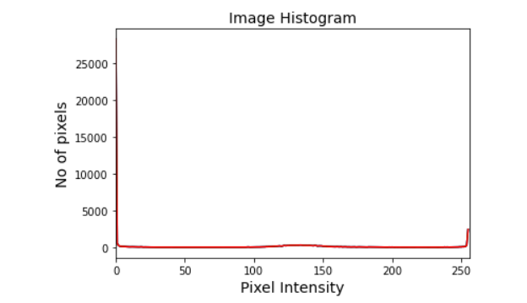
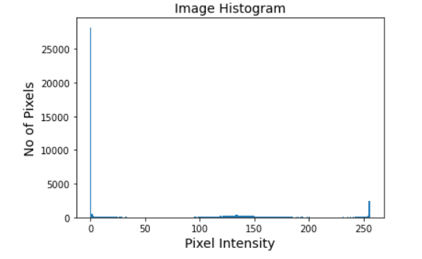
Work done & Results
Image Analysis:
“ Detection of intracranial bleeding using an effective neural network ”, Group Name : “kingsmen”

Slide 21
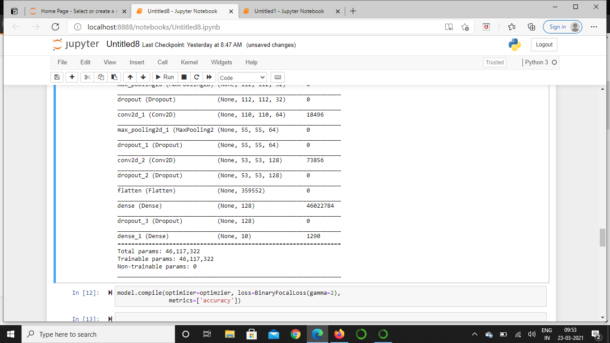
Work done & Results
Weight Balancing
Binary focal loss function generalizes binary cross-entropy by introducing a hyperparameter called the focusing parameter that allows hard-to-classify examples to be penalized more heavily relative to easy-to-classify examples.
“ Detection of intracranial bleeding using an effective neural network ”, Group Name : “kingsmen”

Slide 22
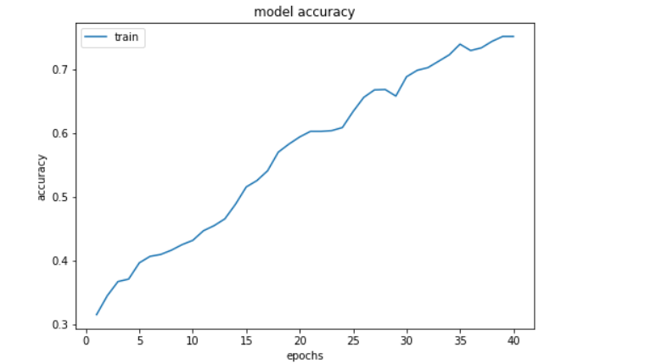
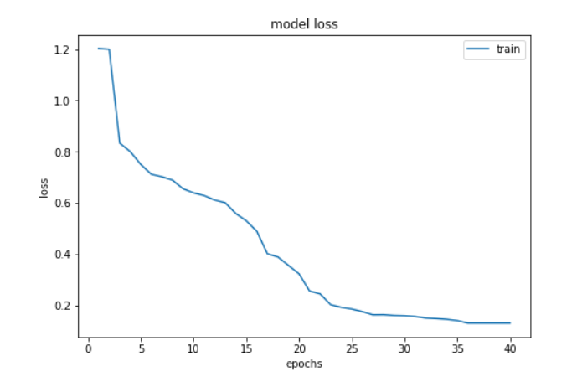
Work done & Results
Accuracy using Alexnet (Train Set)
Epoch : 100
Batch size: 35
Loss : 42.37%
Accuracy : 75.10%
“ Detection of intracranial bleeding using an effective neural network ”, Group Name : “kingsmen”

Slide 23
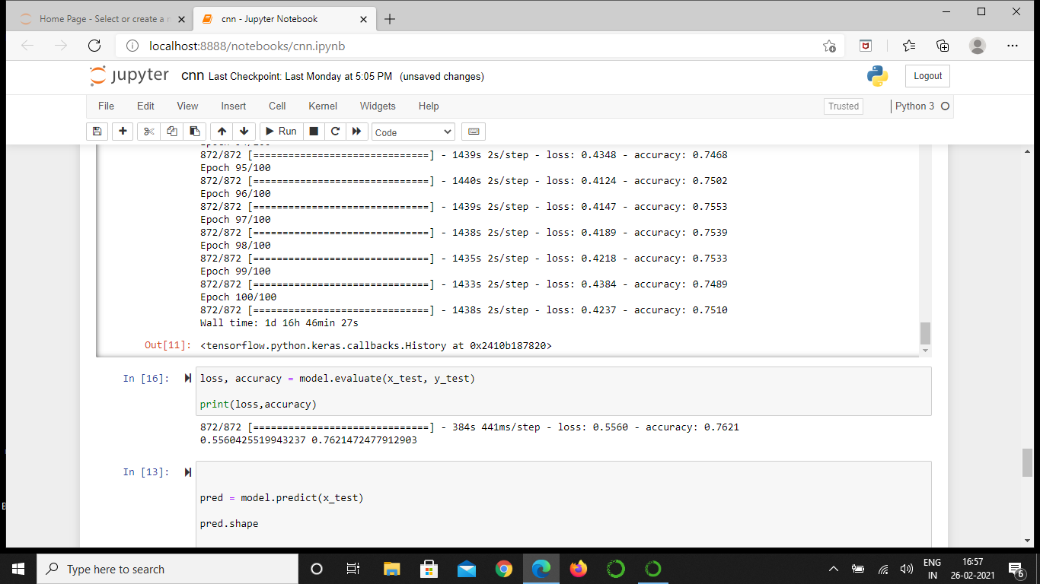
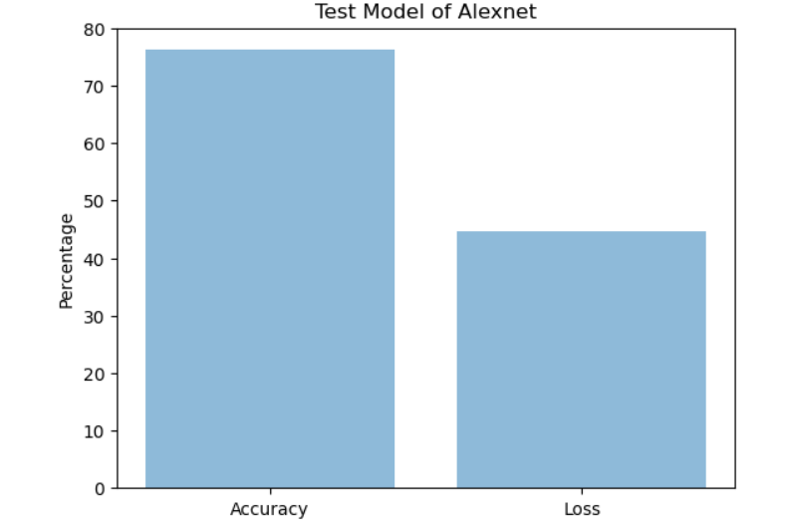
Work done & Results
Accuracy using Alexnet (Test Set)
Loss : 55.60%
Accuracy : 76.21%
“ Detection of intracranial bleeding using an effective neural network ”, Group Name : “kingsmen”

Slide 24
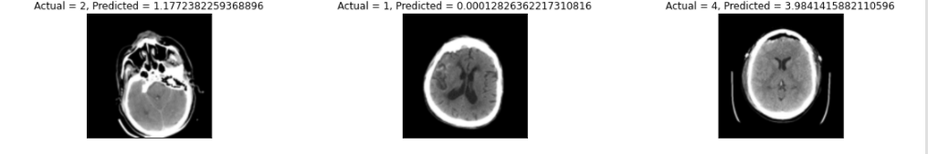
OUTPUT
Predicted Output using Alexnet
“ Detection of intracranial bleeding using an effective neural network ”, Group Name : “kingsmen”

Slide 25
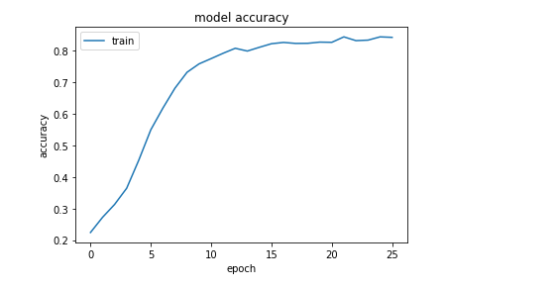
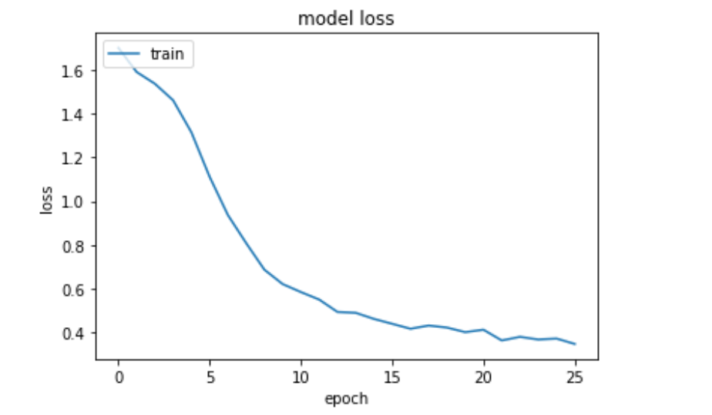
Work done & Results
Accuracy using modified CNN(Train)
Epochs: 20
Batch size: 35
Loss: 41.92%
Accuracy:82.00%
“ Detection of intracranial bleeding using an effective neural network ”, Group Name : “kingsmen”

Slide 26
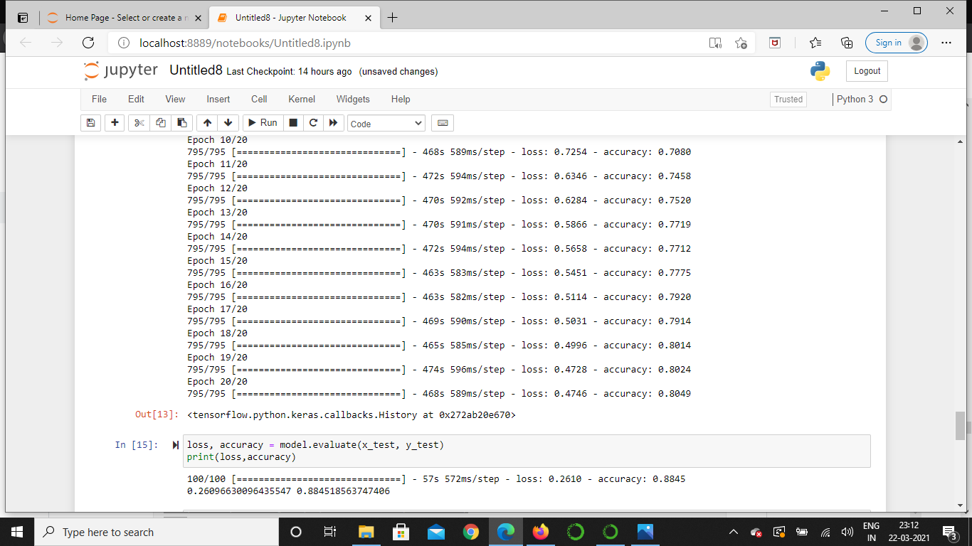
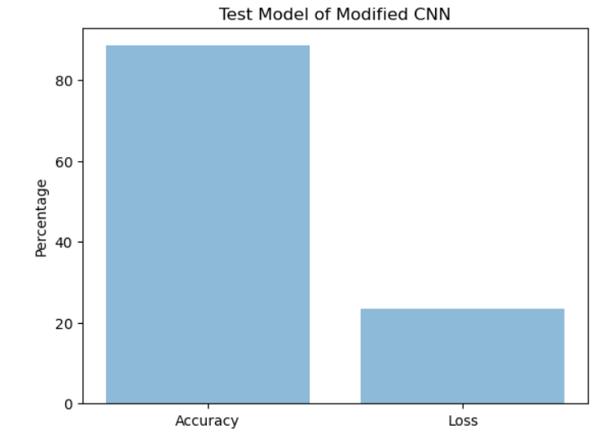
Work done & Results
Accuracy using Modified CNN (Test Set)
Loss: 26.10%
Accuracy: 88.45%
“ Detection of intracranial bleeding using an effective neural network ”, Group Name : “kingsmen”

Slide 27
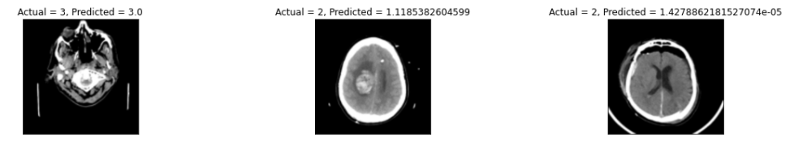
OUTPUT
Predicted Output using Modified CNN
“ Detection of intracranial bleeding using an effective neural network ”, Group Name : “kingsmen”

Slide 28
Roles & Responsibilities
Student Name | Contribution
Teressa Alphonsa Dominic | Concepts, Literature Survey, Paper, PPT, Code, Debugging, Thesis
Karthikeyan | Concepts, Literature Survey, Paper, PPT, Code, Debugging, Thesis
Sanjay Roy | Concepts, Literature Survey, Paper, PPT, Code, Debugging, Thesis
Suriya kumar | Concepts, Literature Survey, Paper, PPT, Code, Debugging, Thesis
“Detection of intracranial bleeding using an effective neural network ”, Group Name : “kingsmen”

Slide 29
Work Plan
Month / Week | Plan
Dec / (1 - 2) | Literature Survey / Zeroth Review / Project Approval
Dec / (3 - 4) | Basic concepts / Dataset collection / Code
Jan / (1 - 2) | CNN / Analyzing the code
Jan / (3 - 4) | Debugging
Feb / (3 - 4) | AlexNet / Debugging / optimizing code for accuracy
Mar / (1-2) | Enhancing AlexNet code / Work on paper
Mar / (3-4) | To use other DL architectures / Work on paper
Apr / (1-2) | Work on paper / Thesis
Apr / (1-2) | Project & Paper submission
“Detection of intracranial bleeding using an effective neural network ”, Group Name : “kingsmen”

Slide 30
Conclusion
Detection of Intracranial bleed at their early stage increases the survival rate of patients. The main reason for many dying of this Intracranial bleeding is because doctors can not diagnose this at a early stage The proposed system will help doctors to find the bleed at early stage.
“ Detection of intracranial bleeding using an effective neural network ”, Group Name : “kingsmen”

Slide 31
References
1] M. Li, L. Kuang, S. Xu and Z. Sha, "Brain Tumor Detection Based on Multimodal Information Fusion and Convolutional Neural Network," in IEEE Access, vol. 7, pp. 180134-180146, 2019, doi: 10.1109/ACCESS.2019.2958370.
2] Y. Liu et al., "Deep C-LSTM Neural Network for Epileptic Seizure and Tumor Detection Using High-Dimension EEG Signals," in IEEE Access, vol. 8, pp. 37495-37504, 2020, doi: 10.1109/ACCESS.2020.2976156.
3] P. Kumar Mallick, S. H. Ryu, S. K. Satapathy, S. Mishra, G. N. Nguyen and P. Tiwari, "Brain MRI Image Classification for Cancer Detection Using Deep Wavelet Autoencoder-Based Deep Neural Network," in IEEE Access, vol. 7, pp. 46278-46287, 2019, doi: 10.1109/ACCESS.2019.2902252.
4] H. H. Sultan, N. M. Salem and W. Al-Atabany, "Multi-Classification of Brain Tumor Images Using Deep Neural Network," in IEEE Access, vol. 7, pp. 69215-69225, 2019, doi: 10.1109/ACCESS.2019.2919122.
5] J. Zheng, D. Lin, Z. Gao, S. Wang, M. He and J. Fan, "Deep Learning Assisted Efficient AdaBoost Algorithm for Breast Cancer Detection and Early Diagnosis," in IEEE Access, vol. 8, pp. 96946-96954, 2020, doi:10.1109/ACCESS.2020.2993536.
“ Detection of intracranial bleeding using an effective neural network ”, Group Name : “kingsmen”

Slide 32
References
6] Singh SP, Wang L, Gupta S, Goli H, Padmanabhan P, Gulyás B. 3D Deep Learning on Medical Images: A Review. Sensors (Basel). 2020 Sep 7;20(18):5097. doi: 10.3390/s20185097. PMID: 32906819; PMCID: PMC7570704.
7]Woźniak, M., Siłka, J. & Wieczorek, M. Deep neural network correlation learning mechanism for CT brain tumor detection. Neural Comput & Applic (2021).
8] T. Hossain, F. S. Shishir, M. Ashraf, M. A. Al Nasim and F. Muhammad Shah, "Brain Tumor Detection Using Convolutional Neural Network," 2019 1st International Conference on Advances in Science, Engineering and Robotics Technology (ICASERT), Dhaka, Bangladesh, 2019, pp. 1-6, doi: 10.1109/ICASERT.2019.8934561.
9] Gumaei, M. M. Hassan, M. R. Hassan, A. Alelaiwi and G. Fortino, "A Hybrid Feature Extraction Method With Regularized Extreme Learning Machine for Brain Tumor Classification," in IEEE Access, vol. 7, pp. 36266-36273, 2019, doi: 10.1109/ACCESS.2019.2904145.
10] M. Gurbină, M. Lascu and D. Lascu, "Tumor Detection and Classification of MRI Brain Image using Different Wavelet Transforms and SVMs," 2019 42nd International Conference on Telecommunications and Signal Processing (TSP), Budapest, Hungary, 2019, pp. 505-508, doi: 10.1109/TSP.2019.8769040.
“ Detection of intracranial bleeding using an effective neural network ”, Group Name : “kingsmen”

Slide 33
References
11] C. Han et al., "Combining Noise-to-Image and Image-to-Image GANs: Brain MR Image Augmentation for Tumor Detection," in IEEE Access, vol. 7, pp. 156966-156977, 2019, doi: 10.1109/ACCESS.2019.2947606.
12] W. Wang, F. Bu, Z. Lin and S. Zhai, "Learning Methods of Convolutional Neural Network Combined With Image Feature Extraction in Brain Tumor Detection," in IEEE Access, vol. 8, pp. 152659-152668, 2020, doi: 10.1109/ACCESS.2020.3016282.
13] G. Manogaran, P. M. Shakeel, A. S. Hassanein, P. Malarvizhi Kumar and G. Chandra Babu, "Machine Learning Approach-Based Gamma Distribution for Brain Tumor Detection and Data Sample Imbalance Analysis," in IEEE Access, vol. 7, pp. 12-19, 2019, doi: 10.1109/ACCESS.2018.2878276.
14] Ye, H., Gao, F., Yin, Y. et al. Precise diagnosis of intracranial hemorrhage and subtypes using a three-dimensional joint convolutional and recurrent neural network. Eur Radiol 29, 6191–6201 (2019).
15]Patel, Ajay & van de Leemput, Sil & Prokop, Mathias & Ginneken, Bram & Manniesing, Rashindra. (2019). Image Level Training and Prediction: Intracranial Hemorrhage Identification in 3D Non-Contrast CT. IEEE Access. PP. 1-1. 10.1109/ACCESS.2019.2927792.
“ Detection of intracranial bleeding using an effective neural network ”, Group Name : “kingsmen”

Slide 34
Thank You
“ Project Title”, Group Name : “xxxxxx”

