Slide 1
Benefits Dependency Network
This tool provides a framework for linking the overall investment objectives and resultant benefits with the business changes necessary to deliver those benefits
Read: right to left from; The FI as customer & their drivers; why they would invest; benefits they would achieve; change they would need to make and tech they would need
Enabling
Technologies
Enabling
Changes
Business
Changes
Benefits
Investment
Objectives
Business
Drivers
Plan data models and data governance to be come data driven organization
Examine impact to existing regulatory framework, process , business model
Reduced physical and transition Risk via early analysis permitting ability to plan change
Reduced Risk: to reputation and avoid stranded assets
Reduce risks asso ciated with Biodiversity loss through better understanding of Risk
data architecture modelling and reporting service
Balance sheet / Capital Mgmt systems applying new treatments to RWA’s
Adopt TCFD/TNFD recommendations re Scenario planning and exec leadership, priority etc
Reduced Credit Risk
as dynamic forward looking data feeds credit risk models
Meet compliance & market authorities’ e.g EU guidance to de-risk assets associated with negative climate & biodiversity exposure
Data , ML, AI, API’s
Reduce operational, and funding overheads due to operational risk and mitigation
Demand Side
Supply Side
Meet societal /institutional sector demand for green purpose, assets, products
Increase revenue opportunities with new business model/ products & align to purpose
Support strong Cloud based technology and services, digital transformation
Early mover advantage. Portfolio hard to build previously without scientific based data
Notes:
Green swan definition Definition of Green swan, BuzzWord from Macmillan Dictionary
‘We discovered 1320 new Teslas’ | APG

Slide 2
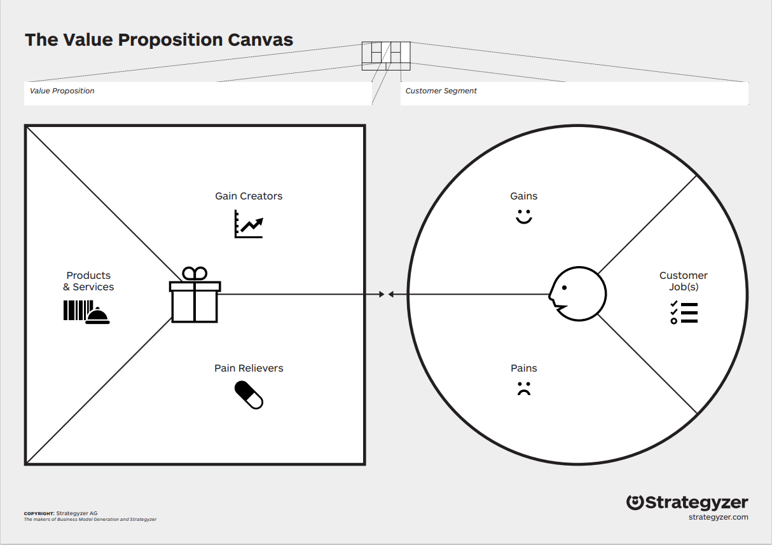
Notes
Key ingredients of each party
Banking and Capital Markets
Attract the best staff via appealing offerings
Improve efficiency at lower cost
Sustainable Growth
Be compliant with regulation “stress test”
Reduce Risk “RWA”
data and analytics to inform bio diversity growth opportunities
Ability to adapt to market changes
Faster time to market
predictive analytics, unstructured analytics
Lower costs
Legacy operations and processes
No way to measure or manage biodiversity to aid decisions
data and analytics to understand bio diversity risk position
Notes:
Report — Enabling secure and scalable non-financial reporting and data flows ► (icebreakerone.org)
B. Convention on biological diversity Zero draft of the post-2020 global biodiversity framework (cbd.int)
2030 and 2050 Goals 10.
The Framework has five long-term goals for 2050 related to the 2050 Vision for Biodiversity. Each of these goals has an associated outcome for 2030. 11
The five goals are:
No net loss by 2030 in the area and integrity of freshwater, marine and terrestrial ecosystems, and increases of at least [20%] by 2050, ensuring ecosystem resilience;
The percentage of species threatened with extinction is reduced by [X%] and the abundance of species has increased on average by [X%] by 2030 and by [X%] by 2050;
Genetic diversity is maintained or enhanced on average by 2030, and for [90%] of species by 2050;
Nature provides benefits to people contributing to: (i) Improvements in nutrition for at least [X million] people by 2030 and [Y million] by 2050; (ii) Improvements in sustainable access to safe and drinkable water for at least [X million] people, by 2030 and [Y million] by 2050; (iii) Improvements in resilience to natural disasters for at least [X million] people by 2030 and [Y million] by 2050; (iv) At least [30%] of efforts to achieve the targets of the Paris Agreement in 2030 and 2050.
The benefits, shared fairly and equitably, from the use of genetic resources and associated traditional knowledge have increased by [X] by 2030 and reached [X] by 2050. C. 2030 Mission 11. The 2030 Mission for this framework is: To take urgent action across society to put biodiversity on a path to recovery for the benefit of planet and people. 12 D. 2030 action targets 12. The Framework has 20 action-oriented targets for 2030 which, if achieved, will contribute to the outcome-oriented goals for 2030 and 2050. Actions to reach these targets should be implemented consistently and in harmony with the Convention on Biological Diversity and other relevant international obligations, taking into account national socioeconomic conditions.13

Slide 3
Business Model Canvas (BMC)
The business model canvas illustrates the fundamental building blocks of a business, providing a high-level, comprehensive view of the various strategic details required to successfully bring a product to market and how the business creates, delivers and captures value.
Example template below explains the nine key canvass segments which ideally should be viewed from right (Customer Segments) to left (Key Partners)
KEY PARTNERS
KEY ACTIVITIES
VALUE PROPOSITIONS
CUSTOMER RELATIONSHIPS
CUSTOMER SEGMENTS
WHAT OTHER COMPANIES / INDIVIDUALS ARE PART OF THE DEVELOPMENT AND GO-TO-MARKET STRATEGY?
WHAT MUST HAPPEN INTERNALLY TO RELEASE THIS PRODUCT?
WHAT IS THIS GOING TO DO FOR THE CUSTOMER TO IMPROVE THEIR BUSINESS / JOB / LIFE?
WHAT IS THE SUPPORT STRATEGY FOR NEW CUSTOMERS?
WHO IS GOING TO USE THE PRODUCT?
KEY
STAKEHOLDERS
DIRECT CLIENTS
Build client facing value prop, integrate into consulting offerings and GTM
COLLABORATIVE –
REMOTE –
e.g. Website , Portals, Self-service Saas
Lead
A
Marketing and Comm’s
REDUCED CREDIT RISK
PASS STRESS TEST
Support
Banking and Capital Markets
B
Connect and pass
Tech platform
KEY RESOURCES
CHANNELS
WHAT PEOPLE, SKILLS, MATERIALS, BUDGET ARE REQUIRED TO DELIVER THE PRODUCT?
HOW WILL THE PRODUCT / SERVICE BE SOLD / DISTRIBUTED?
DIRECT CUSTOMER
INDIRECT CLIENTS
INDIRECT CUSTOMER
MANPOWER
MGMT CONSULTING
CLIENT PIPELINE
MARKETING
Part of a solution managed service
marketplace
OTHER
COST STRUCTURE
REVENUE STREAMS
WHAT COSTS WILL BE INCURRED TO DEVELOP, DISTRIBUTE AND SUPPORT THE PRODUCT?
HOW WILL THE BUSINESS STAKEHOLDERS MAKE MONEY FROM THIS PRODUCT (FOR PROFIT or NOT)?
LEGAL FEES
PROFESSIONAL SERVICES
ADVISORS
SUPPORT FUNCTIONS
ADDITIONAL CLOUD SERVICE RENT SUBSCRIPTIONS
USAGE / SUBSCRIPTION FEES FOR FINAL SERVICE
CONSULTING, AUDIT AND INTEGRATION FEES

Slide 4
Notional GTM Go Live work back plan
Project Schedule and Milestones
POC first wave clients signed
May 30 2025
Onboarded first wave clients
Transactional Testing commences
Go Live with wave 1 FI clients
Sept 31 2025
Oct 31 2025
Dec 1 2025
Partnership marketing launch and internal readiness
Feb 30 2025
Partnering contracts complete
Dec 1 2024
Sales and Marketing value prop MVP

Slide 5
Simple start: We need scenarios and personas from the customer’s POV
High level GTM readiness and Sales process (3 month cycle)
Client interest fulfilled via external facing version of readiness material and then requires workshop
client teams have proposition training and talk to client
TBA
Final ”Go, no-go”?
Agreement in place & Client onboarded
Preliminary ”Go, no-go”
Stop here if basic criteria not met.
Commercial, Pricing and billing model proposed.
Pilot testing with selected audience.
Internal access to value proposition/Video of partnership leads discussing value prop, market issues, value prop and a demo
TBA
TBA
Technology integration testing.
Benefits
Stop
Continue
  Benefits
  Start
  Stop
  Continue
Position partnership rapidly at a key time for biodiversity issue
Engage friendly clients to gain feedback and design MVP GTM per sub sector
Firm up underpinning strategy and criteria upfront. Evolve as we learn.
Focus on simplification….all the time.
Share data, as best we can to get the most from partners
Client confusion and lack of direction
Decision making without scientific peer reviewed data
Client making risk decisions without taking into account biodiversity
Bringing best advice to clients through trusted relationships
Bring best in class partnerships
Improving triple bottom line, People, profit and planet
Reach market innovation in services to customer base through partners.
Increased customer satisfaction and loyalty
Increased cross-sell and up-sell
Improved operational efficiency
Increased channel breadth
Stop doing redundant, repeatable processes. – automate where possible.
Requiring customers to manually integrate services
Restricting customers from performing transactions anytime, anywhere
Scaling cost with transaction volume
Providing banking services anytime, anywhere
Serving customers over any partner channel
Increasing sales of products and services
Increasing customer satisfaction

