Slide 1
ゲシュタルト心理学
National Institute of Technology, Tsuyama College. / Department of Integrated Science and Technology
Takahito Sueda / @terfno

Slide 2
tips: 赤と黒を同時に使うな
National Institute of Technology, Tsuyama College. / Department of Integrated Science and Technology
Takahito Sueda / @terfno

Slide 3
agenda
first of all
I’m terfno
what is Gestalt Psychology
is fun?

Slide 4
first of all
I’m amateur.

Slide 5
first of all
I’m amateur.
maybe I made a mistake.

Slide 6
I’m terfno
am 18.
am magician / cardist
can write little bit
good at design / manage team
like to env setup
psychology

Slide 7
I’m terfno
twitter: @terfno_mai
instagram: @terfno
github: @Terfno

Slide 8
what is Gestalt Psychology
Wikipedia is god.

Slide 9
what is Gestalt Psychology
Wikipedia is god.
https://ja.wikipedia.org/wiki/ゲシュタルト心理学

Slide 10
what is Gestalt Psychology
sorry. just kidding.

Slide 11
what is Gestalt Psychology
there are 4 logic.

Slide 12
what is Gestalt Psychology
there are 4 logic.
proximity
Notes:
proximity – 近接
similarity – パターン
closure – []←みたいな
nice feeling curve – いい感じの曲線

Slide 13
what is Gestalt Psychology
there are 4 logic.
proximity
||||||||
Notes:
proximity – 近接
similarity – パターン
closure – []←みたいな
nice feeling curve – いい感じの曲線

Slide 14
what is Gestalt Psychology
there are 4 logic.
proximity
|| || || ||
Notes:
proximity – 近接
similarity – パターン
closure – []←みたいな
nice feeling curve – いい感じの曲線

Slide 15
what is Gestalt Psychology
there are 4 logic.
proximity
similarity
Notes:
proximity – 近接
similarity – パターン
closure – []←みたいな
nice feeling curve – いい感じの曲線

Slide 16
what is Gestalt Psychology
there are 4 logic.
proximity
similarity
AAAAAAAA
Notes:
proximity – 近接
similarity – パターン
closure – []←みたいな
nice feeling curve – いい感じの曲線

Slide 17
what is Gestalt Psychology
there are 4 logic.
proximity
similarity
AAAAAAAA
Notes:
proximity – 近接
similarity – パターン
closure – []←みたいな
nice feeling curve – いい感じの曲線

Slide 18
what is Gestalt Psychology
there are 4 logic.
proximity
similarity
closure
Notes:
proximity – 近接
similarity – パターン
closure – []←みたいな
nice feeling curve – いい感じの曲線

Slide 19
what is Gestalt Psychology
there are 4 logic.
proximity
similarity
closure
<><><><><>
][][][][][][][][][
()()()()()()()()
}{}{}{}{}{}{}{
Notes:
proximity – 近接
similarity – パターン
closure – []←みたいな
nice feeling curve – いい感じの曲線

Slide 20
what is Gestalt Psychology
there are 4 logic.
proximity
similarity
closure
<><><><><>
][][][][][][][][][
()()()()()()()()
}{}{}{}{}{}{}{
Notes:
proximity – 近接
similarity – パターン
closure – []←みたいな
nice feeling curve – いい感じの曲線

Slide 21
what is Gestalt Psychology
there are 4 logic.
proximity
similarity
closure
<><><><><>
][][][][][][][][][
()()()()()()()()
}{}{}{}{}{}{}{
Notes:
proximity – 近接
similarity – パターン
closure – []←みたいな
nice feeling curve – いい感じの曲線

Slide 22
what is Gestalt Psychology
there are 4 logic.
proximity
similarity
closure
nice feeling curve
Notes:
proximity – 近接
similarity – パターン
closure – []←みたいな
nice feeling curve – いい感じの曲線

Slide 23
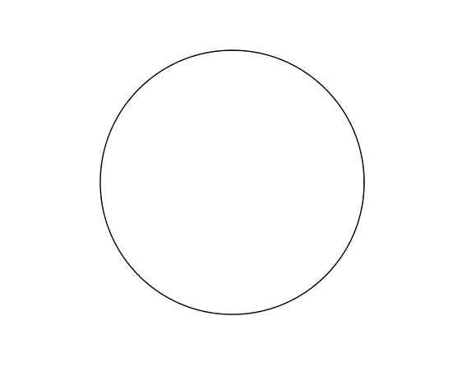
what is Gestalt Psychology
there are 4 logic.
proximity
similarity
closure
nice feeling curve
Notes:
proximity – 近接
similarity – パターン
closure – []←みたいな
nice feeling curve – いい感じの曲線

Slide 24
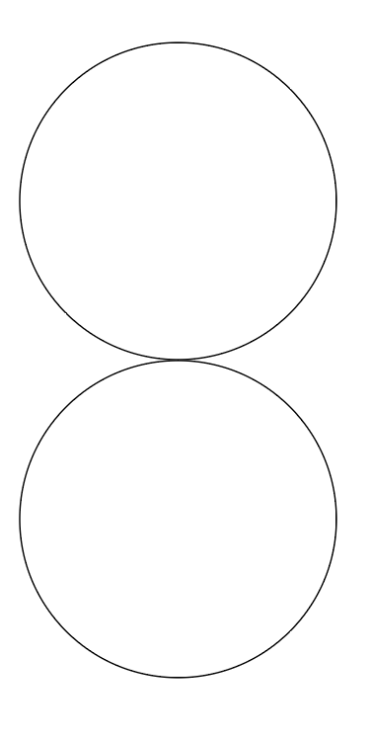
what is Gestalt Psychology
there are 4 logic.
proximity
similarity
closure
nice feeling curve
Notes:
proximity – 近接
similarity – パターン
closure – []←みたいな
nice feeling curve – いい感じの曲線

Slide 25
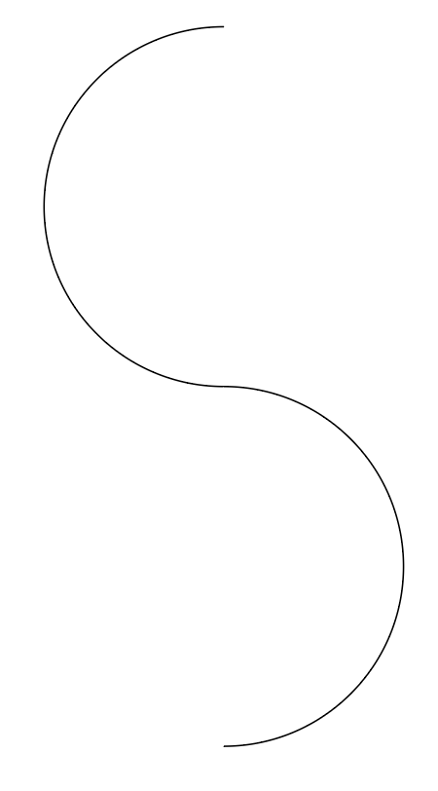
what is Gestalt Psychology
there are 4 logic.
proximity
similarity
closure
nice feeling curve
Notes:
proximity – 近接
similarity – パターン
closure – []←みたいな
nice feeling curve – いい感じの曲線

Slide 26
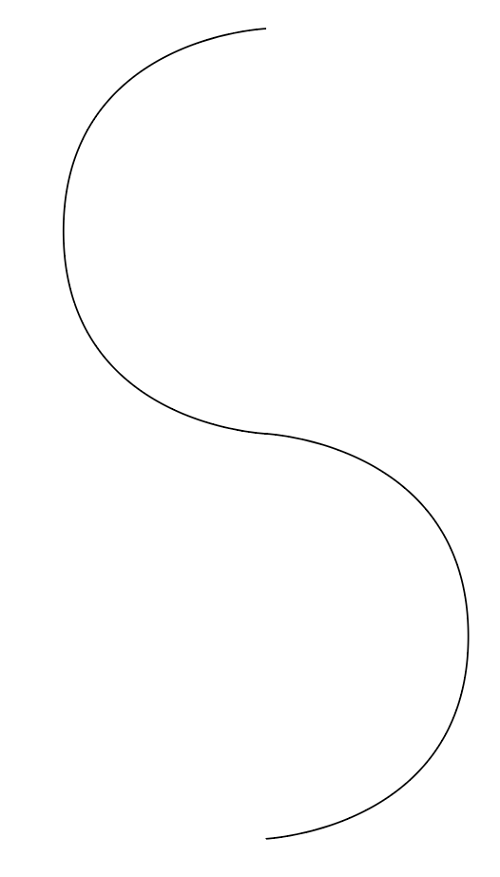
what is Gestalt Psychology
there are 4 logic.
proximity
similarity
closure
nice feeling curve
Notes:
proximity – 近接
similarity – パターン
closure – []←みたいな
nice feeling curve – いい感じの曲線

Slide 27
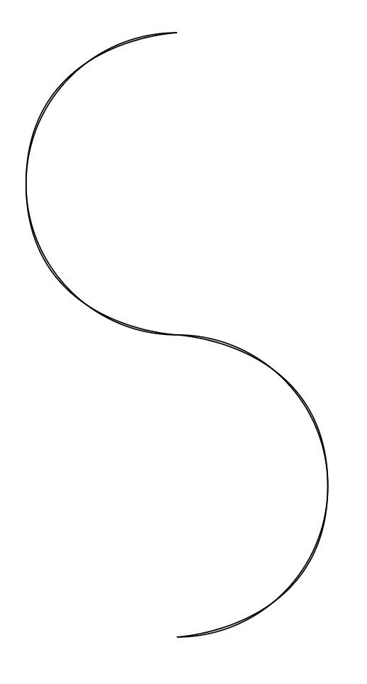
what is Gestalt Psychology
there are 4 logic.
proximity
similarity
closure
nice feeling curve
Notes:
proximity – 近接
similarity – パターン
closure – []←みたいな
nice feeling curve – いい感じの曲線

Slide 28
conclusion
> so, Gestalt Psychology is logic of Design(?)
< probably yes.
Notes:
ゲシュタルト心理学は全体を全体として捉えるみたいなやつ
私達がAを見てAだと思える(?)みたいなやつだと思ってもらえれば

Slide 29
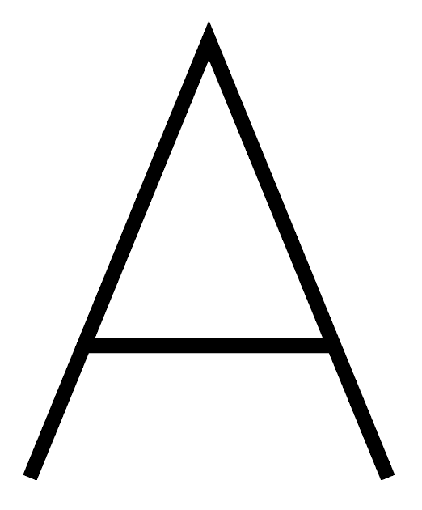
conclusion
> so, Gestalt Psychology is logic of Design(?)
< probably yes.
is A
Notes:
ゲシュタルト心理学は全体を全体として捉えるみたいなやつ
私達がAを見てAだと思える(?)みたいなやつだと思ってもらえれば

Slide 30
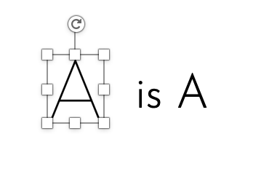
conclusion
> so, Gestalt Psychology is logic of Design(?)
< probably yes.
is A
Notes:
ゲシュタルト心理学は全体を全体として捉えるみたいなやつ
私達がAを見てAだと思える(?)みたいなやつだと思ってもらえれば

Slide 31
is fun?
> is fun?

Slide 32
is fun?
> is fun?
< yep.

Slide 33
is fun?
< Design is tooooooooooo difficult

Slide 34
is fun?
< Design is tooooooooooo difficult
if we learn logic. Design become too easy.

Slide 35
is fun?
< Design is tooooooooooo difficult
if we learn logic. Design become too easy.
Because…

Slide 36
The Design Theory
Proximity
Alignment
Contrast
Repetition
https://webdesign-trends.net/entry/7810

Slide 37
The Design Theory
Proximity← Gestalt Psychology
Alignment← Gestalt Psychology
Contrast← Gestalt Psychology
Repetition← Gestalt Psychology

Slide 38
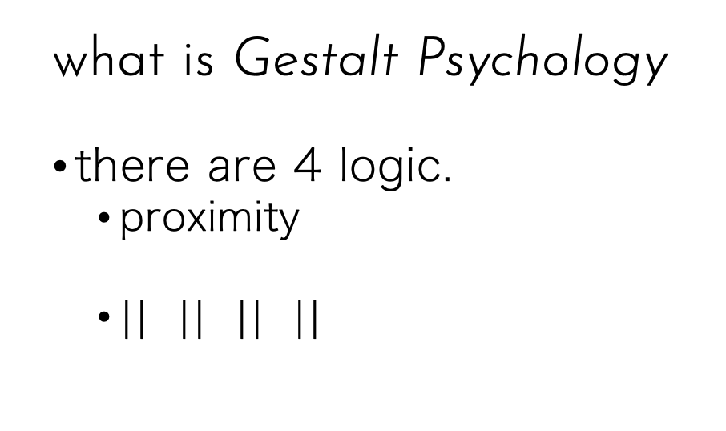
The Design Theory
Proximity← Gestalt Psychology

Slide 39
The Design Theory
Alignment← Gestalt Psychology

Slide 40
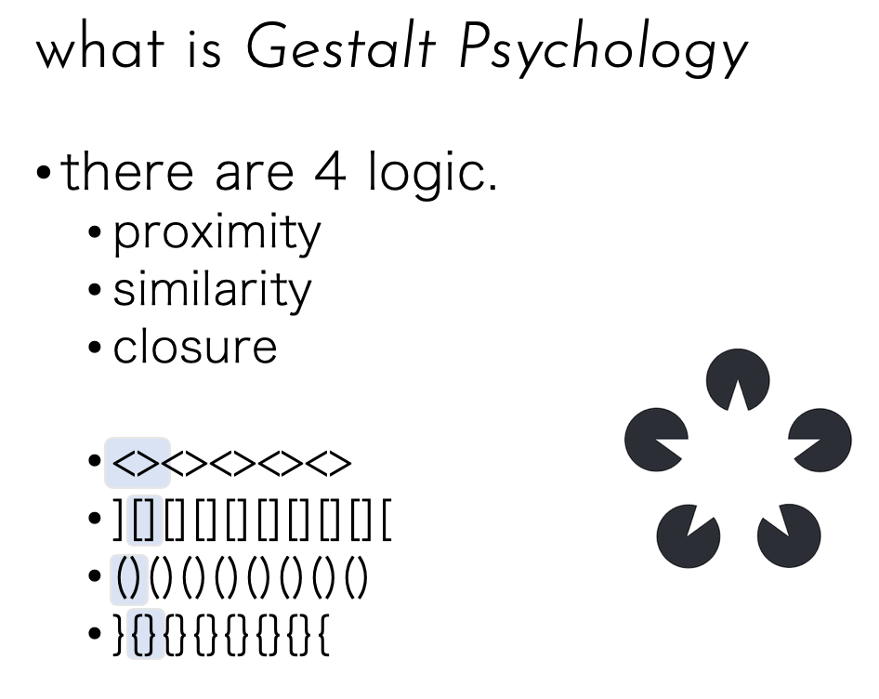
The Design Theory
Contrast← Gestalt Psychology

Slide 41
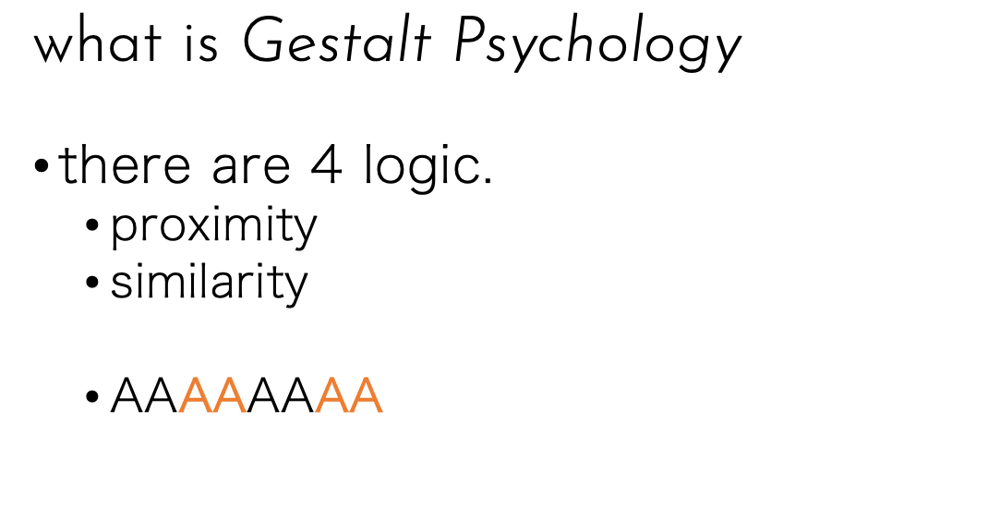
The Design Theory
Repetition← Gestalt Psychology

Slide 42
that’s all

Slide 43
thanks
@terfno

