Slide 1


Open CAMPUS 2018 SYSKEN
2018/08/24 & 2018/08/25
Takahito Sueda

Slide 2
What is SYSKEN

Slide 3
What is SYSKEN
SYSKEN is システム研究部 in 津山高専

Slide 4
What is SYSKEN
We create NEXT

Slide 5
What is SYSKEN
We are crazy 高専生 team

Slide 6
What we doing

Slide 7
What we doing
We are Programmers

Slide 8
What we doing
We are System Engineers

Slide 9
What we doing
We are Web Engineers

Slide 10
What we doing
We are Network Engineers

Slide 11
What we doing
We are Game Engineers

Slide 12
What we doing
We are VR Engineers

Slide 13
What we doing
We are Presenters

Slide 14
What we doing
We are Illustrators

Slide 15
What we doing
We are Video Creator

Slide 16
What we doing
We are Designers

Slide 17
What we doing
We are Artists

Slide 18
What we doing
We play hard with create “NEXT”

Slide 19
Infomation

Slide 20

Infomation
Our Website : sysken.org

Slide 21

Infomation
Our Twitter : @sysken

Slide 22
Infomation
現在開発中のため端末サーバ室への 案内はしておりません。
申し訳ありません

Slide 23
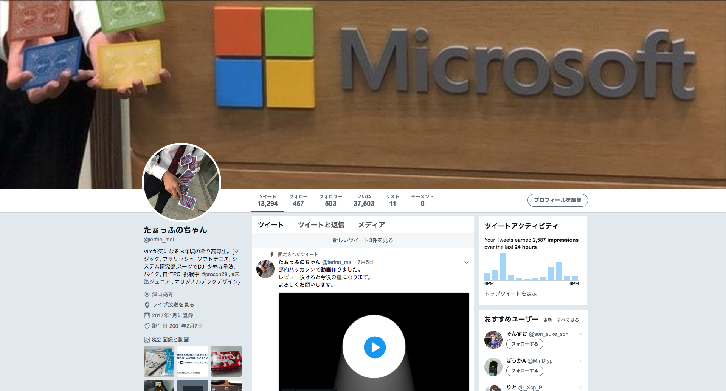
Infomation
Presenter’s Twitter : @terfno_mai

