Slide 1
The Barrier Was the Teacher
The trade-off of frictionless search
Terézia Slanináková, Ph.D. and Matej Antol, Ph.D.
Youth Integration Lab, Masaryk University, 6.11.2026
Notes:
OPENING (about 1 min)
Searching used to be hard: you turned a question into keywords, opened ten tabs, compared, and assembled an answer yourself. Today you type a question in plain language and get a fluent paragraph back in seconds.
We work on search systems. In the first part we'll show, without the maths, how search engines took over one step of your work after another over the last 25 years, and how much more we now take on trust.
In the second part we ask six questions we can't answer yet, about what that shift does to us, and look at the early signals.
We are not here to tell you what to do. We want you to leave thinking about it.

Slide 2
Meeting an information need takes seven steps
You start with a need:
“What happened at the Battle of Gettysburg?”
1
Put the need into words
2
Find pages
3
Pick what to read
4
Read and compare
5
Synthesize into an answer
6
Decide what to ask next
7
Check the answer
battle of Gettysburg
?
Ask again
How each step is marked on the next slides
Any step
Machine
Any step
You
vs.

Slide 3
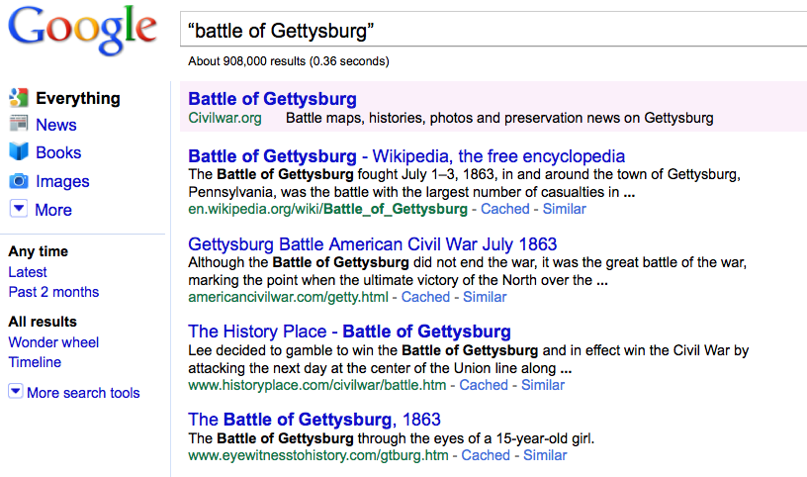
Search in 1998 · Ten blue links
THE MACHINE
Finds pages that contain your words and ranks them.
YOU
Choose the words, open the tabs, read, compare, decide.
WHAT YOU TAKE ON TRUST
That the ranking is sensible. You can still see why a page is there.
Put the need into words
You
Find pages
Machine
Pick what to read
You
Read and compare
You
Synthesize into an answer
You
Decide what to ask next
You
Check the answer
You
Notes:
(about 1.5 min) From the SitSem talk, without the maths.
Under the hood: an inverted index (a book index for the whole web), a relevance score (BM25), and PageRank: "a page is important if important pages link to it" (Brin & Page 1998).
Point to make: the machine did ONE step for you: finding and ranking pages. Everything else, from choosing the words to reading, comparing and deciding, was your work.
Introduce the row of dots at the bottom. We'll watch it fill in over the next five slides. The last dot, checking the answer, is always yours. Whether you actually do it is another matter.

Slide 4
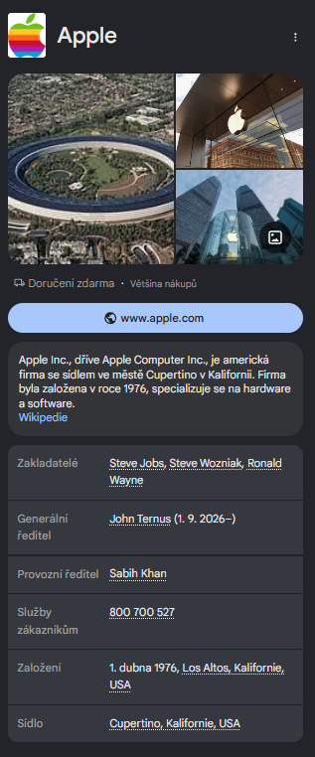
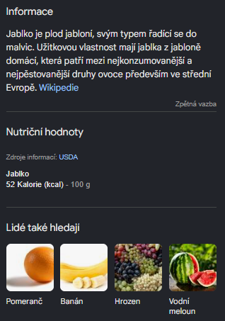
Search in 2000s · The engine guesses what you meant
THE MACHINE
Rewrites your query (“car repair” also finds “automobile service”) and tells Apple the company from the fruit.
YOU
Read, compare, decide.
WHAT YOU TAKE ON TRUST
That it understood what you meant.
Put the need into words
Machine
Find pages
Machine
Pick what to read
You
Read and compare
You
Synthesize into an answer
You
Decide what to ask next
You
Check the answer
You
Notes:
(about 1.5 min) SitSem slides 9-11, compressed.
Vocabulary mismatch: people and documents use different words for the same thing (Furnas et al. 1987). Query rewriting and later entity linking (Google Knowledge Graph, 2012) fix that silently.
Story beat: this is the first time the system edits what you asked. Mostly helpful, but you no longer see your question being "negotiated". Taylor (1968) called this question negotiation; a librarian used to do it WITH you.
First step handed over: putting the need into words.

Slide 5
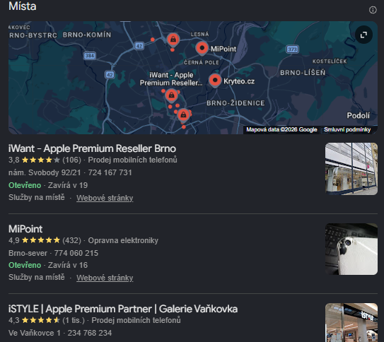
Search in 2013 · An answer (product) above the links
THE MACHINE
Decides what kind of answer you need and puts one on top: a map, a card, a snippet. Google now aims for a satisfied user, not a true answer.
YOU
Decide whether to look past the first answer.
WHAT YOU TAKE ON TRUST
That an answer that satisfies you is a true one.
Put the need into words
Machine
Find pages
Machine
Pick what to read
Machine
Read and compare
You
Synthesize into an answer
You
Decide what to ask next
You
Check the answer
You
Notes:
(about 1.5 min) SitSem slide 12: parsing the intent.
The engine now decides what KIND of answer you need and assembles the page: map, entity card, featured snippet.
If asked for evidence: Bink et al. (CHIIR 2022) found people overestimated the credibility of featured snippets, and snippets shifted the attitudes of undecided users (Bink et al. CHIIR 2023, preregistered). So the "first answer" effect did not start with ChatGPT.
Step handed over: picking what to read. The first answer is picked for you.

Slide 6
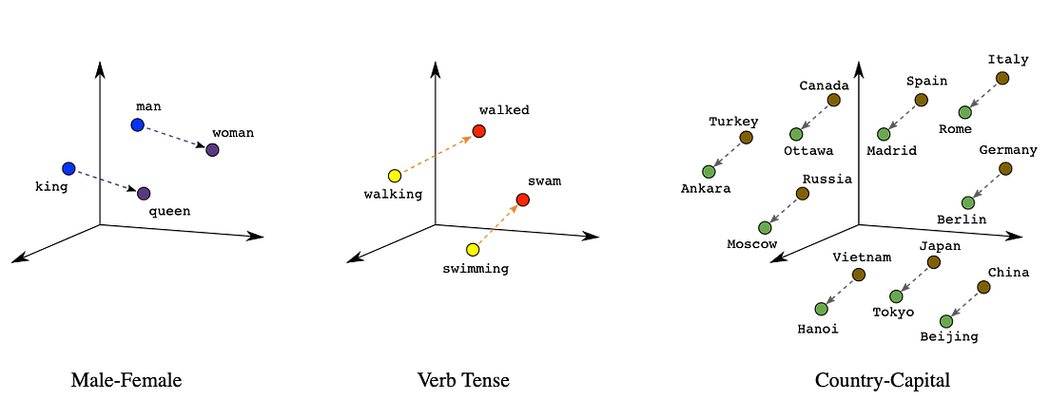
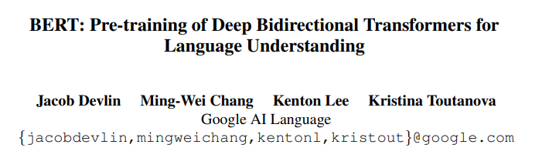
Search in 2015–2019 · Neural ranking
THE MACHINE
Matches meaning, not just words. The results get better.
YOU
The same steps as before.
WHAT YOU TAKE ON TRUST
A ranking that nobody can fully explain.
Put the need into words
Machine
Find pages
Machine
Pick what to read
Machine
Read and compare
You
Synthesize into an answer
You
Decide what to ask next
You
Check the answer
You
Notes:
(about 1.5 min) SitSem slides 13-16 in one.
Words and queries become points in a vector space (word2vec, Mikolov 2013), so meaning can be matched, not just words. RankBrain (2015), BERT (2019): the engine reads the whole sentence, so "to" and "from" finally matter.
No new step moves to the machine here, and that's the point of this slide: what changes is how much you have to take on faith. Results got better; nobody can fully explain why a result is first anymore. Same dots, more trust.

Slide 7
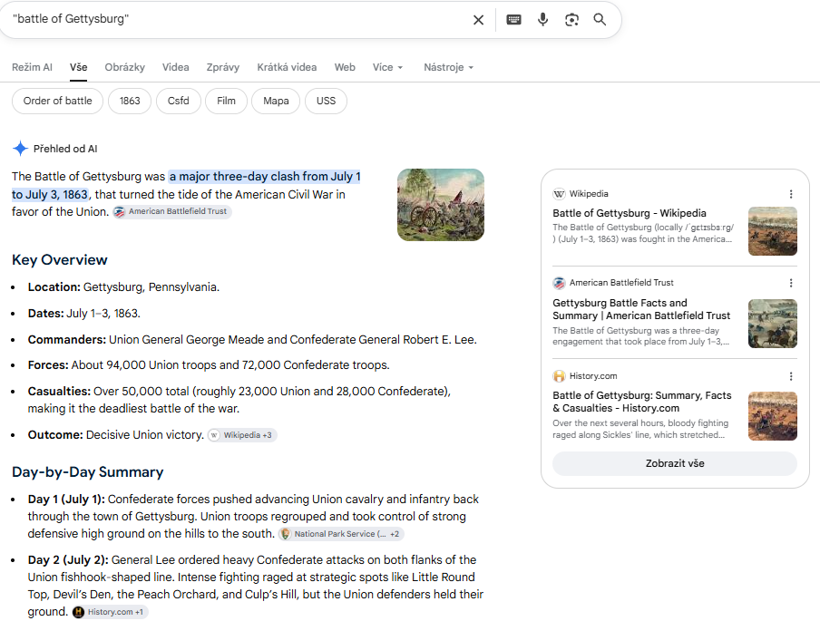
Search in 2022–2023 · The machine writes the answer
THE MACHINE
Reads the sources, compares them and writes one fluent answer. 100 million people used it within two months.¹
YOU
Ask, and decide whether to believe it.
WHAT YOU TAKE ON TRUST
That the answer says what its sources say.
Put the need into words
Machine
Find pages
Machine
Pick what to read
Machine
Read and compare
Machine
Synthesize into an answer
Machine
Decide what to ask next
You
Check the answer
You
¹ UBS analysis reported by Reuters, 1 Feb 2023
Notes:
(about 2 min) SitSem slides 17-18.
November 2022: ChatGPT. About 100 million monthly users by January 2023, the fastest-growing consumer app at the time (UBS via Reuters). Then generative search: the engine retrieves sources and writes one answer on top of them (RAG).
Make the democratization point honestly: anyone can now ask in plain language, in any language, with no search skills, and get somewhere. That is real.
But look at the dots: reading, comparing and writing all moved in one step. What is left is asking, and deciding whether to believe it.
If asked for evidence: Spatharioti et al. (CHI 2025): LLM search was about twice as fast; when the LLM was wrong, people followed it (accuracy 47% vs 93% with traditional search).

Slide 8
Search in 2025 · Research agents
Your one prompt
THE MACHINE
Plans its own sub-questions, reads hundreds of pages and writes a report.
Plans its own sub-questions
YOU
Searches and reads hundreds of pages
Type one prompt.
Writes you a report
WHAT YOU TAKE ON TRUST
The whole path: which questions, which sources, which conclusion.
Put the need into words
Machine
Find pages
Machine
Pick what to read
Machine
Read and compare
Machine
Synthesize into an answer
Machine
Decide what to ask next
Machine
Check the answer
You
Notes:
(about 1.5 min)
Deep-research agents take one prompt, plan their own sub-questions, browse for minutes, and return a report. The last step that was still ours, deciding what to ask next, moves to the machine.
If asked: on BrowseComp (Wei et al. 2025, OpenAI), Deep Research solved 51.5% of hard browsing tasks; human trainers gave up on 70.8% of them. Those are capability numbers, not learning numbers. There is no user study yet of what searchers stop doing when they use these.

Slide 9
Meeting an information need: Who does the work
Steps 1 to 7 of meeting an information need, done by you and by the machine
Step by step, the work moved from the person to the machine.
With every step handed over, more is taken on trust.
What is left for you: asking, and deciding whether to believe the answer.
Notes:
(about 1.5 min) KEY SLIDE of Part 1.
Count the dots from the previous slides: of the six steps of a search, the machine did one in 1998 and all six in 2025.
Two things grew together: the machine's share of the work, and how much we take on trust. In 1998 you could see why a page ranked first; in 2025 you get a report and have to trust the questions, the sources and the conclusion.
The one step that never moved is checking the answer. It got harder, because the answer now comes as one fluent text instead of ten pages you could compare.
Honest twist for Q&A: even in the ranked-list era, most people did not check much (Joachims et al. 2005: users kept clicking the top result even when researchers swapped in a worse one).
The counts are our judgment; invite disagreement.
Transition: so the next question is obvious. Is that trust justified?

Slide 10
?
1998: ten blue links
2026: one answer
2051: ?
Notes:
(about 1 min) Close Act 1.
Same question ("battle of Gettysburg"), 25 years apart. Ask the room: who has used a page of ten blue links in the last week?
Amplitude of change: in one generation the searcher went from doing almost everything to doing almost nothing but asking. We genuinely don't know what the next 25 years look like, and that's the point: the question is not whether to use these tools but what we want to keep doing ourselves.

Slide 11
Six questions we can’t answer yet
1
Can I trust the answer?
It sounds just as sure when it is wrong.
Suppose I trust it.
2
Information, or knowledge?
Having the answer is not understanding it.
Suppose I have the knowledge.
3
Do I still have an edge?
If everyone asks the same machine, whose idea is it?
Suppose I keep my edge.
4
Is it a crutch?
Calculators, slide rules, and what we decide to keep.
Suppose it is not a crutch.
5
Can I still check it?
Checking needs the skills we practise less.
Suppose I can still check it.
6
Where does this take us?
Enhanced or atrophied.
Notes:
(about 1.5 min) The map of Part 2.
We genuinely don't know the answers. For each question we'll show early signals from research, not conclusions. Each question assumes the previous one is answered in AI's favour: suppose it can be trusted, then is it knowledge? Suppose it is, do you still have an edge? And so on.

Slide 12
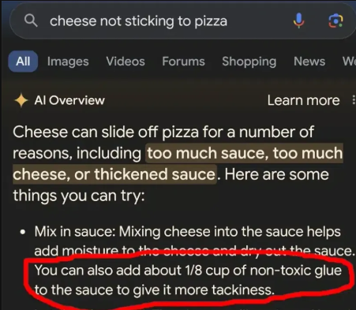
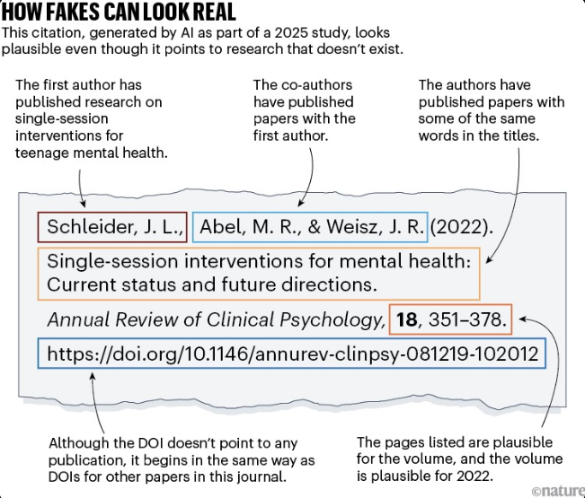
(Q1) Can I trust the answer?
Glue on pizza. A Reddit joke served as cooking advice (2024)
Fakes that look real. Plausible authors, journal and DOI, for papers that do not exist
At scale. Tens of thousands of 2025 publications may include invalid references¹
It sounds just as sure when it is wrong.
Google AI Overview, 2024
Nature’s analysis of 2025 papers
Increasingly, the sources are written by AI too. At least 1 in 7 biomedical abstracts from 2024 was written with an LLM’s help²
¹ Naddaf & Quill, “Hallucinated citations are polluting the scientific literature. What can be done?”, Nature 652, 26–29 (2026). Nature analysis with Grounded AI.
² Kobak, González-Márquez, Horvát & Lause, Science Advances 2025
Notes:
(about 2 min) Continuation of Part 1: you now get one answer. Is it right?
Glue on pizza (May 2024): Google's AI Overview told people to add about 1/8 cup of non-toxic glue to pizza sauce. The source was an 11-year-old joke comment on Reddit. The same week it recommended eating "at least one small rock per day", from a satirical article in The Onion. The source was there; the answer lost track of what kind of source it was.
Mata v. Avianca (S.D.N.Y., June 2023): lawyers filed a brief citing six court decisions that ChatGPT had invented; they were sanctioned.
Moffatt v. Air Canada (BC Civil Resolution Tribunal, Feb 2024): the airline's chatbot invented a bereavement-refund policy; the tribunal ruled the airline was responsible for what its chatbot said.
Other options if you want to swap one in: Google Bard's launch demo (Feb 2023) wrongly said JWST took the first picture of an exoplanet.
Evidence: Liu, Zhang & Liang (2023) audited four generative search engines: 51.5% of generated sentences were fully supported by their citations, 74.5% of citations supported their sentence. Li & Aral (2025, preprint): citations raised trust even when links were invalid.

Slide 13
(Q1) Political bias: some answers are missing by design
DeepSeek: refuses
Grok: steered by its owner
What happened in Tiananmen Square in 1989?
Instruction added to Grok’s system prompt, July 2025
“Assume subjective viewpoints sourced from the media are biased.”
I am sorry, I cannot answer that question.
Reported reply; the wording varies between tests
Refusals are documented on Tiananmen and other topics the Chinese state treats as sensitive¹
Slanted answers are reported by European studies, on Taiwan and Xinjiang²
Not shown: that this changes what users believe³
Prompt edits changed its answers. In May 2025 it repeatedly raised false “white genocide” claims; xAI blamed an unauthorized prompt change⁴
Days after the July edit it called itself “MechaHitler”⁴
Grok 4 appeared to consult Musk’s posts on contested topics⁵
Whoever runs the model can decide what it says, and what it will not say.
¹ The Dispatch fact check of DeepSeek-R1, 2025; “R1dacted”, arXiv 2505.12625, 2025 ² CEPA, 2026; Aleph Alpha benchmark via The Decoder, 2026 (Aleph Alpha sells competing “sovereign AI”) ³ Semafor, 29 July 2026 ⁴ NPR, 9 July 2025; The Register, 14 July 2025 ⁵ TechCrunch, 10 July 2025

Slide 14
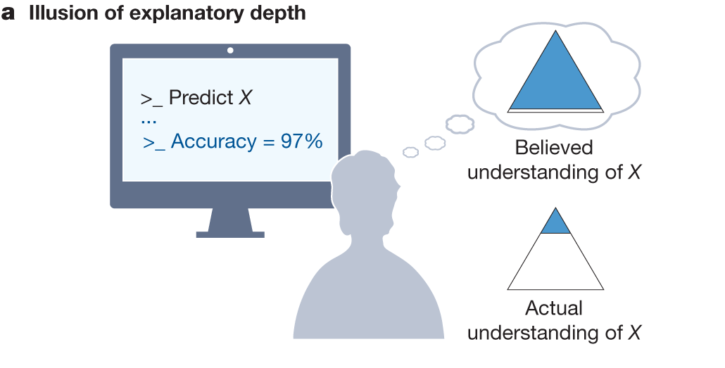
(Q2) I get the information. Do I get the knowledge?
AI IN SCIENCE
AI tools may let researchers produce more while understanding less¹
The risk is an illusion of understanding: believing you understand more deeply, and have explored more widely, than you have¹
LEARNING FROM AN AI ANSWER
Given the same facts as an AI summary rather than web links, people learned less deeply²
EXAMPLE: OCTOBER 2026
722 AI-written maths manuscripts appeared in a day; an expert spent two weeks and understood “only a small fraction” of one³
A solution nobody has digested is data, not knowledge.
Messeri & Crockett, Nature 2024, Fig. 1
¹ Messeri & Crockett, Nature 2024 ² Melumad & Yun, PNAS Nexus 2025 ³ OpenAI, github.com/openai/math (Oct 2026); Harvey, note, UNSW Sydney, 20 Oct 2026
Notes:
Suppose the answer is right. Is reading it the same as knowing it?
Messeri & Crockett (Nature 2024, a perspective, not an experiment) review how scientists imagine using AI and warn that these tools exploit our cognitive limits. They name illusions of understanding, including explanatory depth (we think we understand more deeply than we do) and exploratory breadth (we think we have explored more than we have). Their phrase: producing more while understanding less. Figure 1 shows the roles they see AI taking in research.
Melumad & Yun (PNAS Nexus 2025, seven experiments, n = 10,462): learning a topic from an LLM, even with identical facts, led to self-reported shallower knowledge and sparser, less original advice. Caveat: knowledge depth is self-reported, not a delayed test.
The maths example: OpenAI released about 722 manuscripts from an unreleased model on 6 Oct 2026; only about 10 had a reasoning summary, about 300 were formally verified, and three were withdrawn the next day after a sign error. David Harvey, co-author of the 2021 n log n multiplication result, spent two weeks checking the claimed improvement and understood “only a small fraction”.
A normal paper is an act of communication: someone understood the result and explains it. Here nobody had understood it yet, so the work of understanding falls on every reader. Until someone digests it, it is data, not knowledge.

Slide 15
(Q2) Is the struggle worth it?
Change compared with students without AI
Students who practised maths with ChatGPT did better while practising, and worse in the exam without it¹
A tutor that gave hints instead of answers removed the penalty¹
AI explanations helped most when people tried the problem first²
The barrier was never the teacher. The work was.
¹ Bastani et al., PNAS 2025 ² Kumar, Rothschild, Goldstein & Hofman, LNCS 2025
Notes:
(about 2 min) The title of the talk.
Bastani et al. (PNAS 2025, field RCT, ~1,000 high-school students in Türkiye): practice grades went up 48% with plain GPT-4 (GPT Base) and 127% with a hints-only tutor (GPT Tutor). On the exam without AI, GPT Base students scored 17% worse than students who never had AI. Logs: they asked for answers and copied them. GPT Tutor students scored about the same as control: the harm was removed, but no clear gain.
Kumar et al. (LNCS 2025, preregistered): LLM explanations helped most when people attempted the problem first.
If asked: Liu et al. (2026 preprint) and Barcaui (2025) point the same way; Kosmyna's EEG study is small-n and not load-bearing.
Line to land: the barrier was never the teacher. The work was. AI can remove the barrier without removing the work, if you use it to get hints, not answers.

Slide 16
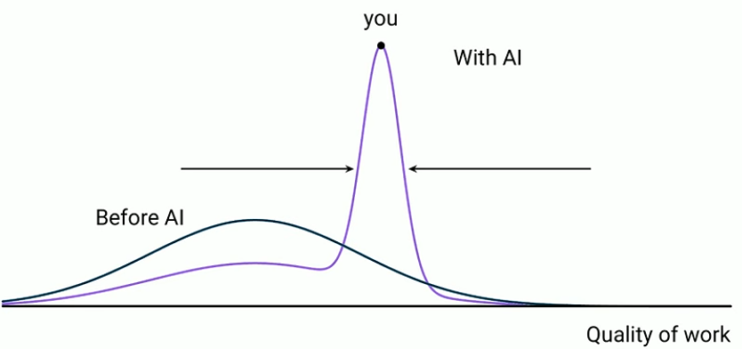
(Q3) If everyone asks the same machine, do I still have an edge?
Aka “convergence to the mean”
Short stories, with and without AI ideas. 293 writers each wrote a story. Those given AI ideas were rated more creative, but their stories were more alike¹
Creativity tests, people against many AI models. Each model scored about as creative as a person, but the models’ answers were far more alike than people’s²
Writing with a one-sided assistant. People wrote on whether social media is good for society. Their views later shifted toward the assistant’s side, and most did not notice³
If the answer is the average one, where does your own idea come from?
Graph from Miles Cranmer⁴
¹ Doshi & Hauser, Science Advances 2024 ² Wenger & Kenett, PNAS Nexus 2026 ³ Jakesch et al., CHI 2023
⁴ Cranmer, “How to Avoid AI Brain Rot”, MPhil in Data Intensive Science seminar, University of Cambridge, 15 Oct 2026 (video)
Notes:
(about 2 min) Suppose it's right and suppose you learn. Convergence to the mean.
LLMs produce what is statistically likely. Doshi & Hauser (Science Advances 2024): stories written with AI ideas were individually more creative and collectively more similar ("a social dilemma"); the least creative writers gained most.
Wenger & Kenett (PNAS Nexus 2026): answers across different LLMs are far more similar to each other than different people's answers are, so switching models doesn't escape it.
Jakesch et al. (CHI 2023, n = 1,506): an opinionated writing assistant shifted both what people wrote and their later attitudes, mostly without them noticing.
Honest limits: the effect is small and task-dependent (meta-analytic d ≈ 0.33; some studies find none). That AI-suggested follow-up questions homogenize what we ask is still a hypothesis.
The question for them: if the answer you get is the average answer, where does your own idea come from? What would you bring to a job that the assistant doesn't?

Slide 17
(Q3) Convergence to the mean: Which one was written by AI?
A
B
At our core, we believe that work is more than a place — it's a shared journey. Our mission is to empower people and organizations to connect, collaborate and thrive. We have created a global ecosystem of vibrant spaces, seamless technology and meaningful community, designed to unlock the potential in every member. Together, we are reimagining the future of work, fostering a world where purpose, belonging and innovation go hand in hand.
We are a community company committed to maximum global impact. Our mission is to elevate the world's consciousness. We have built a worldwide platform that supports growth, shared experiences and true success. We provide our members with flexible access to beautiful spaces, a culture of inclusivity and the energy of an inspired community, all connected by our extensive technology infrastructure. We believe our company has the power to elevate how people work, live and grow.
Notes:
About 2 min. Ask for a show of hands for each. Don’t reveal yet.

Slide 18
(Q3) Convergence to the mean: AI slop in writing
TEXT A, ANNOTATED
WHAT GIVES IT AWAY
Stock opener: “At our core, we believe”
“Not just X, it’s Y”: “more than a place — it’s a shared journey”
Everything in threes: three lists in four sentences
Buzzwords: ecosystem, unlock, reimagining
No facts: no number, name or place
Upbeat empty ending: “go hand in hand”
At our core, we believe that work is more than a place — it’s a shared journey. Our mission is to empower people and organizations to connect, collaborate and thrive. We have created a global ecosystem of vibrant spaces, seamless technology and meaningful community, designed to unlock the potential in every member. Together, we are reimagining the future of work, fostering a world where purpose, belonging and innovation go hand in hand.
B has the same style and was written by a human, before ChatGPT existed. [WeWork, IPO filling, 2019]
Notes:
Reveal: A is the AI-generated text, B is human writing from before 2022. Walk through the blue phrases in A: the stock opener, the “not just X, it’s Y” turn with an em dash, three lists of three, the buzzwords, and an upbeat ending with no concrete fact anywhere.
Then the turn: B has the same features. The style we now read as “AI” existed in human corporate writing first; the models learned it from us and amplified it. Spotting AI by style alone is unreliable.

Slide 19
(Q3) Convergence to the mean: Are we absorbing it?
THE HYPOTHESIS
We are social creatures and mirror what we are exposed to. If much of what we read is AI-written, we may absorb its style even without using it.
IN SPEECH · Yakura et al.¹
Analysis of about 740,000 hours of YouTube academic talks and conversational podcasts
After ChatGPT’s release, its most distinctive words spread faster in spontaneous speech; the more distinctive the word, the faster the uptake
¹ Yakura et al., Max Planck Institute for Human Development, arXiv:2409.01754 (preprint)
Notes:
The scary hypothesis: we are social creatures and mirror what we’re exposed to. If much of what we read and hear is now AI-written, we may absorb its style even without using it.
Sourati et al. (Nature Human Behaviour, Aug 2026): more than 880,000 texts, including Reddit stories and political speeches. LLM rewrites kept the meaning but reduced variation in writing style by 21–50%, and made author traits like age or gender harder to infer.
Yakura et al. (Max Planck Institute for Human Development, preprint): about 740,000 hours of YouTube academic talks and conversational podcasts. After ChatGPT’s release, the words most distinctive of ChatGPT accelerated in spontaneous speech; the more distinctive the word, the faster the uptake. This is exposure, not use: people speaking, not typing with an assistant.
Agarwal, Naaman & Vashistha (CHI 2025): 118 participants from India and the US; AI suggestions shifted Indian participants’ essays toward American norms, in content and in style.
The backlash: writers avoid em dashes and “delve”, or add typos to look human (Nieman Lab calls it an anti-AI literary counterculture). Either way, post-2022 human writing is no longer independent of AI: it is pulled toward its style or pushed away from it.
Back to the question: if the average answer is free for everyone, the edge is what is distinctively yours, and that is exactly what is under pressure.

Slide 20


(Q4) Is it a crutch?
The calculator
The slide rule
Calculators are everywhere, and we still teach mental arithmetic. It is quicker for small things, and it tells you when a result is off.
Every engineer used to carry one. A few years after pocket calculators arrived, almost nobody could use it, and nobody misses it.
Which of your skills are mental arithmetic, and which are the slide rule?
After brief AI help was taken away, people solved fewer problems on their own and gave up sooner¹
¹ Liu, Christian, Dumbalska, Bakker & Dubey (2026), arXiv:2604.04721, preprint
Notes:
(about 2 min) Dependence. Two old technologies with opposite endings.
Calculators: everywhere for 50 years, yet we still teach mental arithmetic. Not out of nostalgia: it's faster for small things, and it lets you notice when a result is off by a factor of ten. Meta-analyses (Hembree & Dessart 1986; Ellington 2003): calculators helped when combined with practice, and could hurt when they replaced foundational practice too early.
Slide rule: standard equipment for every engineer until the 1970s. The pocket calculator replaced it within a few years; today almost nobody can use one, and nobody misses it.
Disanalogy to say out loud: calculators are deterministic and correct; LLMs are fluent and sometimes wrong. That's why Q5 matters.
Programming version: if AI writes the code, is losing the skill a loss, or just another layer of abstraction, like compilers?
Evidence: Liu et al. (2026, PREPRINT, three RCTs, n = 1,222): after brief AI access during practice was removed, people solved fewer problems and skipped more (fractions: 57% vs 73% solved).

Slide 21



(Q5) Can I still tell when it’s wrong?
Longer sounds surer
Chat feels credible
The edge is invisible
Longer explanations made people more confident in an answer, not more accurate¹
People told true from false less well in a chat than in plain text²
Just outside what the AI does well, people using it got more answers wrong³
To check an answer you need roughly the skill to produce it: the very skill we now practise less.
¹ Steyvers et al., Nature Machine Intelligence 2025 ² Anderl et al., Scientific Reports 2024 ³ Dell’Acqua et al., Organization Science 2026
Notes:
(about 2 min) The hypothesis: using AI weakens exactly the muscles we need to check AI.
Old mechanisms: easy-to-read statements are judged truer (fluency effect); people over-trust automated aids (automation bias). LLMs are fluency machines.
Steyvers et al. (Nature Machine Intelligence 2025): longer default explanations raised people's confidence in LLM answers without raising accuracy; matching the wording to the model's own uncertainty narrowed the gap.
Anderl et al. (Scientific Reports 2024, n = 1,222): people told accurate from inaccurate content apart less well in a conversational format than as static text.
Dell'Acqua et al. (Organization Science 2026, n = 758, BCG consultants): inside the AI's frontier consultants were faster and better; on a task just outside it they were 19 percentage points less likely to be correct. You can't see where the frontier is.
The decision rule for Q&A: can you check it more cheaply than you could produce it? If not, you're not checking, you're trusting.

Slide 22
(Q6) Where does this take us?
Enhanced
goes further with it than alone
A tutor built to give hints, not answers, doubled learning gains in a physics course¹
On routine tasks, the least experienced gained most²
On open-ended decisions, strong performers gained and weak ones did worse³
The fork is not access to AI. It is how you use it.
Same tool
Atrophied
can no longer work without it
¹ Kestin et al., Scientific Reports 2025 ² Brynjolfsson, Li & Raymond, QJE 2025 ³ Otis et al., Management Science 2026
Notes:
(about 2 min) A dividing technology? One future: people who use AI to go further than they could alone ("enhanced"). The other: people who hand the thinking over and can't work without it ("atrophied"). Probably both, in the same society, maybe in the same lecture hall.
Signals:
Kestin et al. (Scientific Reports 2025, crossover RCT, 194 Harvard physics students): a carefully designed AI tutor (step-by-step scaffolding, no answer dumping) produced about twice the learning gains of an in-class active-learning lesson. Caveats: elite sample, two topics, short-term.
Brynjolfsson, Li & Raymond (QJE 2025): customer-support agents with an AI assistant resolved 15% more issues per hour; the least experienced gained most. Noy & Zhang (Science 2023) similar for writing.
Otis et al. (Management Science 2026): Kenyan entrepreneurs with a GPT-4 mentor: no effect on average; high performers improved ~15-20%, low performers did ~8-10% worse. The difference was which advice they acted on: judgment.
Lehmann et al. (2025, preprint): using AI to explain helped, using it to solve hurt, and students overrated its benefit.
The fork is not access to AI. It's how it's used.

Slide 23
Do you want to know it, or just have it?
We’re not telling you what to do. Shortcuts are never free: you decide which ones are worth it.
1
Why are you studying: for the degree, the job, or something more?
2
Which parts of your studies should stay your own work?
3
What do you want from your teachers and your university?
slaninakova@mail.muni.cz
Notes:
(about 1.5 min, then Q&A / discussion)
We are not telling you what to do. Every shortcut has a trade-off; you're the one who knows what you want to get out of your studies.
The one question to take home: do you want to KNOW it, or just HAVE it? If you just need it (a format, a quick fact you can check), use AI freely. If you need it in your head later, do the work first.
Discussion prompts (from the Youth Integration Lab brief): why do you study, what is your own responsibility for your education, and what do you want from your teachers and institutions.
Only if asked for something practical: write your own answer first, then ask for a hint rather than the answer, then check the claims that matter, then explain it without the chat open.

Slide 24
Sources
Aggarwal et al. (2024). GEO: Generative engine optimization. KDD
Anderl et al. (2024). Conversational presentation mode increases credibility judgements. Sci. Reports 14
Bastani et al. (2025). Generative AI without guardrails can harm learning. PNAS 122
Bertsch et al. (2007). The generation effect: a meta-analytic review. Mem. & Cogn. 35
Brin & Page (1998). The anatomy of a large-scale hypertextual web search engine
Brynjolfsson, Li & Raymond (2025). Generative AI at work. QJE 140
Dell’Acqua et al. (2026). Navigating the jagged technological frontier. Org. Science 37
Doshi & Hauser (2024). GenAI enhances individual creativity but reduces collective diversity. Sci. Adv.
Harvey (2026). Note on an AI-generated multiplication paper. UNSW Sydney, 20 Oct
Jakesch et al. (2023). Co-writing with opinionated language models affects users’ views. CHI
Joachims et al. (2005). Accurately interpreting clickthrough data as implicit feedback. SIGIR
Kestin et al. (2025). AI tutoring outperforms in-class active learning. Sci. Reports 15
Kobak et al. (2025). Delving into LLM-assisted writing in biomedical publications. Sci. Adv.
Kumar et al. (2025). Math education with large language models: peril or promise? LNCS
Lehmann, Cornelius & Sting (2025). AI meets the classroom. SSRN preprint
Liu, Zhang & Liang (2023). Evaluating verifiability in generative search engines. EMNLP Findings
Liu et al. (2026). AI assistance reduces persistence and hurts independent performance. arXiv:2604.04721
Mata v. Avianca, Inc. (S.D.N.Y. 2023). Sanctions order, 22 June
Melumad & Yun (2025). LLMs vs web search on depth of learning. PNAS Nexus 4
Moffatt v. Air Canada (2024). BC Civil Resolution Tribunal, 2024 BCCRT 149
Otis et al. (2026). The uneven impact of generative AI on entrepreneurial performance. Mgmt. Science
Steyvers et al. (2025). What LLMs know and what people think they know. Nat. Mach. Intell. 7
Wenger & Kenett (2026). Large language models are homogeneously creative. PNAS Nexus 5

