Slide 1
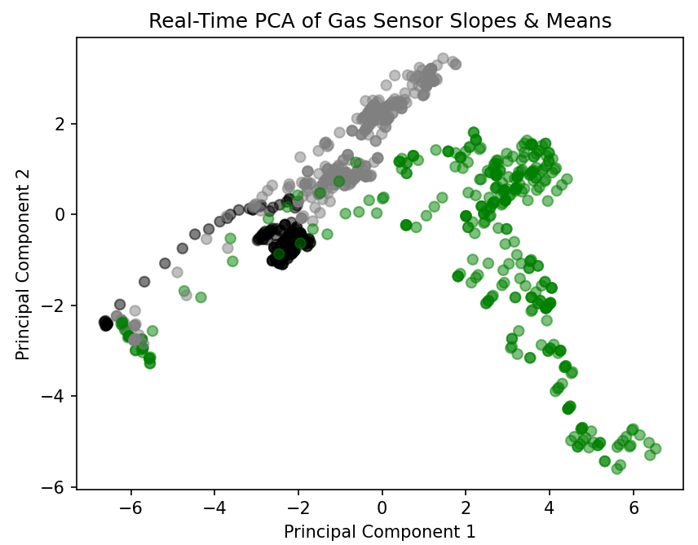
ROOM AIR SIGNAL
ACCUMULATION
ODOR AIR SIGNAL
ACCUMULATION
RESET

