Slide 1
Application frameworks
NodeJS

Slide 2

Overview
NodeJS
Event loop
Use cases
Advantages and disadvantages
Package manager
Require
Let’s do coding
Source : https://www.overviewdocs.com/

Slide 3
NodeJS
Developed by Ryan Dahl.
Created with the aim of creating real-time websites with push capabilities (websockets).
NodeJS is an open source, cross platform runtime environment for server-side and networking applications.
Build on V8 engine, Chrome’s JavaScript engine.
Uses event-driven, non-blocking I/O model which makes NodeJS lightweight and efficient.
Ideal for data-intensive real-time applications that run across distributed devices.
NodeJS comes with several JavaScript libraries that help basic programming.
NodeJS eco-system ‘npm’ is the largest in the world for open source libraries.

Slide 4
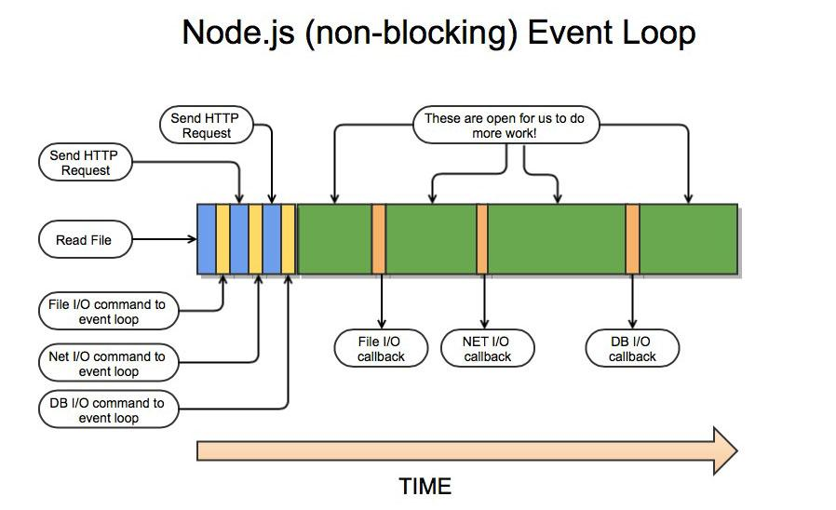
Event loop

Slide 5
Use cases
Not the best platform for CPU intensive heavy computational applications.
Ideal for building fast and scalable network applications.
NodeJS is capable of handling a huge number of simultaneous connections with high throughput.
For each connection NodeJS does not spawn new Thread causing max out of memory instead handle all in single thread using non-blocking I/O model.
NodeJS has achieved over 1 Million concurrent connections.
Bubbling errors up to NodeJS core event loop will cause crashing the entire program.

Slide 6




Use cases
I/O bound applications.
Data streaming applications.
Data intensive real-time applications.
JSON APIs based applications.
Single page applications.

Slide 7
Advantages
Ability to use single programming language from one end of the application to the other end.
NodeJS applications are easy to scale both horizontally and vertically.
Delivers improved performance since V8 engine compile the JS code into machine code directly.
Performance increased via caching modules into memory after the first use.
Easily extensible.
Support for common tools like unit testing.
Well build ‘npm’ package manager and it’s large number of reusable modules.

Slide 8
Disadvantages
Even though there are number of libraries available, the actual number of robust libraries is comparatively low.
Not suitable for computationally intensive tasks.
Asynchronous programming model is complex than synchronous model.

Slide 9
Node package manager
Reusable NodeJS components easily available through online repository.
Build in version and dependency management.
Build in scripting mechanism.
Global installations will be available throughout the system while local installations will only be available for that particular application.
By default all the dependencies will get installed to ‘node_modules’ directory.
‘package.json’ contains all information related to the NodeJS application. The file be placed in the root directory of the application.
‘package.json’ will contain name, version, author, repository, required node version, scripts and dependencies etc.

Slide 10
Node package manager…
To denote the compatible version numbers npm has mechanism for defining them;
Less than or equal ‘<=’, greater than or equal ‘>=’.
Approximately equivalent to ‘~’.
Compatible with ‘^’.
Any ‘*’.
Any ‘1.2.x’.
Latest ‘latest’
There are two types of dependencies ‘devDependencies’ (development time dependencies) and ‘dependencies’ (application runtime dependencies).

Slide 11
Node require
NodeJS follows commonJS pattern when loading modules.
Require modules get loaded synchronously and will be cached after the first use.
If the file does not start with ./, ../, or / module is not a core module NodeJS will look the dependency on the node_modules directory.

Slide 12
Let’s do some coding
Hello world.
Read file.
Write file.
Stream the content of a file.
Create event and subscribe to it.
Create a child process and message passing between two processes.
Create a web server and listen to a port via http protocol.
Add a separate module and use it.
Use a promise.

Slide 13


