Slide 1
Bugzilla Tutorial

Slide 2
What is Bugzilla?
Bugzilla is a bug- or issue-tracking system.
  Bug-tracking systems allow individual or groups of developers effectively to keep track of outstanding problems with their product.
An Open Source product
  covered by the Mozilla Public License
See: http://www.bugzilla.org

Slide 3
Before entering a bug
Make sure the bug has not been previously reported!
  Use the Bugzilla Query Form
Next, be sure that you've reproduced your bug using the latest build released
  Development process may produce new builds even daily, and the bug you've found may already have been fixed.

Slide 4
A useful bug report has two qualities
Reproducible
  If an engineer can't see it or conclusively prove that it exists, the engineer will probably stamp it "WORKSFORME" or "INVALID", and move on to the next bug. Every relevant detail you can provide helps.
Specific
  The quicker the engineer can isolate the issue to a specific problem, the more likely it'll be expediently fixed.

Slide 5
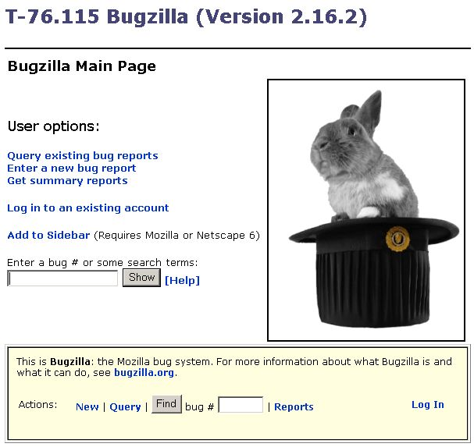

Slide 6
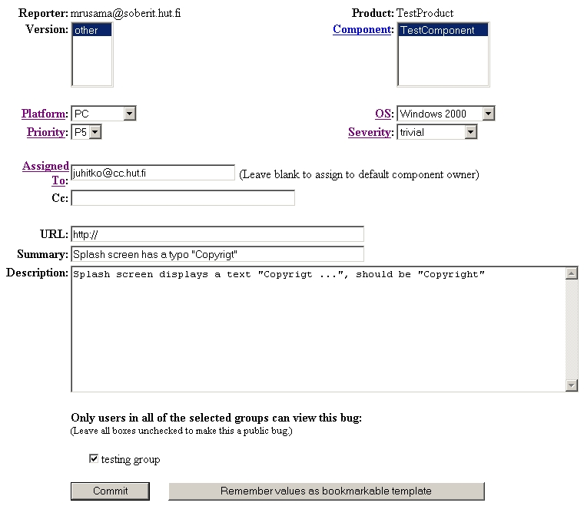

Slide 7
Where did you find the bug?

Slide 8
How important is the bug?

Slide 9
Who will be following up on the bug?

Slide 10
  What can you tell the engineer about the bug?

Slide 11
  Who is allowed to view this bug?

Slide 12
  Submit!
Create a template?

Slide 13
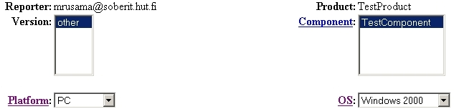
Where did you find the bug?
Product - In which product did you find the bug?
Version - In which product version did you find the bug?
Component - In which component does the bug exist?
Platform - On which hardware platform did you find this bug?
OS - On which Operating System (OS) did you find this bug?

Slide 14
Where did you find the bug?
Product - In which product did you find the bug?
  In this course, group name is same as the product name
Version - In which product version did you find the bug?
  We're not yet using this field. Just leave the default value as you found it.
Component - In which component does the bug exist?
  By default, your product has only the ”default” component
  Click on the ’Component’ link to see descriptions of each component.
Platform - On which hardware platform did you find this bug?
  e.g. Macintosh, SGI, Sun, PC, ...
  If you know the bug happens on all hardware platforms, choose 'All'. Otherwise, select the platform that you found the bug on, or "Other" if your platform isn't listed.
OS - On which Operating System (OS) did you find this bug?
  e.g. Linux, Windows NT, Mac OS 8.5.
  If you know the bug happens on all OSs, choose 'All'. Otherwise, select the OS that you found the bug on, or "Other" if your OS isn't listed.

Slide 15
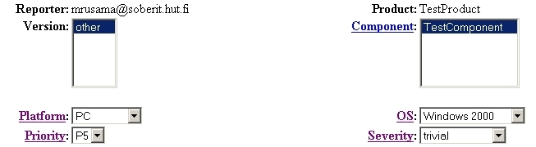
Severity - How important is the bug?
Severity: How damaging is the bug? The impact of a bug.
  This item defaults to ’unspecified'.
  To determine the most appropriate severity for a particular bug, click on the Severity link for a full explanation of each choice, from ’Critical’ to ’Enhancement’.
You should specify what severities you are planning to use

Slide 16
Severity Values
Unspecified – the default value, severity not specified
Blocker - Blocks development and/or testing work
Critical - crashes, loss of data, severe memory leak
Major - major loss of function
Minor - minor loss of function, or other problem where easy workaround is present
Trivial - cosmetic problem like misspelled words or misaligned text
Enhancement - Request for enhancement, ideas

Slide 17
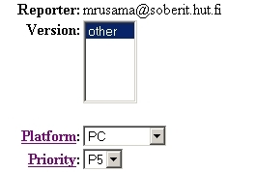
Priority
This field describes the importance and order in which a bug should be fixed.
Utilized by the managers and programmers or engineers to prioritize their work to be done.
The available priorities are:
  P1 Most important
  P2
  P3
  P4
  P5 Least important

Slide 18

Who will be following up on the bug?
Assigned To - Which engineer should be responsible for fixing this bug?
Cc - Who else should receive e-mail updates on changes to this bug?
You would not normally change either of these fields from their default values!
  In this course default component owner is ”randomly” chosen, so you may need to change the values.

Slide 19
Who will be following up on the bug?
Assigned To: Which engineer should be responsible for fixing this bug?
  Bugzilla will automatically assign the bug to a default engineer upon submitting a bug report; the text box exists to allow you to manually assign it to a different engineer.
Cc: Who else should receive e-mail updates on changes to this bug?
  List the full e-mail addresses of other individuals who should receive an e-mail update upon every change to the bug report.

Slide 20
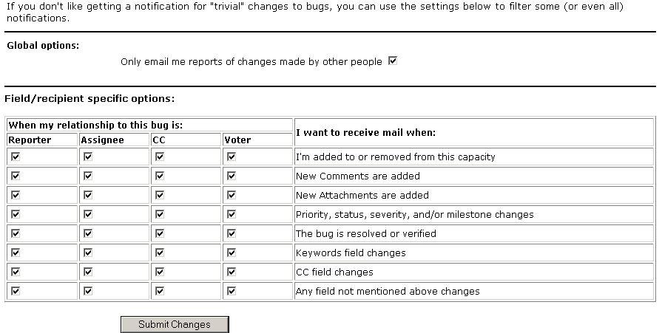
To change email settings
page footer ’prefs’ link→’Email settings’

Slide 21
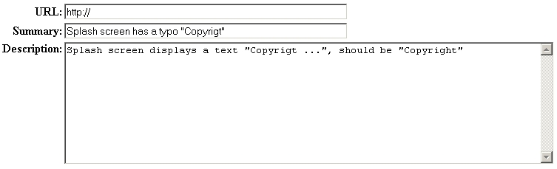
What can you tell about the bug?
URL - On what URL did you discover this bug?
Summary - How would you describe the bug, in approximately 60 or fewer characters?
Description - What else can you tell the engineer about this bug?

Slide 22
What can you tell about the bug? - Description
What else can you tell the engineer about this bug?
Provide as detailed of a problem diagnosis in this field as possible, including as much as possible of the following information:
  Overview Description - More detailed expansion of summary.
  Steps to Reproduce - The minimal set of steps necessary to trigger the bug. Include any special setup steps.
  Actual Results - What the application did after performing the above steps.
  Expected Results - What the application should have done, were the bug not present.
  Build Date & Platform - Date and platform of the build that you first encountered the bug in.
  Additional Builds and Platforms - Whether or not the bug takes place on other platforms or browsers.
  Additional Information - Minimized HTML snippets, Talkback crash IDs, and any other debugging information. (ATTACHEMENT)

Slide 23
Bug Life-Cycle
Transition is allowed from any open state to the ”Resolved” state
Unconfirmed
New
Assigned
Resolved
Verified
Reassign
Reopened
Closed
Open States
End States

Slide 24
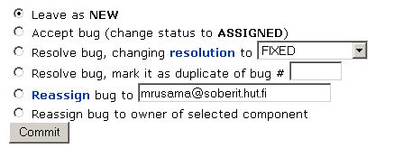
Bug Status – Open States
NEW - This bug has recently been added to the assignee's list of bugs and must be processed.
  Bugs in this state may be accepted, and become ASSIGNED, passed on to someone else, and remain NEW, or resolved and marked RESOLVED.
ASSIGNED - This bug is not yet resolved, but is assigned to someone who thinks they can fix it.
  From here bugs can be given to another person and become NEW, or resolved and become RESOLVED.
REOPENED - The bug was once resolved, but the resolution was deemed incorrect.
UNCONFIRMED - Nobody has validated that this bug needs to be fixed.
  Usually, an UNCONFIRMED bug will be left unconfirmed until someone has verified that the bug the reporter submitted actually occurs.

Slide 25
Bug Status – End States
RESOLVED - A resolution has been made, and it is awaiting verification by the QA.
  From here bugs are either re-opened and become REOPENED, are marked VERIFIED, or are closed for good and marked CLOSED.
VERIFIED- QA has looked at the bug and the resolution and agrees that the appropriate action has been taken.
  Bugs remain in this state until the product they were reported against actually ships, at which point they become CLOSED.
CLOSED - The bug is considered dead, the resolution is correct, and the product the bug has been reported against is terminated or shipped.
  Any zombie bugs who choose to walk the earth again must do so by becoming REOPENED. This state is rarely ever used.
NOTE: Resolution values can only be specified for bugs being in one of the end states!

Slide 26
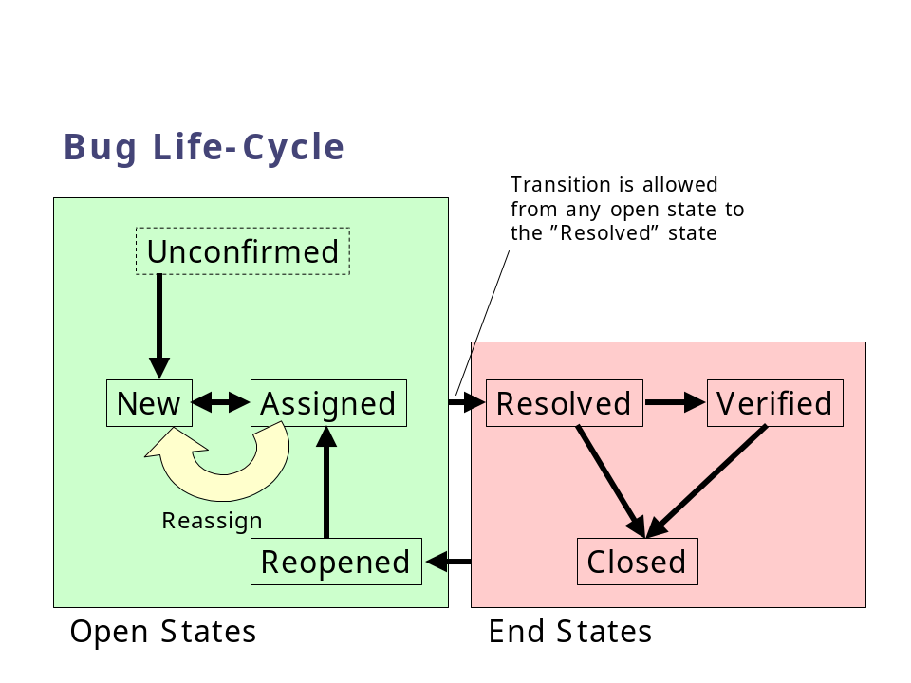
Resolution
The resolution field indicates what happened to this bug.
Only bugs in”Resolved” state will be marked with one of the resolutions.
All bugs which are in one of the ”Open” states have no associated resolution.

Slide 27
Resolution
FIXED - A fix for this bug is checked into the tree and tested.
INVALID - The problem described is not a bug.
WONTFIX - The problem described is a bug which will never be fixed.
LATER - The problem described is a bug which will not be fixed in this version of the product.
REMIND - The problem described is a bug which will probably not be fixed in this version of the product, but might still be.
DUPLICATE - The problem is a duplicate of an existing bug. Marking a bug duplicate requires the bug number of the duplicate and that number will be placed in the bug description.
WORKSFORME - All attempts at reproducing this bug were futile, reading the code produces no clues as to why this behavior would occur. If more information appears later, please re-assign the bug, for now, file it.

