Slide 1
GUI Based testing
Selenium

Slide 2
Contents:
Introduction to GUI based testing
Selenium testing
Test case recording
Analyze Test Runner
Test Suits
Commands

Slide 3
GUI-based Testing
Testing GUI software systems is different from testing non-GUI software
  Non-GUI testing: suites are composed of test cases that invoke methods of the system and catch the return value/s;
  GUI-based testing: suites are composed of test cases that are:
      able to recognize/identify the components of a GUI;
      able to exercise GUI events (e.g., mouse clicks);
      able to provide inputs to the GUI components (e.g., filling text fields);
      able to test the functionality underlying a GUI set of components;
      able to check the GUI representations to see if they are consistent with the expected ones;
      often, strongly dependent on the used technology;

Slide 4
Tools for GUI-based testing
GUI testing advantages
Automation is feasible
  Several frameworks and tools support it
Easy to conduct for non-expert people
It is funny to do
Marathon
Abbot
Guitar
HtmlUnit, HttpUnit,JWebUnit
HtmlFixture
Selenium
Java
Web

Slide 5
Selenium
Open source test tool for web applications.
Run in browser
Test browser compatibility & system functionality.
Easy to use.
  Test cases are written in pure HTML
  Clean and impressive UI

Slide 6
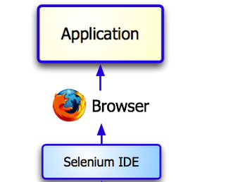

Slide 7
Selenium Features
Supports Cross Browser Testing. The Selenium tests can be run on multiple browsers.
Allows scripting in several languages like Java, C#, PHP and Python.
Assertion statements provide an efficient way of comparing expected and actual results.
Inbuilt reporting mechanism.
Softsmith Infotech

Slide 8
HTML
Selenium saves all information in an HTML table format
  Command – Tells Selenium what to do using actions or assertions Ex.) type
  Target – Tells Selenium which HTML element a Value – Used for any command that might need a value of some kind Ex.) Hello
  command refers to Ex.) textbox

Slide 9
Where to get it?
You can use Selenium-Core and customize everything
But it is easier to just get a Firefox plug-in “Selenium-IDE” that helps you “record” test cases
You can record how an app is being used and then play back those recordings followed by asserts
Get everything at: www.openqa.org/selenium/

Slide 10
Selenium IDE Installation
Using Firefox, first, download the IDE from the SeleniumHQ downloads page When downloading from Firefox, you’ll be presented with the Window A. (See Next Slide)
Select Install Now. The Firefox Add-ons window pops up, first showing a progress bar, and when the download is complete, displays the Window B. (See Next Slide)
Restart Firefox. After Firefox reboots you will find the Selenium-IDE listed under the Firefox Tools menu.
Softsmith Infotech

Slide 11
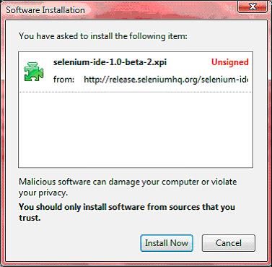
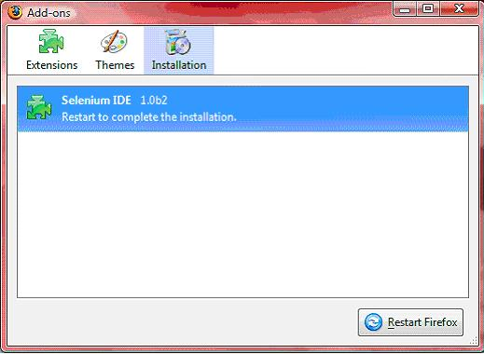
Selenium Installation
Window A
Window B
To run the Selenium-IDE, simply select it from the Firefox Tools menu. It opens as follows with an empty script-editing window and a menu for loading, or creating new test cases. (See Next Slide)
Softsmith Infotech

Slide 12
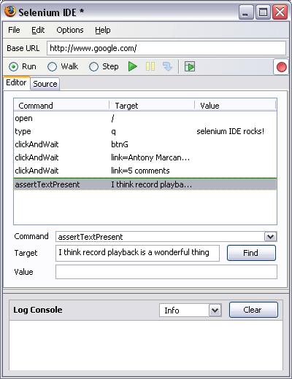
Selenium IDE - UI
Start and Stop
Recording
Replay
Toolbar
Selenese
Script
Editor
Accessor
Area
Selenium Log
Softsmith Infotech

Slide 13
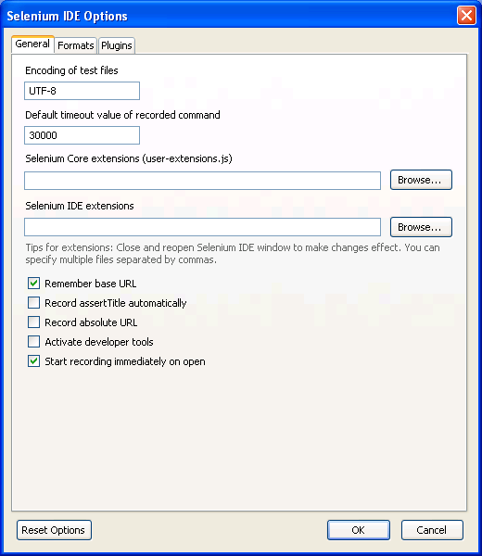
Selenium Options
Selenium Options allow you to
Set The Text Encoding Format
Set the Default Page Time Out
Set The Base URL recording option
Adding Selenium Core and IDE Extension
Add Automatic Page Title Assertions
There are also other options under development
Softsmith Infotech

Slide 14
Recoding a Selenium Test Case
Open Firefox that has the IDE installed
Open the base URL of the application to record.
Keep the application in a common base state.
Go To Tools → Selenium IDE and the IDE will be opened
Now perform the operations on the application as you are testing the application.
Once you are done with the recording click on the stop recording button and save the test case through the file menu. By default it will be saved as a selenese script (HTML format)
Softsmith Infotech

Slide 15
General Selenium Commands
clicking a link - click or clickAndWait commands
entering values - type command
selecting options from a drop-down listbox - select command
clicking checkboxes or radio buttons - click command
Softsmith Infotech

Slide 16
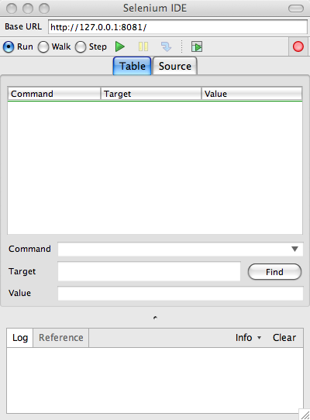
Selenium IDE
The root of web application you want to test
The list of actions in the actual test case to execute
The log of the events that were executed, including any errors or warning that may have occurred

Slide 17
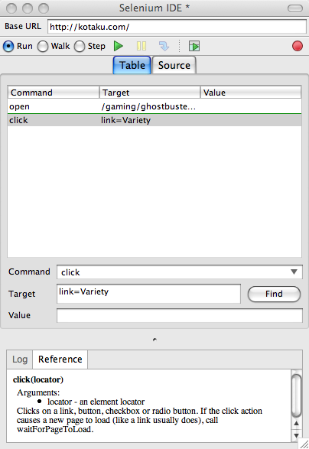
Selenium IDE
Record test actions
Execution Commands
Try the test in the Web based TestRunner
Reference of the currently selected command
Specify commands, including asserts

Slide 18
Running Options
Run a Test Case
  Click the Run button to run the currently displayed test case.
Run a Test Suite
  Click the Run All button to run all the test cases in the currently loaded test suite.
Stop and Start
  The Pause button can be used to stop the test case while it is running. The icon of this button then changes to indicate the Resume button. To continue click Resume.
Stop in the Middle
  You can set a breakpoint in the test case to cause it to stop on a particular command. This is useful for debugging your test case. To set a breakpoint, select a command, right-click, and from the context menu select Toggle Breakpoint.
Softsmith Infotech

Slide 19
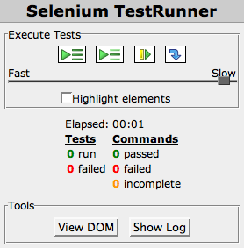
Test Runner Control

Slide 20
Test Runner Control
Pause/Play Execution
Step through Execution
Run Selected Test
Control Speed of Execution
Run All Tests
Highlight Elements in the Execution
Summary of the Test
View the DOM of the current Page being tested
View the log of the current execution

Slide 21
Running Your First Selenium Script
Make sure the application is in the common base state.
Click on the run button. Here you can also control the speed of the execution using the toolbar
Once the test is run you can view the test log in the bottom of the IDE window
Softsmith Infotech

Slide 22
Exercise 01 – Recording test and use IDE
Open “https://accounts.google.com”.
Assert Title of the application
Enter a valid username and password and submit the details to login.
Verify that the user is re-directed to the Home page.
Save test case
Analyze commands , target , values
Upload your script to moodle

Slide 23
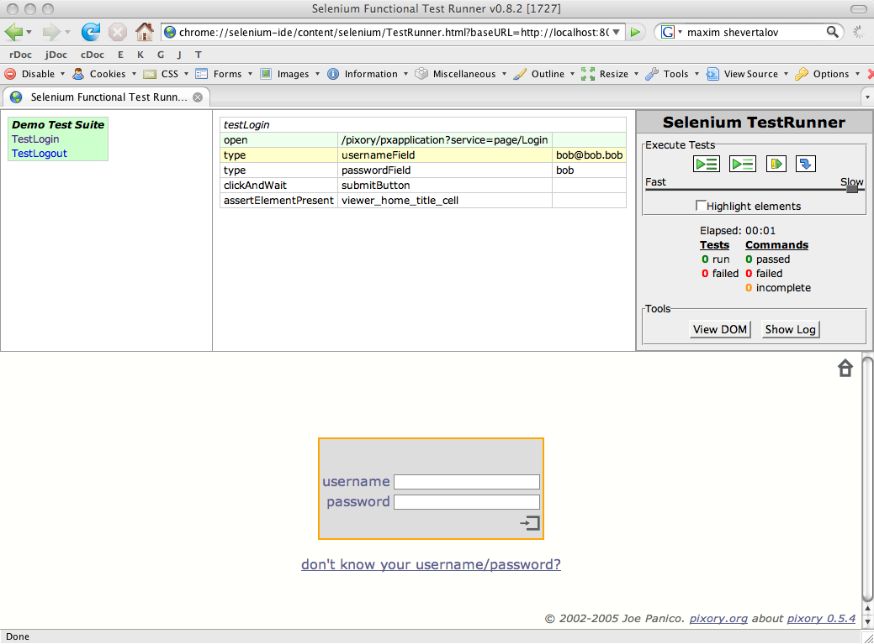
Test Suite

Slide 24
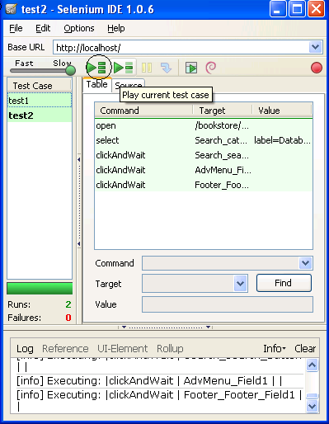
Creating a Test Suite
In the Selenium IDE you can create any number of test cases and save them as test suite.
To Run the test Suite click on the “Play entire test suite” button as shown below.
Test Suite with
Test1 & test2
Softsmith Infotech

Slide 25
Test Suite
Execution Control
Test Cases
Steps of the test case
Application being tested

Slide 26
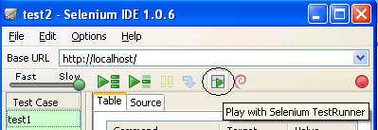
Playing The test Suite with Test Runner
Test Runner allows you to run the test case in a browser loaded with the Selenium-Core TestRunner.
Test runner is invoked by clicking the below Shown button in the IDE
On Clicking the Test Runner Button you will the window as seen in the next slide
Softsmith Infotech

Slide 27
Exercise 02 – Test suites
1. Use http://www.courseweb.sliit.lk as base url
a) navigate to the login page.
(http://www.courseweb.sliit.lk. /login/index.php)
b) Navigate to “Forgotten your username? password?”
c) Click on calculate
d) Click on start over
e) Save test case (ex1t1)
2. Use http://www.courseweb.sliit.lk. /login/forgot_password.php as base url
a) Improve your script for validate the Login to the site page title by applying verify commands and assert commands
b) Please enter either your username or your registered email address in the appropriate box
e) Save test case (ex1t2)
3. Create a Test suite including ex1t1 and ex1t2. Run the test suite
Upload your script to moodle

Slide 28
Commands Actions
Open
  Opens the target URL
Click*
  Clicks on the target element
Type*
  Enters the value specified by the value into the specified target element
Select*
  Selects a drop-down value specified by the value in the specified target element

Slide 29
Command Actions
SelectWindow
  Selects a popup window using the id specified by the target. If NULL, it returns to the main window
GoBack
  Simulates user clicking back in the browser
Close
  Simulates user clicking the close button of a popup window
Pause
  Pauses the execution of a script for an amount of time in milliseconds specified in the target

Slide 30
Command Actions
fireEvent
  Simulate an event to trigger the onevent handler where the target specifies the element and the value specifies the event
waitForValue
  Waits for an input, specified by the target, to have a certain value, specified by the value (Warning: If event doesn’t occur, apply previous fix to stop running script)
Store
  Stores the value specified by the target into the variable specified by the value

Slide 31
Command Actions
StoreValue
  Stores the value of an input field, specified by the target, into a variable specified by the value
storeText
  Stores the text of an element, specified by the target, into a variable specified by the value
storeAttribute
  Stores the value of an element attribute into a variable

Slide 32
Command Actions
chooseCancelOnNextConfirmation
  Instructs Selenium to select cancel on the next javascript dialog raised
answerOnNextPrompt
  Instructs Selenium to return the specified target in response to the next prompt.
Wait
  Used when going to a new page

Slide 33

Selenium WaitFor Commands
waitForPageToLoad
    This command will make the script to wait till the page loads.
    Syntax is waitForPageToLoad(timeout); Time out is the maximum time the script will wait for the page to load.
Softsmith Infotech

Slide 34
Exercise 03 - Commands
Record the Script
Go to Google
Type Apple
Navigate to the first link
Use Clink and ClickandWait commands for Activity Enter
Upload your script to moodle

Slide 35
Session Expectations :
- Familiar with GUI based testing
- Work with Selenium testing using:
Test case
Test Suite
Commands
Analyze the Test Runner

