Slide 1
Software Engineering Process & Quality Management
SOFTWARE TESTING PRINCIPLES AND CONCEPTS

Slide 2
Contents
Topic 1: Software Testing: Introduction
Topic 2 : Software Testing Lifecycle
Topic 3 : Test Designing: Code Based (Control Flow & Data Flow)
Topic 4 : Mutation Testing
Topic 5 : Agile Test Strategies
Topic 6 : Risk Management
Topic 7 : Software Testing Process Improvement
Topic 8 : Test Reporting & Evaluation

Slide 3
Practical Sessions
Manual testing
X-Studio
J unit
Selenium
etc.

Slide 4
Evaluation
Mid Test : 20%
Group Assignment : Tool Demonstration - 10%
Online Exam : Based on Practical Sessions - 10%

Slide 5
What is testing?
Software testing consists of the dynamic validation of the behaviour of a program on a finite set of test cases, suitably selected from the usually infinite executions domain, against the expected behaviour.

Slide 6
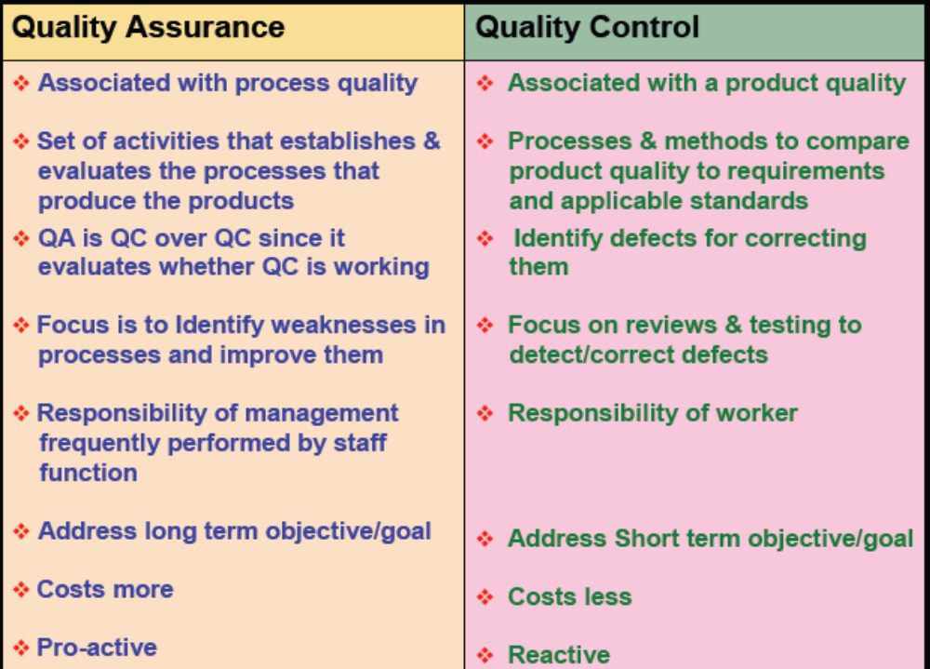
Quality Assurance versus Quality Control

Slide 7
Types of Test Activities
Testing can be broken up into four general types of activities
  Test Design
  Test Automation
  Test Execution
  Test Evaluation
Each type of activity requires different skills, background knowledge, education and training
    1.a) Criteria-based
    1.b) Human-based

Slide 8
Types of Test Activities – Summary
1a. | Design | Design test values to satisfy engineering goals
 | Criteria | Requires knowledge of discrete math, programming and testing
1b. | Design | Design test values from domain knowledge and intuition
 | Human | Requires knowledge of domain, UI, testing
2. | Automation | Embed test values into executable scripts
 |  | Requires knowledge of scripting
3. | Execution | Run tests on the software and record the results
 |  | Requires very little knowledge
4. | Evaluation | Evaluate results of testing, report to developers
 |  | Requires domain knowledge
These four general test activities are quite different
It is a poor use of resources to use people inappropriately
Most test teams use the same people for ALL FOUR activities !!

Slide 9
Terminology (V&V – by IEEE)
Validation:
are we building the right software?
Verification:
are we building the software right?

Slide 10
Terminology (V&V – by IEEE)
Validation : The process of evaluating software at the end of software development to ensure compliance with intended usage
Verification : The process of determining whether the products of a given phase of the software development process fulfill the requirements established during the previous phase
IV&V stands for “independent verification and validation”

Slide 11
Static and Dynamic Testing
Static Testing : Testing without executing the program
  This include software inspections and some forms of analyses
  Very effective at finding certain kinds of problems – especially “potential” faults, that is, problems that could lead to faults when the program is modified
Dynamic Testing : Testing by executing the program with real inputs

Slide 12
Software Faults, Errors & Failures
Software Fault : A static defect in the software
Software Failure : External, incorrect behavior with respect to the requirements or other description of the expected behavior
Faults in software are design mistakes and will always exist

Slide 13
Testing & Debugging
Testing : Finding inputs that cause the software to fail
Debugging : The process of finding a fault given a failure

Slide 14
Test Case
Test Case Values : The values that directly satisfy one test requirement
Expected Results : The result that will be produced when executing the test if the program satisfies it intended behavior

Slide 15
Observability and Controllability
Software Observability : How easy it is to observe the behavior of a program in terms of its outputs, effects on the environment and other hardware and software components
  Software that affects hardware devices, databases, or remote files have low observability
Software Controllability : How easy it is to provide a program with the needed inputs, in terms of values, operations, and behaviors
  Easy to control software with inputs from keyboards
  Inputs from hardware sensors or distributed software is harder
  Data abstraction reduces controllability and observability

