Slide 1
IEEE 829 Test Documents

Slide 2
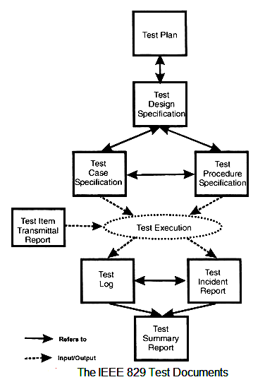
IEEE 829 Test Documents

Slide 3
IEEE 829 Test Documents
IEEE 829 - Test Plan
The Test Plan is the pivotal document around which all the software testing projects revolve. It describes:
  what has to be done,
  to what quality standard,
  with what resource,
  to what time scale,
  and outlines the risks and how they would be overcome.
IEEE 829 - Test Design Specification
Creating the test design is the first stage in developing the tests for a software testing project.
It records what needs to be tested, and is derived from the documents that come into the testing stage, such as requirements and designs.
It records which features of a test item are to be tested, and how a successful test of these features would be recognized.

Slide 4
IEEE 829 Test Documents
IEEE 829 - Test Case Specification
The test cases are produced when the test design is completed. Test cases specify for each testing requirement:
The exact input values that will be input and the values of any standing data that is required,
The exact output values and changes of value of the internal system state that are expected,
And any special steps for setting up the tests.
Defining the expected values is very important, for only by doing this can discrepancies be spotted. However in some projects they are not defined which results in a very poor quality set of test cases.
A feature from the Test Design may be tested in more than one Test Case, and a Test Case may test more than one feature.

Slide 5
IEEE 829 Test Documents
IEEE 829 - Test Procedure Specification
The Test Procedures are developed from both the Test Design and the Test Case Specification.
The document describes how the tester will physically run the test, the physical set-up required, and the procedure steps that need to be followed.
The standard defines ten procedure steps that may be applied when running a test.
IEEE 829 - Test Item Transmittal Report
It describes the items being delivered for testing, where to find them, what is new about them, and gives approval for their release.
The importance of the document is to provide to the testers a warranty that the items are fit to be tested and gives a clear mandate to start testing.
Do not start testing without receiving one!

Slide 6
IEEE 829 Test Documents
IEEE 829 - Test Log
The Test Log records the details of what Test Cases have been run, the order of their running, and the results of the test.
The results are either the test passed, meaning that the actual and expected results were identical, or it failed and that there was a discrepancy.
If there is a discrepancy than one or more Test Incident Reports are raised or updated, and their identities recorded on the Test Log.
IEEE 829 -Test Incident Report
This document is deliberately named as an incident report, and not a fault report.
The reason is that a discrepancy between expected and actual results can occur for a number of reasons other than a fault in the system.
These include the expected results being wrong, the test being run wrongly, or inconsistency in the requirements meaning that more than one interpretation could be made.

