Slide 1
Software Testing Process

Slide 2
Traditional Single V Model
The V model is a simple variant of the traditional waterfall model of system or software development.
the V model builds on the waterfall model by emphasizing verification and validation.
The V model takes the bottom half of the waterfall model and bends it upward into the form of a V, so that the activities on the right verify or validate the work products of the activity on the left.
@ Dr. Aneesh Kishna Slide <number>

Slide 3
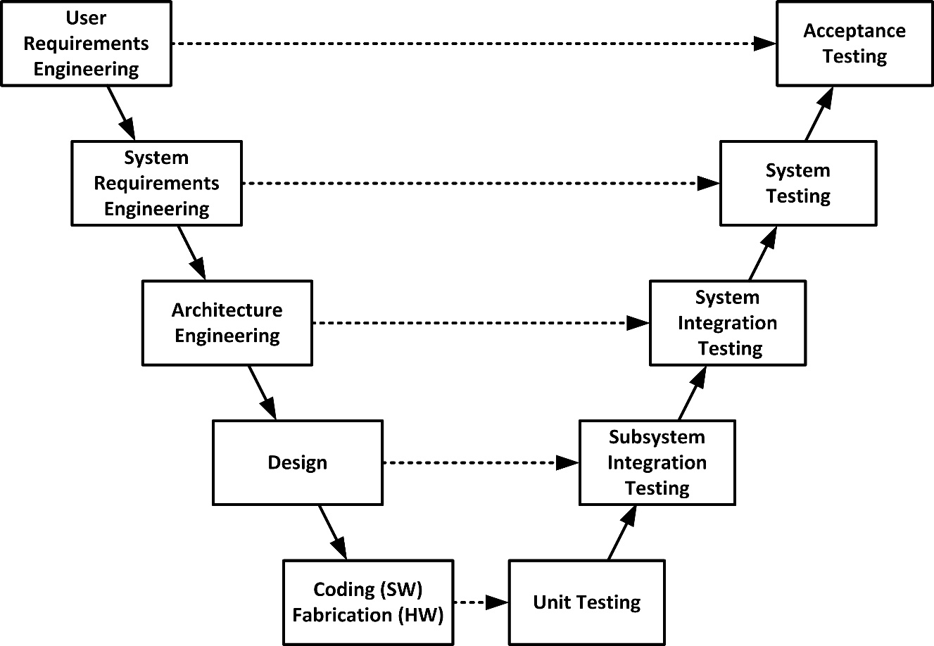
Traditional Single V Model

Slide 4
Tester’s Single V Model of Testable Work Products
traditional V model does not adequately capture development from the tester’s point of view.
tester’s single V model
is oriented around these work products rather than the activities that produce them.
the left side of the V illustrates the analysis of ever more detailed executable models
the right side illustrates the corresponding incremental and iterative synthesis of the actual system.
Thus, this V model shows the executable work products that are tested rather than the general system engineering activities that generate them.

Slide 5
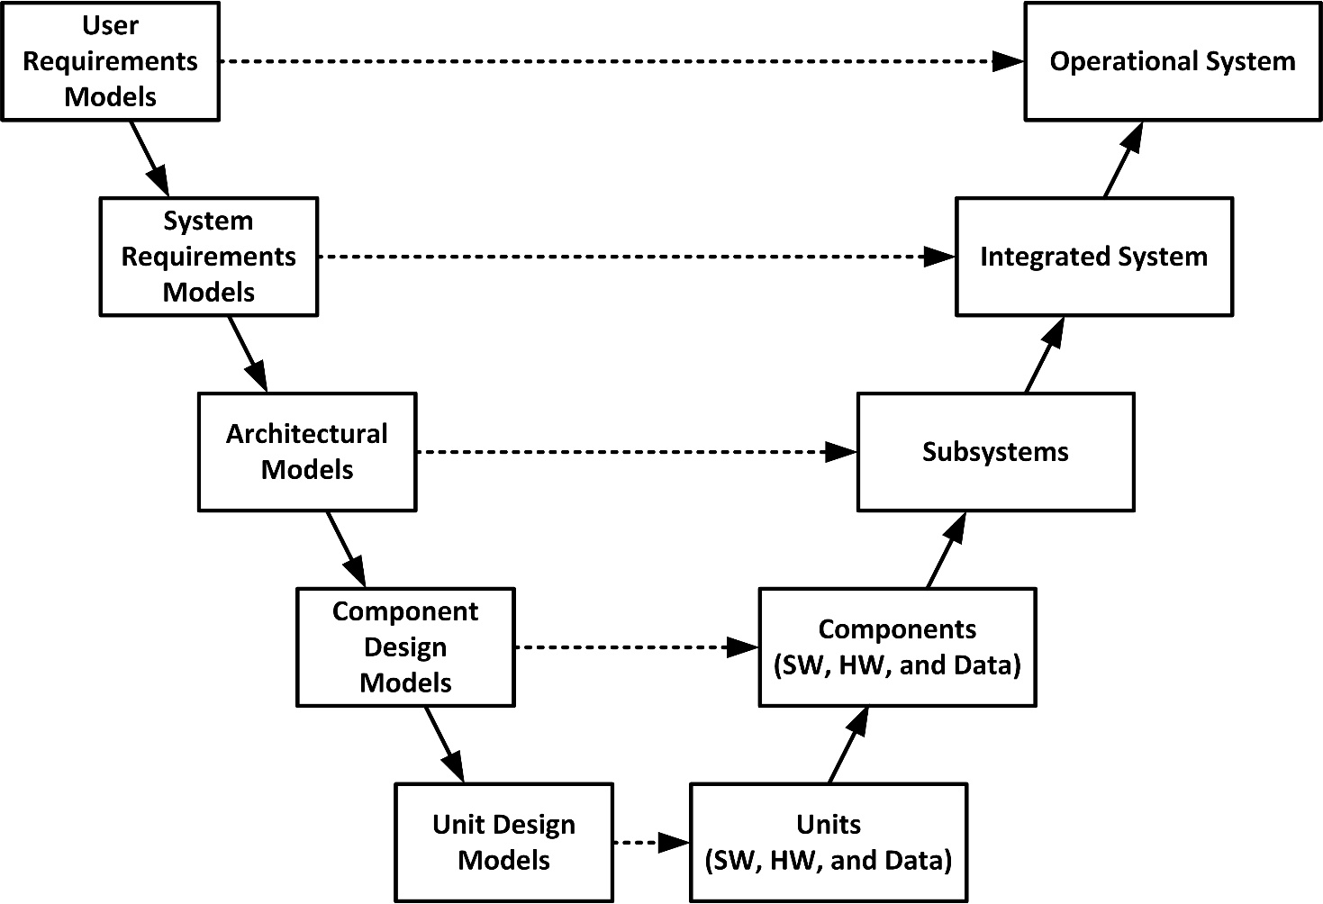
Tester’s Single V Model of Testable Work Products

Slide 6
Tester’s Double V Model
Traditionally, only the right side of the V model dealt with testing.
The requirements, architecture, and design work products on the left side of the model have been documents and informal diagrams that were best verified by such manual verification techniques as analysis, inspections, and reviews.
With the advent of model-based development, the requirements, architecture, and design models became better defined by using more formally defined modeling languages,
The double V model allows us to detect and fix defects in the work products on left side of the V before they can flow into the system and its components on the right side of the V.
In the double V model, every executable work product should be tested.
This process typically involves testing an executable requirements, architecture, or design model (or possibly a prototype) that is implemented in a modeling language (often state-based) such as
  SpecTRM Requirements Language (SpecTRM-RL), Architecture Analysis and Design Language (AADL), and Program Design Language (PDL)

Slide 7
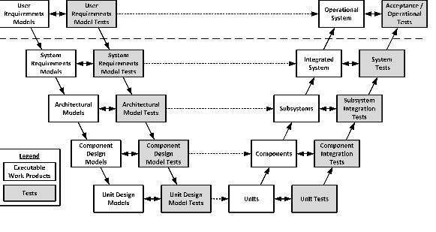
Tester’s Double V Model

Slide 8
The Tester’s Triple V Model
The final variant of the traditional V model, the triple V model, consists of three interwoven V models.
The left V model shows the main executable work products that must be tested.
The middle V model shows the types of tests that are used to verify and validate these work products.
The right V model shows the verification of these testing work products in the middle V.
The triple V model uses the term verification rather than tests because the tests are most often verified by analysis, inspection, and review.

Slide 9
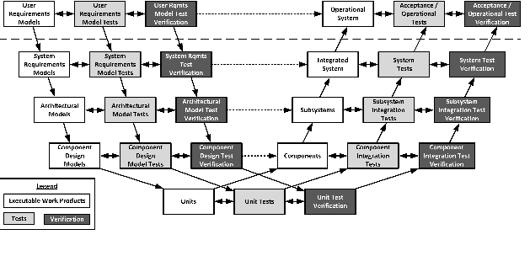
The Tester’s Triple V Model

Slide 10
Verification: Are we building the product right?
Definition
The process of evaluating work-products (not the actual final product) of a development phase to determine whether they meet the specified requirements for that phase.
Objective
To ensure that the product is being built according to the requirements and design specifications. In other words, to ensure that work products meet their specified requirements
Items
Plans, Requirement Specs, Design Specs, Code, Test Cases
Activities
Reviews, Walkthroughs, Inspections

Slide 11
Validation: Are we building the right product?
Definition
The process of evaluating software during or at the end of the development process to determine whether it satisfies specified business requirements.
Objective
To ensure that the product actually meets the user’s needs, and that the specifications were correct in the first place.
Items
The actual product/software
Activities
Testing

Slide 12
Testing Levels
Unit testing
It is basically done by the developers to make sure that their code is working fine and meet the user specifications.
They test their piece of code which they have written like classes, functions, interfaces and procedures.
Component testing
is also called as module testing.
The basic difference between the unit testing and component testing is in unit testing the developers test their piece of code but in component testing the whole component is tested.

Slide 13
Testing Levels
Integration testing
Integration testing is done when two modules are integrated, in order to test the behavior and functionality of both the modules after integration. Below are few types of integration testing:
    Big bang integration testing
    Top down
    Bottom up

Slide 14
Stubs & Drivers
Stub (dummy sessions) replaces a called component for integration testing
Driver (dummy sessions): test harness: scaffolding
specially written or general purpose (commercial tools)
  invoke baseline
  send any data baseline expects
  receive any data baseline produces (print)
each baseline has different requirements from the test driving software

Slide 15
Testing Levels
System testing: In system testing the testers basically test the compatibility of the application with the system.
Acceptance testing: Acceptance testing are basically done to ensure that the requirements of the specification are met.
Alpha testing: Alpha testing is done at the developers site. It is done at the end of the development process
Beta testing: Beta testing is done at the customers site. It is done just before the launch of the product.

Slide 16
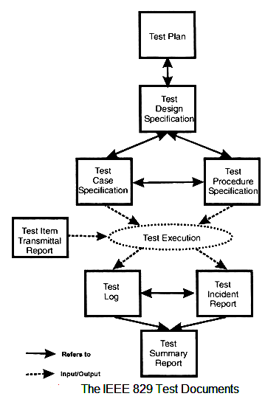
IEEE 829 Test Documents

Slide 17
IEEE 829 Test Documents
IEEE 829 - Test Plan
The Test Plan is the pivotal document around which all the software testing projects revolve. It describes:
  what has to be done,
  to what quality standard,
  with what resource,
  to what time scale,
  and outlines the risks and how they would be overcome.
IEEE 829 - Test Design Specification
Creating the test design is the first stage in developing the tests for a software testing project.
It records what needs to be tested, and is derived from the documents that come into the testing stage, such as requirements and designs.
It records which features of a test item are to be tested, and how a successful test of these features would be recognized.

Slide 18
IEEE 829 Test Documents
IEEE 829 - Test Case Specification
The test cases are produced when the test design is completed. Test cases specify for each testing requirement:
The exact input values that will be input and the values of any standing data that is required,
The exact output values and changes of value of the internal system state that are expected,
And any special steps for setting up the tests.
Defining the expected values is very important, for only by doing this can discrepancies be spotted. However in some projects they are not defined which results in a very poor quality set of test cases.
A feature from the Test Design may be tested in more than one Test Case, and a Test Case may test more than one feature.

Slide 19
IEEE 829 Test Documents
IEEE 829 - Test Procedure Specification
The Test Procedures are developed from both the Test Design and the Test Case Specification.
The document describes how the tester will physically run the test, the physical set-up required, and the procedure steps that need to be followed.
The standard defines ten procedure steps that may be applied when running a test.
IEEE 829 - Test Item Transmittal Report
It describes the items being delivered for testing, where to find them, what is new about them, and gives approval for their release.
The importance of the document is to provide to the testers a warranty that the items are fit to be tested and gives a clear mandate to start testing.
Do not start testing without receiving one!

Slide 20
IEEE 829 Test Documents
IEEE 829 - Test Log
The Test Log records the details of what Test Cases have been run, the order of their running, and the results of the test.
The results are either the test passed, meaning that the actual and expected results were identical, or it failed and that there was a discrepancy.
If there is a discrepancy than one or more Test Incident Reports are raised or updated, and their identities recorded on the Test Log.
IEEE 829 -Test Incident Report
This document is deliberately named as an incident report, and not a fault report.
The reason is that a discrepancy between expected and actual results can occur for a number of reasons other than a fault in the system.
These include the expected results being wrong, the test being run wrongly, or inconsistency in the requirements meaning that more than one interpretation could be made.

