Slide 1
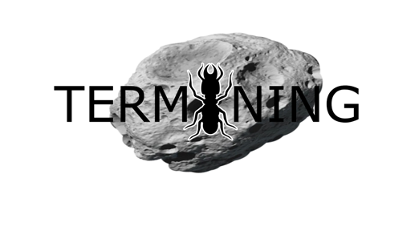
A Space Apps Challenge 2016 Conceptual Project under the Challenge “Asteroid Mining”

Slide 2
“Termining” Concept
“Genealogy tree” of space robots scanning and mining asteroids in order to bring resources to Earth as well as auto-refuel themselves.
3 types of existing asteroids:
1)Carbonaceous (C-type) containing water as ice,
2)Silicaceous (S-type) containing silica (silicon oxide) and some metal,
3)Metallic (M-type) containing larger amounts of metals (80% iron – 20% nickel, iridium, platinum!, and more).

Slide 3
Necessity for different miner robots to implement different tasks: “Termining” suggestion for 1)Water mining robots and 2)Metal mining robots (drillers).

Slide 4
Space Robots “Genealogy Tree” Description
Orbital factory spacecraft in orbit around Earth.
Hive “mother spacecrafts” sent to follow orbits of specific asteroids.
“Daughterly robots” asteroid surface scanners and miners (both water and metal).
The concept is that all “daughterly robots” communicate with each other with use of machine learning.Human intervention is limited ideally to zero.

Slide 5
*From data taken by asteroid databases we know the spectral analysis of many asteroids in asteroid belt between Mars and Jupiter so as for the spacecraft around Earth to “decide” where and what types of robots to send (e.g. water or metal miners).
*Use of existing satellite networks could detect new asteroids possible candidates for mining.

Slide 6
Suggested Mission Planning
At first, orbital factory (around Earth) calculates all possible orbit transfers.
The orbit with the greater efficiency factor (e.g. least fuel consumption) and lower risk factor should ideally be chosen.
The calculations are to take under consideration all known space objects’ orbits and dynamic map of the area from which the hive “mother spacecraft” will pass so as to avoid possible unwanted collisions.

Slide 7
Asteroids worth mining
Even if asteroids have purer materials compared to the Moon due to their big porosity, not all asteroids are worth mining.
Dr. Martin Elvis (Harvard-Smithsonian University) claims that about 10 near-Earth Objects (NEOs) are highly likely to be resourceful.
Asteroid size matters (diameter > 100m preferred).
Very small asteroids have even smaller gravity as well.
However, near-zero gravity is an issue to consider for all asteroid missions.

Slide 8
According to Dr. Elvis, asteroids <100m also contain less water.
Dr. Elvis has developed an equation based on previous existing equation and finally worth exploiting asteroids near us are determined by the product of the following probabilities more or less:
1) The probability for the asteroid to have resources,
2) The probability to have resources in considerable quantity,
3) The probability reaching the asteroid,
4) The probability of a successful mining operation,
5) The number of asteroids worth mining.

Slide 9
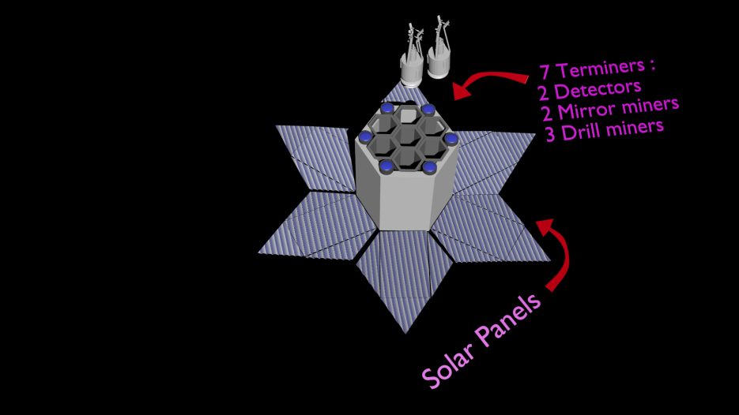
Miner Robot Types
But let’s say the asteroid has been chosen.Hive is set to orbit around the asteroid.
Hive carries
1)robots for spectral scanning of asteroid surface,
2)robots water miners,
3)driller robots (both for buried ice rock and metal extraction).

Slide 10
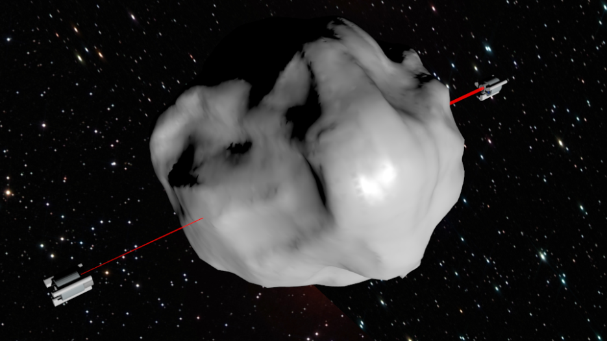
Brief description of Asteroid Scanning robots Operation
Types of sensors used for asteroid surface scanning are the following:
1) Hyperspectral sensors and LiDAR used for scanning the surface of the asteroid identifying materials.
2)A CT Scanner is used to map the interior of an asteroid revealing its composition and material distribution.
3)Ground sounding equipment for further asteroid composure examination.

Slide 11
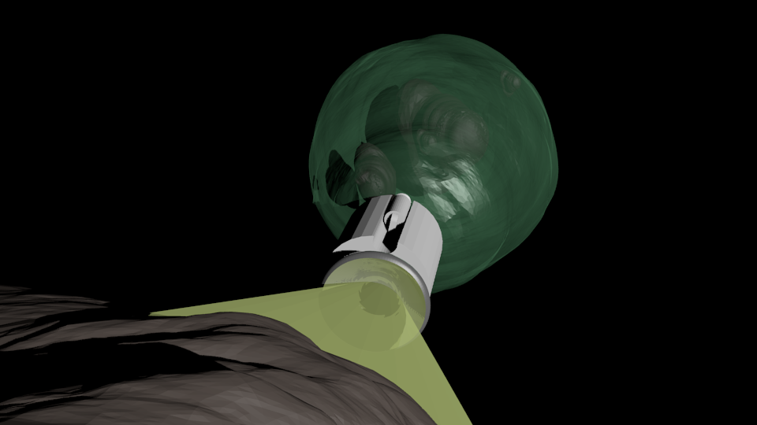
Brief description of Water Miner robots Operation
Water mining robot uses solar energy in order to break the ice of asteroid surface.
Operation as magnyfying lense – many mirrors focus solar energy in one part on asteroid surface.
Ice pieces are gathered in “bag” attached to the robot.
Necessity for cooler inside “bag”.
Ice pieces mechanically guided into bag.

Slide 12
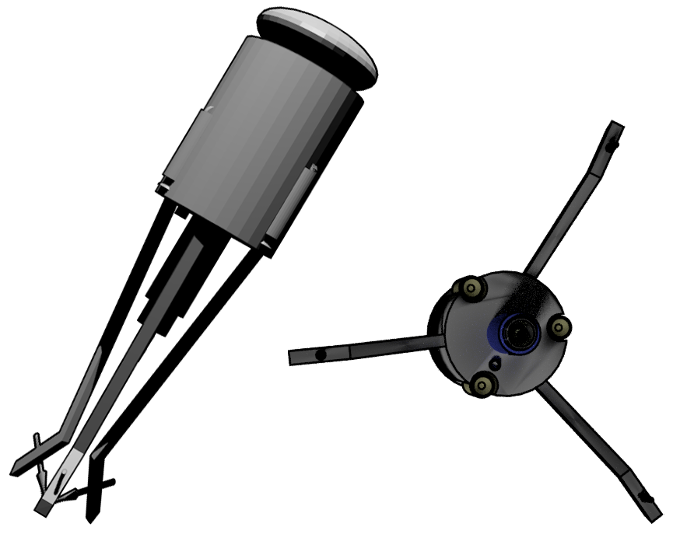
Brief description of Driller Miner robots Operation
Use for metal extraction or ice buried in asteroid volume.
Drill has hole in the middle and material is pushed into “bag” as drilling gets deeper.
*Under consideration proposals:
-”Bags” from carbon nanotubes?Carbon nanotubes strengthen the material which contains them (already use in ship dyings).

