Slide 1
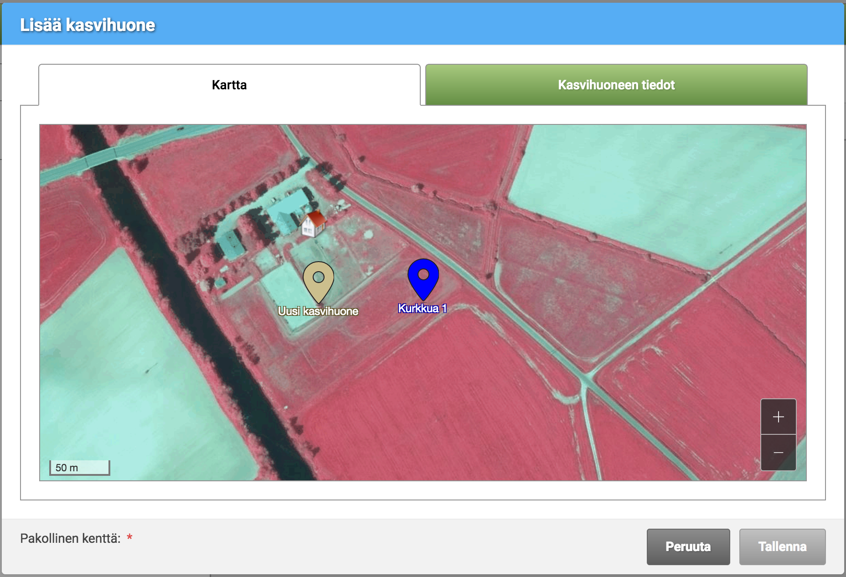
Greenhouse subsidy UI refactoring

Slide 2
Greenhouse subsidy UI refactoring
The previous version of the service was done with JQuery
The goal was to make a new one with AngularJS with a better UX
First I went through all the previous material: user support websites, UI-specifications, prototypes and user feedback of the current service
Then I designed rough layouts for the website with pen and paper
Then I designed new wireframe layouts with Sketch
Then I coded the front with the AngularJS based UI framework components
The end result was HTML and CSS layouts for the service and full UI description with pictures in Confluence
The work was done with a lot of collaboration with the customer, and design and dev teams. Also, there were many rounds of informal usability tests
Customer Quote: ”Solidabis uudisti Kasvihuonetuen hakemisen käyttöliittymän samalla kun palvelun teknologia vaihdettiin JQery:stä Angular:iin. Lopputulos on ollut paljon edellistä versiota toimintavarmempi ja käyttäjät ovat olleet tyytyväisiä uuteen versioon.”

Slide 3
