Slide 1
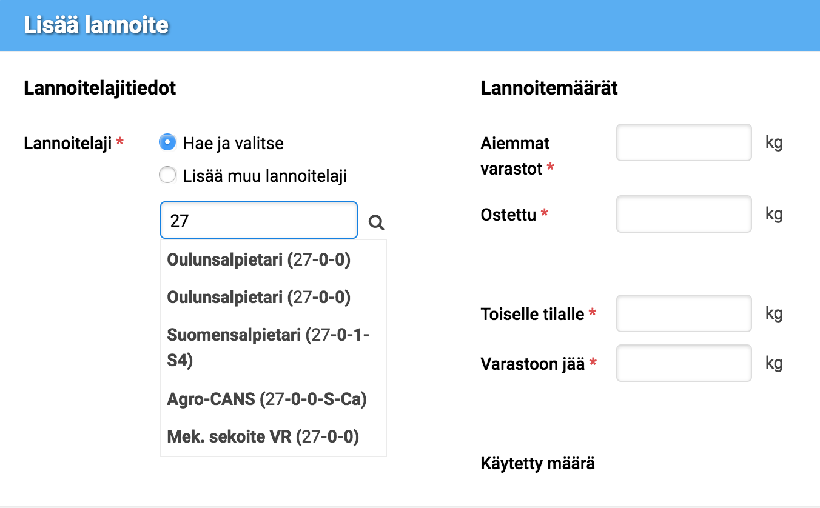
Nutrient Attachment

Slide 2
Nutrient attachment UI creation
There was no digital version of the service
The goal was to make one with AngularJS with a usable UX
First I went through all the current material: laws, user support websites, paper forms
Then I designed rough layouts for the website with pen and paper
Then I designed new wireframe layouts with Sketch based on the Design System components
The end result was Sketch layouts for the service and full UI description with pictures in Confluence
A particular problem was a selection of the right fertilizer from a list of c. 1500. We solved this with a lot of concepting and prototyping and quick usability testing
The work was done with a lot of collaboration with the customer, and design and dev teams. Also, there were many rounds of informal usability tests

Slide 3
