Slide 1
THE ALL-INCLUSIVE PARADOX
Predicting Churn at Steve's Luxury Resort
Why premium guests leave — and what we can do about it
Team-Union · MMAI 869 · Final Project

Slide 2
THE PROBLEM
Half of Steve's premium guests don't come back.
THE BUSINESS QUESTION
50.4%
Which guests will leave — and why?
Goal:
Build a churn classifier · target retention campaigns at the at-risk cohort.
Metric:
Macro F1 · evaluated on held-out Kaggle test set.
Surprise:
Brief warned of imbalance — data is balanced. No resampling needed.
of guests churn
6,954 training guests · 1,739 test guests
Class balance: 49.6% retained · 50.4% churned
Steve's Luxury Resort · MMAI 869 · Team-Union
2 / 12

Slide 3
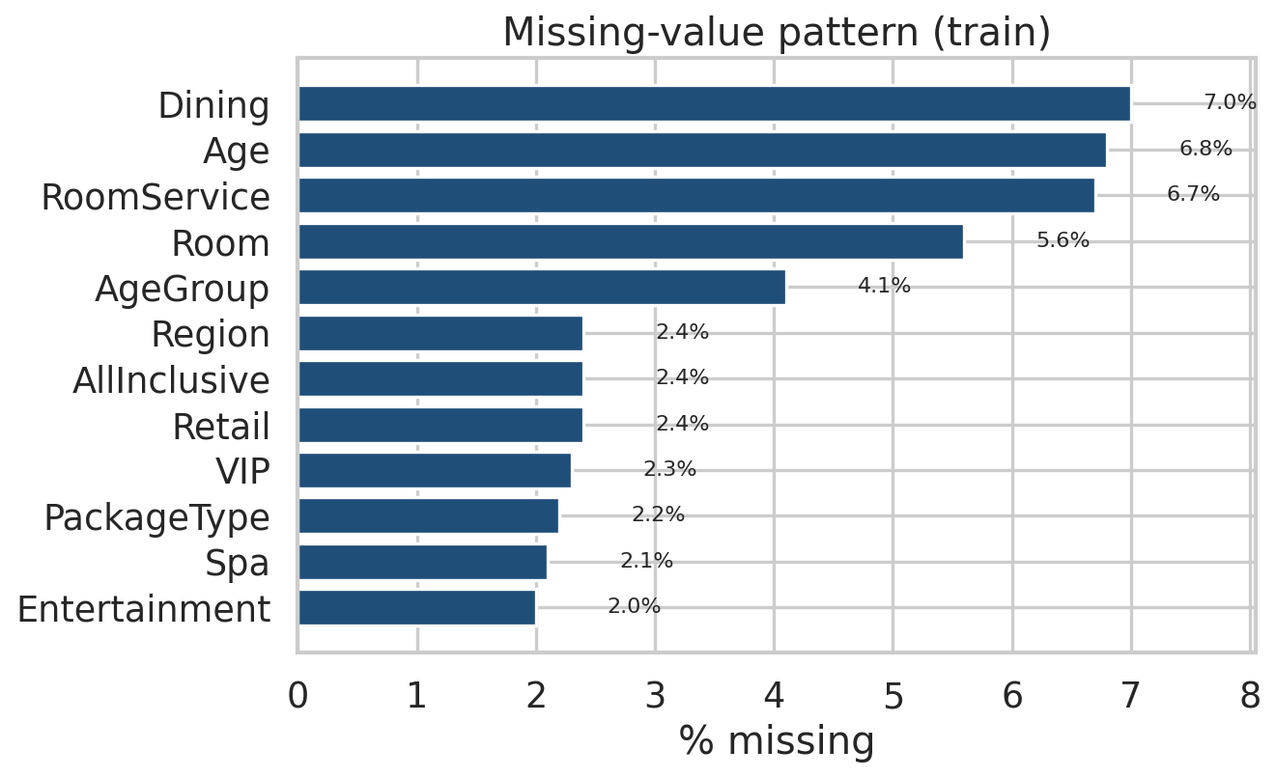
DATA TOUR
21 features, 13 with missing values, one near-unique field.
WHAT WE GET
Booking
BookingDate · PromoCode · Region · Channel
Stay & Demographics
AllInclusive · Room (Wing/Floor/View) · Package · Age · VIP
On-site Spending ($)
RoomService · Dining · Retail · Spa · Entertainment
Loyalty Signals
LoyaltyPoints · SurveyScore · DaysSinceEmail · Referral
Missingness as a feature.
PromoCode 47% null = no promo (kept as category). For the other 12 columns we add explicit missingness flags.
Steve's Luxury Resort · MMAI 869 · Team-Union
3 / 12

Slide 4
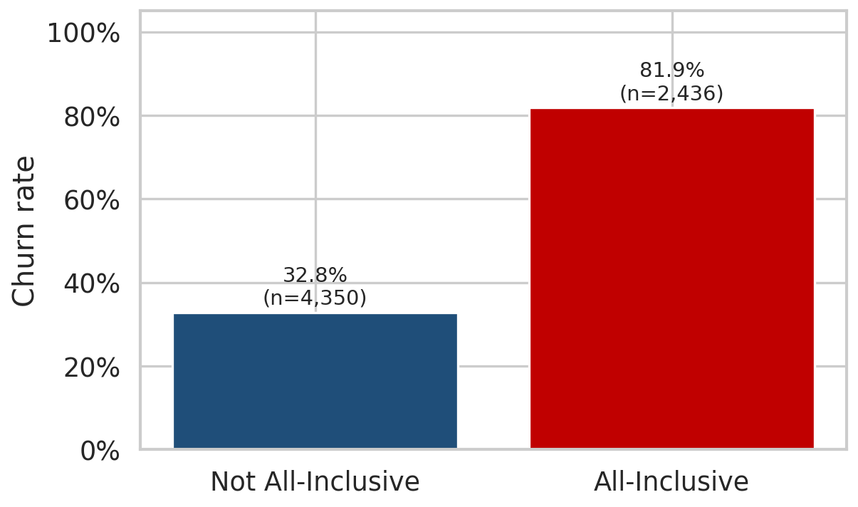
EUREKA #1
Premium guests churn 2.5× more often.
THE PARADOX
82% vs 33%
All-Inclusive guests churn at 81.9% — Non-AI at 32.8%.
HYPOTHESIS
All-Inclusive is sold as a one-shot experience. Without micro-purchases (dining, activities), no everyday loyalty habits form.
Steve's Luxury Resort · MMAI 869 · Team-Union
4 / 12

Slide 5
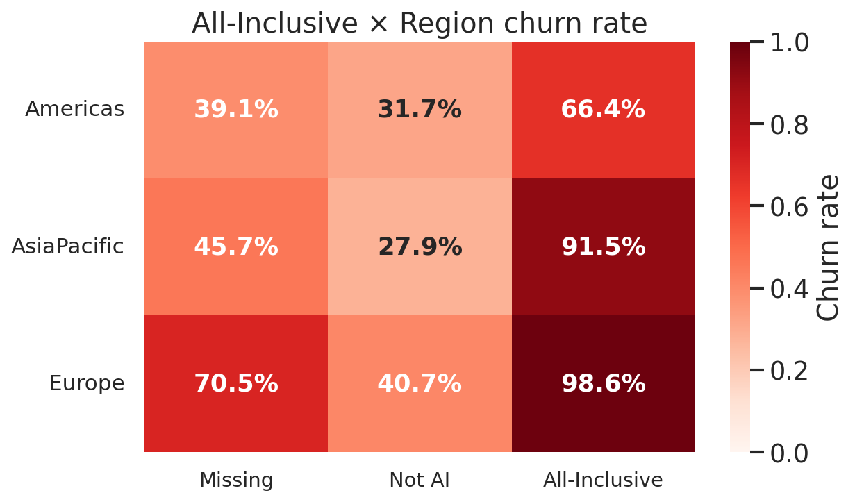
EUREKA #2
All-Inclusive in Europe is essentially a churn certainty.
98.6%
All-Inclusive + Europe (n=722)
91.5%
All-Inclusive + AsiaPacific (n=528)
28-41%
Non-All-Inclusive · all regions
→ The interaction is far more predictive than either feature alone.
Steve's Luxury Resort · MMAI 869 · Team-Union
5 / 12

Slide 6
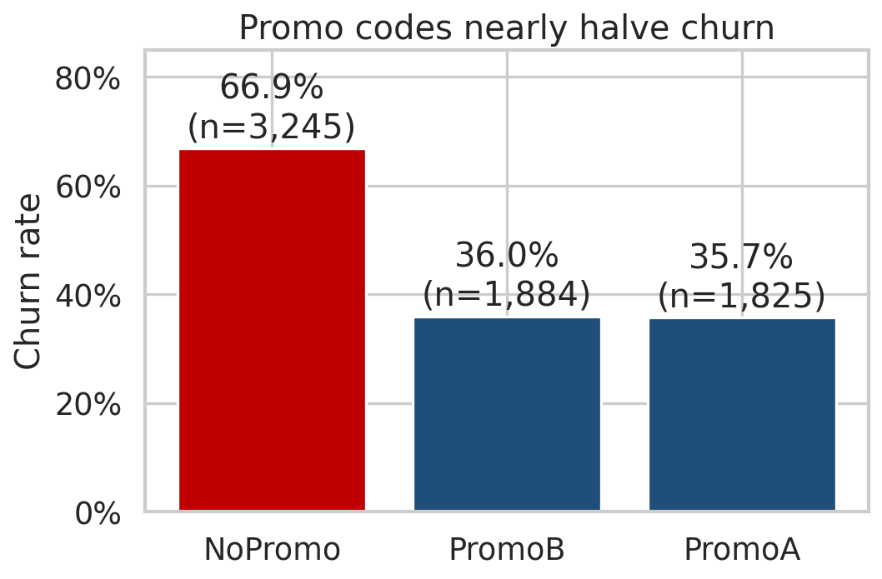
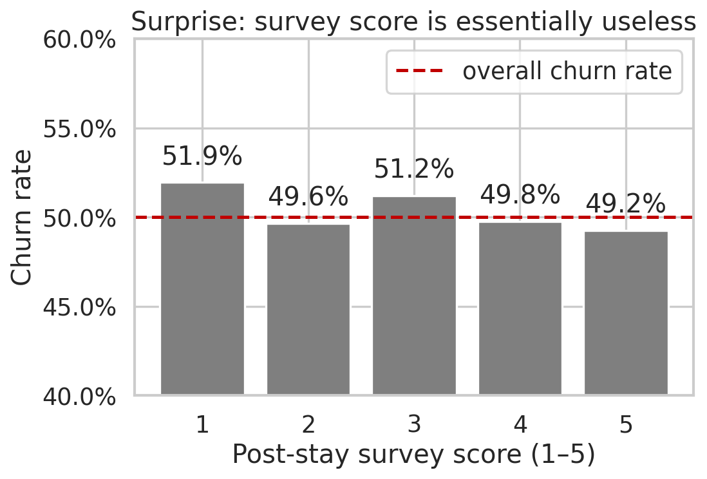
WHAT WORKS · WHAT DOESN'T
Promotions cut churn in half. Surveys tell us nothing.
Promotions retain customers — promos halve churn (67% → 36%).
SurveyScore is essentially useless — every score sits at ~50%.
Steve's Luxury Resort · MMAI 869 · Team-Union
6 / 12

Slide 7
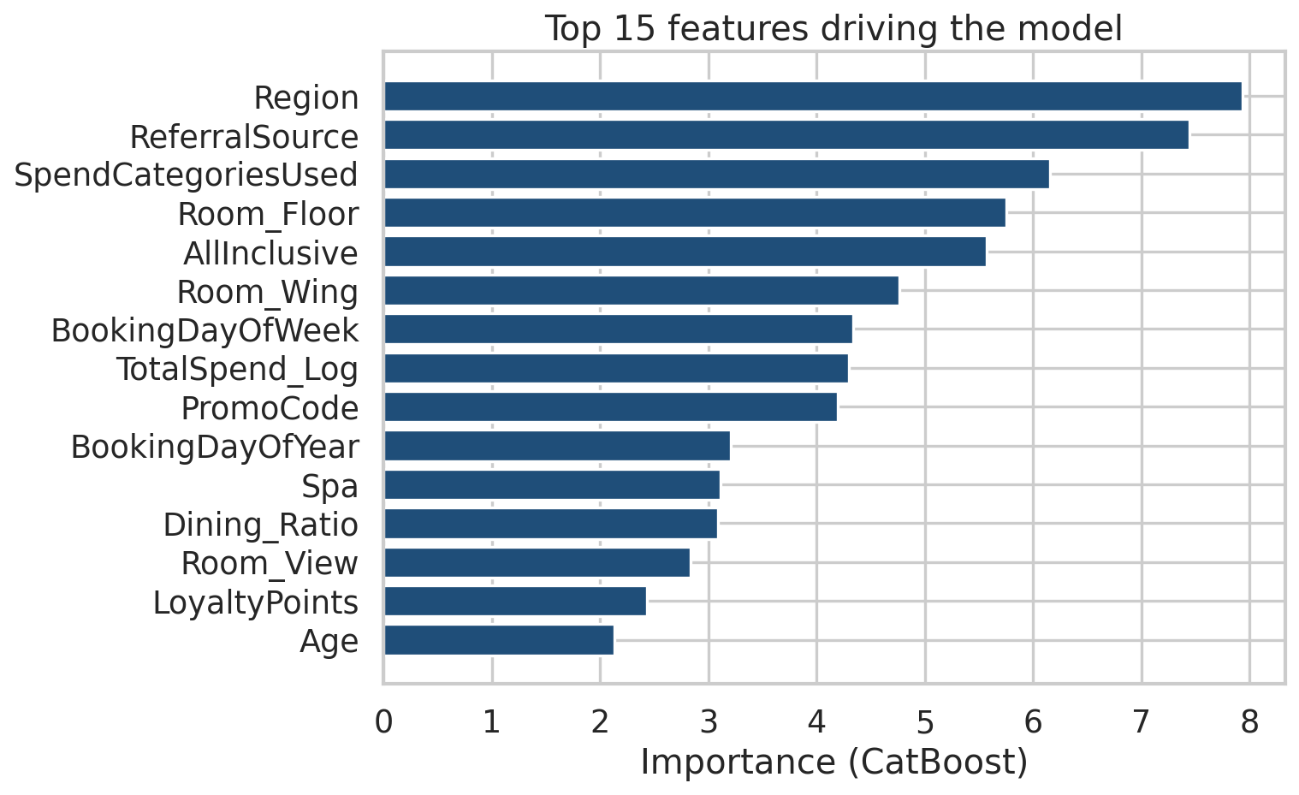
FEATURE ENGINEERING
30 new features. 5 of them ended up in the top 10.
WHAT WE TRIED
✓
Room split
Wing / Floor / View ← 5298 unique → 8/numeric/2
✓
Date features
Year, Month, DayOfWeek, Quarter, IsWeekend
✓
Spend features
TotalSpend, log-transforms, ratios, categories-used
✓
Missingness flags
12 explicit binary cols ← captures null patterns
—
Domain interactions
AI×Europe, AI×Adventure, HasPromo
—
Native cat handling
CatBoost / LightGBM without OHE
Half of the model's top 10 features were engineered.
Steve's Luxury Resort · MMAI 869 · Team-Union
7 / 12

Slide 8
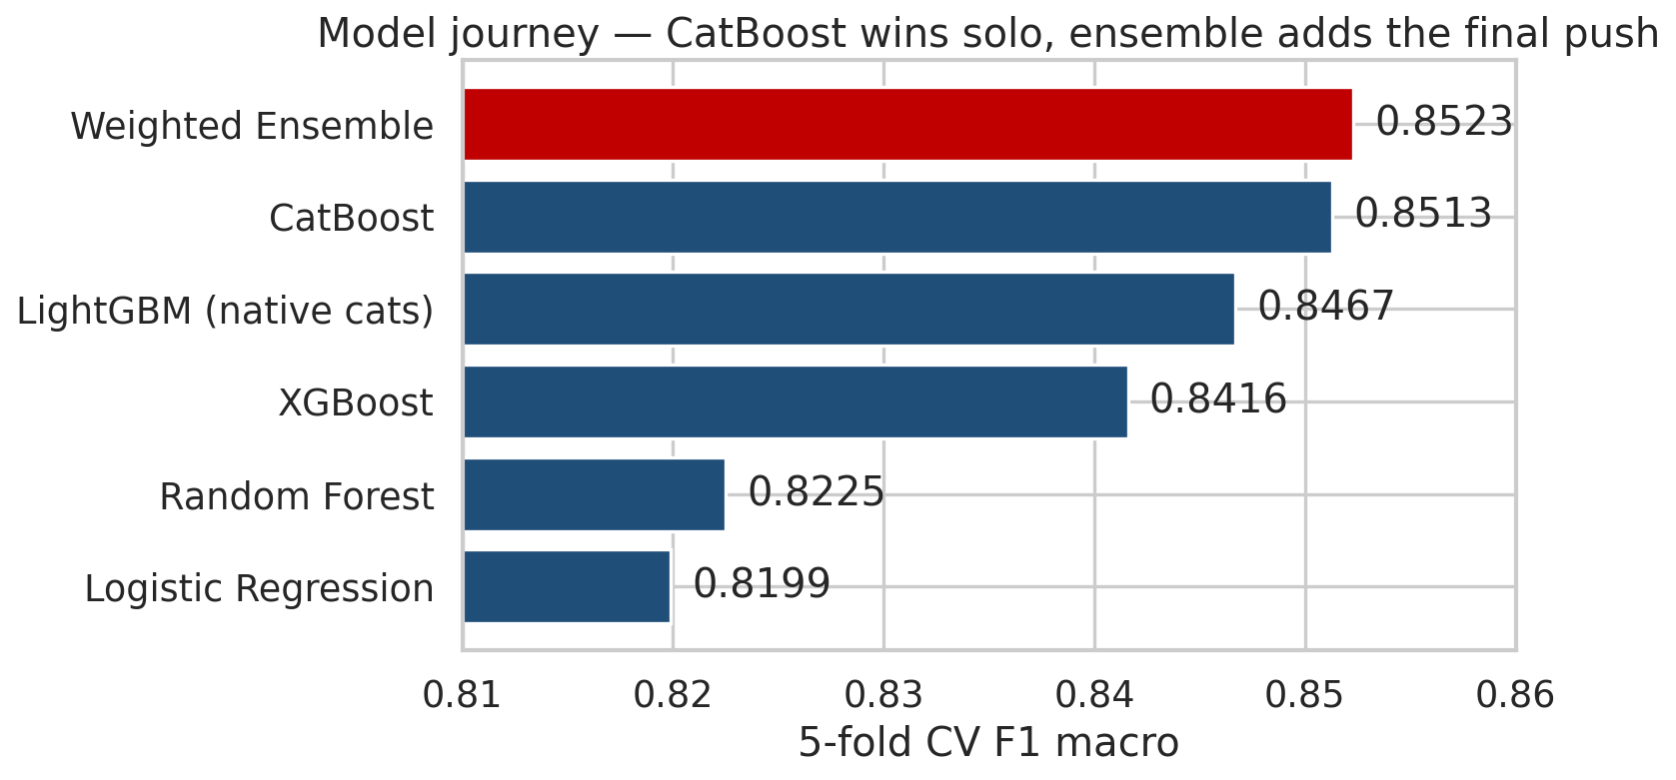
MODEL JOURNEY
5 algorithms, 2 paradigms, one clear winner.
RUBRIC CHECKS
✓ Non-tree model: Logistic Regression (0.8199)
✓ Tree-based: Random Forest (0.8225)
✓ Boosting: XGBoost · LightGBM · CatBoost
✓ Ensemble: Weighted soft-vote of top 3
CV ↔ LB
All scores are 5-fold stratified CV F1-macro. We expect LB ≈ CV ± 0.005 given OOF stability (std 0.005–0.008).
Steve's Luxury Resort · MMAI 869 · Team-Union
8 / 12

Slide 9
HYPERPARAMETER TUNING
Diminishing returns hit fast on a 7k-row dataset.
THE SEARCH
THE RESULT
12 CatBoost configs explored:
depth ∈ {4, 5, 6, 7, 8}
learning_rate ∈ {0.03, 0.05, 0.07, 0.10}
l2_leaf_reg ∈ {3, 5, 7}
iterations ∈ {300, 500, 700, 1000}
Plus Optuna infrastructure ready (in src/tune_catboost.py)
Defaults already win.
Best tuned config:
CV F1 = 0.8497 (vs baseline 0.8513)
Threshold tuning:
+0.07 pp · balanced data, 0.5 already optimal
Why? Differences (±0.005–0.008) are within one σ — we're at the noise floor for a 7k-row dataset.
Steve's Luxury Resort · MMAI 869 · Team-Union
9 / 12

Slide 10
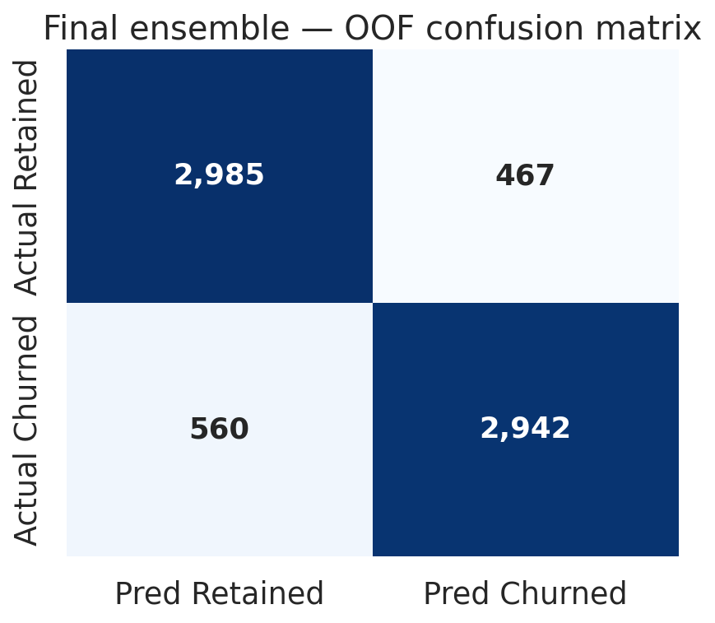
BEST MODEL
0.5 × CatBoost + 0.3 × LightGBM + 0.2 × XGBoost.
0.8523
+0.19 pp
+3.2 pp
OOF METRICS
Retained class
Precision 0.84
Recall 0.86
Churned class
Precision 0.86
Recall 0.84
Macro F1 0.85
Symmetric. No class neglected — balanced data behaves predictably.
OOF F1-macro · weighted ensemble
vs CatBoost
solo
vs Logistic
Regression
Steve's Luxury Resort · MMAI 869 · Team-Union
10 / 12

Slide 11
WHERE THE MODEL GETS IT RIGHT · AND WRONG
Confidently right on the cohort. Wrong on the noise.
3 CORRECT — high confidence
3 WRONG — confidently wrong
Profile · all 3 examples:
AllInclusive · Europe · Adventure · No promo · Dining $0
Predicted churn probability:
Guest 166287 → 99.98%
Guest 552514 → 99.98%
Guest 931435 → 99.97%
Insight:
Model has learned the deadly cohort exactly. The All-Inclusive Europe Adventure segment really is a churn machine.
Guest 350637
Looks like the deadly cohort (AI · EU · Adventure)
Pred 99.2% churn — actually retained.
Guest 303315
Looks like a safe cohort (Americas · Promo · NotAI)
Pred 0.7% churn — actually churned.
Guest 748080
Looks like a safe cohort (AsiaPacific · PromoB · NotAI)
Pred 1.0% churn — actually churned.
Insight:
Real-world noise. Need life-event data to predict these.
Steve's Luxury Resort · MMAI 869 · Team-Union
11 / 12

Slide 12
IF WE HAD MORE TIME
CLOSING
Next steps & lessons learned.
Where this team would go next.
NEXT STEPS →
LESSONS LEARNED ✦
1. Stacking with a meta-learner — typically +0.2–0.5 pp over blending.
2. Optuna, 100+ trials per model — we ran ~12 manual configs.
3. Pseudo-labeling confident test predictions to grow the train set.
4. External data: macroeconomic conditions in Europe during booking month — the 98.6% Europe number begs for an explanation.
5. Cluster analysis to formalize guest personas (the brief's optional ask).
1. Counterintuitive insights win presentations. The All-Inclusive paradox is what executives remember.
2. FE drove interpretation more than accuracy. Trees found the same splits, but engineered features made our story clear.
3. Don't tune past the noise floor. Within ±1σ, you're chasing folds, not lift.
4. Read the metric carefully. F1-macro on balanced data behaves nothing like F1 on imbalanced data.
5. Simple ensembles win. A weighted soft-vote of 3 boosters gave us our final +0.19 pp.
Thank you · Q&A

