Slide 1
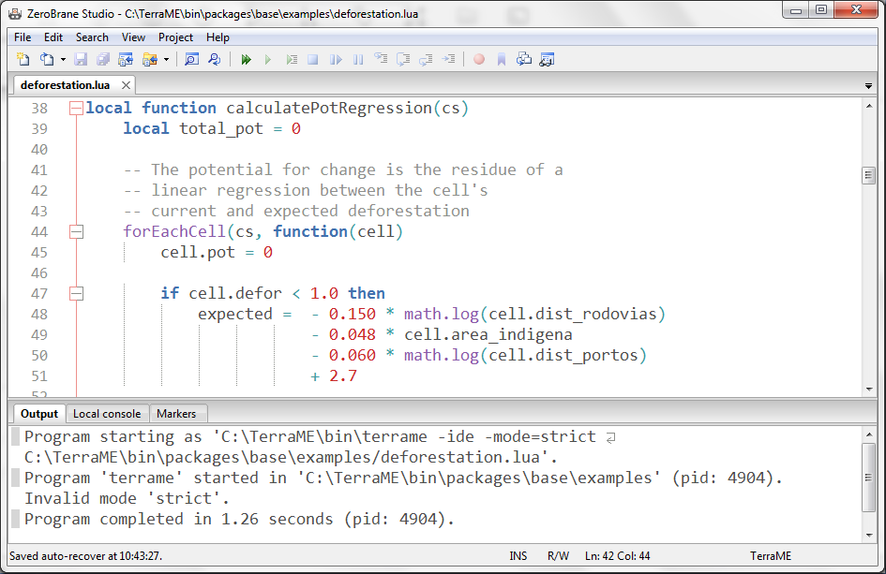
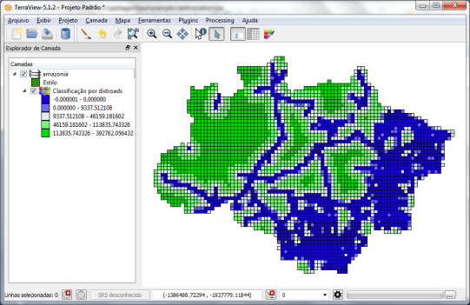
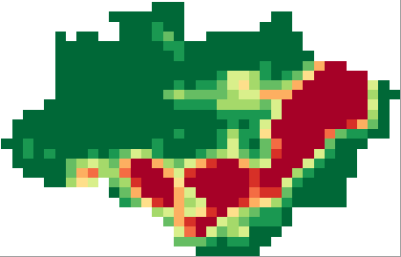
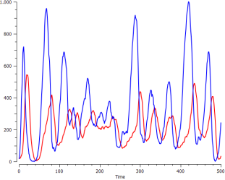
Code Editor
Syntax highlight
Model description
TerraME
Model verification
Model simulation
Add-on packages
GIS
Data acquisition
Data visualization
Data management
Data analysis
Data
Source code
Data
Data

