Slide 1
Name:
Will Dargan
Specification & learning objectives
By the end of this topic you will have studied:
Simple logic diagrams using the operations AND, OR and NOT.
Truth tables.
Combining Boolean operators using AND, OR and NOT to two levels.
Applying logical operators in appropriate truth tables to solve problems.
Resources
We recommend the OCR endorsed text book from PG Online for use during your GCSE studies.
Craig'n'Dave videos for SLR 2.4
Notes:
Activity…

Slide 2


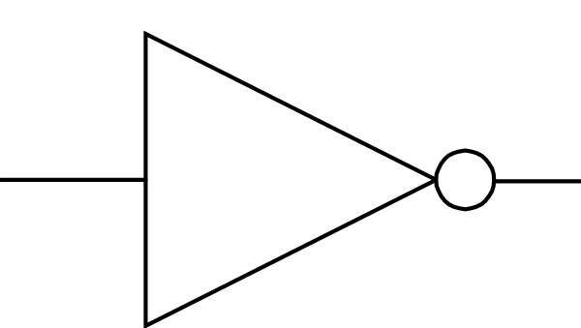
Simple logic diagrams using the operations AND, OR and NOT
Logic gates are the fundamental building blocks of digital integrated circuits.
They are what a computer CPU and arithmetic logic unit are made of. Logic gates can be drawn with an image representing the gate or written with a character.
A
A
A
B
B
AND
OR
NOT
∧
∨
¬
A | B | Output
0 | 0 | 0
0 | 1 | 0
1 | 0 | 0
1 | 1 | 1
A | B | Output
0 | 0 | 0
0 | 1 | 1
1 | 0 | 1
1 | 1 | 1
A | Output
0 | 1
1 | 0
Notes:
Label the 3 logic gates correctly: NOT AND OR in the first box underneath each symbol.
Underneath these labels, show the symbol used for the gate: ∨ ¬ ∧ in the second box.
Complete the truth tables for each logic gate. Use these logic gate symbols to complete the exercises on the following slides.

Slide 3
Combining Boolean operators using AND, OR and NOT to two levels
Logic diagram for the expression: A AND C
Alternative notation : A ∧ C
A
C
Notes:
Draw the logic gate for the expression: A AND C

Slide 4
Combining Boolean operators using AND, OR and NOT to two levels
Logic diagram for the expression: (A OR B) AND C
Alternative notation : (A V B) ∧ C
A
B
C
Notes:
Draw the logic gate for the expression: (A OR B) AND C

Slide 5
Combining Boolean operators using AND, OR and NOT to two levels
Logic diagram for the expression: (NOT A) OR B
Alternative notation : ¬A V B
A
B
Notes:
Draw the logic gate for the expression: NOT A OR B

Slide 6
Combining Boolean operators using AND, OR and NOT to two levels
Logic diagram for the expression: (A AND B) OR (C AND D)
Alternative notation : (A ∧ B) V (C ∧ D)
A
B
C
D
Notes:
Draw the logic gate for the expression: (A AND B) OR (C AND D)

Slide 7
Combining Boolean operators using AND, OR and NOT to two levels
Logic diagram for the expression: NOT(A AND B)
Alternative notation : ¬(A ∧ B)
A
B
Notes:
Draw the logic gate for the expression: NOT(A AND B)

Slide 8
Applying logical operators in truth tables to solve problems
A | B | C | D
0 | 0 | 0 | 1
0 | 1 | 0 | 1
1 | 0 | 0 | 1
1 | 1 | 1 | 0
A
C
D
B
A | B | C | D
0 | 0 | 0 | 1
0 | 1 | 1 | 0
1 | 0 | 1 | 0
1 | 1 | 1 | 0
A
C
D
B
Notes:
Complete the truth table for the expression: NOT(A AND B)
Complete the truth table for the expression: NOT(A OR B)

Slide 9
Applying logical operators in truth tables to solve problems
A | B | C | D | E | F
0 | 0 | 0 | 0 | 1 | 0
0 | 0 | 1 | 0 | 0 | 0
0 | 1 | 0 | 0 | 1 | 0
0 | 1 | 1 | 0 | 0 | 0
1 | 0 | 0 | 0 | 1 | 0
1 | 0 | 1 | 0 | 0 | 0
1 | 1 | 0 | 1 | 1 | 1
1 | 1 | 1 | 1 | 0 | 0
A
D
B
F
E
C
Notes:
Complete the truth table for the expression: (A AND B) AND NOT C

Slide 10
Applying logical operators in truth tables to solve problems
A | B | C | D | E | F
0 | 0 | 0 | 0 | 1 | 1
0 | 0 | 1 | 0 | 0 | 0
0 | 1 | 0 | 1 | 1 | 1
0 | 1 | 1 | 1 | 0 | 1
1 | 0 | 0 | 1 | 1 | 1
1 | 0 | 1 | 1 | 0 | 1
1 | 1 | 0 | 1 | 1 | 1
1 | 1 | 1 | 1 | 0 | 1
A
D
B
F
E
C
Notes:
Complete the truth table for the expression: (A OR B) OR NOT C

Slide 11
Applying logical operators in truth tables to solve problems
A | B | C | D | E | F
0 | 0 | 0 | 1 | 0 | 0
0 | 0 | 1 | 1 | 1 | 1
0 | 1 | 0 | 1 | 1 | 1
0 | 1 | 1 | 1 | 1 | 1
1 | 0 | 0 | 0 | 0 | 0
1 | 0 | 1 | 0 | 1 | 0
1 | 1 | 0 | 0 | 1 | 0
1 | 1 | 1 | 0 | 1 | 0
D
A
F
B
E
C
Notes:
Complete the truth table for the expression: NOTA AND (B OR C)

Slide 12
Applying logical operators in truth tables to solve problems
A | B | C | D | E | F | G
0 | 0 | 0 | 0 | 0 | 0 | 0
0 | 0 | 0 | 1 | 0 | 1 | 0
0 | 0 | 1 | 0 | 0 | 1 | 0
0 | 0 | 1 | 1 | 0 | 1 | 0
0 | 1 | 0 | 0 | 1 | 0 | 0
0 | 1 | 0 | 1 | 1 | 1 | 1
0 | 1 | 1 | 0 | 1 | 1 | 1
0 | 1 | 1 | 1 | 1 | 1 | 1
1 | 0 | 0 | 0 | 1 | 0 | 0
1 | 0 | 0 | 1 | 1 | 1 | 1
1 | 0 | 1 | 0 | 1 | 1 | 1
1 | 0 | 1 | 1 | 1 | 1 | 1
1 | 1 | 0 | 0 | 1 | 0 | 0
1 | 1 | 0 | 1 | 1 | 1 | 1
1 | 1 | 1 | 0 | 1 | 1 | 1
1 | 1 | 1 | 1 | 1 | 1 | 1
A
E
B
G
C
F
D
Notes:
Complete the truth table for the expression: (A OR B) AND (C OR D)

Slide 13
Applying logical operators in truth tables to solve problems
A | B | C | D | E | F | G
0 | 0 | 0 | 0 | 0 | 0 | 0
0 | 0 | 0 | 1 | 0 | 0 | 0
0 | 0 | 1 | 0 | 0 | 0 | 0
0 | 0 | 1 | 1 | 0 | 1 | 0
0 | 1 | 0 | 0 | 1 | 0 | 0
0 | 1 | 0 | 1 | 1 | 0 | 0
0 | 1 | 1 | 0 | 1 | 0 | 0
0 | 1 | 1 | 1 | 1 | 1 | 1
1 | 0 | 0 | 0 | 1 | 0 | 0
1 | 0 | 0 | 1 | 1 | 0 | 0
1 | 0 | 1 | 0 | 1 | 0 | 0
1 | 0 | 1 | 1 | 1 | 1 | 1
1 | 1 | 0 | 0 | 1 | 0 | 0
1 | 1 | 0 | 1 | 1 | 0 | 0
1 | 1 | 1 | 0 | 1 | 0 | 0
1 | 1 | 1 | 1 | 1 | 1 | 1
A
E
B
G
C
F
D
Notes:
Complete the truth table for the expression: (A OR B) AND (C AND D)

Slide 14
Applying logical operators in truth tables to solve problems
A | B | C | D | E | F | G
0 | 0 | 0 | 0 | 0 | 0 | 0
0 | 0 | 0 | 1 | 0 | 0 | 0
0 | 0 | 1 | 0 | 0 | 0 | 0
0 | 0 | 1 | 1 | 0 | 1 | 1
0 | 1 | 0 | 0 | 0 | 0 | 0
0 | 1 | 0 | 1 | 0 | 0 | 0
0 | 1 | 1 | 0 | 0 | 0 | 0
0 | 1 | 1 | 1 | 0 | 1 | 1
1 | 0 | 0 | 0 | 0 | 0 | 0
1 | 0 | 0 | 1 | 0 | 0 | 0
1 | 0 | 1 | 0 | 0 | 0 | 0
1 | 0 | 1 | 1 | 0 | 1 | 1
1 | 1 | 0 | 0 | 1 | 0 | 1
1 | 1 | 0 | 1 | 1 | 0 | 1
1 | 1 | 1 | 0 | 1 | 0 | 1
1 | 1 | 1 | 1 | 1 | 1 | 1
A
E
B
G
C
F
D
Notes:
Complete the truth table for the expression: (A AND B) OR (C AND D)

Slide 15
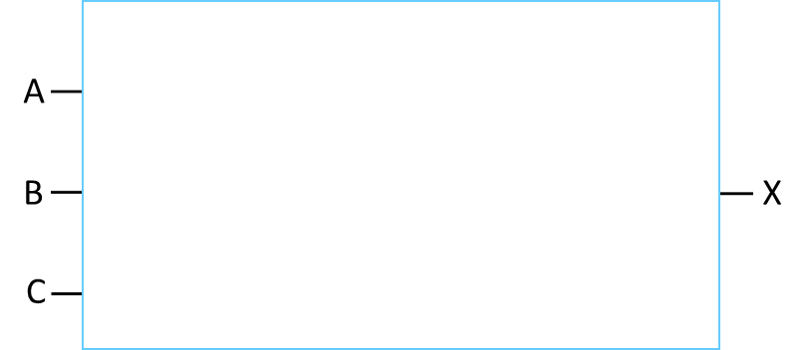
Create, complete or edit logic diagrams and truth tables for given scenarios
Logic diagram and truth table for the following scenario:
“An alarm goes off (OUTPUT X) if a movement sensor is triggered (INPUT A), AND it is also night (INPUT B). Regardless of these situations it should always go off if anyone triggers the alarm manually (INPUT C).”
A | B | C | W = A AND B | X = W OR C
0 | 0 | 0 | 0 | 0
0 | 0 | 1 | 0 | 1
0 | 1 | 0 | 0 | 0
0 | 1 | 1 | 0 | 1
1 | 0 | 0 | 0 | 0
1 | 0 | 1 | 0 | 1
1 | 1 | 0 | 1 | 1
1 | 1 | 1 | 1 | 1
Notes:
Read the scenario presented on the slide
In the box complete the logic diagram for this scenario, you can use the “Logic gate symbols” from the other slides.
Complete the truth table for the logic diagram. Note: You made choose to choose the intermediate outputs as well.

Slide 16

Create, complete or edit logic diagrams and truth tables for given scenarios
Logic diagram and truth table for the following scenario:
“A holding cell in a police station has two electronic security doors (INPUT A and INPUT B). If the camera is on (INPUT C) OR the occupied sign is on (INPUT D), AND either of the doors has not properly been closed then a warning speaker should sound (OUTPUT X).”
A | B | C | D | V = A OR B | W = C OR D | X = V AND W
0 | 0 | 0 | 0 | 0 | 0 | 0
0 | 0 | 0 | 1 | 0 | 1 | 0
0 | 0 | 1 | 0 | 0 | 1 | 0
0 | 0 | 1 | 1 | 0 | 1 | 0
0 | 1 | 0 | 0 | 1 | 0 | 0
0 | 1 | 0 | 1 | 1 | 1 | 1
0 | 1 | 1 | 0 | 1 | 1 | 1
0 | 1 | 1 | 1 | 1 | 1 | 1
1 | 0 | 0 | 0 | 1 | 0 | 0
1 | 0 | 0 | 1 | 1 | 1 | 1
1 | 0 | 1 | 0 | 1 | 1 | 1
1 | 0 | 1 | 1 | 1 | 1 | 1
1 | 1 | 0 | 0 | 1 | 0 | 0
1 | 1 | 0 | 1 | 1 | 1 | 1
1 | 1 | 1 | 0 | 1 | 1 | 1
1 | 1 | 1 | 1 | 1 | 1 | 1
Notes:
Read the scenario presented on the slide
In the box complete the logic diagram for this scenario, you can use the “Logic gate symbols” from the other slides.
Complete the truth table for the logic diagram. Note: You made choose to choose the intermediate outputs as well.

Slide 17

Create, complete or edit logic diagrams and truth tables for given scenarios
Logic diagram and truth table for the following scenario:
“A factory has an automated manufacturing system which operates in an “ON” state (OUTPUT X) if either it is manually switched on by an operator (INPUT A), OR a computer system triggers a scheduled production run (INPUT B). The system also has an emergency override (INPUT C) which in its normal operating state is feeding no signal to the computer system, when it is pressed however it triggers a positive “TRUE” state (1) which should result in the system shutting down.”
A | B | C | V = A OR B | W = NOT C | X = V AND W
0 | 0 | 0 | 0 | 1 | 0
0 | 0 | 1 | 0 | 0 | 0
0 | 1 | 0 | 1 | 1 | 1
0 | 1 | 1 | 1 | 0 | 0
1 | 0 | 0 | 1 | 1 | 1
1 | 0 | 1 | 1 | 0 | 0
1 | 1 | 0 | 1 | 1 | 1
1 | 1 | 1 | 1 | 0 | 0
Notes:
Read the scenario presented on the slide
In the box complete the logic diagram for this scenario, you can use the “Logic gate symbols” from the other slides.
Complete the truth table for the logic diagram. Note: You made choose to choose the intermediate outputs as well.

Slide 18
Assessment |  |  |  | Target: |  | Overall grade:
Minimum expectations by the end of this unit
□ | You should have learnt terms 218-223 from your GCSE Level Key Terminology during this unit.
□ | You have completed all the pages of the workbook
□ | Score 80% in the end of unit test.
Feedback
Breadth |  | Depth |  |  | Understanding
□ All aspects complete |  | □ Excellent level of depth |  |  | □ All work is accurate
□ Most aspects complete |  | □ Good level of depth |  |  | □ Most work is accurate
□ Some aspects complete |  | □ Basic level of depth shown |  |  | □ Some work is accurate
□ Little work complete |  | □ Little depth and detail provided |  |  | □ Little work is accurate
Comment & action |  |  | Student response

Slide 19
Reflection & Revision checklist
Confidence | Clarification
☹ 😐 ☺ | I can construct simple logic diagrams using the operations AND, OR and NOT.
☹ 😐 ☺ | I can construct truth tables for the operations AND, OR and NOT.
☹ 😐 ☺ | I can construct a truth table for a given logic diagram.
☹ 😐 ☺ | I can apply logical operators in appropriate truth tables to solve problems.
My revision focus will need to be:

