Slide 1
Name:
Will Dargan
Specification & learning objectives
By the end of this topic you will have studied:
The purpose of the CPU: The fetch-execute cycle
Common CPU components and their function: ALU, CU, Cache, Registers
Von Neumann architecture: MAR, MDR, Program Counter, Accumulator
How common characteristics affect their performance: Clock speed, cache size, number of cores
The purpose, characteristics and examples of embedded systems
Resources
We recommend the OCR endorsed text book from PG Online for use during your GCSE studies.
Craig’n’Dave videos for SLR 1.1
Notes:
Activity…

Slide 2
What actions occur during the fetch-execute cycle
?
?
?
STAGE 3:
STAGE 1:
What the central processing unit (CPU) does:
STAGE 2:
STAGE 1: Fetch instructions
During the first stage the following actions occur:
The CPU fetches the next command from RAM.
The program counter is increased by one.
STAGE 2: Decode instructions
During the second stage the following actions occur:
The CPU works out what it needs to do.
STAGE 3: Execute instructions
During the third stage the following actions occur:
The CPU does what it needs to do.
Notes:
1. Complete the blank boxes.

Slide 3
About the CPU
The CPU has a small amount of memory on the chip called registers.
The registers are called:
Memory Address Register
Memory Data Register
Program Counter
Accumulator
Acronym:
MAR
MDR
PC
ACC
Purpose:
Stores the location in memory to be used by the MDR. Holds the address of where data is to be fetched or stored.
Holds data fetched from, or to be written to the memory.
Holds the address of the next instruction.
Holds the results of calculations.
The CPU also has these components:
Arithmetic Logic Unit
This component performs calculations, e.g. addition/subtraction and logical decisions, e.g. does this equal…?
Control Unit
This component decodes instructions and sends signals to control how data moves around the CPU.
Cache
This memory provides fast access to frequently used instructions and data without having to go to the main memory (RAM).
Notes:
2. Complete the blank boxes. The program counter has already been done for you as an example.

Slide 4
The von Neumann architecture (an abstracted view)
Central Processing Unit (CPU)
An explanation of the von Neumann architecture:
Input
Control Unit (CU)
Arithmetic Logic Unit (ALU)
Instructions are stored in RAM.
Data is stored in RAM.
Frequently use data is stored in Cache.
Cache is a super fast memory.
Clock
ALU
CPU
CU
PC
MDR
MAR
ACC
Register
Output
Accumulator (ACC)
Program Counter (PC)
Memory Data Register (MDR)
Memory Address Register (MAR)
Storage devices
Cache
Communication devices
RAM
Notes:
3. Label the various components of the Von Neumann architecture, some have been done for you.
4. Provide an explanation of the Von Neumann architecture, make sure to include:
- What it consists of.
- How data and instructions are stored.

Slide 5
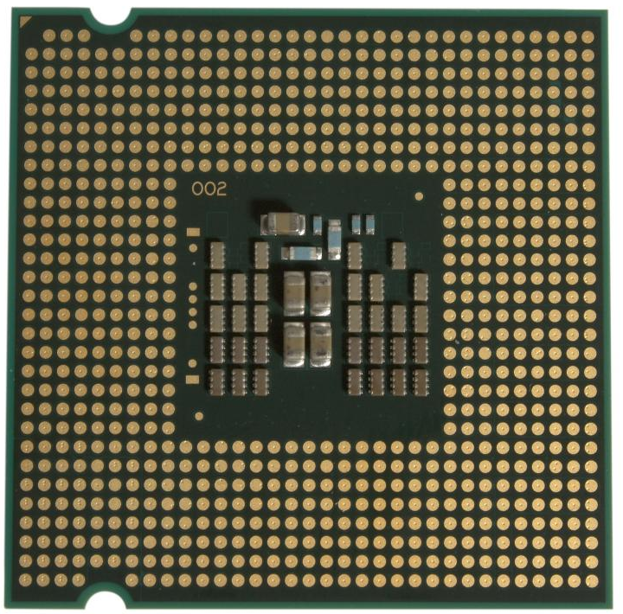
Factors affecting the speed of the CPU
Clock Speed
Cache Size
Number of Cores
Notes:
5. Label three factors affecting the speed of a CPU in the solid outline boxes.
6. Write a description of the factor in the dotted outline box.

Slide 6
Embedded systems
Embedded systems are:
Computer Systems that are inside other devices.
Examples of embedded systems:
The Apollo guidance module.
Hospital Equipment
Engine management in cars.
Notes:
7. Explain what an embedded system is.
8. Illustrate with pictures some examples of embedded systems.
9. Explain how these devices input, process and output data, making them examples of computers.

Slide 7
Assessment |  |  |  | Target: |  | Overall grade:
Minimum expectations by the end of this unit
□ | You should have learnt terms 1-15 from your GCSE Level Key Terminology during this unit.
□ | You have completed all the pages of the workbook
□ | Score 80% in the end of unit test.
Feedback
Breadth |  | Depth |  |  | Understanding
□ All aspects complete |  | □ Excellent level of depth |  |  | □ All work is accurate
□ Most aspects complete |  | □ Good level of depth |  |  | □ Most work is accurate
□ Some aspects complete |  | □ Basic level of depth shown |  |  | □ Some work is accurate
□ Little work complete |  | □ Little depth and detail provided |  |  | □ Little work is accurate
Comment & action |  |  | Student response

Slide 8
Reflection & Revision checklist
Confidence | Clarification
☹ 😐 ☺ | I can explain the purpose and function of the CPU
☹ 😐 ☺ | I can describe the fetch-execute cycle
☹ 😐 ☺ | I can explain what the Arithmetic Logic Unit is
☹ 😐 ☺ | I can explain what the Control Unit is
☹ 😐 ☺ | I can explain what cache is
☹ 😐 ☺ | I can explain what is meant by the term Register
☹ 😐 ☺ | I can explain what the Memory Address Register in the Von Neumann architecture is
☹ 😐 ☺ | I can explain what the Memory Data Register in the Von Neumann architecture is
☹ 😐 ☺ | I can explain what the program counter is used for
☹ 😐 ☺ | I can explain what the accumulator is used for
☹ 😐 ☺ | I can explain how the clock speed affects the CPU performance
☹ 😐 ☺ | I can explain how the cache size affects the CPU performance
☹ 😐 ☺ | I can explain how the number of cores affects the CPU performance
☹ 😐 ☺ | I can explain the purpose of embedded systems
☹ 😐 ☺ | I can give examples of embedded systems
My revision focus will need to be:

