Slide 1
Name:
William Dargan
Specification & learning objectives
By the end of this topic you will have studied:
The units of data storage: Bit, Nibble, Byte, Kilobyte, Megabyte, Gigabyte, Terabyte, Petabyte
How data needs to be converted into a binary format to be processed by a computer
Data capacity and calculation of data capacity requirements
How to convert positive denary whole numbers to binary (up to and including 8 bits) and vice versa
How to add two binary integers together (up to and including 8 bits) and explain overflow errors which may occur
How to convert denary whole numbers into 2-digit hexadecimal numbers and vice versa
How to convert binary integers to their hexadecimal equivalents and vice versa
Binary shifts
The use of binary codes to represent characters and the term ‘character set’
The relationship between the number of bits per character in a character set, and the number of characters which can be represented, e.g.: ASCII, Unicode
How an image is represented as a series of pixels, represented in binary and what image metadata is
The effect of colour depth and resolution on: The quality of the image, The size of an image file
How sound can be sampled and stored in digital form
The effect of sample rate, duration and bit depth on: The playback quality, The size of a sound file
The need for compression
Types of compression: Lossy, Lossless
Resources
We recommend the OCR endorsed text book from PG Online for use during your GCSE studies.
Craig'n'Dave videos for SLR 1.2
Notes:
Activity…

Slide 2


Bit, nibble, byte, kilobyte & megabyte
Bit:
0
Binary digit. Boolean values: False or True.
Nibble:
0
1
0
1
4 bits. Half a byte. An encoded number for an LCD display.
Byte:
0
1
0
0
0
0
0
1
A
8 bits. A single character.
Kilobyte:
1000
KB
The symbol for a kilobyte is
You can store a few paragraphs of text in a single kilobyte. In the 1980s, a 5.25 inch floppy disk would store 160-360 kilobytes of data.
Megabyte:
1000000
MB
The symbol for a megabyte is
You can store a in a single megabyte. In the 1990s, a 3.5 inch floppy disk would store 1.44 megabytes of data.
Notes:
Show how the Boolean value “False” is represented in binary in one bit.
Show how a nibble can be used to store the number 5: useful for single digits of LCD displays.
Show how the number 65 can be stored in 8 bits: useful for a single character. 65 = “A”.
State how many bytes in a kilobyte and show the symbol for a kilobyte (should be in capital letters).
Complete the description of a megabyte.

Slide 3
Gigabyte, terabyte & petabyte
Gigabyte:
10^9
The symbol for a gigabyte is
GB
You can store 12 hours of music in a single gigabyte. In the 1990s, a MiniDisc would store 1 gigabyte of data.
Terabyte:
10^12
TB
The symbol for a terabyte is
You can store 1 million novels in a single terabyte. In 2018 hard disks in computers have terabytes of data capacity.
Petabyte:
10^15
PB
The symbol for a petabyte is
You can store 100 years of television in a single petabyte. The amount of data Google processes in an hour can be measured in petabytes.
Notes:
Complete the descriptions of a gigabyte, terabyte and petabyte. Show approximations in terms of 10 to the power x.

Slide 4
Units of data storage
Unit conversions:
Bytes | KB | MB | GB
6567 | 6.567 | 0.006567 | 0.000006567
130 | 0.130 | 0.000130 | 0.000000130
10700000 | 10700 | 10.700 | 0.010700
2300000 | 2300 | 2.300 | 0.002300
5000000 | 5000 | 5 | 0.005
140000000 | 1400000 | 1400 | 1.400
50000000 | 50000 | 50 | 0.05
200000000 | 200000 | 200 | 0.2
Sophie has 1500 high resolution 5Mb photographs.
What size memory card in GB will she need as a minimum to store these images?
7.5GB
A portable video player stores films in a compressed format on flash memory. Each film is 4.7GB.
How many films can a 32GB player store?
6
A dashboard camera records video at 120MB per second. How much storage is required in gigabytes for 30 seconds of footage?
3.6GB
Notes:
Complete the boxes to show the number of bytes expressed in different units. Use approximations, e.g. 1000MB = 1 GB.
Answer the questions for the 3 scenarios.

Slide 5






Units of data storage
The human brain stores 2,500,000GB of data.
0.004MB of RAM in Apple’s first computer in 1976.
=
2.5
PB
=
4
KB
15.4PB video uploaded to YouTube in 2012.
IBM’s Watson supercomputer
16TB RAM.
=
15400
TB
0.016
=
PB
Large Hadron Collider produces 0.47GB data per second.
All the DNA in a human body cell is 1.5GB.
=
470
MB
=
1500
MB
Notes:
Complete the boxes to show how much storage capacity is required for each of the scenarios.

Slide 6
Why data needs to be converted into a binary format to be processed by a computer
Computers store data in binary (0 or 1) because:
An electrical signal is either on or off.
Notes:
10. Consider how data is stored in RAM, hard disks, CD-R/DVD-R, CD-RW/DVD-RW and flash drives. Draw some illustrations of this to help explain why data needs to be converted into binary format to be processed by a computer.

Slide 7
Calculating the data capacity requirements
Typical examples of file sizes:
File type | Approximate size
1 page word processed file with no images | 0.1MB (100KB)
Postcard sized photograph | 6MB
3 minute MP3 music file | 6MB
1 minute compressed video file | 50MB
Standard definition feature film | 4000Mb (4GB)
High definition feature film | 8000-15000Mb (8-15GB)
Typical examples using the data above:
A 100 page book with 30 postcard sized photos:
250MB
Photo album with 230 postcard sized photos and 40 half minute video clips:
70GB
A portable music player capable of holding 3000x3 minute songs and ¼ postcard sized track thumbnail images:
324.004005TB
Notes:
11. Calculate the storage requirements of the example scenarios.

Slide 8
How to convert positive denary whole numbers (0-255) into 8 bit binary numbers and vice versa
Notes:
12. Have a go at the conversions on the binary conversions spreadsheet.
13. Copy and paste some of your conversions onto this slide as evidence of your work. Denary to binary on the left, binary to denary on the right.

Slide 9
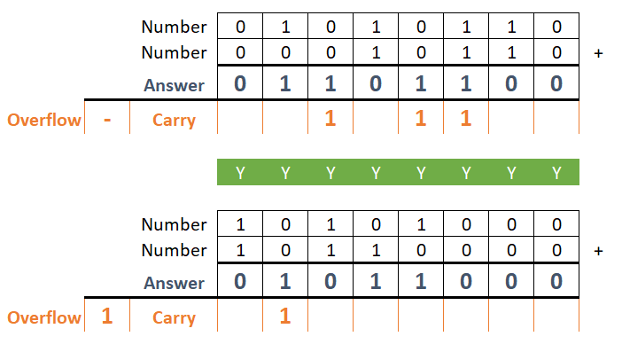
Adding two 8 bit binary integers and overflow errors.
Overflow errors can occur when adding binary numbers because:
There is not enough space for the final answer.
Notes:
14. Using the binary addition spreadsheet, copy and paste some of your calculations onto this slide as evidence of your work. Show at least one example of an overflow.
15. Explain why overflow errors can occur when adding binary numbers.

Slide 10
Binary shifts
A left shift performs a:
Multiplication
00001010
00010100
10x2^1=20
A right shift performs a:
Division
00001010
00000101
10x2^-2=5
Notes:
16. Explain what a left binary shift of 1 digit achieves.
17. Illustrate a left shift on an 8 bit binary number without an overflow.
18. Explain what a right binary shift of 1 digit achieves.
19. Illustrate a right shift on an 8 bit binary number without an underflow.

Slide 11
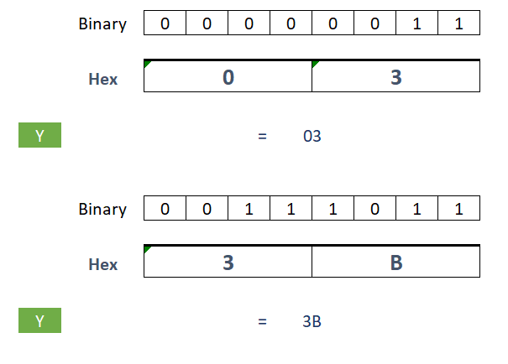
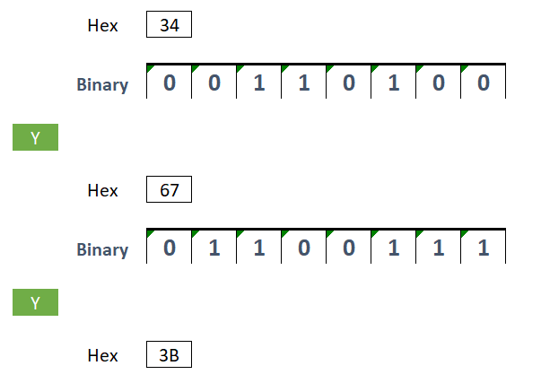
Converting from binary to hexadecimal equivalents and vice versa.
Denary | Binary | Hex
0 | 0000 | 0
1 | 0001 | 1
2 | 0010 | 2
3 | 0011 | 3
4 | 0100 | 4
5 | 0101 | 5
6 | 0110 | 6
7 | 0111 | 7
8 | 1000 | 8
9 | 1001 | 9
10 | 1010 | A
11 | 1011 | B
12 | 1100 | C
13 | 1101 | D
14 | 1110 | E
15 | 1111 | F
Notes:
20. Complete the exercises in the binary-hexadecimal conversions spreadsheet.
21. Copy and paste some of your conversions onto this slide as evidence of your work. Binary to hex on the left, hex to binary on the right.

Slide 12
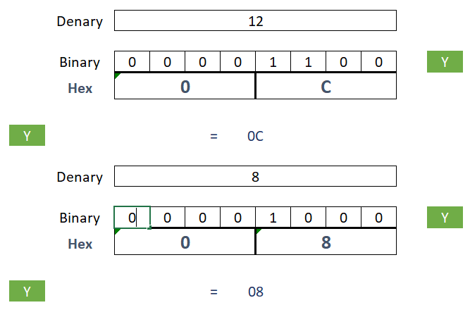
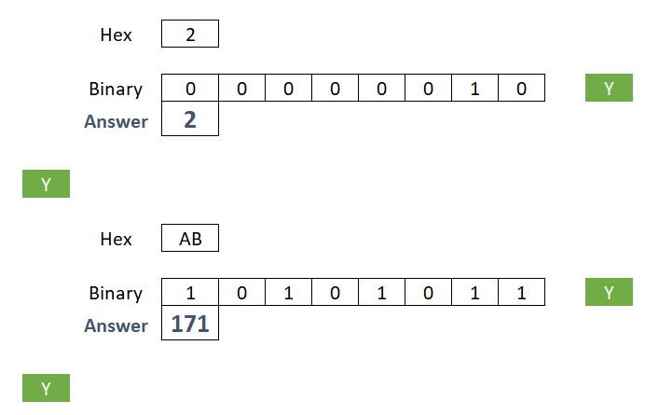
Converting positive denary whole numbers (0-255) into 2 digit hexadecimal numbers and vice versa
How to convert from denary to hexadecimal:
How to convert from hexadecimal to denary:
Divide the denary number by the unit, each time using the result of the previous calculation. Convert any 2 digit numbers in to hex A-F.
Multiply unit by the digit and add all results together.
Notes:
22. In the top box copy and paste some of your conversions onto this slide as evidence of your work. Denary to hex on the left and hex to denary on the right.
23. In the bottom boxes describe how to convert from denary to hex and hex to denary.

Slide 13
Number conversions
Denary
18
Binary
11001110
Denary
101
Binary
00100010
Hexadecimal
22
Hexadecimal
78
Denary
140
Binary
01100101
Denary
11
Hexadecimal
AB
Denary
40
Binary
01100000
Binary
11011000
Denary
209
Denary
74
Binary
00110000
Binary
11111111
Hexadecimal
2B
Hexadecimal
6A
Denary
190
Binary
00001011
Hexadecimal
FF
Hexadecimal
8C
Hexadecimal
1F
Denary
86
Binary
01001010
Denary
99
Binary
00111111
Denary
130
Binary
00101011
Denary
96
Binary
01011101
Hexadecimal
D8
Denary
10
Binary
11010001
Hexadecimal
5D
Hexadecimal
BE
Hexadecimal
56
Hexadecimal
3F
Notes:
24. Complete the puzzle by rotating and aligning all the pieces to their equivalent numbers.

Slide 14
Characters and character sets
Computers store and process all data in binary. Therefore all data including text, images and sounds must be represented with just 0’s and 1’s.
How my first name is stored in binary using the 8 bit Extended ASCII character set:
Letter | Binary
W | 0 | 1 | 0 | 1 | 0 | 1 | 1 | 1
i | 0 | 1 | 1 | 0 | 1 | 0 | 0 | 1
l | 0 | 1 | 1 | 0 | 1 | 1 | 0 | 0
l | 0 | 1 | 1 | 0 | 1 | 1 | 0 | 0
My binary bracelet:
Notes:
25. Research the binary ascii table to find the binary code for each letter of the alphabet: http://sticksandstones.kstrom.com/appen.html
26. Take each letter of your first name and convert it into binary.
27. Using the symbols representing white beads (0) and black beads (1), copy and paste these onto the bracelet to spell out your name. The vertical lines provide a guide for each group of 8 bits. Delete any unused sections.

Slide 15
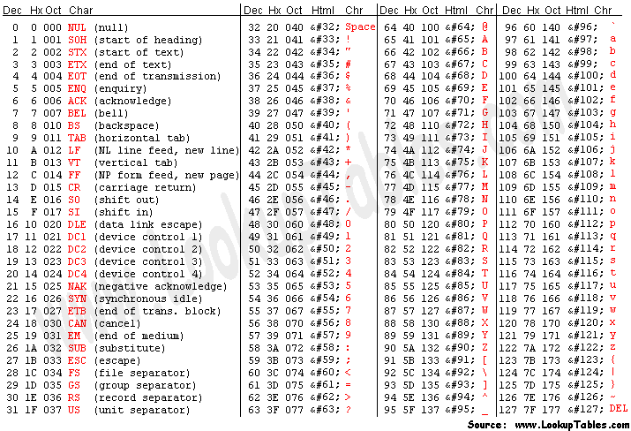
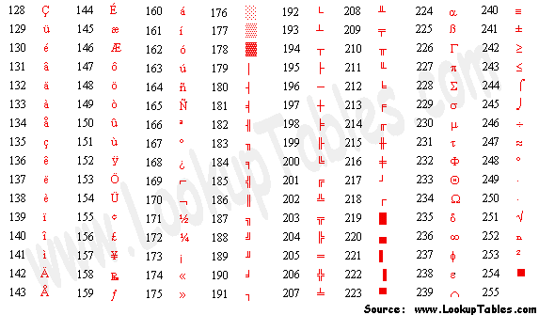
Characters and character sets
A character set is:
List of characters recognised my a computer’s hardware of software.
ASCII is a 7 bit character set. This means you can represent
128
256
Extended ASCII is an 8 bit character set. This means you can represent
characters in that set because there are 2⁷ permutations of 7 bits.
characters in that set because there are 2⁸ permutations of 8 bits.
Standard ASCII character set. Characters 32-127:
Extended ASCII character set. Characters 128-255:
Notes:
28. Explain the term, “character set”.
29. State how many characters can be stored in a 7 bit character set such as ASCII and an 8 bit character set such as extended ASCII.
30. Show the characters for denary values 32-127 for ASCII and 128-255 for extended ASCII. It is easier to do this by finding an image of the ASCII table and cropping it down to size.

Slide 16
Characters and character sets
Unicode was introduced because
Extended-ASCII didn’t have enough characters.
☺ 0000000000000001
☻ 0000000000000010
♥ 0000000000000011
♦ 0000000000000100
♣ 0000000000000101
♠ 0000000000000110
Notes:
31.State why UNICODE was created as a further extension of ASCII.
32. Research the UNICODE character set and illustrate six emojis and their binary code. You will need to find conversion tools to help you with this task.

Slide 17
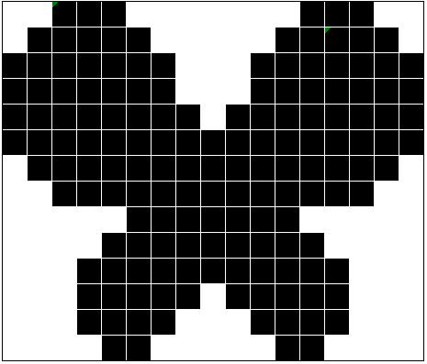
Bitmap images
1 bit image:
1
bit.
In this image each pixel is stored in:
Meta data includes:
Dimensions, resolution
The file size can be calculated as:
The file size for this image is:
Notes:
33. Using the bitmaps exercise spreadsheet, colour the pixels of the 1 bit image.
34. Paste a copy of the image into the box on the left as evidence of your work.
35. State how many bits are used to store the colour of each pixel in this image.
36. State 4 items of data that could be included in the meta-data for this image.
37. Describe how the file size could be calculated.
Calculate the raw file size in bits for this image. State any assumptions you make.

Slide 18
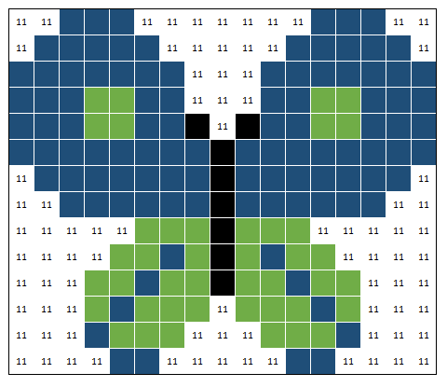
Bitmap images
2 bit image:
2
bits.
In this image each pixel is stored in:
The file size for this image is:
The colour palette meta-data is:
Notes:
39. Using the bitmaps exercise spreadsheet, colour the pixels of the 2 bit image.
40. Paste a copy of the image into the box on the left as evidence of your work.
41. State how many bits are used to store the colour of each pixel in this image.
42. Calculate the raw file size in bits for this image. State any assumptions you make.
43. Show the bit pattern for the colour palette stored as meta-data with the image.

Slide 19

Bitmap images
3 bit image:
In this image each pixel is stored in:
2
bits.
The impact on file size of colour depth:
The impact on file size of resolution:
Notes:
44. Using the bitmaps exercise spreadsheet, colour the pixels of the 3 bit image.
45. Paste a copy of the image into the box on the left as evidence of your work.
46. State how many bits are used to store the colour of each pixel in this image.
47. Explain the impact on file size and image quality of increasing the colour depth (bits per pixel).
48. Explain the impact on file size and image quality of increasing the resolution (width and height) of the picture.

Slide 20
How sound can be sampled and stored in digital form
101
100
011
Bit depth (3-bits)
010
001
000
Binary for the sound could be:
010 011 001 010 011 010 011 010 001 100 011 010 011
39
bits.
Notes:
49. Place a dot to illustrate the sample that would be taken to digitise this sound wave at each sample rate interval.
50. Show the binary for this sound (assuming a bit depth of 3 bits per sample).
51. Calculate how many bits would be required to store this sound sample.

Slide 21
The effect of doubling the bit rate on the quality of the sound and file size
1010
1001
1000
0111
0110
0101
Bit depth (4-bits)
0100
0011
0010
0001
0000
Binary for the sound could be:
0100 0101 0001 0100 0101 0011 0101 0100 0011 1001 0111 0100 0110
52
bits.
The quality has:
Got better because there are more bits than the previous.
Notes:
52. Add additional gridlines and binary to the left axis to show a doubling of the bit depth.
53. Place a dot to illustrate the sample that would be taken to digitise this sound wave at each sample rate interval.
54. Show the binary for this sound (assuming a bit depth of 4 bits per sample).
55. Calculate how many bits would be required to store this sound sample.
56. Describe what has happened to the quality of the sound sample as a result.

Slide 22
The effect of doubling the sample rate and bit rate on the quality of the sound and file size
1010
1001
1000
0111
0110
0101
Bit depth (4-bits)
0100
0011
0010
0001
0000
Binary for the sound could be:
0100 0101 0101 0011 0001 0010 0100 0101 0101 0100 0011 0100 0101 0101 0100 0011 0011 0110 1001 1001 0111 0101 0011 0110
96
bits.
The quality has:
Got better because the sample rate has increased.
Notes:
57. Add additional gridlines and binary to the bottom axis to show a doubling of the sample rate.
58. Place a dot to illustrate the sample that would be taken to digitise this sound wave at each sample interval.
59. Show the binary for this sound (assuming a bit depth of 4 bits per sample).
60. Calculate how many bits would be required to store this sound sample.
61. Describe what has happened to the quality of the sound sample as a result.

Slide 23
Compression will
Make files smaller
and is used because
Some files may need to be condensed for storage or sending to another computer.
Lossy compression loses some of the data when the file is compressed. This reduces the quality, but also significantly reduces file size.
Lossy compression is used for
Images, videos and sound files
and cannot be used for
Text files.
Lossless compression does not lose any of the data when the file is compressed. Instead, the data is encoded in a different way.
Lossless compression is used for
Text files
and is less effective for
Images, videos and sound files.
Notes:
62. Complete the boxes to explain the purpose and types of compression.

Slide 24
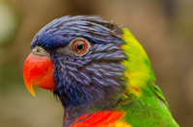





Lossy compression
Lossy compression loses some of the data when the file is compressed. This reduces the quality, but significantly reduces file size.
With JPEG encoding below you can see that increasingly larger regions of the picture are drawn with the same colour as the compression increases.
100% quality:30KB
80% quality:20KB
60% quality:18KB
2
3
40% quality:16KB
20% quality:14KB
2% quality:14KB
4
5
6
Notes:
63. If you have access to a graphics application that will allow you to save JPEG images at different levels of quality, show the image at 80%, 60%, 40%, 20% and 2% quality. If not, your teacher will provide you with the images you need.
64. State the file size of each image.

Slide 25
Lossless compression
An example of run-length lossless compression:
Colour palette:
You don’t need to know about specific compression algorithms for exams. This exercise is just so you understand how it could work.
Assuming the first 3 bits are the colour and the next 4 bits are the number of pixels of that colour: The first two lines of the image encoded in binary are:
111 0010 000 1100 111 0011 000 0010 111 0010 111 0001 000 0001 001 110 000 0011 001 0001 000 0001 111 0010
126
83
Uncompressed total bits:
With lossless compression total bits:
Notes:
Run-length encoding is a lossless compression technique. Instead of each individual pixel being stored, the colour followed by the number of pixels horizontally of that colour are stored in binary instead. E.g. 001 1011 would mean eleven pixels of blue.
65. Show the binary for the first two lines of this image.
66. Compare the raw data size and the compressed data size.

Slide 26
Lossless compression
Assuming 3 bits for colour and 4 bits for number of pixels:
Notes:
SUPER CHALLENGE: Can you encode the complete image with lossless run-length encoding? Can you find out the percentage saving by using this compression technique for this image?

Slide 27

Units of data storage
Case study:
Elizabeth is looking to upgrade her phone. She is choosing between model A and model B.
 | Model A | Model B
Storage capacity | 64GB | 256GB
Camera | 8 mega-pixel, 24bit colour | 12 mega-pixel, 24 bit colour
Video | 1080p (2 mega-pixel) at 24 fps, 30 fps, or 60 fps | 4K HD (8 mega-pixel) at 24 fps, 30 fps, or 60 fps
Consider that 32GB of data storage will be used for apps. Assume 50% compression.
Maximum number of photographs that could be stored on the phone:
667 photos
888 photos
Notes:
67. Calculate how many photographs could be stored on each device in this scenario. You may use approximations. Show your working.
SUPER CHALLENGE: Can you show your teacher how many 3 minute video clips could be stored?

Slide 28
Assessment |  |  |  | Target: |  | Overall grade:
Minimum expectations by the end of this unit
□ | You should have learnt terms 30-60 from your GCSE Level Key Terminology during this unit.
□ | You have completed all the pages of the workbook
□ | Score 80% in the end of unit test.
Feedback
Breadth |  | Depth |  |  | Understanding
□ All aspects complete |  | □ Excellent level of depth |  |  | □ All work is accurate
□ Most aspects complete |  | □ Good level of depth |  |  | □ Most work is accurate
□ Some aspects complete |  | □ Basic level of depth shown |  |  | □ Some work is accurate
□ Little work complete |  | □ Little depth and detail provided |  |  | □ Little work is accurate
Comment & action |  |  | Student response

Slide 29
Reflection & Revision checklist
Confidence | Clarification
☹ 😐 ☺ | I can explain the following units of storage: bit, nibble, byte, kilobyte, megabyte, gigabyte, terabyte, petabyte
☹ 😐 ☺ | I can explain why data needs to be converted into a binary format in order to be processed by a computer.
 | I can explain how to calculate data capacity requirements
☹ 😐 ☺ | I can explain how to convert positive denary whole numbers (0-255) into 8 bit binary numbers and vice versa.
☹ 😐 ☺ | I can explain how to add two 8 bit binary integers.
☹ 😐 ☺ | I can explain what overflow is and why it might occur when performing binary addition.
☹ 😐 ☺ | I can explain how to convert positive denary whole numbers (0-255) into 2 digit hexadecimal numbers and vice versa.
☹ 😐 ☺ | I can explain how to convert binary integers to their hexadecimal equivalents and vice versa
☹ 😐 ☺ | I can explain what a binary shift is and why I would use it.
☹ 😐 ☺ | I can explain how binary codes are used to represented characters.
☹ 😐 ☺ | I can explain what a character set is.
☹ 😐 ☺ | I can explain the relationship between the number of bits per character in a character set and the number of characters it can represented.
☹ 😐 ☺ | I can explain the difference between the ASCII and the Unicode character set.
My revision focus will need to be:

Slide 30
Reflection & Revision checklist
Confidence | Clarification
☹ 😐 ☺ | I can explain how an image is represented as a series of pixels is represented in binary.
☹ 😐 ☺ | I can explain what meta data is and provide some examples.
☹ 😐 ☺ | I can explain the effect of colour depth and resolution on the size of an image file.
☹ 😐 ☺ | I can explain how sound can be sampled and stored in a digital form.
☹ 😐 ☺ | I can explain how the following factors affect the size of a sound file and the quality of its playback: sample rate
☹ 😐 ☺ | I can explain how the following factors affect the size of a sound file and the quality of its playback: sample duration
☹ 😐 ☺ | I can explain how the following factors affect the size of a sound file and the quality of its playback: bit depth
☹ 😐 ☺ | I can explain the need for compression.
☹ 😐 ☺ | I can explain what lossy compression is.
☹ 😐 ☺ | I can explain what lossless compression is.
☹ 😐 ☺ | I can explain the advantages and disadvantages of lossy vs lossless compression.
My revision focus will need to be:

