Slide 1
Name:
Will Dargan
Specification & learning objectives
By the end of this topic you will have studied:
Forms of attack: Malware, Social engineering (e.g. phishing, people as the 'weak point'), Brute-force attacks, Denial of service attacks, Data interception and theft, The concept of SQL injection
Common prevention methods: Penetration testing, anti-malware software, Firewalls, User access levels, Passwords, Encryption, Physical security
Resources
We recommend the OCR endorsed text book from PG Online for use during your GCSE studies.
Craig'n'Dave videos for SLR 1.4
Notes:
Activity…

Slide 2
The Hackers Handbook: front cover
Notes:
In this piece of work you are creating a set of notes on the topic of system security in the form of a booklet titled, “The Hackers Handbook”. To make it interesting, you are writing this from the perspective of the hacker to another hacker! The page is A5 landscape shown by the box. Make sure all the content is within the box.
Start by creating a suitable front cover. The dotted line indicates the saddle stitch (where the booklet would be stapled or bound) You could use fancy fonts in this work from: http://www.flamingtext.com/

Slide 3
The Hackers Handbook: page 1 - Malware
Malware is software designed to infect computers and commit crimes.
Some examples are:
Viruses
Trojans
Worms
Ransomware
Spyware
Adware
Once your computer has been infected a hacker may be able to delete files; save key presses or continuously shut it down or slow it down.
Software is available to scan for malware and remove it from your computer, this is called Anti-virus software.
Notes:
Create a page about malware. Include: - A definition of what malware is. - The different forms of malware. - What a hacker can do with malware. - Techniques someone might use to stop the hacker using a malware attack. - A specific real-world case study example. - A feature box on ransomware.

Slide 4
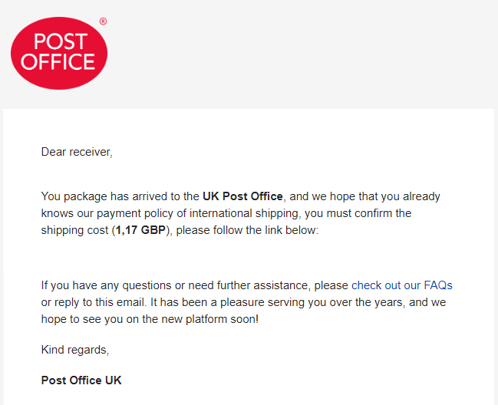
The Hackers Handbook: page 2 - Phishing
With a phishing attack the hacker will disguise their software as something completely legitimate and often hard to distinguish from the real thing.
If a hacker is successful then they may be able to access victims accounts and bank cards to steal money.
Notes:
Create a page about phishing. Include: - A definition of what phishing is. - What a hacker can achieve with a successful phish. - What you should do to ensure a victim doesn’t recognise the scam. - Feature box with an example of a phishing email a hacker could use as a template. Include a typical header found on an email. - A chart of the growth of phishing using the data from APWG below. Format: year – number of phishing reports.
2005173063 2006 268126 2007 327814 2008 335965 2009 412392 2010 313517 2011 284445 2012 320081 2013 491399 2014 704178 2015 1413978

Slide 5
The Hackers Handbook: page 3 – Brute force attack
With a brute force attack a hacker will use powerful computers or networks to try 1000s of possibilities for passwords.
The main reason for a brute force attack is the theft of data.
Protection against this type of attack is simple: using strong passwords.
Popular passwords include:
123456
password
1234567890
111111
Notes:
Create a page about brute force attacks. Include: - A definition of what a brute force attack is. - The purpose of a brute force attack. - What to look out for if someone is protecting against this type of attack: i.e. features of sites that are not worth bothering with. - A list of popular passwords. - Feature box explaining a dictionary hack approach.

Slide 6
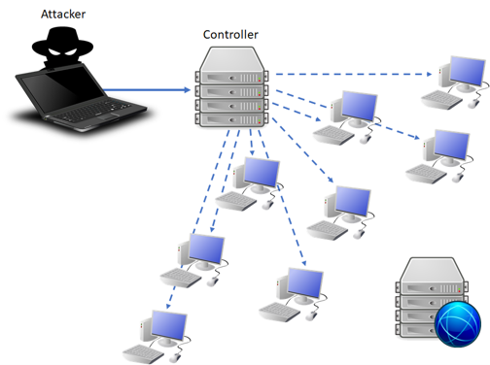


The Hackers Handbook: page 4 – Denial of service attack
A denial of service attack involves many computers sending requests to a single server which slows it down. This type of attack cannot harm files or your computer.
Notes:
Create a page about denial of service attacks. Include: - A definition of what a denial of service attack is. - An illustration showing how DDOS attacks work, including zombies. - What a network manager might do to protect against an attack.

Slide 7
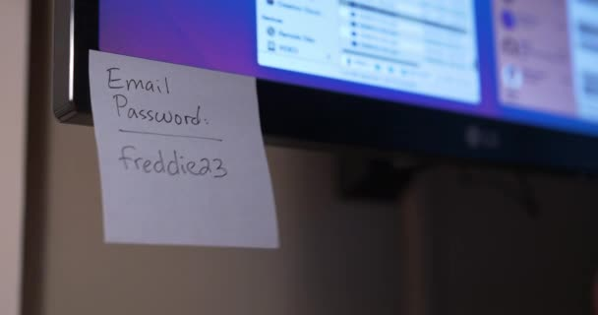
The Hackers Handbook: page 5 – Data interception and theft
A data interception attack is when a hacker listens to the data on a wired or wireless network to gain access to sensitive data or passwords.
This allows them to access corporate data or personal accounts.
Notes:
Create a page about data interception and theft. Include: - A definition of what data interception and theft is. - What a hacker can gain by intercepting data. - A picture of hardware/software that can be used to packet sniff. - Images of common mistakes people make: passwords attached to computers, not logging off, memory sticks left behind. - A list of “enemies of the hacker”: techniques that a company might use to protect against data interception.

Slide 8
The Hackers Handbook: page 6 – SQL injection
SQL Injections means putting a piece of code into a database. This will be run when that data is selected.
A hacker may want to use this because sensitive data from the database could be output.
DELETE FROM * WHERE *
Notes:
Create a page about SQL injection. Include: - A definition of what a SQL injection attack is. - Why a hacker would want to use a SQL injection hack. - Examples of code a hacker could try that would cause a SQL injection. A good source of easy to understand examples is: https://en.wikipedia.org/wiki/SQL_injection

Slide 9
The Hackers Handbook: back cover
Notes:
If you have time, create a back cover for your book.

Slide 10
People as a weak point in secure systems
Social engineering refers to psychological manipulation of people into performing actions or divulging confidential information. A type of confidence trick for the purpose of information gathering, fraud, or system access. It is often one of many steps in a more complex fraud operation.
List of mistakes that people make with system security:
Writing passwords on post-its on monitors
Not installing system updates
Leaving computers unlocked
Leaving doors unlocked
Leaving memory sticks in computers
Leving print outs available
Notes:
List the mistakes that people make in terms of network security. Try to create a wide ranging list, but remember this is about human actions, not technical issues.

Slide 11
People as a weak point in secure systems
Notes:
Design a landscape banner in the large box.
This banner will be used as a desktop wallpaper for all computers in a local office
It should be bold, simple and clear
It should make the point that personal computing security is everyone's business
Pick one area to make the focus of your poster in order to educate e.g. Weak and default passwords

Slide 12
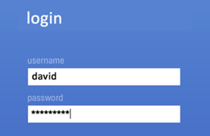

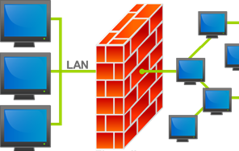
Common prevention methods to forms of attack – part 1
User access levels – what is it?
Encryption – what is it?
Firewall – what is it?
Different user access levels will have different permissions, this way not every user on the network will be able to access important and sensitive files.
Encryption is applying a piece of code to some data to be sent across a network. This code alters the message so it is unreadable unless a decryption key is applied.
Firewalls monitor internet traffic in and out of your computer, they block unauthorised connections and control authorised ones.
When it would be used:
When it would be used:
When it would be used:
Corporate environment, system administrators and users.
When sending secure data across a network.
All the time to protect from malicious internet traffic on a WAN.
Notes:
Place the three images into the appropriate boxes at the bottom of the page.
In the large boxes along the top write a description which shows your understanding of the network security method mentioned.
In the smaller boxes underneath write a sentence which shows an example of when this type of network security method might typically be used.

Slide 13
Common prevention methods to forms of attack – part 2
Firewalls
Passwords
Physical security
Penetration testing
Firewalls control internet traffic coming and going out of your computer.
Strong passwords will protect against brute force attacks.
Locking doors, using security cameras and alarms, locking PC cases.
Hiring people to try and hack your system to find weak points.
Notes:
Place the following headings in the appropriate boxes above each column:
- Anti-malware software
- Passwords
- Physical security
- Penetration testing
In the panel under each image right click the border of the box and choose “Edit text”.
Enter a description / explanation of the security measure shown.

Slide 14
Assessment |  |  |  | Target: |  | Overall grade:
Minimum expectations by the end of this unit
□ | You should have learnt terms 97-109 from your GCSE Level Key Terminology during this unit.
□ | You have completed all the pages of the workbook
□ | Score 80% in the end of unit test.
Feedback
Breadth |  | Depth |  |  | Understanding
□ All aspects complete |  | □ Excellent level of depth |  |  | □ All work is accurate
□ Most aspects complete |  | □ Good level of depth |  |  | □ Most work is accurate
□ Some aspects complete |  | □ Basic level of depth shown |  |  | □ Some work is accurate
□ Little work complete |  | □ Little depth and detail provided |  |  | □ Little work is accurate
Comment & action |  |  | Student response

Slide 15
Reflection & Revision checklist
Confidence | Clarification
☹ 😐 ☺ | I can explain forms of attacks
☹ 😐 ☺ | I can explain threats posted to networks including: Malware
☹ 😐 ☺ | I can explain threats posted to networks including: Phishing
☹ 😐 ☺ | I can explain threats posted to networks including: People as weak points
☹ 😐 ☺ | I can explain threats posted to networks including: Brute force attacks
☹ 😐 ☺ | I can explain threats posted to networks including: Denial of service attacks
☹ 😐 ☺ | I can explain threats posted to networks including: Data interception / theft
☹ 😐 ☺ | I can explain threats posted to networks including: SQL injections
☹ 😐 ☺ | I can explain how to identify and prevent vulnerabilities by using: Penetration testing
☹ 😐 ☺ | I can explain how to identify and prevent vulnerabilities by using: Firewalls
☹ 😐 ☺ | I can explain how to identify and prevent vulnerabilities by using: User access levels
☹ 😐 ☺ | I can explain how to identify and prevent vulnerabilities by using: Anti-malware software
☹ 😐 ☺ | I can explain how to identify and prevent vulnerabilities by using: Usernames / passwords
☹ 😐 ☺ | I can explain how to identify and prevent vulnerabilities by using: Encryption
☹ 😐 ☺ | I can explain how to identify and prevent vulnerabilities by using: Physical security
My revision focus will need to be:

