Slide 1
Name:
Will Dargan
Specification & learning objectives
By the end of this topic you will have studied:
The purpose and functionality of operating systems: User interface, Memory management and multitasking, Peripheral management and drivers, User management, File management
The purpose and functionality of utility software
Utility system software: Encryption software, Defragmentation, Data compression
Resources
We recommend the OCR endorsed text book from PG Online for use during your GCSE studies.
Craig'n'Dave videos for SLR 1.5
Notes:
Activity…

Slide 2
The purpose and functionality of operating systems
The purpose of an Operating System is to:
Provide a platform for the user to run programs on.
Operating system software falls under the following category of software:
System Software
The other type of software which also falls under this same category is:
Utility Software
Operating system
User
Applications
User Interface
Operating System
Utility Programs
Memory Management
File
Management
Device Drivers
Hardware
Notes:
Complete the boxes.
Solve the jigsaw to illustrate the features of an operating system.

Slide 3
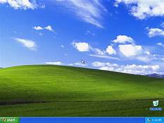
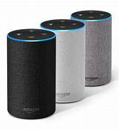
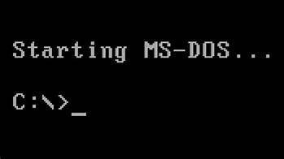
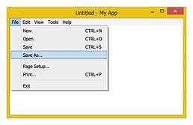
User interfaces
Features of a graphical user interface (GUI):
WIMP Interface – Windows Icons Menus Pointers
Visual
Interactive
Intuitive
Optimised for mouse and touch
Features of a natural language interface:
Responds to commands in spoken language
Features of a menu interface:
Features of a command line interface:
Text based
Less resource heavy than GUI
Lots of commands
For more advanced users
Successive menus presented to the user
Single options chosen at each stage
Notes:
Write a set of bullet points for each type of user interface to identify their key features in the white boxes.
Put a suitable picture in each of the coloured boxes.

Slide 4

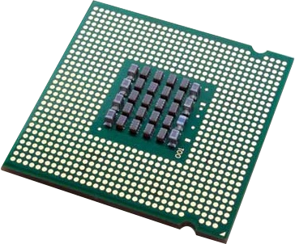
Memory management: multi-tasking
Multi-tasking is:
Programs taking a small amount of the CPUs time in a cycle.
Programs are loaded from secondary storage, usually a hard disk into random access memory.
Programs are held by the operating system in a queue.
The program at the front of the queue runs its code on the processor.
After a small amount of time, the program stops running and is moved to the back of the queue.
The next program at the front of the queue then starts running.
The cycle continues with newly loaded programs joining the queue, and programs that are closed leaving the queue.
Notes:
Complete the definition of multi-tasking.
Look at all the programs you have running at the moment, including the ones in the taskbar. Show these cycling on the stopwatch by inserting and labelling a segmented cycle SmartArt object.

Slide 5


Memory management: loading and managing programs
a. Program loaded.
b. Program loaded.
X
c. Program closed.
RAM:
RAM:
RAM:
d. Program loaded.
Where to put it in memory.
When programs are loaded, the operating system decides:
fragmented
As programs are loaded and closed over time, the memory becomes:
RAM:
The operating system keeps track of these different parts of a program held in different areas of the memory.
Virtual memory
If the memory becomes full,
will need to be used.
To make this easier, the memory is divided into equal sized parts called pages.
Notes:
Show what happens to the memory in each of these stages by colouring the boxes to represent program fragments: a. Two block program loaded from the disk into RAM. b. One block program loaded from the disk into RAM. c. Two block program is closed, freeing up the memory used. d. Three block program loaded from the disk into RAM.
Complete the description of memory management.

Slide 6
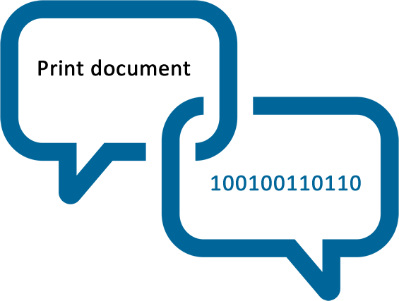
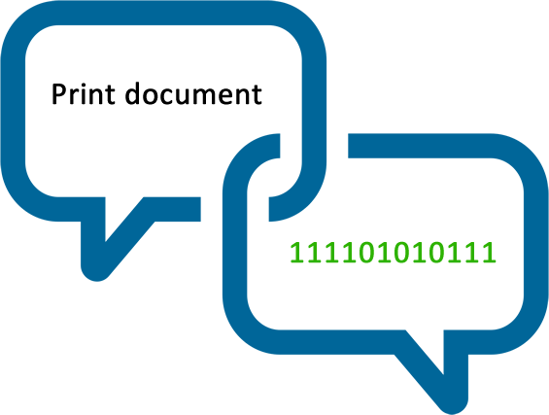

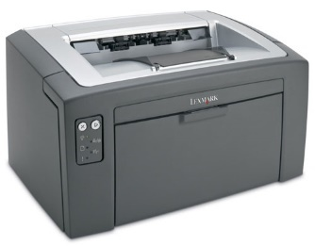
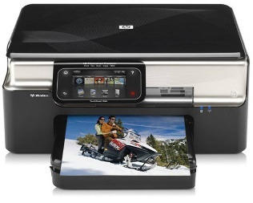
Peripheral management and drivers
How the operating system manages peripherals:
The OS uses software called device drivers to translate operating system instructions into hardware instructions.
OS
OS
DRIVER
DRIVER
Document created using a word processor
Document created using a word processor
A laser printer attracts toner particles to magnetised areas of the paper. Heat is used to fuse the toner to the page.
An Inkjet printer sprays different coloured inks onto the page one row at a time.
Notes:
Explain how an operating system can print the same document created using a word processor, to two different types of printer using very different technologies.

Slide 7
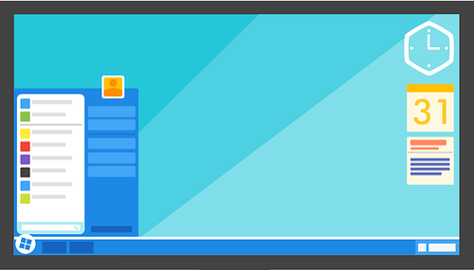
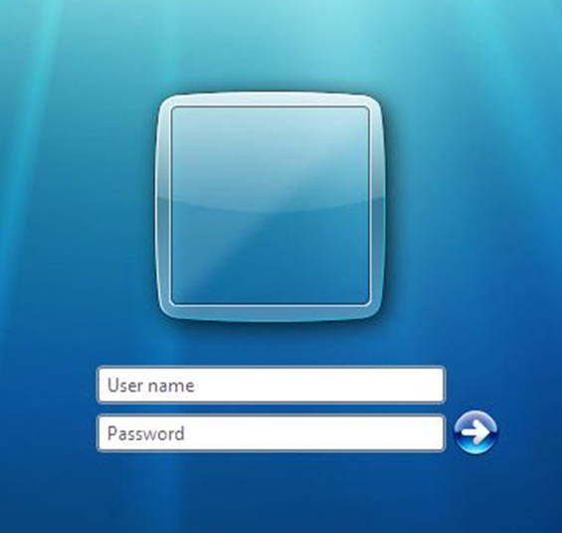
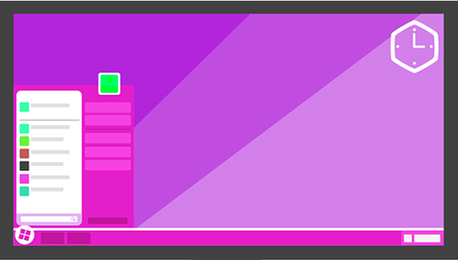
User management
User management means:
Providing for different users to log into computer.
The operating system will retain settings for each user, such as icons, desktop backgrounds etc.
2
1
3
Notes:
Explain what user management means.
Illustrate this with example pictures: a. search for a picture of an operating system login page for box 1. b. search for two different pictures of an operating system desktop for boxes 2 and 3.

Slide 8
File management
Computers store data in
files
In many operating systems, each file has an
extension
that tells the operating system which program to load
the file into when it is opened. The operating system presents the folder structure to the user, allowing files to be
renamed
deleted
copied
and
moved
As files are saved and deleted, over time the hard disk will become
fragmented
which will slow the computer down.
A folder structure for files doesn’t really exist, but files are presented like this as part of the user interface to make the computer easy to use.
A typical folder structure is:
Root
User 1
Desktop
User 3
User 2
Notes:
Complete the paragraph explaining file management in an operating system. Use the words: deleted, fragmented, moved, files, edited, extension, renamed
Show part of your folder/file structure to 3 levels in the hierarchical SmartArt object. The highest folder is always called the “root”. You can add more boxes underneath the root as you need them.

Slide 9
Utility system software
Three utilities include:
Encryption
Defragmentation
Data Compression
Utility 1:
Utility 2:
I love computer science → h gjyw erthipoz fgbbnl
1111111111 000000000000 11111 00000 → 1010 1100 0101 0101
Encryption utilities use an algorithm to scramble plain text into cipher text.
The text can only be decrypted with a key.
Compression utilities red2uce the size of a file so that it takes up less space, and is quicker to download over The Internet.
Compressed files must be extracted before they can be read.
Utility 3:
→
Defragmentation utilities reorganise files on a hard disk, putting fragments of files back together, and It collects together free space.
This reduces the movement of a read/write head across the surface of the disk, which speeds up file access.
Solid state drive should not be defragmented.
Notes:
State three utility programs that are systems software.
Identify, name and describe the three utility programs illustrated.
Make sure you use these words in your descriptions: cipher text, decrypted, key, disk space, download, extracted, reorganise, speeding up access, solid state.

Slide 10
Assessment |  |  |  | Target: |  | Overall grade:
Minimum expectations by the end of this unit
□ | You should have learnt terms 110-122 from your GCSE Level Key Terminology during this unit.
□ | You have completed all the pages of the workbook
□ | Score 80% in the end of unit test.
Feedback
Breadth |  | Depth |  |  | Understanding
□ All aspects complete |  | □ Excellent level of depth |  |  | □ All work is accurate
□ Most aspects complete |  | □ Good level of depth |  |  | □ Most work is accurate
□ Some aspects complete |  | □ Basic level of depth shown |  |  | □ Some work is accurate
□ Little work complete |  | □ Little depth and detail provided |  |  | □ Little work is accurate
Comment & action |  |  | Student response

Slide 11
Reflection & Revision checklist
Confidence | Clarification
☹ 😐 ☺ | I can explain the purpose and functionality of on Operating System
☹ 😐 ☺ | I can explain the following in regards to Operating Systems: user interface
☹ 😐 ☺ | I can explain the following in regards to Operating Systems: memory management
☹ 😐 ☺ | I can explain the following in regards to Operating Systems: peripheral management and drivers
☹ 😐 ☺ | I can explain the following in regards to Operating Systems: user management
☹ 😐 ☺ | I can explain the following in regards to Operating Systems: file management
☹ 😐 ☺ | I can explain what utility system software is
☹ 😐 ☺ | I can explain what encryption software is
☹ 😐 ☺ | I can explain what defragmentation is
☹ 😐 ☺ | I can explain what data compression is
My revision focus will need to be:

