Slide 1
Name:
Specification & learning objectives
By the end of this topic you will have studied:
Defensive design considerations: Anticipating misuse, Authentication
Input validation
Maintainability: Use of sub programs, Naming conventions, Indentation, Commenting
The purpose of testing
Types of testing: Iterative, Final/terminal
Identify syntax and logic errors
Selecting and using suitable test data: Normal, Boundary, Invalid, Erroneous
Refining algorithms
Resources
We recommend the OCR endorsed text book from PG Online for use during your GCSE studies.
Craig'n'Dave videos for SLR 2.3
Notes:
Activity…

Slide 2
Defensive design: Input validation
Input validation means:
Checking data input by the user meets specific criteria.
Type of validation:
Type Check
Range Check
Presence Check
Format Check
Length Check
Explanation:
The data is the correct data type.
The data is in the correct range.
There is data present.
Data is in the correct format.
Data is the correct length.
Example:
Integer, Real, String or Boolean
1-3
“Hello World!”
DD/MM/YYYY
10
If not year.isnumeric():
valid = False
if choice < "1" or choice > "3": valid = False
If choice == "":
valid = False
divider1 = date[2:3]
divider2 = date[5:6]
if divider1 != "/" or divider2 != "/":
valid = False
If len(choice)!=13:
valid = False
Code example:
It might be possible to cast an input string into a number after input.
Whitelists can be used to store all the valid data inputs a program should accept. E.g. A, B, C in a menu.
Blacklists are invalid data inputs a program should reject. E.g. /?* in filenames.
Notes:
Complete the boxes to identify and describe validation checks that should be performed on inputs.
Write a program that asks the user to enter a date in the format dd/mm/yyyy The program should validate the data in the following ways, and output which type of check was failed or that the date is valid: a. there is some input; b. the date is 10 characters long; c. the date is in the correct format with / symbols in the correct place in the string; d. the day, month and year are all numbers; e. the day and month cannot be less than 1; f. the month cannot be more than 12; g. the year cannot be less than 1900; h. the day cannot be more than 29 if the month is 02; i. the day cannot be more than 30 for the months 02, 04, 06, 09 or 11. j. the day cannot be more than 31 for the months 01, 03, 05, 07, 08, 10 or 12. k. the day can be 29 for month 02 if the year is exactly divisible by 4.

Slide 3
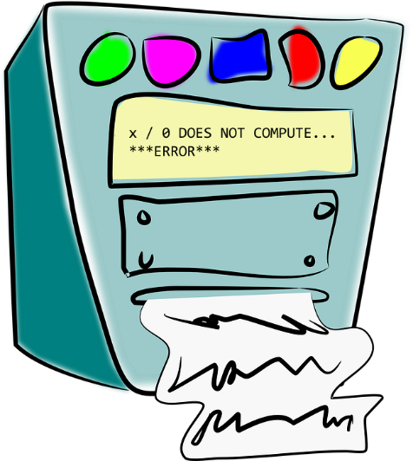



Defensive design: Anticipating misuse
Even with valid inputs there are a number of reasons why a program could crash. These should be trapped by the programmer with exception handling code.
Corrupt files
Broken network connection
Broken hardware
Exceptions
A user might also misinterpret the on-screen prompts, or enter data into the wrong input box. A programmer should plan for all possible eventualities.
Notes:
Complete the boxes to state some of the contingencies that need to be planned for when writing robust programs. Use the illustrations to help you identify potential problems that might occur when a program is running.

Slide 4
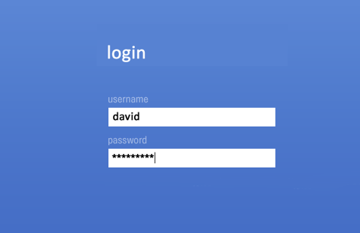
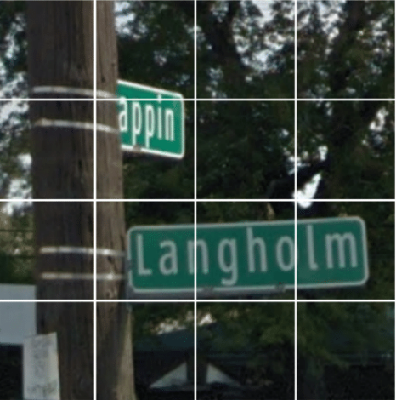
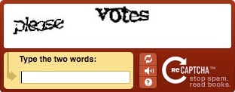
Defensive design: Authentication
Many computer systems contain secure data or need to be protected against internet bots. A programmer can use authentication techniques to minimise potential computer misuse.
Captchas protect against bot attacks by asking the user to complete a problem only solvable by a human.
Authentication with username and password locks systems to unauthorised access.
Notes:
Explain the two methods of authenticating a user illustrated. Explain what a user might be able to do if they have forgotten their credentials and how newly sign-up users for online services are authenticated. Explain how online systems are susceptible to bots, how this can be prevented. What additional facilities are offered to users who may find these authentication techniques difficult to use?
Write a program to validate an email address: must contain a @. Must be sanitised to lower case. Dot cannot be a first or last character. Double dots are not permitted.
SUPER CHALLENGE: Research what makes a strong password. Create a program to validate a password entered as secure.

Slide 5
Maintainability
#---------------------------------------------------------------------------
def gcf_of(factors1,factors2):
#Finds the greatest common factor (gcf) in two input lists
index = 0
#Check all the numbers in the factors1 list until the same number is found in the factors2 list
#Needs the lists to be in numerical order
while factors1[index] not in factors2:
index = index + 1
#Return the highest number found in both lists
return factors1[index]
#---------------------------------------------------------------------------
def factors_of(number):
#Returns a list of all the factors for a number
factors = []
#Check all numbers from the number input down to 0
for countdown in range(number,0,-1):
#If the number divided by the count down has no remainder...
if number % countdown == 0:
#...it is a factor and is added to the list
factors.append(countdown)
return factors
#---------------------------------------------------------------------------
#Main program starts here
#Input the numbers to find greatest common factor
input1 = int(input("Enter a number: "))
input2 = int(input("Enter a number: "))
#Find the factors of the two numbers input
factors1 = factors_of(input1)
factors2 = factors_of(input2)
#Output the greatest common factor of the two numbers
print("The GFC of",input1,"and",input2,"is",gcf_of(factors1,factors2))
The problem with the program below is that it is very difficult to understand what is happening.
def gcf(f1,f2):
x = 0
while f1[x] not in f2:
x = x + 1
return f1[x]
def fcts(x):
f = []
for c in range(x,0,-1):
if x % c == 0:
f.append(c)
return f
x = int(input("Enter a number: "))
y = int(input("Enter a number: "))
f1 = fcts(x)
f2 = fcts(y)
print(gcf(f1,f2))
Ways in which the second program has been made more readable:
Notes:
Explain 4 ways in which the program on the right has been made more readable than the same program on the left.
Add data input sanitisation and validation to this program so only valid integers can be input.

Slide 6
Refining algorithms in order to make them more robust
The following is a very simple program which asks a student for their first initial, the first three letters of their surname, the year of their birth and their age. It then concatenates these three variables together and outputs the result as a username:
firstInitial = input("Enter your forename initial: ")
surname = input("Enter the first 3 letters of your surname: ")
year = input("Enter the year you where born: ")
age = input("Enter your age in the range 11-19")
username = firstInitial + surname + str(year) + str(age)
print("Your username is:" + username)
This algorithm could be made more robust by:
Notes:
The code shown on this slide has been written using the OCR reference language which you will see in your exams.
In the box suggest a range of ways in which the program shown could be made more robust.

Slide 7
The purpose and types of testing
Four main reasons why a program should be thoroughly tested before being given to a user:
Iterative testing
Final/Terminal testing
Notes:
Identify four reasons why a program should be tested.
Identify when iterative and terminal testing takes place during program development.
Suggest 3 things that could be tested in each of iterative and terminal testing.

Slide 8
How to identify syntax and logic errors
Program to accept an input of 1, 2 or 3 only using a whitelist:
Correct program:
valid = False
while not valid:
valid = True
print("1. Play game")
prnt ("2. Save game")
print("3. Quit")
choice = input("Enter choice:")
if not choice in ["1","2","3"]:
valid = False
print("Option",choice,"chosen.")
Type of error in the program:
Reason this is an error:
Notes:
Draw a red box around the line of code containing an error. (There is only one error in the program)
State which type of error it is: syntax or logic.
Explain why this is an error.
Show the correct program with the correction highlighted with a green box. You might want to check it works in Python first!

Slide 9
How to identify syntax and logic errors
Program to accept an input of 1, 2 or 3 only using a whitelist:
Correct program:
valid = True
while not valid:
valid = True
print("1. Play game")
print("2. Save game")
print("3. Quit")
choice = input("Enter choice:")
if not choice in ["1","2","3"]:
valid = False
print("Option",choice,"chosen.")
Type of error in the program:
Reason this is an error:
Notes:
Draw a red box around the line of code containing an error. (There is only one error in the program)
State which type of error it is: syntax or logic.
Explain why this is an error.
Show the correct program with the correction highlighted with a green box. You might want to check it works in Python first!

Slide 10
How to identify syntax and logic errors
Program to accept an input of 1, 2 or 3 only using a whitelist:
Correct program:
valid = True
while not valid:
valid = True
print("1. Play game")
print("2. Save game")
print("3. Quit")
choice = input("Enter choice:")
if not choice in [1,2,3]:
valid = False
print("Option",choice,"chosen.")
valid = False
while not valid:
valid = True
print("1. Play game")
print("2. Save game")
print("3. Quit")
choice = input("Enter choice:")
if not choice in ["1","2","3"]:
valid = False
print("Option",choice,"chosen.")
Type of error in the program:
Reason this is an error:
Notes:
Draw a red box around the line of code containing an error. (There is only one error in the program)
State which type of error it is: syntax or logic.
Explain why this is an error.
Show the correct program with the correction highlighted with a green box. You might want to check it works in Python first!

Slide 11
How to identify syntax and logic errors
Program to accept an input of 1, 2 or 3 only using a whitelist:
Correct program:
valid = True
while not valid:
valid = True
print("1. Play game")
print("2. Save game")
print("3. Quit")
choice = input(Enter choice:)
if not choice in [1,2,3]:
valid = False
print("Option",choice,"chosen.")
Type of error in the program:
Reason this is an error:
Notes:
Draw a red box around the line of code containing an error. (There is only one error in the program)
State which type of error it is: syntax or logic.
Explain why this is an error.
Show the correct program with the correction highlighted with a green box. You might want to check it works in Python first!

Slide 12
How to identify syntax and logic errors
Program to accept an input of 1, 2 or 3 only using a whitelist:
Correct program:
valid = True
while not valid:
valid == True
print("1. Play game")
print("2. Save game")
print("3. Quit")
choice = input(Enter choice:)
if not choice in [1,2,3]:
valid = False
print("Option",choice,"chosen.")
Type of error in the program:
Reason this is an error:
Notes:
Draw a red box around the line of code containing an error. (There is only one error in the program)
State which type of error it is: syntax or logic.
Explain why this is an error.
Show the correct program with the correction highlighted with a green box. You might want to check it works in Python first!
Create a program to output the factorial of a number. Include suitable input sanitisation and validation for the program.

Slide 13
Selecting and using suitable test data
A program is to be written which will accept a score entered by the user in the range 0-110.
The user enters the following inputs, these are examples of the following categories of data:
Data entered:
Type of data:
Explanation of this type of data:
Additional example of this type of data:
57
0
105
“Dave”
Notes:
A program is to be written which will accept a score entered by the user in the range 0-110. The user has supplied the data values in the left hand column of boxes:
State what type of test data each is in the second column, select from: Normal, Boundary, Invalid, Erroneous
Provide a description of this category of test data in the third column
Provide a further example of test data which would fall into the same category in the fourth column

Slide 14
Selecting and using suitable test data
A typical test table for the program that asks the user to make a choice from 3 items numbered 1-3:
1. Play game
2. Save game
3. Quit
Enter choice:
Test No. | Data input | Type of test | Expected output
1
2
3
4
5
6
7
9
It is important to test a range of valid, invalid and erroneous data inputs.
Notes:
Complete the table to show 9 tests that could be performed on this program.

Slide 15
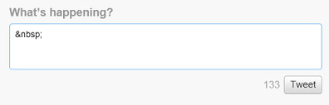
Selecting and using suitable test data
In September 2017, Twitter announced it was testing doubling the number of characters in a tweet from 140 to 280 characters. Twitter’s character limit is a holdover from the app’s early days when tweets were sent as texts, which were limited to 160 characters. It has since become one of the product’s defining characteristics. A typical test table that could be used:
Test No. | No. characters input | Type of test | Reason for the test
1
2
3
4
5
Notes:
Complete the table to show 5 tests that could be performed on this program.
Write a program to simulate an input tweet of up to 280 characters. It should allow the user to enter text and output the number of characters that were remaining after the input. Inputs of more than 280 characters are rejected with the number of characters over shown as a negative number.
SUPER CHALLENGE: Can you allow the user to enter a multi-line tweet using a list to store each line input, terminating when the line contains no characters? Extend the program so it only stops when a tweet of 0 characters is entered.

Slide 16
Assessment |  |  |  | Target: |  | Overall grade:
Minimum expectations by the end of this unit
□ | You should have learnt terms 200-217 from your GCSE Level Key Terminology during this unit.
□ | You have completed all the pages of the workbook
□ | Score 80% in the end of unit test.
Feedback
Breadth |  | Depth |  |  | Understanding
□ All aspects complete |  | □ Excellent level of depth |  |  | □ All work is accurate
□ Most aspects complete |  | □ Good level of depth |  |  | □ Most work is accurate
□ Some aspects complete |  | □ Basic level of depth shown |  |  | □ Some work is accurate
□ Little work complete |  | □ Little depth and detail provided |  |  | □ Little work is accurate
Comment & action |  |  | Student response

Slide 17
Reflection & Revision checklist
Confidence | Clarification
☹ 😐 ☺ | I can explain the following defensive design consideration: input validation.
☹ 😐 ☺ | I can explain the following defensive design consideration: anticipating misuse.
☹ 😐 ☺ | I can explain the following defensive design consideration: authentication.
☹ 😐 ☺ | I can explain how adding comments improves the maintainability of my code.
☹ 😐 ☺ | I can explain how indentation and white space improves the maintainability of my code.
☹ 😐 ☺ | I can explain how use of sub programs improves the maintainability of my code.
☹ 😐 ☺ | I can explain how adopting naming conventions improved the maintainability of my code.
☹ 😐 ☺ | I can explain the purpose of testing.
☹ 😐 ☺ | I can explain what is meant by iterative testing.
☹ 😐 ☺ | I can explain what is meant by final / terminal testing.
☹ 😐 ☺ | I can identify both syntax and logic errors in code.
☹ 😐 ☺ | I can select and use suitable test data for a program.
☹ 😐 ☺ | I can explain what is meant by “normal” test data.
☹ 😐 ☺ | I can explain what is meant by “boundary” test data.
☹ 😐 ☺ | I can explain what is meant by “Invalid” test data.
☹ 😐 ☺ | I can explain what is meant by “Erroneous” test data.
☹ 😐 ☺ | I can refine algorithms in order to make them more robust.
My revision focus will need to be:

