Slide 1


Drive for Change

Slide 2
Why Juice
Reduces cost of electricity for CCA customers through optimized time & RTP charging windows
Promotes charging during solar surplus generation hours
Supports a “take your SAID on the road” program for workplace charging
Provides rebates to reduce the cost barrier for low income buyers
Notes:
Juice helps CCAs create enable EV owners to save money on EV charging costs by leap frogging the IOU established rate schedules and
Implement new EV RTP rate that all EV owners have access to to start gaining funds for incentives and future level 1 EVSE installments
Push workplace charging incentives by implementing "Bring your SAID with you" program, with communication with public workplace charges
Create rebate program to incentivize lower income EV adoption. This rebate is funding by the savings from parts 1 and 2

Slide 3
App Demo

Slide 4
Potential value for incentives: $63M/year
$130/year of energy cost savings (see slide 8)
$123/year of LCFS revenue (based on $0.16/kWh for LCFS)
Assuming 10% adoption of Bay Area households (250,000 EV owners)
Assuming 200+ commute days a year at 50 miles/day

Slide 5
How to Juice: $ Savings
Notes:
Using PG&E Electric Schedule EV as a basis for what a typical EV charger will cost
Using a projection of the RTP as a basis for the generation charge from a CCA
The cost savings is calculated as the difference between the PG&E bundled EV rate, and the PG&E unbundled EV rate with the RTP as the generation charge
This savings is split between the CCA and the customer as the CCA sees fit, for this analysis we did 60/40
The new EV rate will be PG&E unbundled EV rate, plus the RTP, plus 40% of the savings
Including LCFS for the customer (giving the credits to the CCA to then have a bill credit associated)

Slide 6
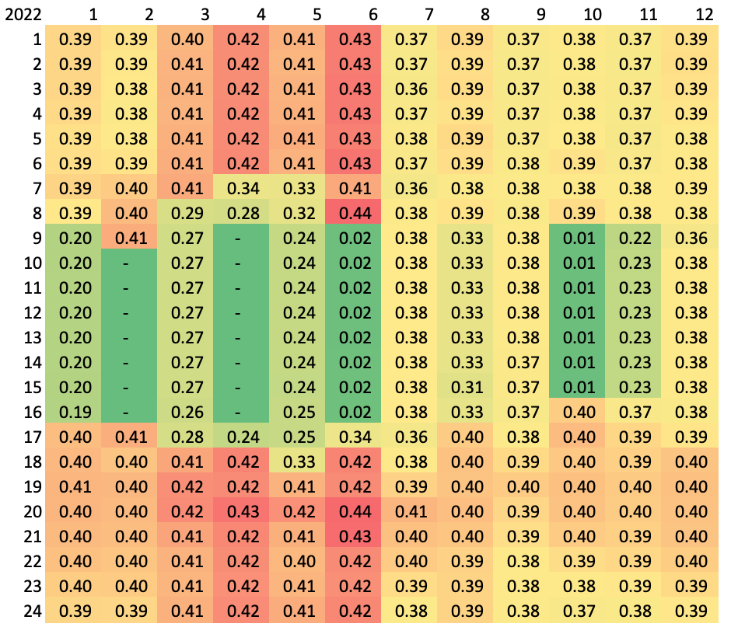
How to Juice: GHG Benefits
CPUC 2022 Clean Net Short Table
Notes:
Utilizing the CPUC 2022 Clean Net Short table to visually express to the customer the impact their charging has based on time of day

Slide 7
Assumptions
EV load is from marginal power purchases (i.e., imbalance purchases)
CCAs have established agreements with EVSE providers for workplace charging
CCAs have access to control residential EVSE charging
CCAs scheduling coordinators create a projection for real time pricing

Slide 8
Energy cost savings exhibit
Ex-Juice rate basis:
EV owners use PG&E EV bundled schedule & charge at 12 AM at home
Juice rate basis:
EV owners use PG&E EV un-bundled schedule + RTP + optimized charging window between 6 pm to 6 am
See next slide for example

Slide 9
