Slide 1
R&S PAE
Nick Lalic
VNA Software Developer
Rohde & Schwarz North America
June 19th, 2017

Slide 2
R&S PAE
The R&S PAE application measures Power Added Efficiency (PAE) and Drain Efficiency (DE) of an amplifier using a ZVA and external DMM(s).
An arbitrary number of external DMMs can be used
DMMs are controlled via text-based DMM Driver(s) containing SCPI commands
DMMs are triggered via the User Control port of the ZVA with a special DB25 to BNC adapter

Slide 3
Sections
DMM driver format
Pulsed RF setup
Define busy signal
User Control Adapter

Slide 4
DMM Driver Format
The text-based DMM driver is JSON format
The following sections (key, value pairs) are required:
“setup scpi”
“set points scpi”
“start scpi”
“sleep after start scpi”
“query data scpi”
“measurement type”

Slide 5
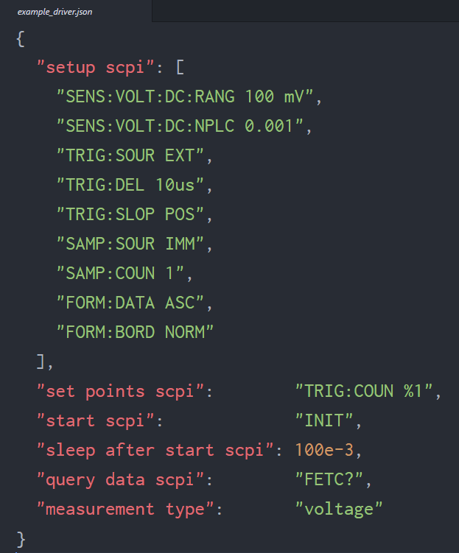
DMM Driver Format
A complete example driver for the Keysight 34465A DMM is as follows:

Slide 6
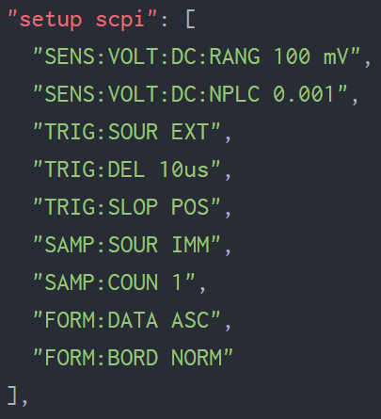
DMM Driver Format
“setup scpi” is an array of scpi commands to initialize the DMM for measurement. These commands are sent before anything else.

Slide 7
DMM Driver Format
These setup scpi commands do the following:
Set sensitivity range to 100 mV
Set number of power line cycles (NPLC)
Set external trigger
Set trigger delay to 10us
Set trigger to rising edge
Set point timing to immediately after delay
Set sample count per trigger to 1
Transfer data in ASCII format (with commas)
Set binary transfer bit order to “normal” (not “swapped”) *This is unnecessary for ASCII format, but it is left in for illustrative purposes.

Slide 8
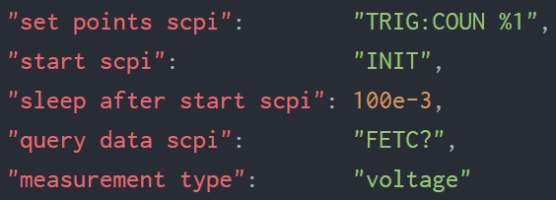
DMM Driver Format
The additional parameters should be straightforward, with the exception of
“sleep after start scpi”: This value is a sleep time (in seconds) that is performed by the application between the “start scpi” and the beginning of the VNA sweep. This is necessary because for some DMMs there is no way to query readiness after “start scpi” (in this case “INIT”) is sent, but we must ensure that the DMM is in fact ready for triggering to start
“measurement type”: For the moment, only voltage measurements across a shunt resistor are supported. In the future this might change; the “measurement type” field is a placeholder for future options.

Slide 9
Pulsed RF
The VNA must be setup for pulsed RF to be able to control the timing and duration of the individual point measurements, and coordinate this timing with the external DMM.
Currently, pulsed RF is only an option on the ZVA
Pulsed RF is software option ZVA-K7

Slide 10
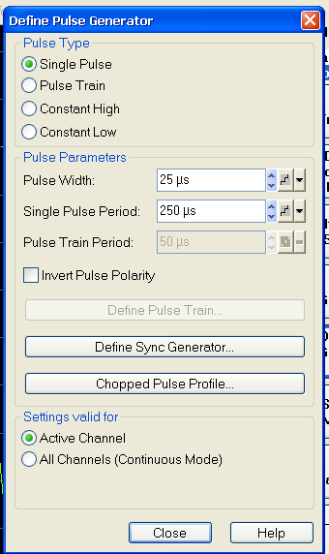
Pulsed RF
To setup pulsed RF:
Mode (hard key) -> Def Pulse Generator
Set Pulse Type to Single Pulse
Set Pulse Width, Period

Slide 11
Pulsed RF
Pulse width must be longer than ZVA, DMM sampling time
ZVA sampling times:

Slide 12
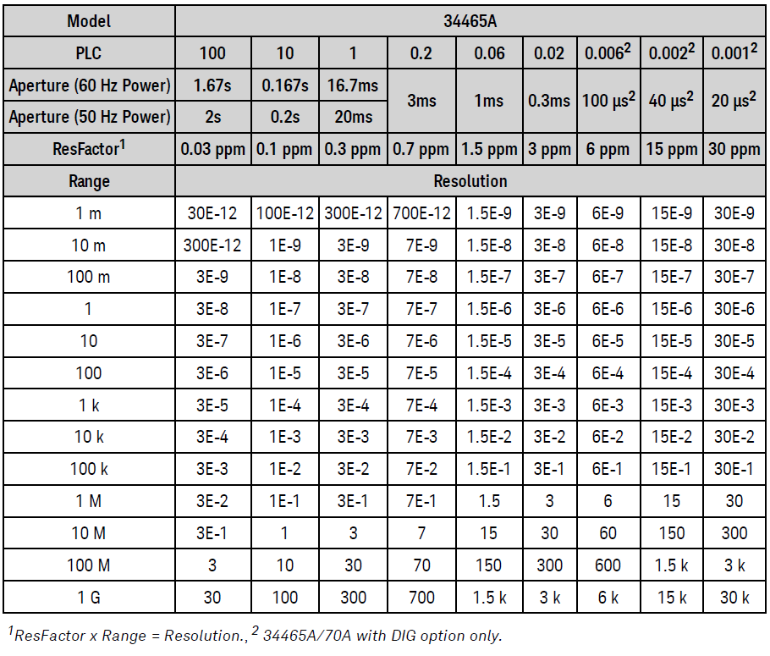
Pulsed RF
Check the documentation for your particular DMM to ensure that sampling times are within the pulsed RF timing.
For illustrative purposes, here are the sampling times for the Keysight 34465A with various settings
For the previous DMM driver example:
Range: 100 mV
PLC: 0.001
Sampling time: 3 µs

Slide 13
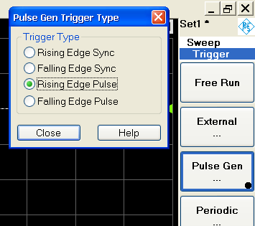
Pulsed RF
Sweep -> Trigger -> Pulse Gen…
Rising Edge Pulse
Pulse Gen... Should be selected

Slide 14
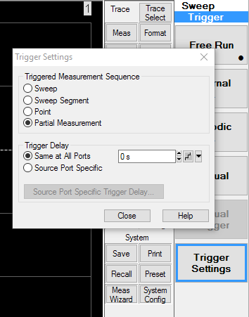
Pulsed RF
Trigger Settings
Triggered Measurement Sequent to Partial Measurement
Trigger Delay (Optional)

Slide 15
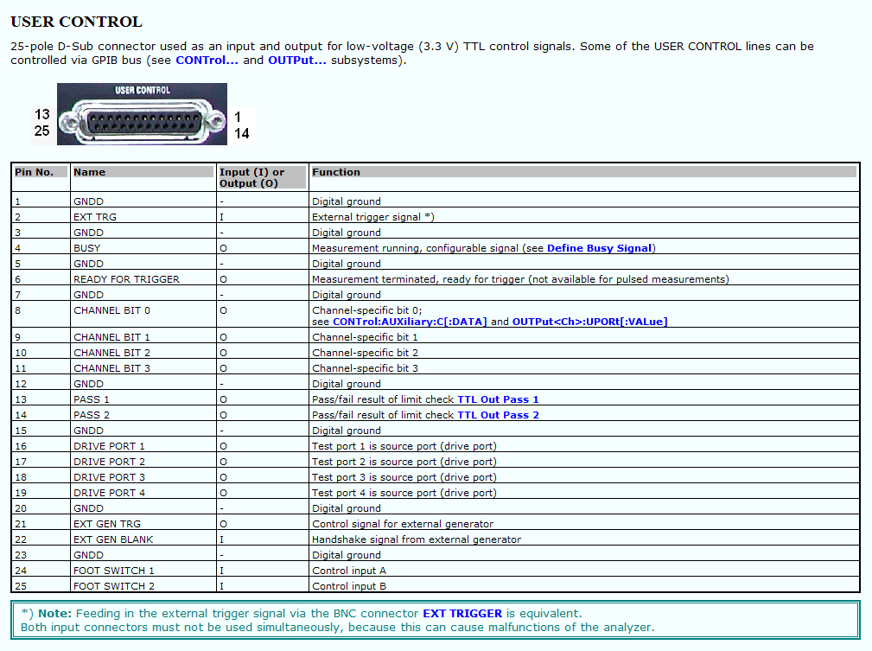
Define Busy Signal
The busy signal is a user-defined signal that indicates the state of measurement of the ZVA
The busy signal is tied to pin 4 of the User Control DB25 connector

Slide 16
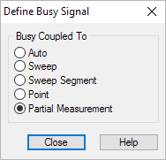
Define Busy Signal
For our purposes, we will define the busy signal to pulse high whenever a source port is driving the DUT
To set busy signal, go to: Sweep (hard key) -> More 1/2 (soft key) -> Define Busy Signal…
Set Busy Coupled To: Partial Measurement

Slide 17
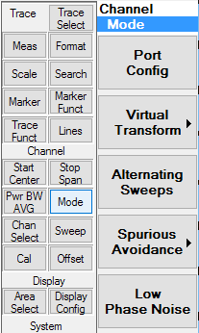
Define Busy Signal
It is also important to know which order the partial measurements are occurring.
Ensure that Alternating Sweeps is disabled.
Mode (hard key) -> Alternating Sweeps (soft key, unchecked)

Slide 18
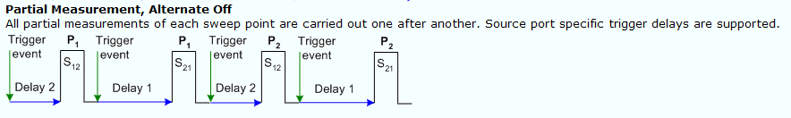
Define Busy Signal
The busy signal and measurement timing should look as follows.
Examples and explanations can be found in the ZVA manual here, specifically expand the “Relation to Trigger Settings” section in this page: https://www.rohde-schwarz.com/webhelp/webhelp_zva/start.htm#mmi_reference/channel/mode/alternate.htm

Slide 19
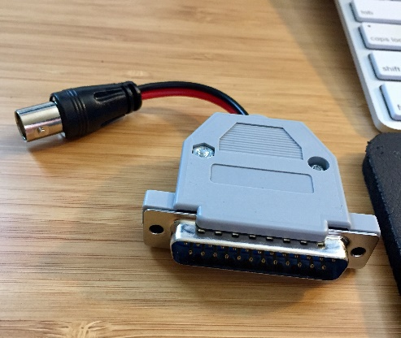
User Control Adapter
To use the User Control - Busy signal with most DMMs a DB25 to BNC adapter is required.
Connect User Control pin 3 (ground) to BNC ground
Connect User Control pin 4 (busy) to BNC signal
The following parts may be helpful:
DB25 male connector kit https://www.amazon.com/dp/B01N21NLJ8/ref=cm_sw_r_cp_dp_T2_asBszbDM54HW1
BNC female connector https://www.amazon.com/dp/B00B889QEO/ref=cm_sw_r_cp_dp_T2_ktBszb0TTNM5D

Slide 20
Contact
Greg Bonaguide Senior Product Line Engineer
Spectrum Analyzers
Vector Network Analyzers
Northeastern Region
+1 (774) 2820028 greg.bonaguide@rsa.rohde-Schwarz.com
Nick Lalic VNA Software Developer
San Francisco, CA
+1 (424) 200-2846 nick.lalic@rsa.rohde-schwarz.com
http://vna.rs-us.net
Phone Support: +1 (888) TEST-RSA

