Slide 1
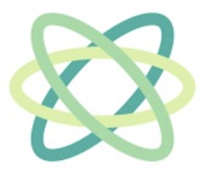
terra labs
terra labs
terralabs
Tether Kickoff
fall 2026 · sep 27

Slide 2

welcome to

Slide 3
today
where this project comes from, where it's going, and how we get there
01
02
03
04
05
who we are
cove
tether
the sim
the plan
your two PMs
the 7-DOF arm we built last spring
turning cove into an inchworm
what's already built in software
roadmap, open questions, first week

Slide 4
pm introductions
two of us: one on hardware, one on software
John Peng
Steve Lu
hardware PM
software PM
ECE sophomore at USC. worked on cove's controls: ROS 2, CAN, MIT-mode torque control, e-stop logic. leads mech + electrical on tether.
leads tether's software: the sim, motion planning, and the controls stack that runs on the robot.

Slide 5
cove
spring 2026
terralabs
where we're starting

Slide 6
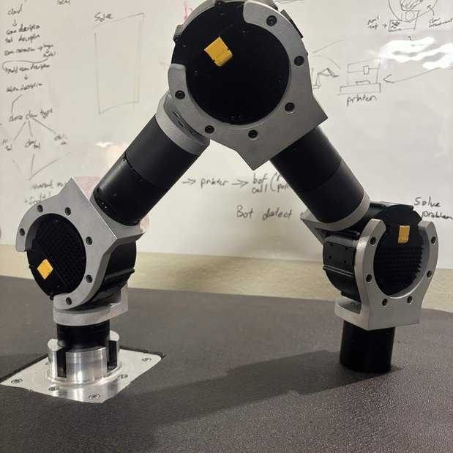
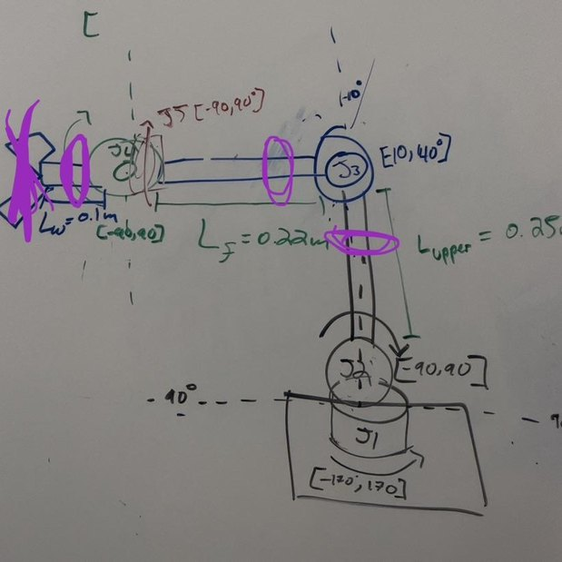
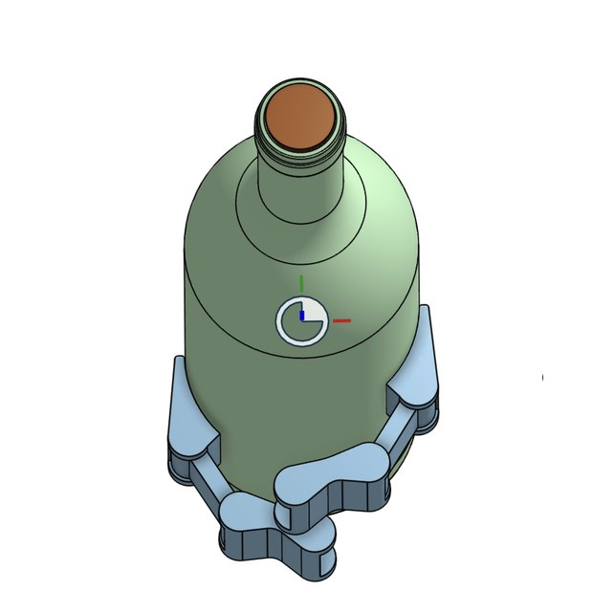
cove: the goal
build a 7-DOF arm from scratch that can pick up and pour a wine bottle
7 joints, Z-X-Z-X-Z-X-Z, symmetric so the same parts could become an inchworm
day zero: sketch it, check reach and torque, start ordering that night
the target: grab the bottle, pour, release

Slide 7
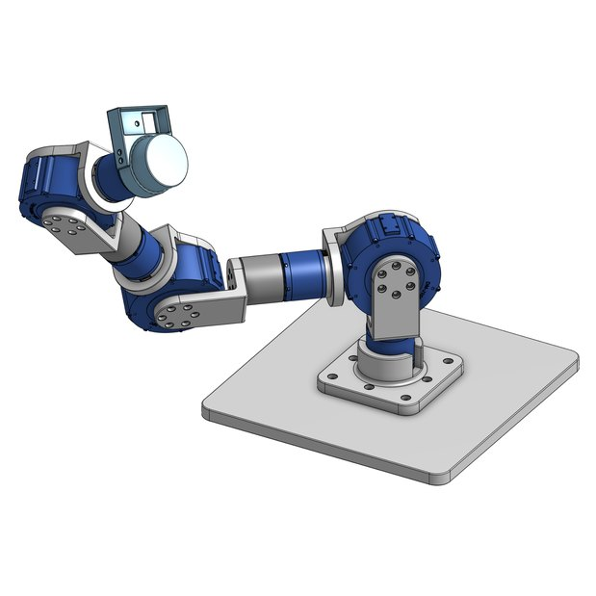
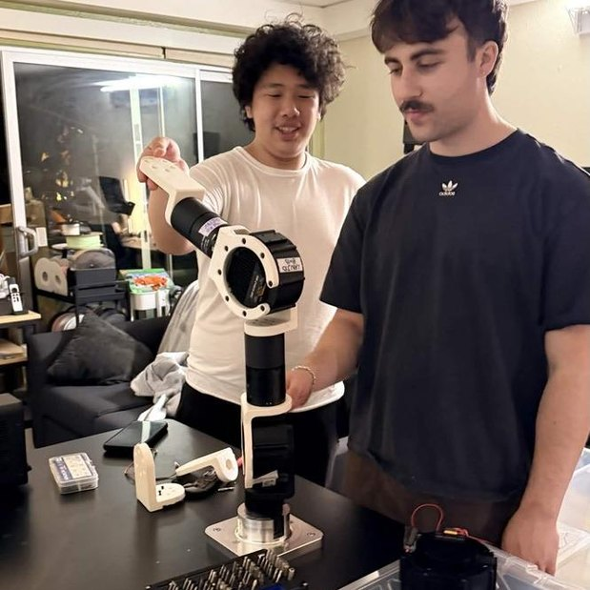
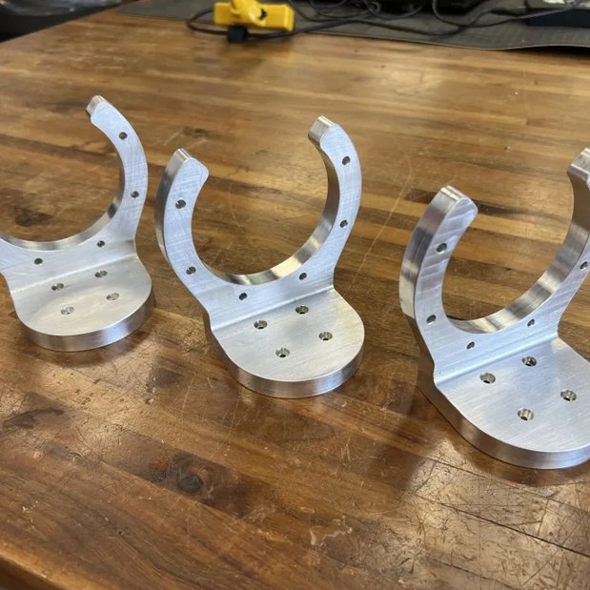
cove: how we built it
size it on paper → CAD → print everything → machine to aluminum
every part pre-sized from stress spreadsheets, then modeled in OnShape
printed every part first to get fitment right. plastic is cheap
1 week on a 3-axis mill: 8 aluminum parts from 3 pieces of stock, $308

Slide 8
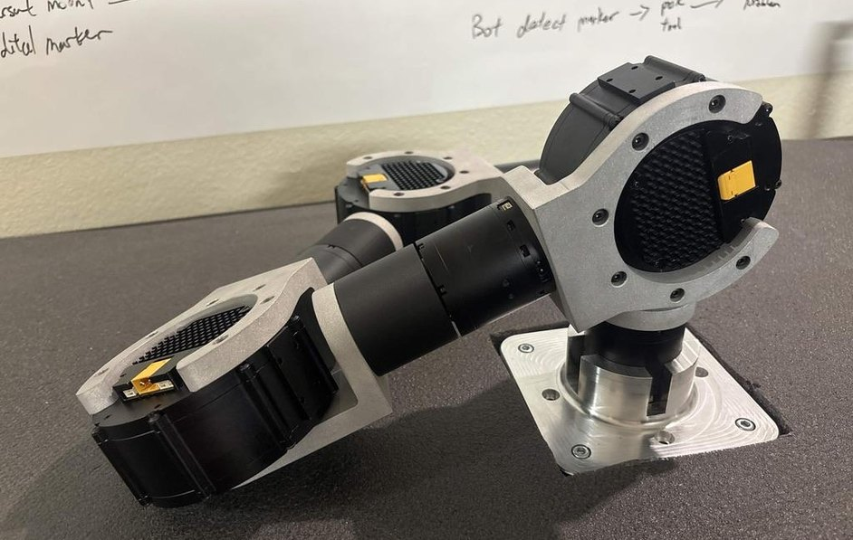
cove by the numbers
what the finished arm could do
7
≈50 Nm
joints on one CAN bus
working torque budget
≈7 kg
$308
payload at full reach
aluminum stock for 8 parts
full assembled arm, before wires

Slide 9
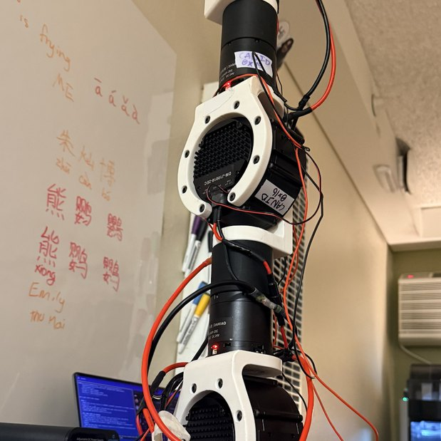
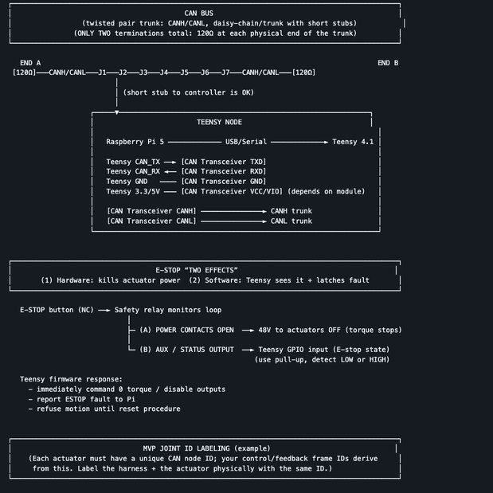
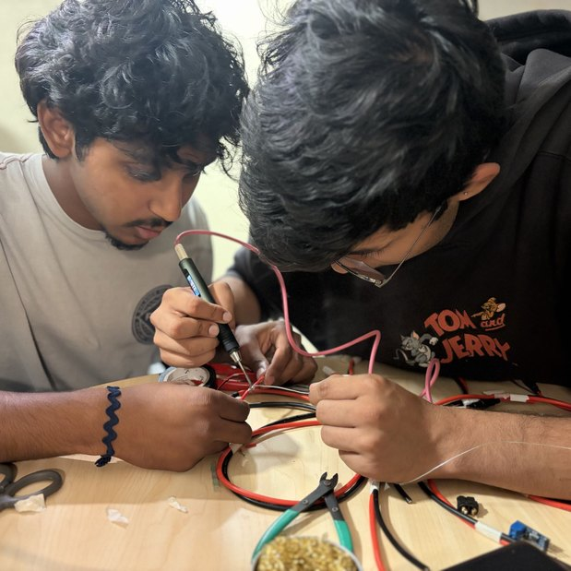
cove: electronics
one CAN bus, one power rail, one host computer
7 Damiao actuators with built-in encoders + torque sensing, daisy-chained on CAN
Raspberry Pi host, CAN/UART bridge, hardware e-stop on motor power
24 V power trunk down the arm (XT-60/XT-30), cables routed with slack

Slide 10
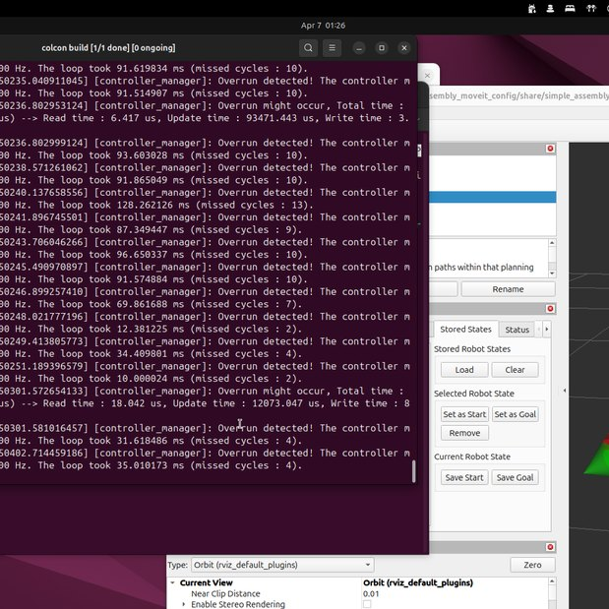
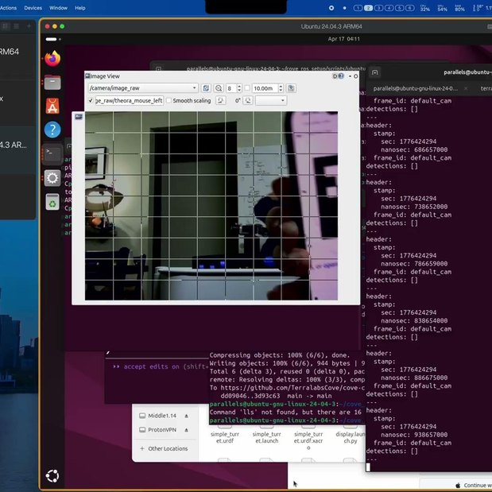
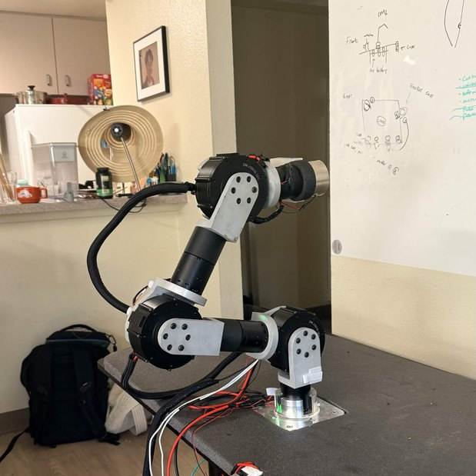
cove: software
ROS 2 on a Raspberry Pi, MoveIt2 for planning, AprilTags to find targets
URDF exported from OnShape → RViz + MoveIt2 for IK and joint commands
camera reads AprilTags → target pose → MoveIt2 plans → CAN → motors
electromagnet end effector: no gripper roll to solve, one less thing for IK

Slide 11
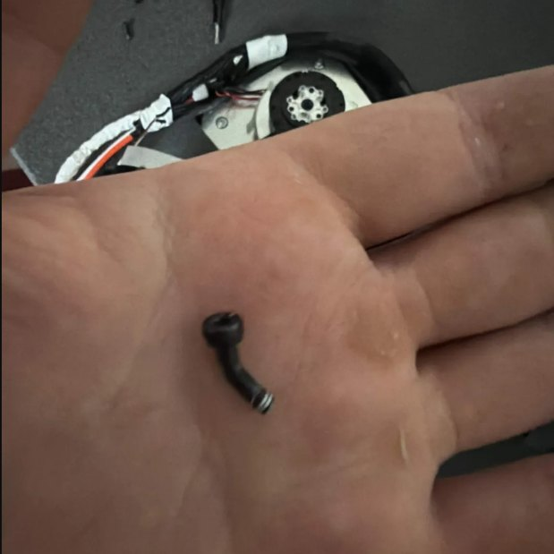
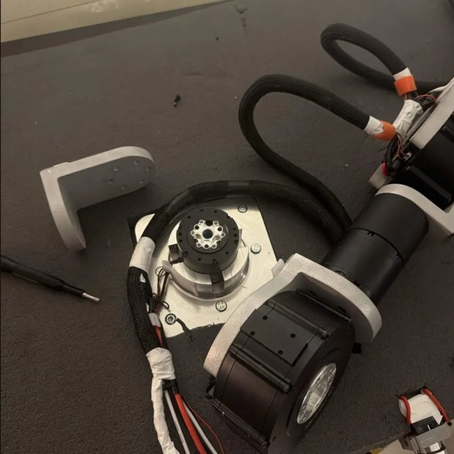
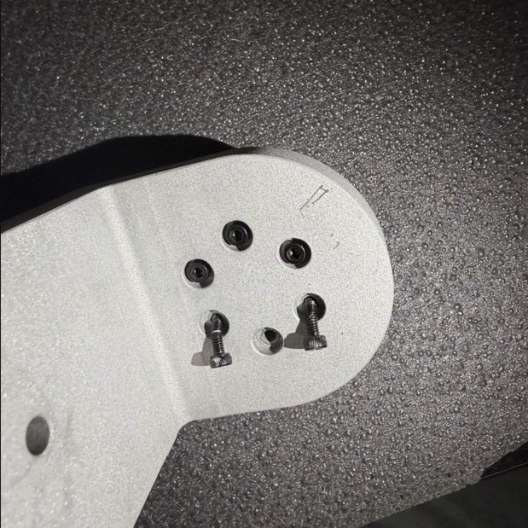
cove: the disaster
apr 26: the bottom threads failed under load and the arm fell. we rewired and rebuilt it
the thread that let go
4 broken actuators, blown fuses, fried CAN ports
stripped holes at the base

Slide 12
tether
fall 2026
terralabs
where we're going

Slide 13
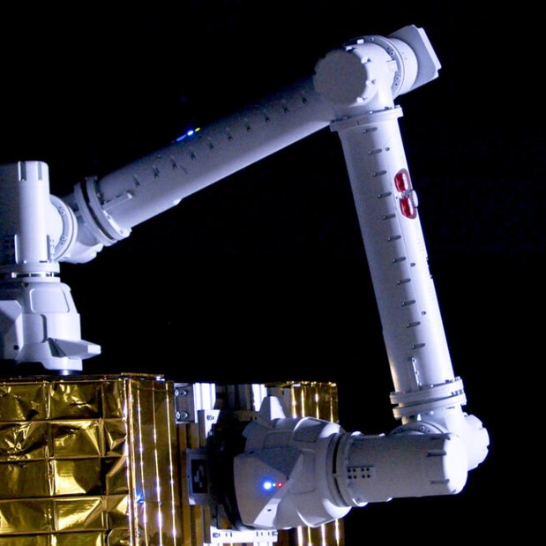
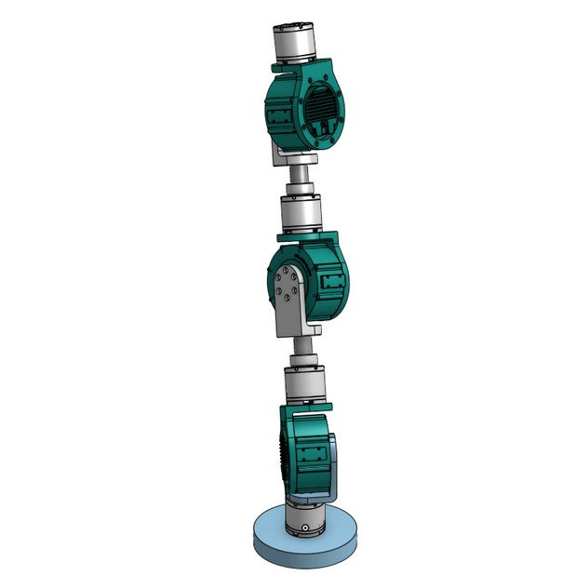
tether: the idea
put a gripper on both ends of cove and let it walk: one end holds on, the other moves
1
A holds on, B swings forward
2
B grabs the next spot
3
A lets go
4
A swings forward, repeat
inspiration: GITAI's IN1, an inchworm arm with grapple end effectors on both ends
no fixed base and no cable to a wall: everything rides on the arm
cove's joint chain is symmetric, so either end can be the base

Slide 14
what changes from cove
 | cove (spring) | tether (fall)
base | bolted to a base plate | none: either end can anchor
end effectors | electromagnet on one end | a gripper on both ends
power | 24 V, 240 A bench supply | onboard battery + BMS
wiring | cables with slack, rotation limited by wiring | slip rings or managed cable winding
compute | Pi on the arm, visuals on a laptop over SSH | onboard, in a closed package
the task | pour a wine bottle | walk, climb, and still manipulate
the tether column is the plan, and most of it is still open. that is what this team is for.

Slide 15
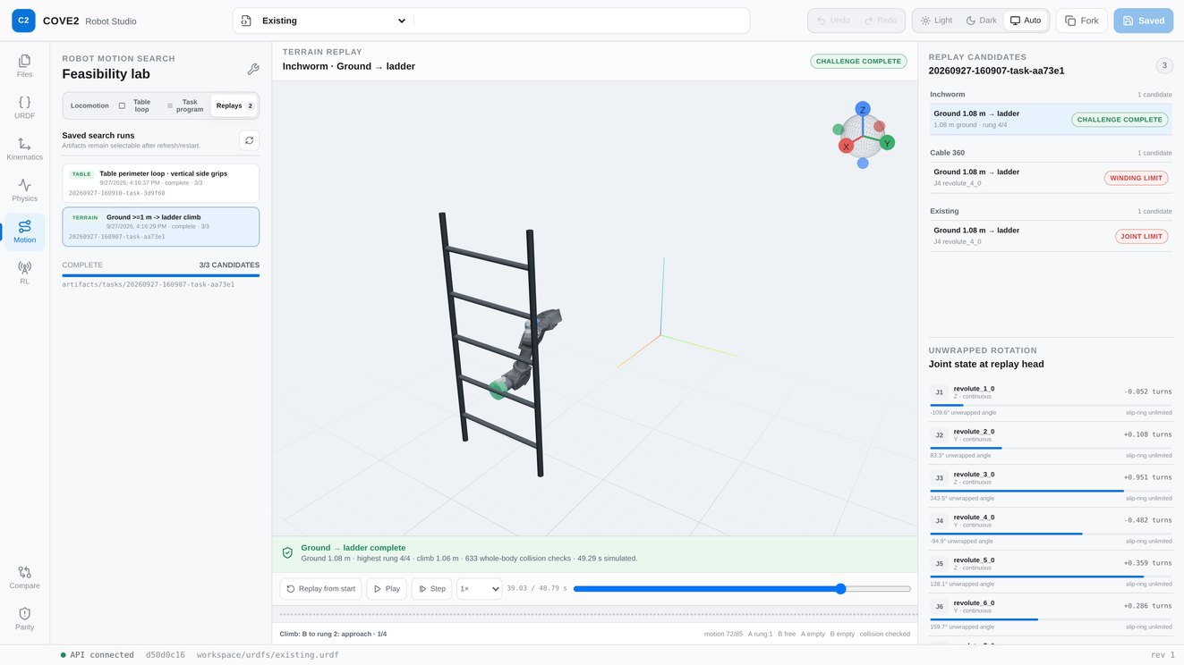
what's already built in software
COVE2 Robot Studio: test the design in a browser before we cut metal
works today
editor built on cove's real URDF
two-ended FK/IK: drive either end
PyBullet collision checks on every motion
motion search: walk → ladder, table loop, task programs
not yet
trained RL (the RL worker is a test harness)
contact, friction, and torque limits
collision geometry checked against the real arm
motion replay: inchworm climbing the ladder, every frame collision checked

Slide 16
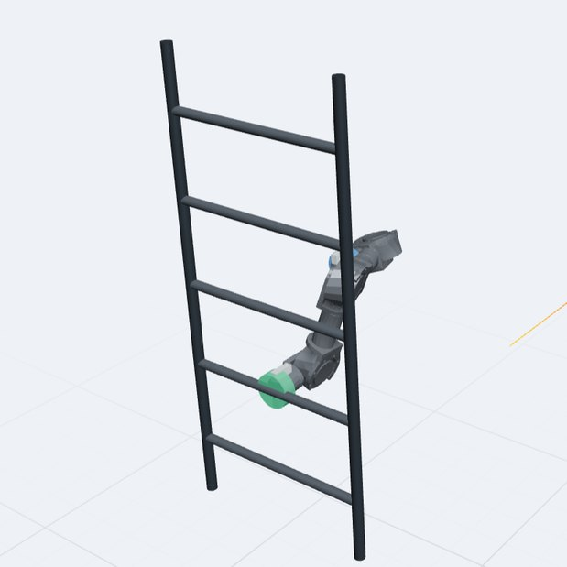
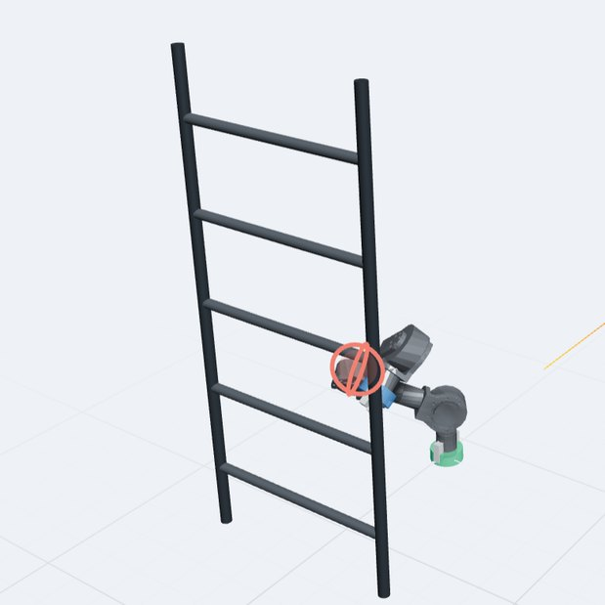
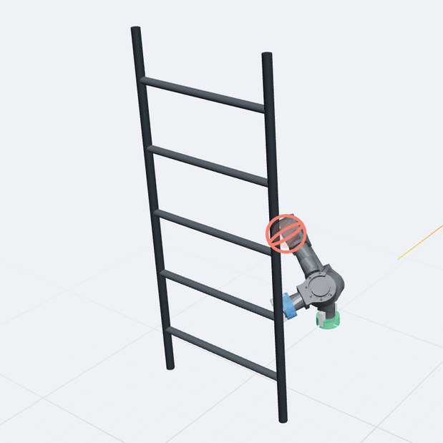
three ways to route wires through the joints
same motions in the sim: only inchworm climbed the ladder and closed the table loop
inchworm (slip rings): walked 1.08 m, climbed all 5 rungs
cable 360 (±360° joints): hit the twist limit before the ladder
existing (cove as built): J4 hit its 145° limit at the ladder
from today's run of the repo sim on cove's URDF, with an assumed ±0.5-turn cable budget. not validated against hardware yet.

Slide 17
roadmap (draft)
software de-risks the design while hardware bench tests the parts, then they meet
software
G0
model freeze: audit cove vs URDF
G1
kinematic feasibility
G2
scripted dynamics
G3
contact + RL robustness
G5
integrated locomotion
first supported steps on the real robot, compared against the sim logs
hardware
G4
gripper pull-off test
G4
battery + BMS bench test
G4
slip ring / cable rotation test
G4
compute thermals + motor watchdogs
done in sim
started
next
rough timing: G0 + G2 in the first month, G3 and the G4 bench tests mid-semester, first G5 steps by the end. we set real dates together.

Slide 18
big open questions
the problems this team gets to solve
01
the grippers
what do both ends grab, and how hard? rungs, table edges, scaffold members
02
wires through joints
slip rings or managed cable winding. the sim already says this decides what motions are possible
03
power on board
a battery + BMS riding on the arm, and the weight that comes with it
04
lifting itself
cove held a payload off a fixed base. tether holds up its own body from either end
05
compute on board
a Pi in a closed package: heat, comms, watchdogs
06
sim to real
the URDF isn't hardware truth yet. audit cove, then trust the sim

Slide 19
where we are
cove is built and moves. tether exists in the sim: on cove's model it can plan a collision-free walk, a ladder climb, and a loop around a table. nothing physical for tether exists yet. that's this semester.
what’s next
first two weeks: everyone gets the sim running, hardware audits cove against the URDF (G0), and we pick gripper concepts to bench test.

Slide 20
terra labs
terra labs
terralabs
questions?

