Slide 1
NETWORK DESIGN PROPOSAL
FOR AIRPORTS
COMPUTER COMMUNICATIONS PROJECT

Slide 2
N E T W O R K D E S I G N P R O P O S A L
F O R A I R P O R T S
TEAM
T E A M M E M B E R S
Muhammad Waseem
RA2011003010905
Aadit Bhargava
RA2011003010920
Sayan Kumar Bag
RA2011003010951
Anant Goyal
RA2011003010959
Vibhor Kumar Dewangan
RA2011003010969
18CSS202J
Computer Communications

Slide 3
N E T W O R K D E S I G N P R O P O S A L
F O R A I R P O R T S
PROJECT SCOPE
The project calls for the design and implementation of a secure network for a modern airport in which we maintain the security ,quality and safety of systems.
Airports are sensitive areas we need a proper design to prevent any unauthorized access from any users. This project helps us build a design that deny access.
18CSS202J
Computer Communications

Slide 4
N E T W O R K D E S I G N P R O P O S A L
F O R A I R P O R T S
OBJECTIVES
To build a highly durable network used in large airports and used by large numbers of users per year.
To build a high throughput network.
To provide a high security level for the airport’s network.
To provide a high quality of service for the airport’s network.
To prevent accidental damage to the network's private data,
its users, or their devices.
To maintain the users’ details in a secure way.
To support the FMS (Flight Management System).
18CSS202J
Computer Communications

Slide 5
N E T W O R K D E S I G N P R O P O S A L
F O R A I R P O R T S
INTRODUCTION
Airports are the sensitive places around the world.
Network Security plays a major role on computer network, especially in where high quality of services are required.
Modern technology takes edge over the primitive ones where lot of energy, resources and time were wasted.
18CSS202J
Computer Communications

Slide 6
N E T W O R K D E S I G N P R O P O S A L
F O R A I R P O R T S
PROBLEM STATEMENT
The project will be used by 3 groups, namely:
Airport Authority
Flight Service Providers
Guests
18CSS202J
Computer Communications

Slide 7
N E T W O R K D E S I G N P R O P O S A L
F O R A I R P O R T S
PROBLEM STATEMENT
Airport Authority
Flight Service Providers
Guests
The airport authority maintains a server which handles the
flight management controls.
They will have access only to the specific server in the airport authority network and not to any other systems.
The guest users have wireless access to a high speed internet connection via password.
18CSS202J
Computer Communications

Slide 8
N E T W O R K D E S I G N P R O P O S A L
F O R A I R P O R T S
PROBLEM STATEMENT
The project is designed to secure the network from
the following threats:
Unauthorized access devices.
DHCP Snooping.
Internal Access.
18CSS202J
Computer Communications

Slide 9
N E T W O R K D E S I G N P R O P O S A L
F O R A I R P O R T S
VLAN TECHNOLOGY
The network design method that we will be using will
be of VLAN methodology.
VLAN (virtual local area network) is also known as a virtual LAN.
This technology can logically partition and isolate one or more physical LANs into multiple broadcast domains.
VLANs allow network administrators to automatically limit access to a specified group of users by dividing workstations into different isolated LAN segments.
18CSS202J
Computer Communications

Slide 10
N E T W O R K D E S I G N P R O P O S A L
F O R A I R P O R T S
WHY VLAN?
A Virtual LAN can prioritize data, separate private and public networks, or secure specific devices.
Administrators can keep data from merging over into the voice traffic lane.
Prioritizing using VLANs helps maintain the quality of service users expect.
Another common use of VLANs is separating private and public networks.
18CSS202J
Computer Communications

Slide 11
N E T W O R K D E S I G N P R O P O S A L
F O R A I R P O R T S
ADVANTAGES OF VLAN
Help with network efficiency by reducing extraneous traffic.
Enhance security by creating a virtual boundary around that business unit.
Improve bandwidth performance by limiting node-to-node and broadcast traffic.
Save workplace disruption, as there is no need to physically match up ports and switches on a network.
18CSS202J
Computer Communications

Slide 12
N E T W O R K D E S I G N P R O P O S A L
F O R A I R P O R T S
DESIGN ANALYSIS
DHCP (Dynamic Host Configuration Protocol) servers established for each switch to provide IP address automatically.
A firewall introduced such that security level for accessing the router and other components is hard.
Airport authorities are given access to all other devices that are connected in the design.
Guest users are denied of accessing other users or servers; only internet is provided.
Flight management can access guest users but not airport authorities.
18CSS202J
Computer Communications

Slide 13
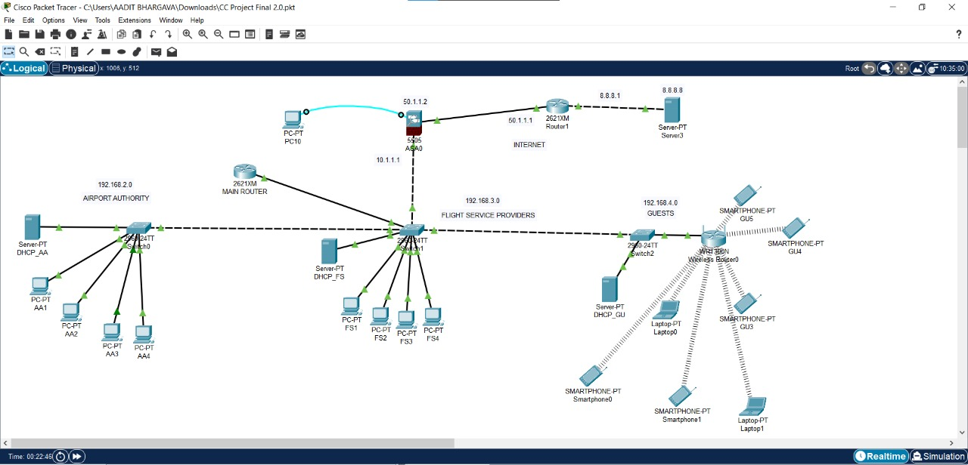
N E T W O R K D E S I G N P R O P O S A L
F O R A I R P O R T S
FINAL TOPOLOGY
18CSS202J
Computer Communications

Slide 14
N E T W O R K D E S I G N P R O P O S A L
F O R A I R P O R T S
FUNCTIONALITIES
Provides connections to the airport authority of 20 users; the flight service providers of 40 users and the maximum numbers of guests are estimated to be 100.
DHCP server is assigning dynamic IP addresses to users on the network.
Once the DHCP server service is on IP is provided automatically.
Firewall protection for the design so no unauthorized connections are made within or outside of the confined switches.
18CSS202J
Computer Communications

Slide 15
N E T W O R K D E S I G N P R O P O S A L
F O R A I R P O R T S
CONCLUSION
In this report, we present the design and deployment of a secure network for airport.
In this project we configured VLAN’s, access and trunk ports and routing protocol and DHCP on switches and provide screenshots and test connectivity in depth.
The proposed system will provide enhanced security, stability and high speed internet to the users at any part.
As a result of these techniques, the airport’s network is ready to provide a secure environment with a high quality of service and safety for the airport’s system and passengers.
18CSS202J
Computer Communications

