Slide 1

I’m Jeff DeRemer
Going to be 47th
Here to discuss one of my plans: Ice Halo

Slide 2
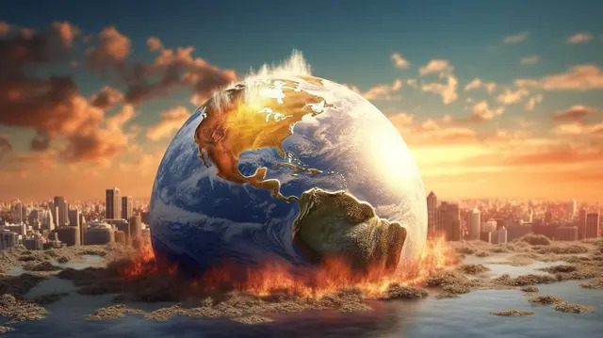
State of the earth, now?
We all share many threats
#1 - Global Warming

Slide 3
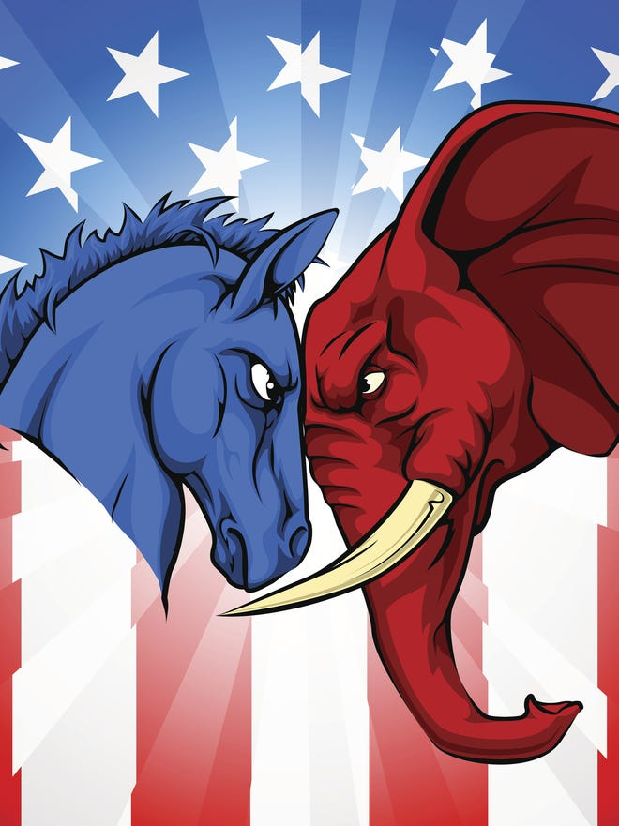
Current political offerings;
Business as usual
= “Fight!”
We are anything but “Business as Usual”

Slide 4
I hate sensationalists
But that’s where we are
It’s not “Coming”
It arrived at our doorstep at the end of last summer
This summer will be our first true taste of Hell on Earth

Slide 5
I can & will address these issues
To do this – we all (and that includes you) need to rise above “The Fight”
We need creative thinkers, able to adapt & respond to whatever is coming our way

Slide 6
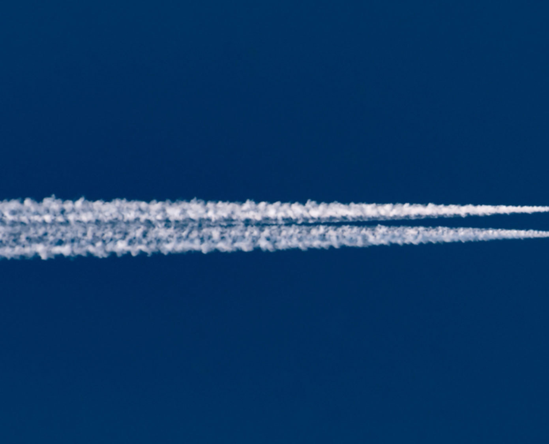
The Big Idea on this one is a miles-wide* ribbon of ice – created by our flying bus infrastructure – which we can use to block the sun’s heat
We are going to create “contrails”
(not by using jet engines)
We create as many of these ribbons as are needed, anywhere they’re requested
Like that -> except ½ mile wide ☺

Slide 7
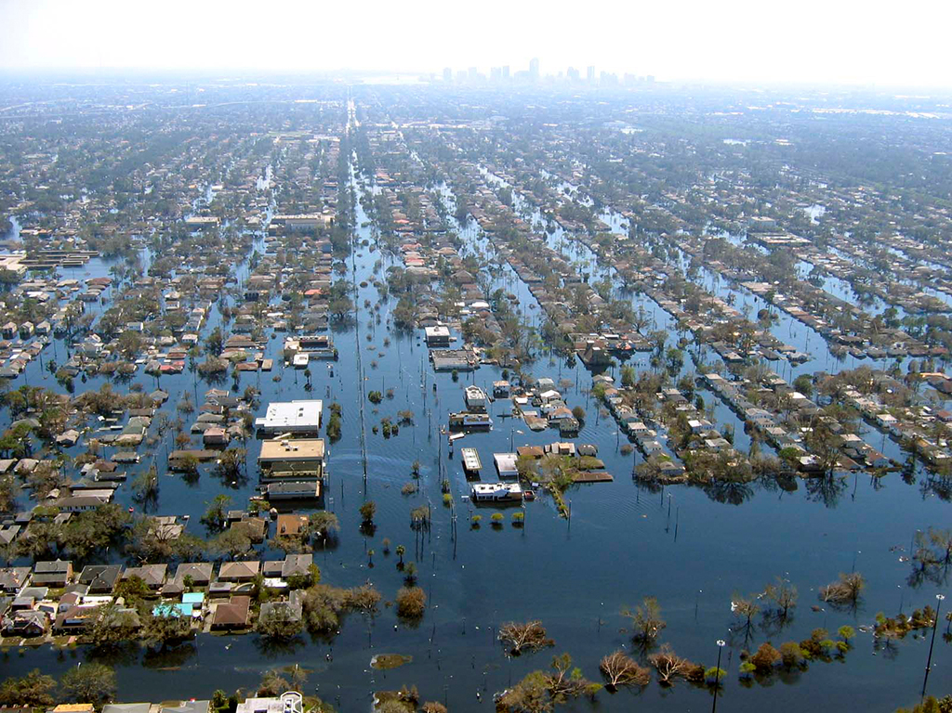
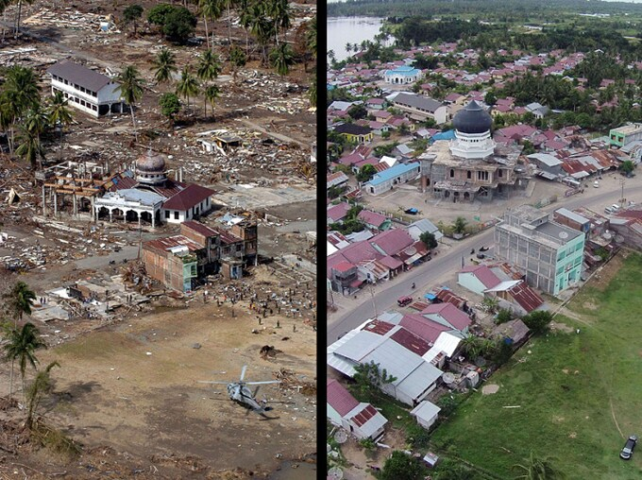
The growing number & intensity of storms is going to peak
2005’s Hurricane Katrina was a warm-up for just how unprepared we are
The real storms are coming up, over these next few summers
Starting this year

Slide 8
Also – someone who can tackle the big 3:
Oil & Gas
Plastics
Transportation

Slide 9
If something here was interesting to you – please let me hear from you:

