Slide 1
PROJECT EVALUATION

Slide 2
Strategic Assessment
Technical Assessment
Cost Benefit Analysis
Cashflow Forecasting
Cost Benefit Evaluation techniques
Risk Evaluation

Slide 3
PROJECT EVALUATION
Project evaluation is normally carried out in step 0 of stepwise
Project evaluation is a step by step process of collecting, recording and organizing information about
  Project results
  short - term outputs (immediate results of activities or project deliverables)
  Long – term outputs (changes in behaviour , practice or policy resulting from the result.

Slide 4
Why is project evaluation important:
project evaluation is important for answering the following questions-
- what progress has been made?
- were the desired outcomes achieved? Why?
- whether the project can be refined to achieve better outcomes?
- do the project results justify the project inputs?
What are the challenges in monitoring and evaluation?
- getting the commitment to do it.
- establishing base lines at the beginning of the project.
- identifying realistic quantitative and qualitative indicator.
- finding the time to do it and stricking to it.
- getting feedback from your stakeholders.
- reporting back to your stakeholders.

Slide 5
STRATEGIC ASSESSMENT
WHAT IS STRATEGIC PLANNING?
Strategic planning is defined as an organization’s process of defining its strategy , or direction and making decisions on allocating its resources to pursue this strategy, including its capital and people
- it deals with:
- what do we do?
- for whom do we do it?
- how do we excel?

Slide 6
STRATEGIC ASSESSMENT is the first criteria for project evaluation
  For evaluating and managing the projects, the individual projects should be seen as components of a programme. Hence need to do programme management.
Programme management:
D.C. Ferns defined “a programme as a group of projects that are managed in a co-ordinated way to gain benefits that would not be possible were the projects to be managed independently”.
A programme in this context is a “collection of projects that all contribute to the same overall organization goals”.
Effective programme management requires that there is a well defined programme goal and that all the organization’s projects are selected and tuned to contribure to this goal”

Slide 7
Evaluating of project is depends on:
  How it contributes to programme goal.
  It is viability [ capability of developing or useful].
  Timing.
  Resourcing.
For successful strategic assessment, there should be a strategic plan which defines:
  Organization’s objectives.
  Provides context for defining programme
  Provides context for defining programme goals.
  Provide context for accessing individual project.

Slide 8
In large organization, programme management is taken care by programme director and programme executive , rather than, project manager, who will be responsible for the strategic assessment of project.
Any potential software system will form part of the user organization’s overall information system and must be evaluated within the context of existing information system and the organization’s information strategy.
If a well – defined information system does not exist then the system development and the assessment of project proposals will be based on a more “piece meal approach”.
Piece meal approach is one in which each project being individually early in its life cycle.
Notes:
than,

Slide 9
Typical issues and questions to be considered during strategic assessment
Issue – 1: objectives:
  How will the proposed system contribute to the organization’s stated objectives? How, for example, might it contribute to an increase in market share?
Issue – 2: is plan
  How does the proposed system fit in to the IS plan? Which existing system (s) will it replace/interface with? How will it interact with systems proposed for the later development?

Slide 10
Issue – 3: organization structure:
  What effect will the new system have on the existing departmental and organization structure?
  For example, a new sales order processing system overlap existing sales and stock control functions?
Issue – 4: MIS:
  What information will the system provide and at what levels in the organization? In what ways will it complement or enhance existing management information system?
Issue – 5: personnel:
  In what way will the system proposed system affect manning levels and the existing employee skill base? What are the implications for the organization’s overall policy on staff development.
Issue – 6: image:
  What, if any, will be the effect on customer’s attitudes towards the organization? Will the adoption of, say, automated system conflict with the objectives of providing a friendly service?

Slide 11
Programmes may be
Strategic – several projects together can implement a single strategy
  Merging of two organizations could involve the creation of unified payroll and accounting applications
Business cycle programmes – collection so projects that an organization undertakes within a particular planning cycle is referred to as a portfoilo
  Projects to implement within the budget within the accounting period
Infrastructure programmes – sharing of application between departments
Research and development programmes-risk associated with an innovative projects fluctuate
Innovative partnerships - www
Notes:
Strategic
Several projects together implement a single strategy. For example, merging two organizations will involve many different activities e.g. physical re-organization of offices, redesigning the corporate image, merging ICT systems etc. Each of these activities could be project within an overarching programme.
Business cycle programmes
A portfolio of project that are to take place within a certain time frame e.g. the next financial year
Infrastructure programmes
In an organization there may be many different ICT-based applications which share the same hardware/software infrastructure
Research and development programmes
In a very innovative environment where new products are being developed, a range of products could be developed some of which are very speculative and high-risk but potentially very profitable and some will have a lower risk but will return a lower profit. Getting the right balance would be key to the organization’s long term success
Innovative partnerships
e.g. pre-competitive co-operation to develop new technologies that could be exploited by a whole range of companies

Slide 12
Programme managers versus project managers
Programme manager
  Many simultaneous projects
  Personal relationship with skilled resources
  Optimization of resource use
  Projects tend to be seen as similar
Project manager
  One project at a time
  Impersonal relationship with resources
  Minimization of demand for resources
  Projects tend to be seen as unique
Notes:
The programme manager may well have a pool of staff upon which to call. He/she will be concerned with ensuring the best use of staff e.g ensuring that staff have regular work with no periods of enforced idleness between project tasks. The project leader would think in terms of ‘I need a Java programmer for four weeks’ without being concerned which specific person it is (beyond obvious concerns that they are fully capable).

Slide 13
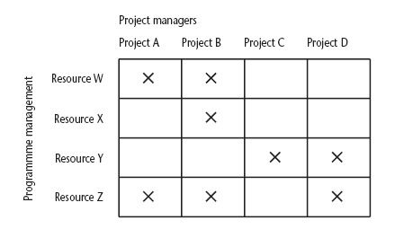
Projects sharing resources
Notes:
During the resource allocation phase of project planning – see chapter/lecture 8 on resource allocation – some project activities could be delayed while waiting for a resource to become available.

Slide 14
Strategic programmes
Different form of programme management is where a portfolio of projects all contribute to a common objective.
    Business objective might be to present a consistent and uniform front to the clients.
Based on OGC guidelines
  PRINCE & PRINCE2 project management
Notes:
The material here is based on the UK government’s Office of Government Commerce (OGC) approach which is described in detail in their publication Managing successful programmes.
The programme director should be someone who is in a prominent position in the organization so that the seriousness and commitment of the organization to the programme are made clear.
An example of what might be a programme is given in Section 3.4 in the text. It might be found at the IOE company that the customers’ experience of the organization can be very variable and inconsistent. The employee who records the customer’s requirements is different from the people who actually carry out the work and different again from the clerk who deals with accounts. Different maintenance engineers deal with different types of equipment. A business objective might be to present a consistent and uniform interface to the client. This objective might need changes to a number of different systems which until now have been largely self-contained. The work to reorganize each individual area might be treated as separate projects, co-ordinated at a higher level as a programme.

Slide 15
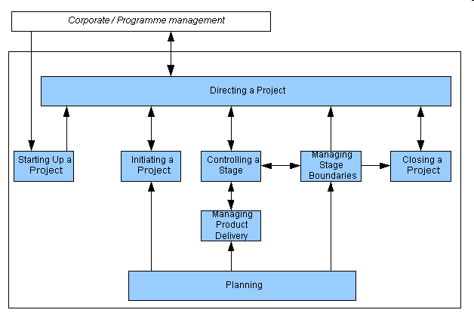
Prince2

Slide 16
Creating a programme - PPVB
Initial planning document is the Programme Mandate describing
  The new services/capabilities that the programme should deliver
  How an organization will be improved
  Fit with existing organizational goals
A programme director appointed a champion for the scheme

Slide 17
The programme brief – equivalent of a feasibility study for the programme
  Vision statement
  The benefits
  Risks and issues
  Estimated costs, timescales and effort
The vision statement – explains the new capability that programme will give the organization
Notes:
The programme brief – is it worth it?
The vision statement – the ‘what’
The blueprint – the ‘how’

Slide 18
The blueprint – explains the changes to be made to obtain the new capability
  Business models outlining the new processes required
  Organizational structure – including the numbers of staff required in the new systems and skills they will need
  The information systems, equipment and other, non staff resources – needed
  Data and information requirement
  Costs, performance and service level requirements

Slide 19
Aids to programme management
Dependency diagrams
  System study/design
  Corporate image design
  Build common systems
  Relocate offices
  Training
  Data migration
  Implement corporate interface

Slide 20
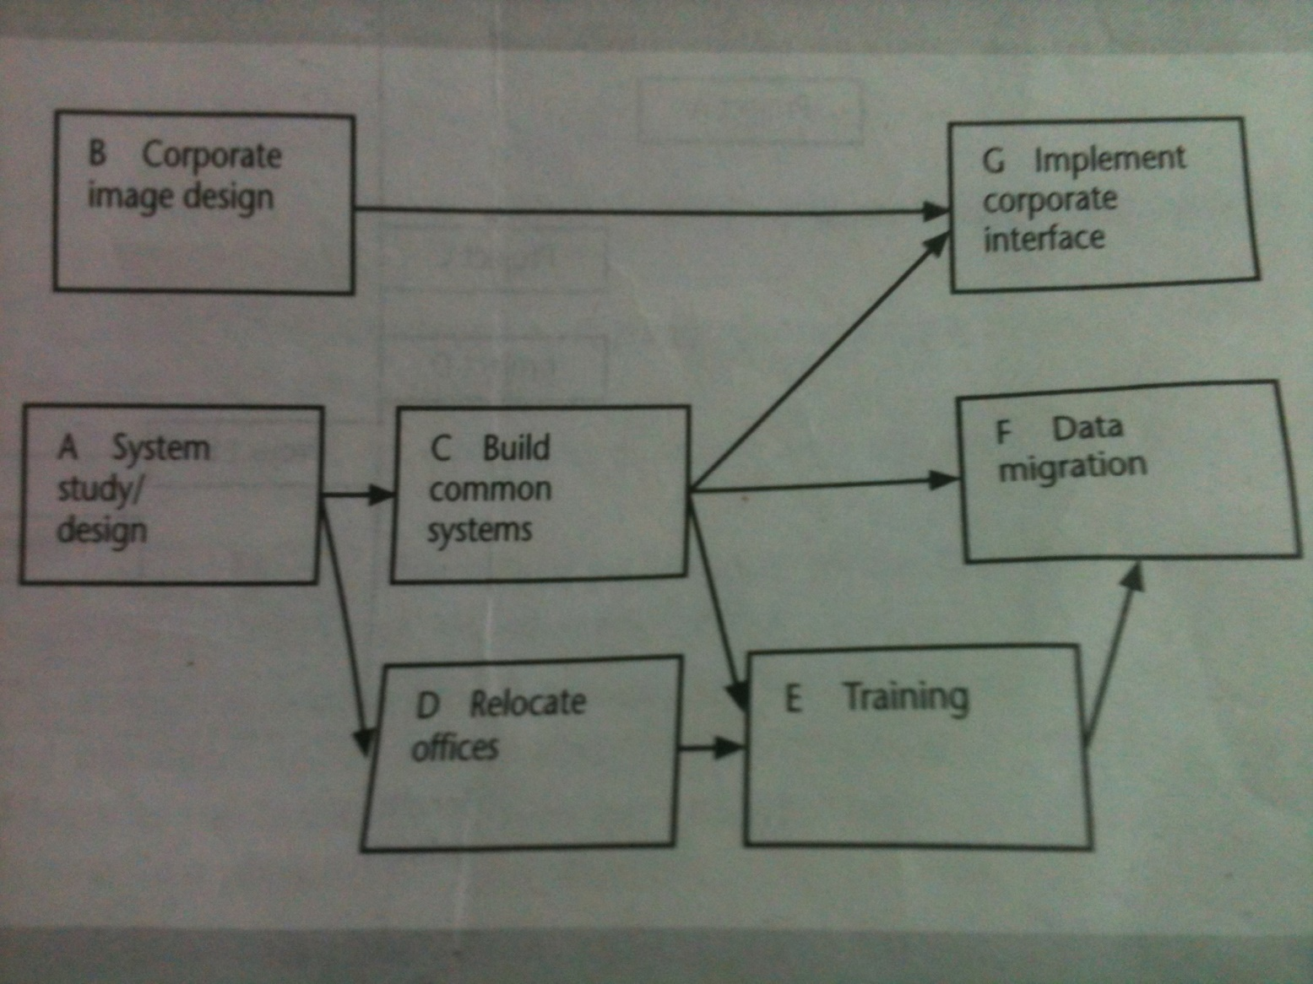

Slide 21
Delivery planning
  Delivery dependency diagram – precursor to programme planning
  Tranche is a group of projects that will deliver their products as one step in the programme
  Tranches – deliverables – tangible benefits

Slide 22
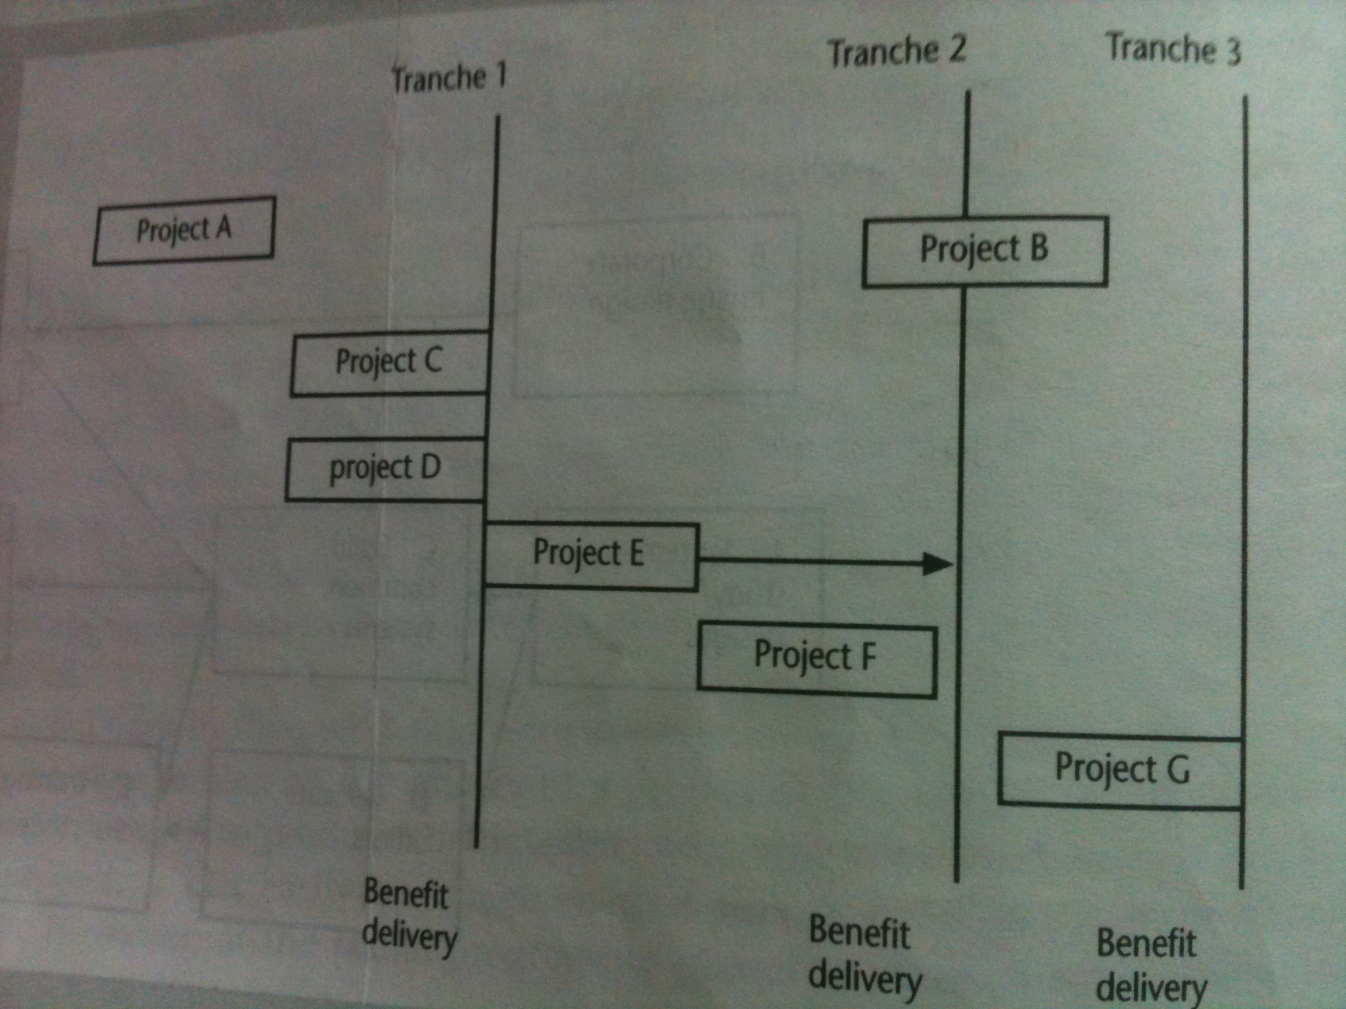

Slide 23
Portfolio management
  Strategic and operational assessment carried by an organization on behalf of customer is called portfolio management [third party developers]
  They make use of assessment of any proposed project themselves.
  They ensure for consistency with the proposed strategic plan.
  They proposed project will form part of a portfolio of ongoing and planned projects
Selection of projects must take account of possible effects on other projects in the portfolio( example: competition of resource) and the overall portfolio profile( example: specialization versus diversification).

Slide 24
Technical assessment
  It is the second criteria for evaluating the project.
  Technical assessment of a proposed system evaluates functionality against available:
    Hardware
    Software
Limitations
  Nature of solutions produced by strategic information systems plan
  Cost of solution. Hence undergoes cost-benefit analysis.

Slide 25
Economic Assessment
COST BENEFIT ANALYSIS
It is one of the important and common way of carrying “economic assessment” of a proposed information system.
This is done by comparing the expected costs of development and operation of the system with its benefits.
So it takes an account:
    Expected cost of development of system
    Expected cost of operation of system
    Benefits obtained
Assessment is based on:
    Whether the estimated costs are executed by the estimated income.
    And by other benefits
For achieving benefit where there is scarce resources, projects will be prioritized and resource are allocated effectively.
The standard way of evaluating economic benefits of any project is done by “cost benefit analysis”

Slide 26
Cost benefit analysis comprises of two steps:
Step-1: identifying and estimating all of the costs and benefits of carrying out the project.
Step-2: expressing these costs and benefits in common units.
Step-1:
  It includes
    Development cost of system.
    Operating cost of system.
    Benefits obtained by system.
  When new system is developed by the proposed system, then new system should reflect the above three as same as proposed system.
Example: sales order processing system which gives benefit due to use of new system.

Slide 27
Step-2:
  Calculates net benefit.
  Net benefit = total benefit = total cost.
  (cost should be expressed in monetary terms).
Three types of cost
Development costs: includes salary and other employment cost of staff involved.
Setup costs: includes the cost of implementation of system such as hardware, and also file conversion, recruitment and staff training.
Operational cost: cost require to operate system, after it is installed.

Slide 28
Three categories of benefits:
Direct benefits: directly obtained benefit by making use of/operating the system.
Example: reduction of salary bills, through the introduction of a new , computerized system.
Assessable indirect benefits: these benefits are obtained due to updation / upgrading the performance of current system. It is also referred as “secondary benefits”.
Example: “use of user – friendly screen”, which promotes reduction in errors, thus increases the benefit.
Intangible benefits: these benefits are longer term, difficult to quantify. It is also referred as “indirect benefits”.
Example: enhanced job interest leads reduction of staff turnover, inturn leads lower recruitment costs.

Slide 29
CASH FLOW FORCASTING
It estimate overall cost and benefits of a product with respect to time.
-ive cashflow during development stage.
+ive cashflow during operating life.
During development stage
Staff wages
Borrowing money from bank
Paying interest to bank
Payment of salaries
Amount spent for installation, buying hw and sw
Income is expected by 2 ways.
Payment on completion
Stage payment

Slide 30
Cost Benefit Evaluation techniques

Slide 31
Cost Benefit Evaluation techniques
It consider
the timing of the costs and benefits
the benefits relative to the size of the investment
Common method for comparing projects on the basic of their cash flow forecasting.
1) Net profit
2) Payback Period
3) Return on investment
4) Net present Value
5) Internal rate of return

Slide 32
Net profit
Net profit
calculated by subtracting a company's total expenses from total income.
showing what the company has earned (or lost) in a given period of time (usually one year).
also called net income or net earnings.
Net profit=total costs-total incomes

Slide 33
Calculate net profit.
Year | Project1 | Project2 | project3
0 | -100000 | -1,000,000 | -120000
1 | 10,000 | 2,00000 | 30,000
2 | 10,000 | 2,00000 | 30,000
3 | 10,000 | 2,00000 | 30,000
4 | 20,000 | 2,00000 | 30,000
5 | 100000 | 3,00000 | 75,000

Slide 34
Calculate net profit.(-ive total cost or total investment)
Year | Project1 | Project2 | project3
0 | -100000 | -1,000,000 | -120000
1 | 10,000 | 2,00000 | 30,000
2 | 10,000 | 2,00000 | 30,000
3 | 10,000 | 2,00000 | 30,000
4 | 20,000 | 2,00000 | 30,000
5 | 100000 | 3,00000 | 75,000
Net profit | 50,000 | 1,00,000 | 75,000

Slide 35
Payback Period
The payback period is the time taken to recover the initial investment.
Or
is the length of time required for cumulative incoming returns to equal the cumulative costs of an investment
Advantages
simple and easy to calculate.
It is also a seriously flawed method of evaluating investments
Disadvantages
It attaches no value to cashflows after the end of the payback period.
It makes no adjustments for risk.
It is not directly related to wealth maximisation as NPV is.
It ignores the time value of money.
The "cut off" period is arbitrary.

Slide 36
Calculate Payback Period
Year | Project1 | Project2 | project3
0 | -100000 | -1,000,000 | -120000
1 | 10,000 | 2,00000 | 30,000
2 | 10,000 | 2,00000 | 30,000
3 | 10,000 | 2,00000 | 30,000
4 | 20,000 | 2,00000 | 30,000
5 | 100000 | 3,00000 | 75,000

Slide 37
Payback Period
Project1 =10,000+10,000+10,000+20,000+1,00,000=1,50,000
Project 2= 2,00,000+2,00,000+2,00,000+2,00,000+3,00,000=11,000,00
Project 3= 30,000+30,000+30,000+30,000 + 75,000 =1,95,000
It ignores any benefits that occur after the payback
period and, therefore, does not measure profitability.
It ignores the time value of money.

Slide 38
RETURN ON INVESTMENT or ACCOUNTING RATE OF RETURN
It provides a way of comparing the net profitability to the investment required.
Or
A performance measure used to evaluate the efficiency of an investment or to compare the efficiency of a number of different investments
Disadvantages
It takes no account of the timing of the cash flows.
Rate of returns bears no relationship to the interest rates offered or changed by bank.

Slide 39
RETURN ON INVESTMENT
ROI = average annual profit * 100
total investment
average annual profit = net profit
total no. of years

Slide 40
Calculate ROI for project 1.
Ans: Total investment =1,00,000
Net profit = 50,000
Total no. of year = 5
Average annual profit=50,000/5=10,000rs
ROI= (10,000/1,00,000) *100 = 10%

Slide 41
Ex1
Calculate the ROI for the following projects and comment, which is the most worthwile.
Investment Netprofit
Project1 150000 50000
Project2 1,000000 1,00000
Project3 450000 40,000
The period of above project is 5 years.

Slide 42
Ex2.
There are two projects x and y. each project requires an investment of rs 20,000. you are required to rank these projects according to the pay back method from the following information.
Year projectx projecty
1 1000 2000
2 2000 4000
3 4000 6000
4 5000 8000
5 8000

Slide 43
Net present value (NPV)
Discounted Cash Flow (DCF) is a cash flow summary adjusted to reflect the time value of money. DCF can be an important factor when evaluating or comparing investments, proposed actions, or purchases. Other things being equal, the action or investment with the larger DCF is the better decision. When discounted cash flow events in a cash flow stream are added together, the result is called the Net Present Value (NPV).
When the analysis concerns a series of cash inflows or outflows coming at different future times, the series is called a cash flow stream. Each future cash flow has its own value today (its own present value). The sum of these present values is the Net Present Value for the cash flow stream.
The size of the discounting effect depends on two things: the amount of time between now and each future payment (the number of discounting periods) and an interest rate called the Discount Rate.

Slide 44

The example shows that:
As the number of discounting periods between now and the cash arrival increases, the present value decreases.
As the discount rate (interest rate) in the present value calculations increases, the present value decreases.

Slide 45
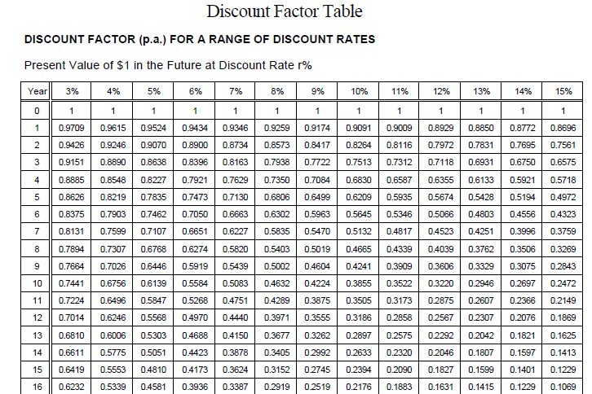

Slide 46
Applying discount factors
Year | Cash-flow | Discount factor(discount rate 10%) | Discounted cash flow
0 | -100,000 | 1.0000 | -100,000
1 | 10,000 | 0.9091 | 9,091
2 | 10,000 | 0.8264 | 8,264
3 | 10,000 | 0.7513 | 7,513
4 | 20,000 | 0.6830 | 13,660
5 | 100,000 | 0.6209 | 62,090
 |  | NPV | 618
Click for more info
The figure of RM618 means that RM618 more would be made than if the money were simply invested at 10%. An NPV of RM0 would be the same amount of profit would be generated as investing at 10%.
Notes:
NPV is the sum of the discounted cash flows for all the years of the ‘project’ (note that in NPV terms the lifetime of the completed application is included in the ‘project’)
The figure of RM618 means that RM618 more would be made than if the money were simply invested at 10%. An NPV of RM0 would be the same amount of profit would be generated as investing at 10%.

Slide 47
Example: Comparing Competing Investments with NPV.
Consider two competing investments in computer equipment. Each calls for an initial cash outlay of $100, and each returns a total a $200 over the next 5 years making net gain of $100. But the timing of the returns is different, as shown in the table below (Case A and Case B), and therefore the present value of each years return is different. The sum of each investments present values is called the Discounted Cash flow (DCF) or Net Present Value (NPV). Using a 10% discount rate
Timing | Discount Rate(10%) | CASE A |  | CASE B
 |  | Net Cash Flow | Present Value | Net Cash Flow | Present Value
Now 0 | 1 | – $100.00 | – $100.00 | – $100.00 | – $100.00
Year 1 | 0.9091 | $60.00 | $54.54 | $20.00 | $18.18
Year 2 | 0.8264 | $60.00 | $49.59 | $20.00 | $16.52
Year 3 | 0.7513 | $40.00 | $30.05 | $40.00 | $30.05
Year 4 | 0.6830 | $20.00 | $13.70 | $60.00 | $41.10
Year 5 | 0.6209 | $20.00 | $12.42 | $60.00 | $37.27
Total |  | Net CF_{A} = $100.00 | NPV_{A} = $60.30 | Net CF_{B} = $100.00 | NPV_{B} = $43.12

Slide 48
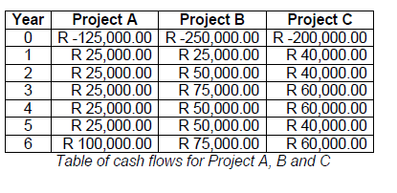
Ex :3

Slide 49
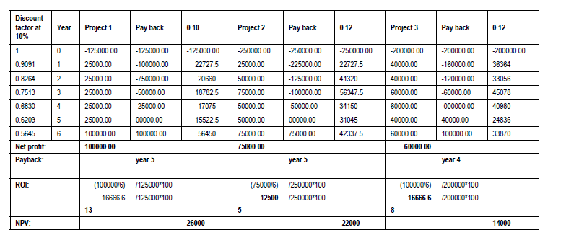
Solution

Slide 50
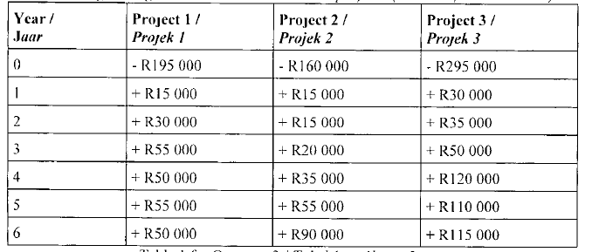
Ex:4

Slide 51
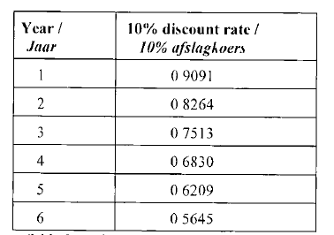

Slide 52
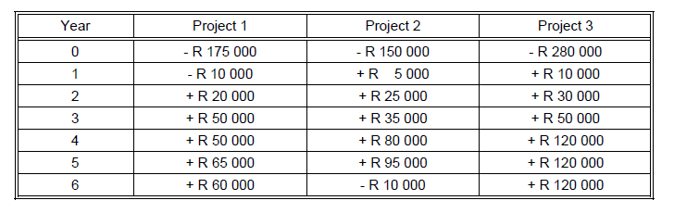
Ex : 5
Consider the following fictitious scenario and some questions related to it. The table below gives the estimated cash flow for three different projects

Slide 53
Based on the above table, answer the following questions:
1 Calculate the net profit of each project.
2 Based on your answer to Question 1 above, which project would you select to develop?
3 Using the shortest payback method as discussed in Hughes and Cotterell, which
project would you now select for development and why?
4 Calculate the Return on Investment (ROI) of each of these projects.
5 Based on your calculation of the ROI of each project in Question 4 above, which
project would you select to develop?
6 Assume a discount rate of 12%. Calculate the Net Present Value (NPV) of each
project.
7 Based on your calculation of each project’s NPV, which project would you now select for development? In general, what conclusion do you reach regarding the viability of these projects? (Base your answer on the NPVs of each project.)
Ans a16.pdf

Slide 54
IRR (Internal Rate Return)
The IRR compares returns to costs by asking: "What is the discount rate that would give the cash flow stream a net present value of 0?"
Timing | Discount Rate(10%) | CASE A |  | CASE B
 |  | Net Cash Flow | Present Value | Net Cash Flow | Present Value
Now 0 | 1 | – $100.00 | – $100.00 | – $100.00 | – $100.00
Year 1 | 0.9091 | $60.00 | $54.54 | $20.00 | $18.18
Year 2 | 0.8264 | $60.00 | $49.59 | $20.00 | $16.52
Year 3 | 0.7513 | $40.00 | $30.05 | $40.00 | $30.05
Year 4 | 0.6830 | $20.00 | $13.70 | $60.00 | $41.10
Year 5 | 0.6209 | $20.00 | $12.42 | $60.00 | $37.27
Total |  | Net CF_{A} = $100.00 | NPV_{A} = $60.30 | Net CF_{B} = $100.00 | NPV_{B} = $43.12

Slide 55
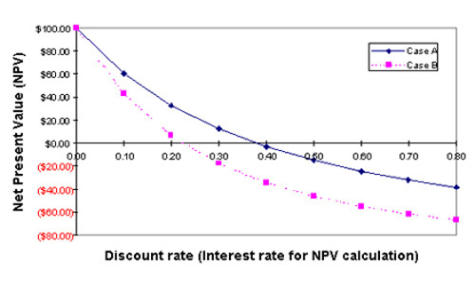
IRR asks a different question of the same two cash flow streams. Instead of proposing a discount rate and finding the NPV of each stream (as with NPV), IRR starts with the net cash flow streams and finds the interest rate (discount rate) that produces an NPV of zero for each. The easiest way to see how this solution is found is with a graphical summary:

Slide 56
These curves are based on the Case A and Case B cash flow figures in the table above. Here, however, we have used nine different interest rates, including 0.0 and 0.10, on up through 0.80.
As you would expect, as the interest rate used for calculating NPV of the cash flow stream increases, the resulting NPV decreases.
For Case A, an interest rate of 0.38 produces NPV = 0, whereas
Case B NPV arrives at 0 with an interest rate of 0.22.
Case A therefore has an IRR of 38%, Case B an IRR of 22%.
IRR as the decision criterion, the one with the higher IRR is the better choice.

Slide 57
Risk Evaluation

Slide 58
Risk evaluation
Risk evaluation is meant to decide whether to proceed with the project or not, and whether the project is meeting its objectives.
Risk Occurs:
When the project exceed its original specification
Deviations from achieving it objectives and so on.
Risk Identification and ranking
Risk and Net Present Value
For riskier projects could use higher discount rates
Ex: Can add 2% for a Safe project or 5 % for a fairly risky one.
Cost benefit Analysis
Risk profile analysis
Decision trees

Slide 59
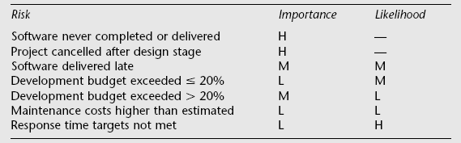
Risk Identification and ranking
Identify the risk and give priority.
Could draw up draw a project risk matrix for each project to assess risks
Project risk matrix used to identify and rank the risk of the project
Example of a project risk matrix
Notes:
In the table ‘Importance’ relates to the cost of the damage if the risk were to materialize and ‘likelihood’ to the probability that the risk will actual occur. ‘H’ indicates ‘High’, ‘M’ indicates ‘medium’ and ‘L’ indicates ‘low’. The issues of risk analysis are explored in much more depth in lecture/chapter 7.

Slide 60
Risk profile analysis
This make use of “risk profiles” using sensitivity analysis.
It compares the sensitivity of each factor of project profiles by varying parameters which affect the project cost benefits.
Eg:
Vary the original estimates of risk plus or minus 5% and re-calculate the expected cost benefits.

Slide 61
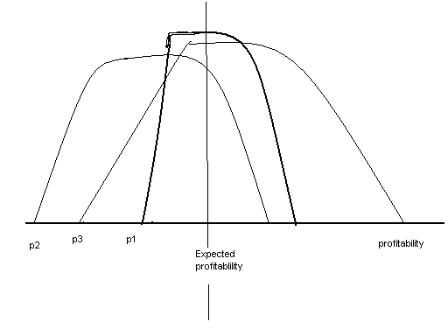
P1 depart far from p2,have large variation
P3 have much profitable than expected
All three projects have the same expected profit
Compare to p2 , p1 is less risky.

Slide 62
Decision trees
Identify over risky projects
Choose best from risk
Take suitable course of action
Decision tree of analysis risks helps us to
Extend the existing system
increase sales
improve the management information
Replace the existing system
Not replacing system leads in loss
Replace it immediately will be expensive.

Slide 63
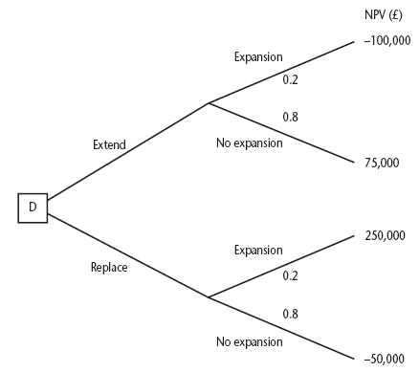
Decision trees
The expected value of Extending system=
(0.8*75,000)-(0.2*100,000)=40,000 Rs.
The expected value of Replacing system=
(0.2*250,000)-(0.8*50,000)=10,000 Rs.
Therefore, organization should choose the option of extending the existing system.
Notes:
The diagram here is figure 3.8 in the text.
This illustrates a scenario relating to the IOE case study. Amanda is responsible for extending the invoicing system. An alternative would be to replace the whole of the system. The decision is influenced by the likelihood of IOE expanding their market. There is a strong rumour that they could benefit from their main competitor going out of business: in this case they could pick up a huge amount of new business, but the invoicing system could not cope. However replacing the system immediately would mean other important projects would have to be delayed.
The NPV of extending the invoicing system is assessed as £75,000 if there is no sudden expansion. If there were a sudden expansion then there would be a loss of £100,000. If the whole system were replaced and there was a large expansion there would be a NPV of £250,000 due to the benefits of being able to handle increased sales. If sales did not increase then the NPV would be -£50,000.
The decision tree shows these possible outcomes and also shows the estimated probability of each outcome.
The value of each outcome is the NPV multiplied by the probability of its occurring. The value of a path that springs from a particular decision is the sum of the values of the possible outcomes from that decision. If it is decided to extend the system the sum of the values of the outcomes is £40,000 (75,000 x 0.8 – 100,000 x 0.2) while for replacement it would be £10,000 (250,000 x 0.2 – 50,000 x 0.80). Extending the system therefore seems to be the best bet (but it is still a bet!).

Slide 64
Ex 1:
NPV (Rs)
Further extension
-100,000
0.5
Extend
80,000
0.5
No extension
D2
Further extension
0.1
0.5
200,000
Extend
Replace
0.5
0.9
No extension
-30,000
D1
Further extension
Replace
0.1
-100,000
0.9
Replace
No extension
75,000
0.2
Further extension
250,000
0.8
No extension
-50,000

