Slide 1

English Project
Authors : Flavien Bigi, Terry Dervaux, Gauthier Freund
Date : 05-18-2015
n°1/10

Slide 2
Introduction
Software to improve your English listening
Test your ability to hear distinct English words
Using PHP, Spotify, MusixMatch

Slide 3
Summary
Analysis
Ideas and technology
Tools, tasks and definition
Conception
Capture
Processing
Feedback
Evolution
Processing
Missing information
Technologies changes

Slide 4

Analysis
Ideas and technology
Ideas
Opportunity to develop an interesting software
Quickly decided to design this application
matches our current interests :
English and music
Technology
Everyone was able to quickly develop in PHP
Flavien and Gauthier had already used the framework Codeigniter

Slide 5
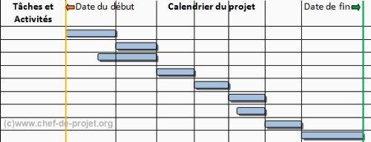
Analysis
Tools and teamwork
The tools
CodeIgniter : give generic methods
Spotify API
Etc
Tasks
Gauthier and me : Models and controllers about database
Terry : capture and processing
Views and design

Slide 6
Analysis
Definition
What is a track for us ?
Sound
Information
track
Lyrics
Notes:
MusiXmatchAPI :
Get lyrics
Get Spotify references
SpotifyAPI :
Get songs
Get information's about tracks

Slide 7
Conception
Overview
Capture
Sound
Processing
Hide the words
Feedback
Ranking
Lyrics
Information
Gameplay
Score
Notes:
Text = Website
Analyer =

Slide 8

Conception
Capture
Our main objective : unlimited content of tracks
How is it done ?
Don’t forget the lyrics
Notes:
In the future we could capture lyrics on soundcloud or xbox musix and let the player use what he preferes
MusiXmatchAPI :
Get link to lyrics
Get unique id for each tracks
SpotifyAPI :
Get songs
Get informations about tracks
Extract lyrics from the link

Slide 9
Conception
Processing
What do we avoid during the process of masking ?
Crowd Lyrics : ooh oh, na-na-naaaaa, yeahhhh! …
Abbrevation : We're, Hustlin’ …
Voice-off / Canons
Gameplay : adaptative process of levels
Level | Hidden words | Combo
Low | 12% | 0%
Med(ium) | 17 % | 5%
High | 25 % | 10%
Notes:
Bracket = parenthèse
The entire line be hidden
Be hidden

Slide 10
Conception
Feedback
Computing a score
Ranking
Personal : player best result
Global : ladder on each track
Now, let move onto the demonstration of our game
Notes:
To show what is the result of our conception

Slide 11

Evolution
Overview
It achieves its goal
Improving your English by listening to music
New features can be developed
Improving game experience of the user

Slide 12
Evolution
Processing
Improving the behavior of the process
Consider uppercase, lowercase
Consider the place of words
Consider typos
Consider punctuations
Consider contractions
Improving the score compute
Consider above changes
Consider the time

Slide 13

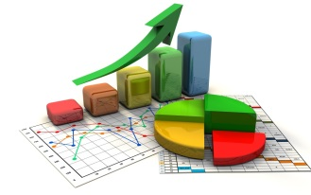
Evolution
Missing information
Adding and modify user’s information
Password
Username
English level
Adding statistics
Best players
Common mistakes
Evolution of English level
Notes:
Common mistakes : on each tracks / for each player

Slide 14
Evolution
Technologies changes
Improving the capture process by :
Soundcloud
Xbox Music
Consistant
Larger
Faster

Slide 15
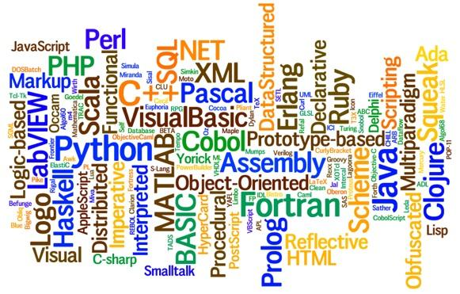
Evolution
Technologies changes
New coding language
To get better performance
To simplify the algorithm

Slide 16
Conclusion
A usefull project for us
Usefull for our english skills
Better listening and understanding of English
Underline difficult words
Usefull for our IT skills
Use of an API
GitHub

Slide 17
Conclusion
What about the future of this project ?
Any questions ?

