Slide 1
TerrierTracks
Hemanshu, Rafael, Ryan & Pratham

Slide 2
Introduction
Ultra-minimalist stock tracking system & trade simulator.
Simple and Interactive through the Terminal
Home menu with numbered options
Buy, sell, view stocks and performance
Stakeholders:
Young code-friendly investors

Slide 3
Process
Incremental Development
Although the process was incremental, the process involved two main halves.
First: Idea Brainstorming, and Diagrams Building.
Second: Code Implementation

Slide 4
System Architecture
Repository Architecture
Google Sheets pulls data from Google Finance API
Google Sheet CSV parsed in Java.
Stock with Attributes
List of Stocks, Favorites (user-defined) & Holdings (psuedo-user-bought)
Pseudo $100,000 balance

Slide 5
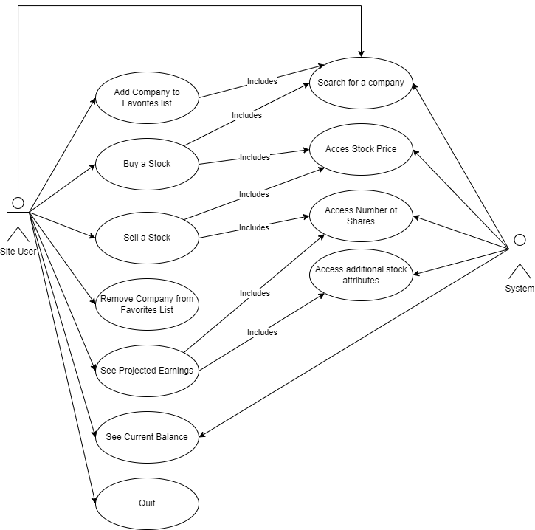
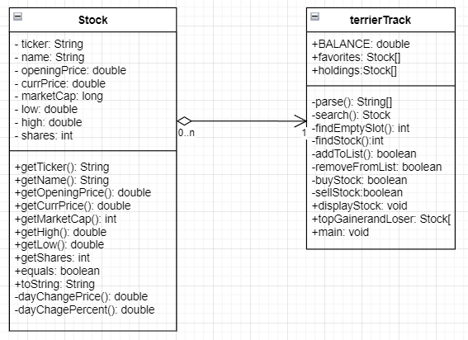
Use Case Diagram
Class Diagram

Slide 6
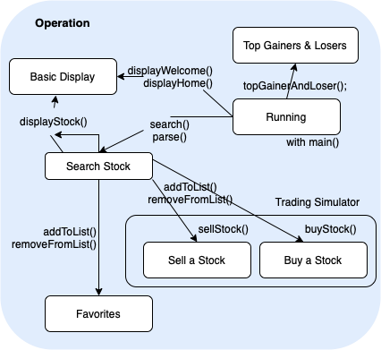
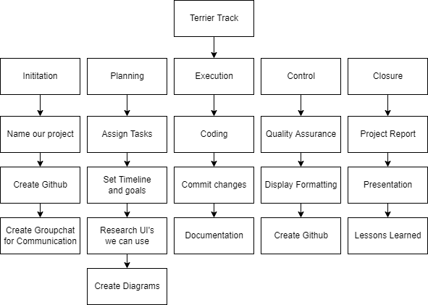
State Diagram
Work Breakdown Structure

Slide 7
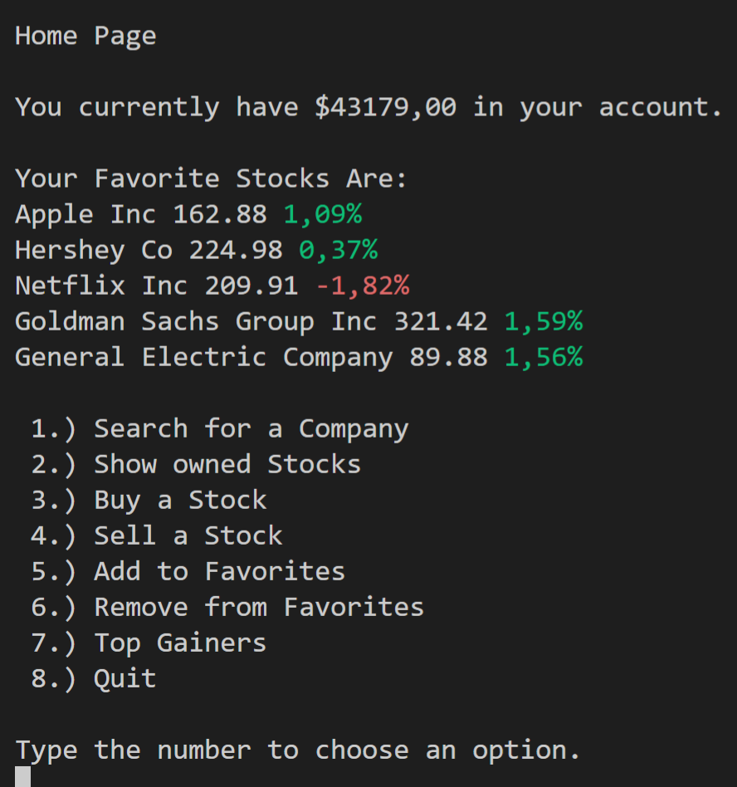
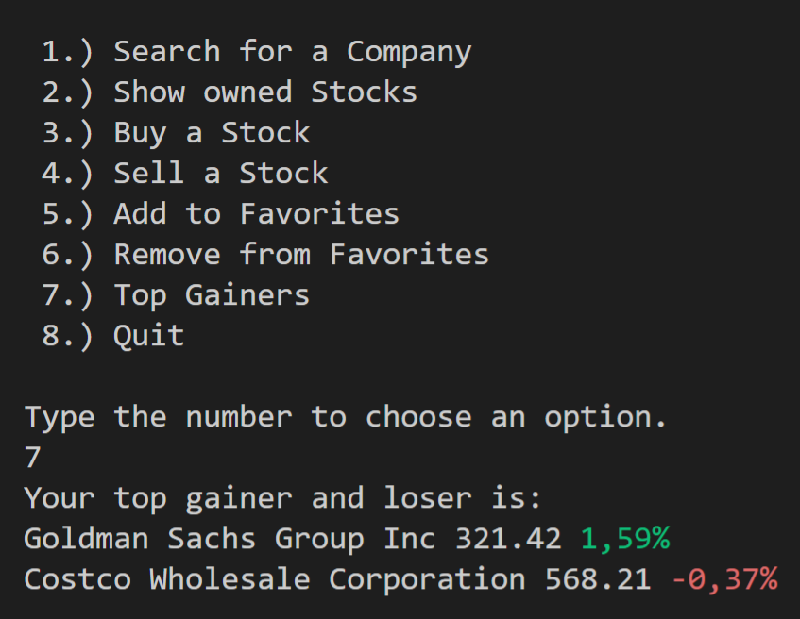

Slide 8
Conclusion
Acknowledgements
Better GUI, potential full-stack application with CS412
SQL Database Management
Further Integration of Real-time Information
More Frequent Detailed Commits on GitHub
Importance of Communication & Early Planning
Thank you so much for this opportunity, Professor Ibrahim.

