Slide 1
CEG 4110 Project 2 Wearable Epilepsy Device & MC Team Team 4 Patterns Matching, Association & Prediction
AUTHORS Ian S. Barney Computer Science Major
Elliot C. Fries Computer Science Major
James S. Languirand Computer Science Major Clayton D. Terrill Computer Engineering Major

Slide 2
Original Requirements
Overview: Abnormalities within a person’s life signals may warn of an upcoming epileptic seizure. So, there will be five signals that the frequency will be monitored for. The signal frequencies will be compared to the patient’s normal statistics to determine if there is an abnormality. Abnormalities within the signals may match a pattern that is associated with an issue. If an issue is detected, a message for the epileptic seizure will be outputted.

Slide 3
Original Requirements Continued
Group Member Requirements:
All group members are required to attend every workshop class and is responsible for their assigned job.
The project will be written in C++.
The project will be written from scratch by the group members.
Group members will write a report regarding the project.
Group members will create a PowerPoint to present.
The due date is April 17th, 2018.

Slide 4
Original Requirements Continued
Group Member Jobs:
Names | Jobs | Status
Clayton Terrill | Requirements and Group Leader | Active
Elliot Fries | Analysis | Active
James Languirand | Design | Active
Ian Barney | Implementation | Active
Jeremy Watson | Testing | Missing

Slide 5
Original Analysis – Noun Extraction
Requirements Overview: Abnormalities within a patient’s life signals may warn of an upcoming epileptic seizure. So, there will be five signals that the frequency will be monitored for. The signal frequencies will be compared to the patient’s normal statistics to determine if there is an abnormality. Abnormalities within the signals may match a pattern that is associated with an issue. If an issue is detected, a message for the epileptic seizure will be outputted.
Nouns: Abnormalities, Signal, Seizure, Frequency, Statistics, Pattern, Patient, Issue

Slide 6
Original Analysis – Noun Classes
Patient Class
Signal Class
Issue Class

Slide 7
Original Analysis – Abstract Nouns
Abstract Nouns:
Abnormalities – Attribute for the Patient Class.
Frequency – Attribute for the Signal Class.
Statistics – Attribute for the Patient Class.
Pattern – Attribute for the Issue Class.
Message – Attribute for the Issue Class.
Nouns Outside of the Boundary:
Seizure – Issues represent specific instances of a Seizure.

Slide 8
Original Analysis – Patient Class
Description:
Creates object representing the patient.
Entity Class and Control Class:
Holds the normal stats for the patient and compares them with the signal.
Attributes:
Abnormalities – Represents if an abnormality was detected within a signal.
Statistics – Normal signal frequencies for the patient.

Slide 9
Original Analysis – Signal Class
Description:
Creates objects representing the Integer values being received from the signals.
Boundary Class:
Receives input from an outside source.
Attributes:
Frequency – The frequency being received from the signal.

Slide 10
Original Analysis – Issue Class
Description:
Creates objects representing the issue patterns.
Entity Class:
Holds the pattern of abnormalities representing the issue.
Attributes:
Pattern – Represents what pattern of signals causes the issue.
Message – The output describing what issue is occurring.

Slide 11
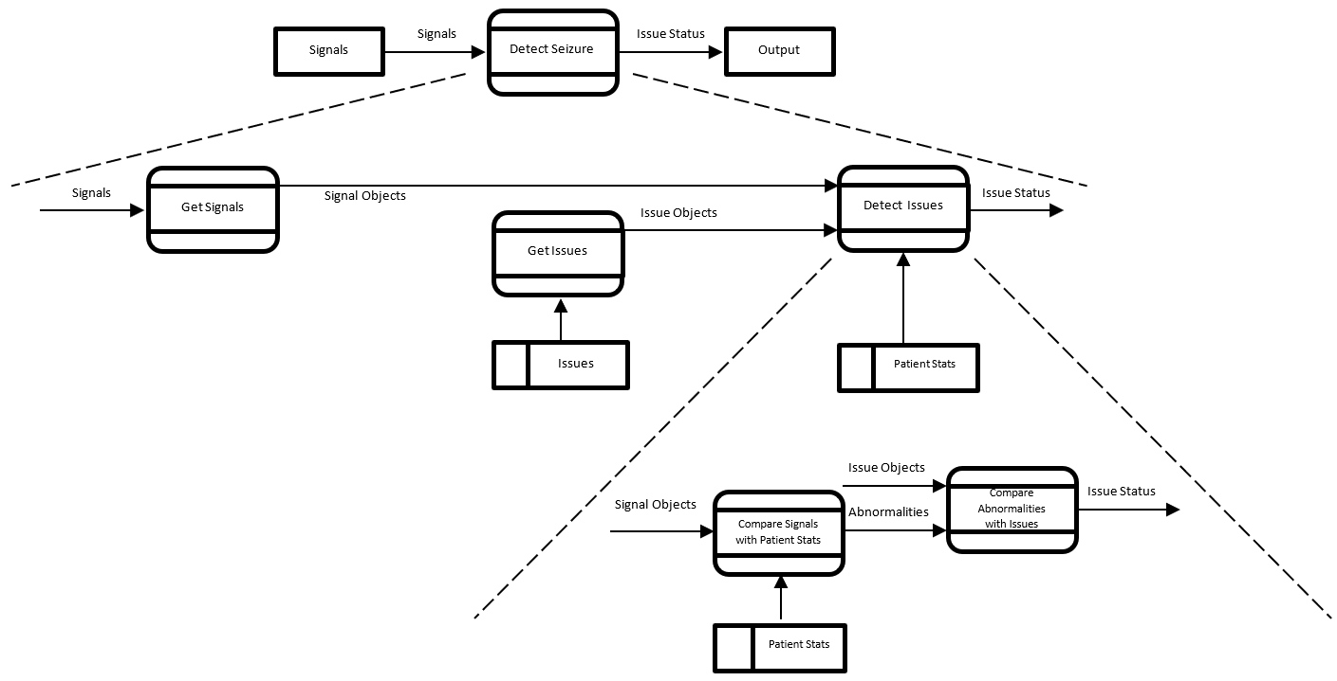
Original Design

Slide 12
Original Implementation
Implementation member worked on the code exclusively.
Implementation member only one who had access.
History of changes were not logged.
The three classes from the original analysis were implemented.
Classes use the attributes outlined in the original analysis.
The flow of data outlined by the original design diagram was used.

Slide 13
Original Testing
Three Test Categories:
Test each module to make sure they behave properly.
Test the modifying and returning of attributes.
Test for a valid Patient stats range.
Range must go from a smaller number to a larger number. (Ex: 80-100)
Test modules connected together with test values.
Signals must be within a range of Patient stats.
Test when Signal Frequency = Lower Boundary of Patient Stats.
Test when Signal Frequency = One Below Lower Boundary of Patient Stats.
Test when Signal Frequency = Upper Boundary of Patient Stats.
Test when Signal Frequency = One Above Upper Boundary of Patient Stats.
Issues must be detected based on signal abnormalities.
Test randomly generated values to ensure functionality.

Slide 14
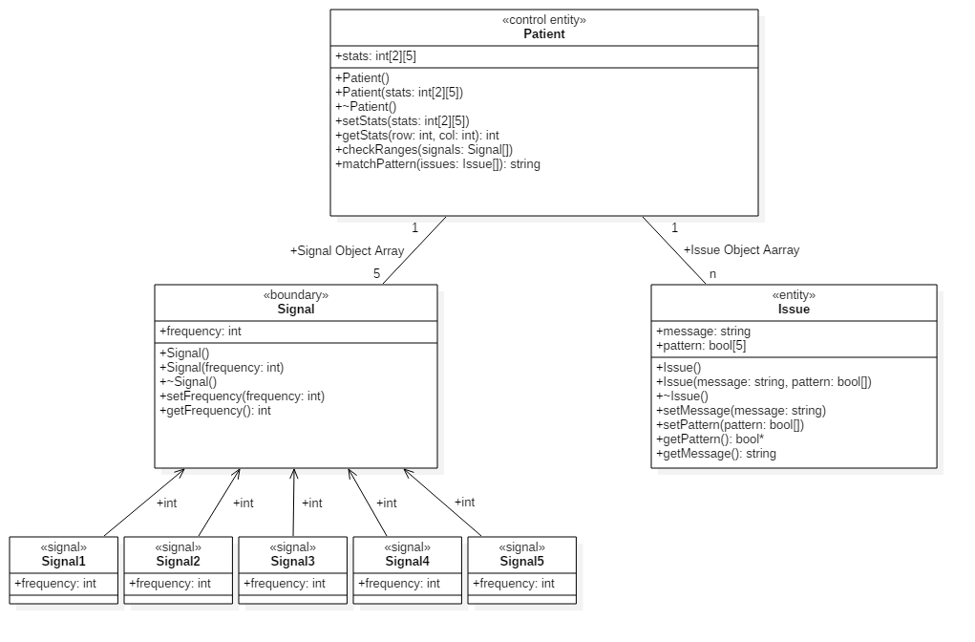
Original UML

Slide 15
Original UML Compatibility
Does not work with the previous group and the project as a whole!
Therefore, the requirements must change.
MOVING TARGET PROBLEM!
So, every workflow must be modified.

Slide 16
Final Requirements
Overview: There are five signals being received and monitored. Each signal carries whether an abnormality was detected or not. The signals are used together and matched to known issue patterns that cause epileptic seizures. If the signals are associated with an issue pattern, then an epileptic seizure is predicted, and a message is produced.

Slide 17
Final Requirements Continued
Group Member Requirements:
All group members are required to attend every workshop class and is responsible for their assigned job.
The project will be written in C++.
The project will be written from scratch by the group members.
Group members will write a report regarding the project.
Group members will create a PowerPoint to present.
If the requirements change, then each group member is required to accommodate them.
All workflows will be completed prior to Tuesday, April 17th, 2018.
A presentation will be presented by the group leader on Thursday, April 19th, 2018.
A full report will be turned in prior to Monday, April 20th, 2018.
(added)

Slide 18
Final Requirements Continued
Group Member Jobs:
Names | Jobs | Status
Clayton Terrill | Requirements and Group Leader | Active
Elliot Fries | Analysis | Active
James Languirand | Design | Active
Ian Barney | Implementation | Active
Jeremy Watson | Testing | Still Missing

Slide 19
Final Analysis – Noun Extraction
Requirements Overview: There are five signals being received and monitored. Each signal carries whether an abnormality was detected or not. The signals are used together and matched to known issue patterns that cause epileptic seizures. If the signals are associated with an issue pattern, then an epileptic seizure is predicted, and a message is produced.
Nouns: Signal, Abnormality, Issue, Pattern, Seizure, Message

Slide 20
Original Analysis – Noun Classes
Signal Class
Issue Class
Seizure Class

Slide 21
Original Analysis – Abstract Nouns
Abstract Nouns:
Abnormality – Attribute for the Signal Class.
Pattern – Attribute for the Issue Class.
Message – Attribute for the Issue Class.
Nouns Outside of the Boundary:
None

Slide 22
Original Analysis – Signal Class
Description:
Creates objects representing the Boolean values being received from the signals.
Boundary Class:
Receives input from an outside source.
Attributes:
Abnormality – Boolean value representing if an abnormality was detected.

Slide 23
Original Analysis – Issue Class
Description:
Creates objects representing the issue patterns.
Entity Class:
Holds the pattern of abnormalities representing the issue.
Attributes:
Pattern – Represents what pattern of signals causes the issue.
Message – The output describing what issue is occurring.

Slide 24
Original Analysis – Seizure Class
Description:
Models algorithms to check if the signals match an issue pattern. If they do, then a seizure was detected and the issue is returned.
Control Class:
Models the algorithms that compares the signals with the patterns to compute if an issue occurred.

Slide 25
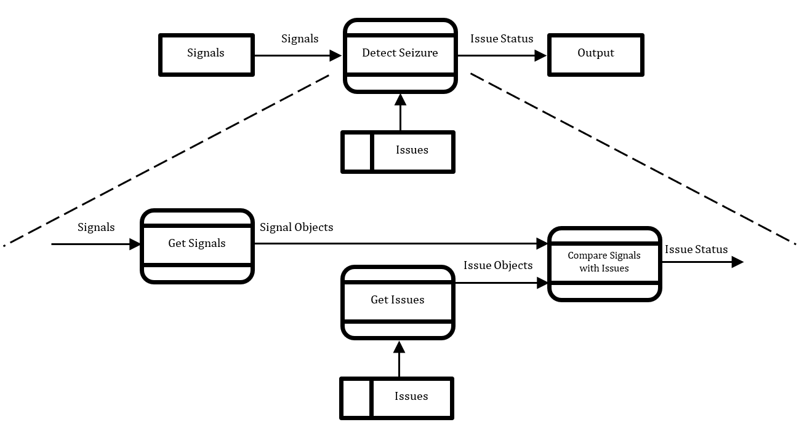
Final Design

Slide 26
Final Implementation
https://github.com/Terrillc13/PatternsMatchingAssociationPrediction
Used Git as a source control.
Allowed for parallel development.
History of changes are logged.
The three classes from the final analysis were implemented.
Two remaining classes from the original analysis were modified.
The Patient Class from the original analysis was removed
The Seizure Class form the final analysis was implemented.
Classes use the attributes outlined in the final analysis.
The flow of data outlined by the final design diagram was used.

Slide 27
Final Testing
Three Test Categories:
Test each module to make sure they behave properly.
Test the modifying and returning of attributes.
Test modules connected together with test values.
Issues must be detected based on signal abnormalities.
Test randomly generated values to ensure functionality.

Slide 28
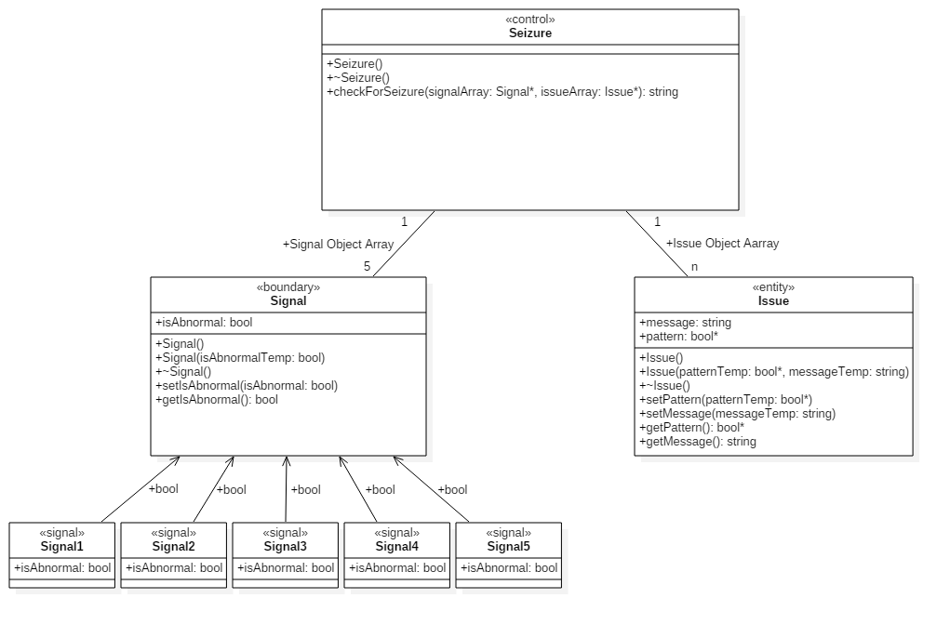
Final UML

Slide 29
Final UML Compatibility
This works with the previous groups UML.
Therefore, the moving target problem has been resolved.
So, our part of the project is ready for integration with the others.

Slide 30
References
Schach, S. R. (2011). Object-Oriented and Classical Software Engineering (Eighth ed.). New York, NY: McGraw-Hill.

