Slide 1
Voting App
Daniel Jessner, 4AHINF

Slide 2
Table of contents
01
02
03
04
Introduction
Implementation
What is the Voting App?
C# ; Java Spring Boot ; HTML, CSS, JS
Problems
Conclusion
What didn‘t go as planned?
Summary, Future

Slide 3
—Lao Tse
„Only those who know their destination will find the way."

Slide 4

Personal Intention
Similarities:
Make private asking sessions
Gather voting information fast
Visualize results
Image 1 – Kahoot Logo

Slide 5
01
Introduction
What is the Voting App?

Slide 6



Voting App
User System
Code System
Log in or register with a personal user.
Give the random generated session code to people you want to join.
Session System
Visualization
Create voting sessions, store them in your account and start them whenever you want.
Visualize the gathered results in both web and desktop.

Slide 7
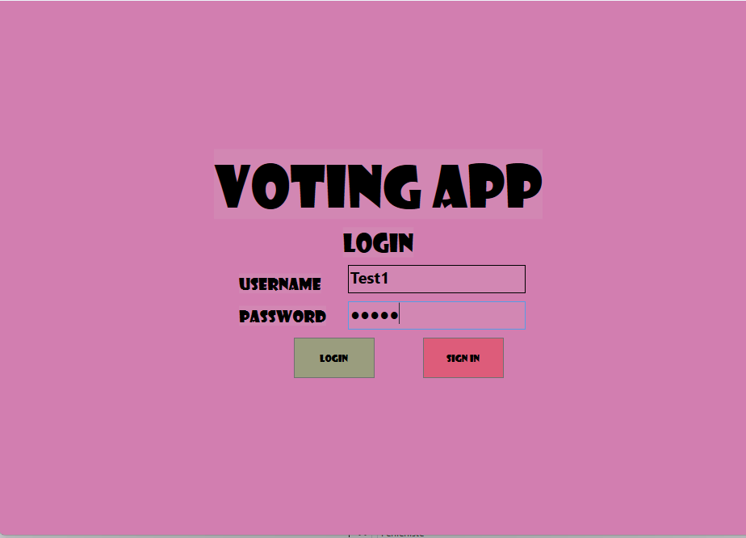
Figure 2 – Voting App Login Page

Slide 8

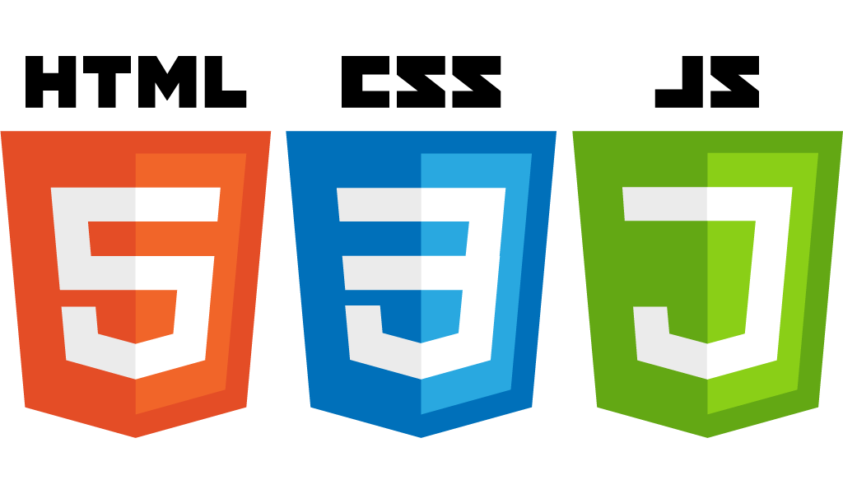

02
Implementation
Figure 3 – Spring Boot Logo
Figure 4 – HTML, CSS, JS Logo
C# ; Java Spring Boot ; HTML, CSS, JS
Figure 5 – C# Logo

Slide 9
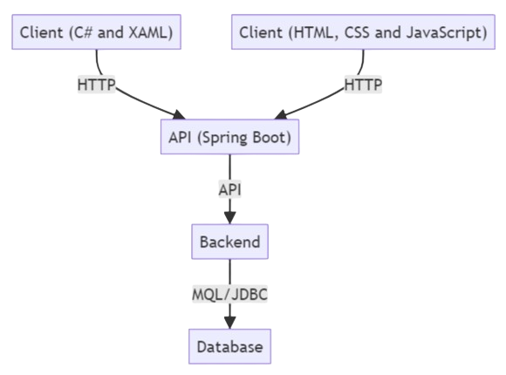
App Architecture
Backend:
- Java Spring Boot
- MongoDB
Frontend:
- C# WPF
- HTML, CSS, JS
Figure 6 – Voting App Architecture

Slide 10
Data Model
Entities, DTOs

Slide 11
API Endpoints
Create, Read, Update, Delete

Slide 12
03
Problems
What didn‘t go as planned?

Slide 13
Problems
01
02
03
Data Model
Visualization
Time
Too thin at the beginning
Bad choice of visualization package
Wrong time estimation

Slide 14
Goals
 | Desktop | Web
Sessions
Session Code
Time Limit
Visualization

Slide 15
04
Conclusion
Summary, Future

Slide 16
Future
Time Limit
Audio Files
01
02
Voting App
Add editable time limit for sessions.
Add functionality to add audio files to sessions.
Images
Answers
03
04
Add functionality to add images to sessions.
Add different types of questions, e.g. open answers

Slide 17
Live Demo
Was it all just fantasy?
Figure 7 – Voting App Login Page

Slide 18
Resources
Photos
Figure 1: https://tomwala.blog/wp-content/uploads/2018/12/kahoot.png
Figure 2: Voting App
Figure 3: https://dev.to/jazzybruno/spring-boot-project-folder-structure-12oe
Figure 4: https://www.htl-salzburg.ac.at/news-detail/programmiersprachen-in-der-elektronik-abteilung.html

Slide 19
Resources
Photos
Figure 5: https://www.heise.de/select/ct/2020/13/2006317524240742331
Figure 6: Voting App README.md
Figure 7: Voting App
Icons
https://www.flaticon.com/de/

Slide 20
Thanks for your attention!

