Slide 1
Dataset
Registered Dogs/Cats of Greater Geelong
2015, updated 2016, updated annually
CSV dataset
46,000+ pets
http://data.gov.au/dataset/geelong-registered-dogs-cats

Slide 2
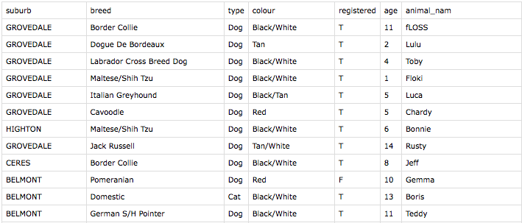
Head of dataset

Slide 3
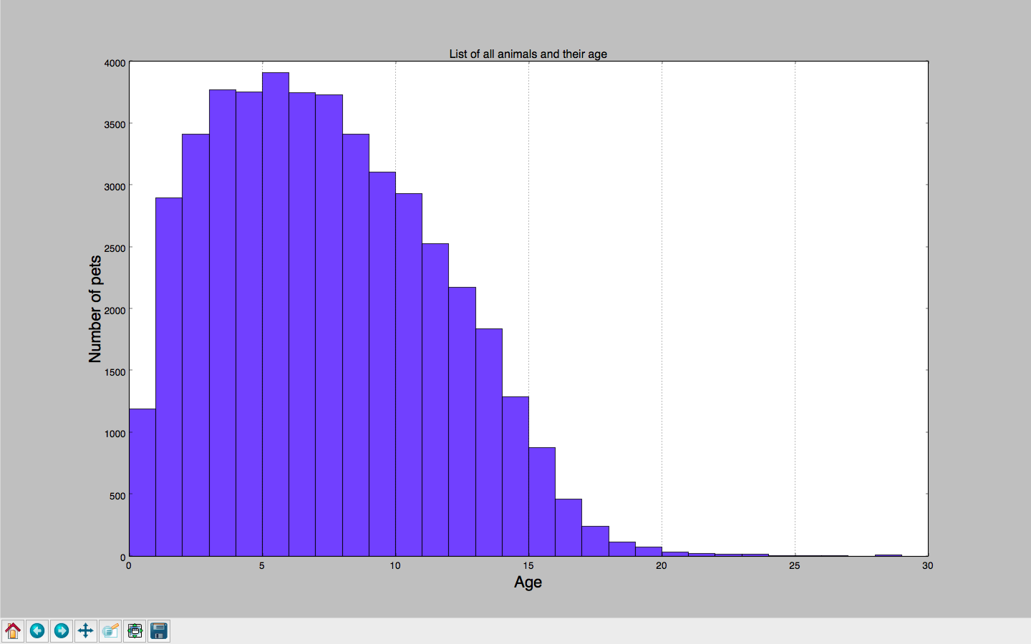

Slide 4
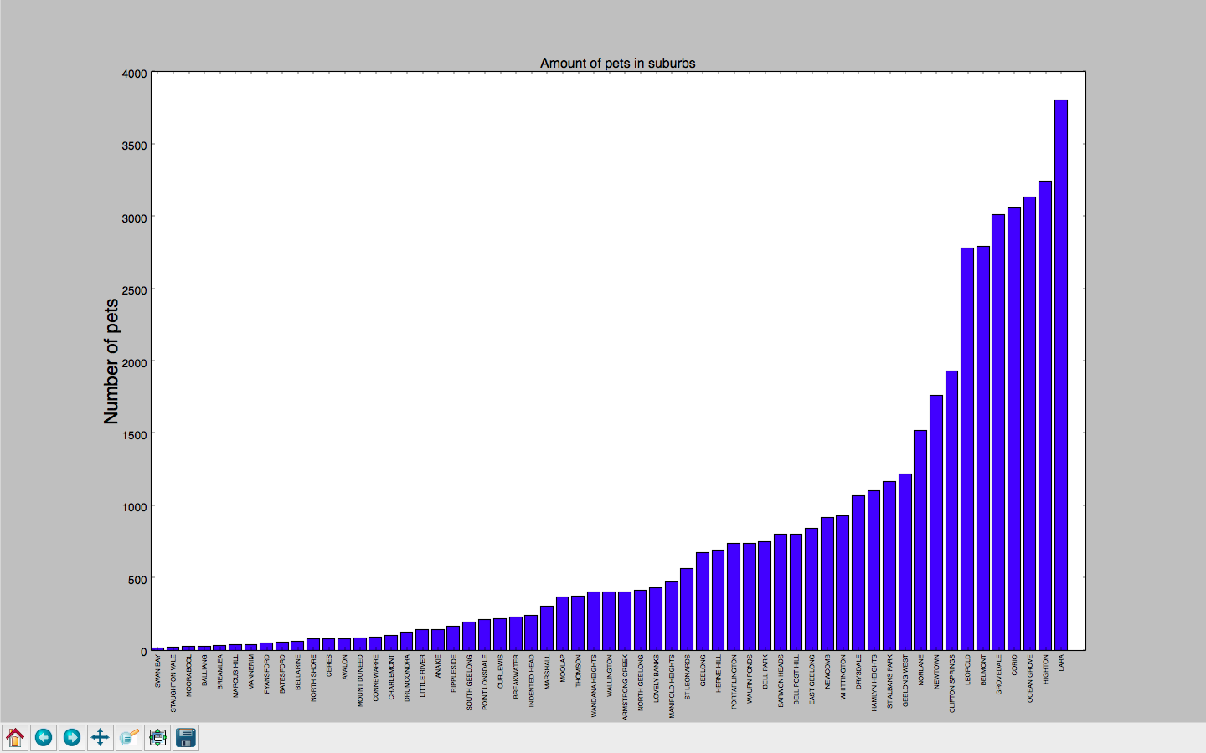

Slide 5
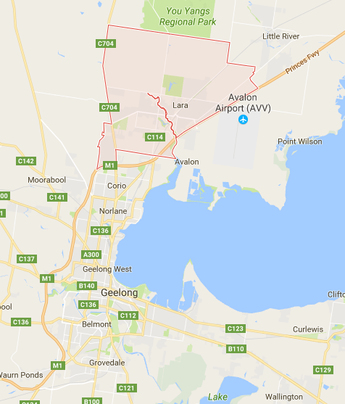

Slide 6
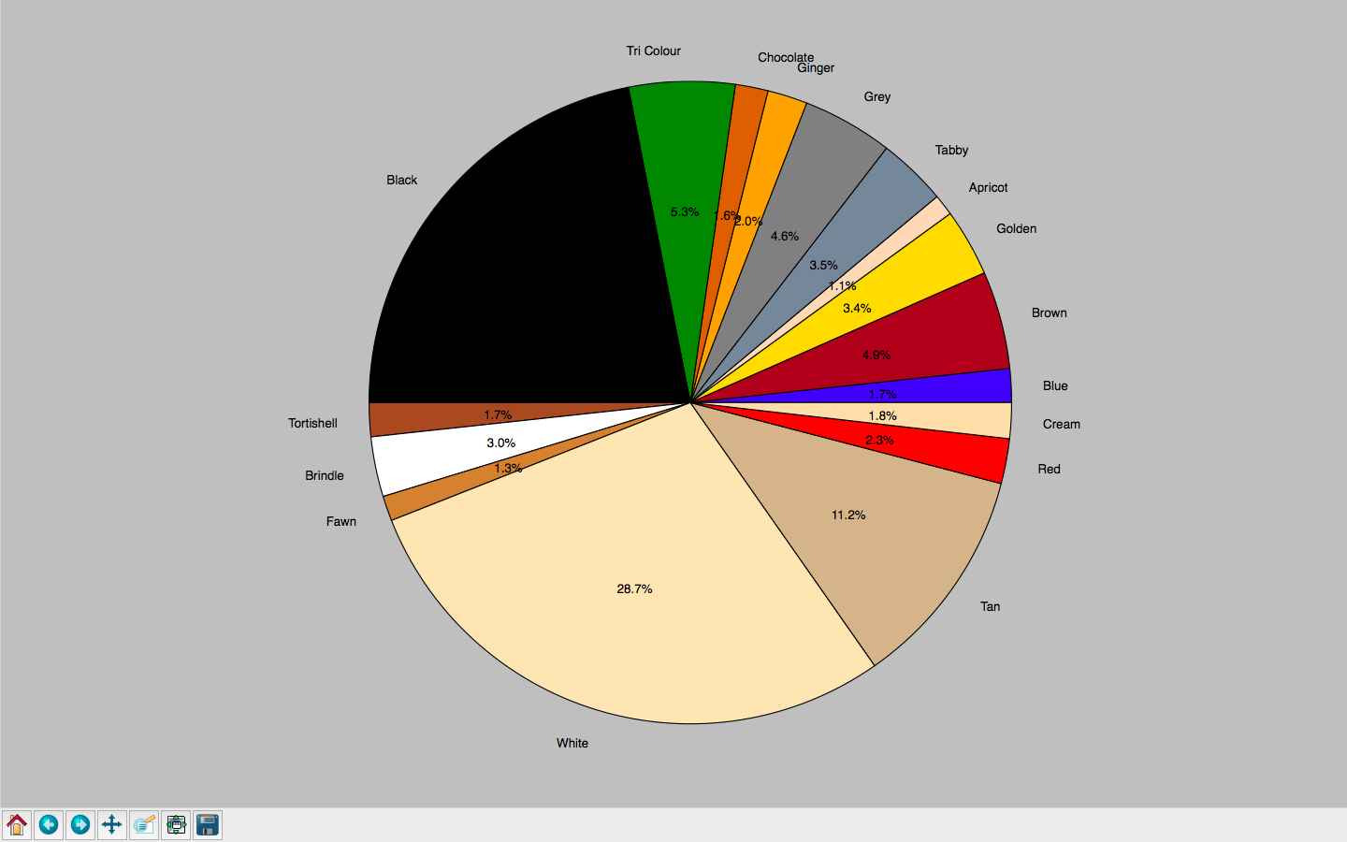

Slide 7
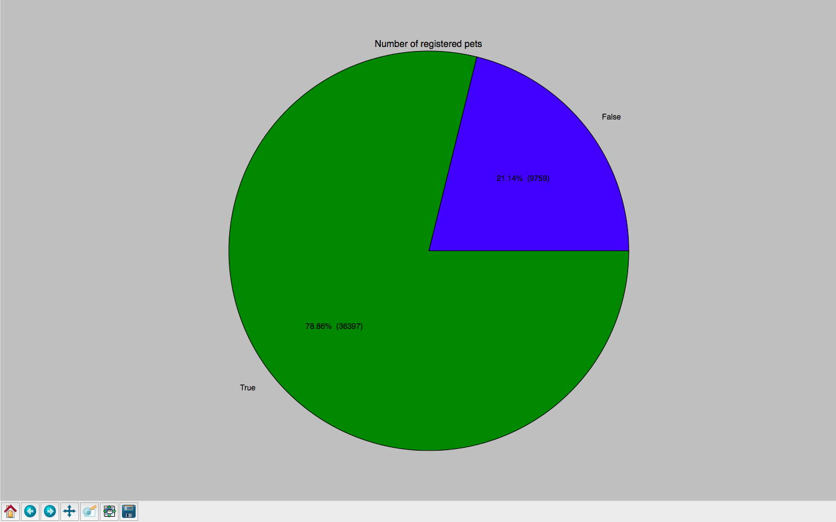

Slide 8
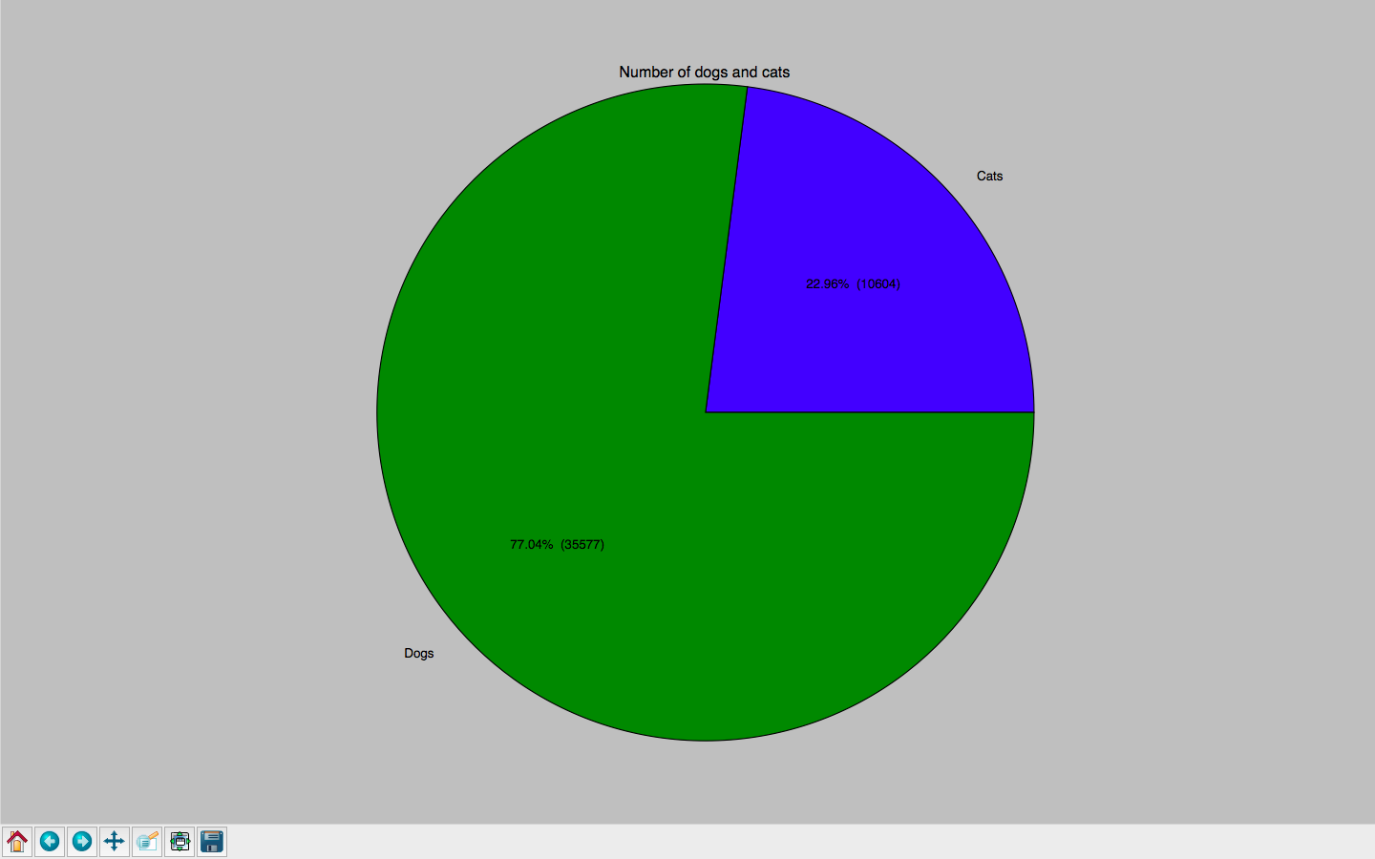

Slide 9
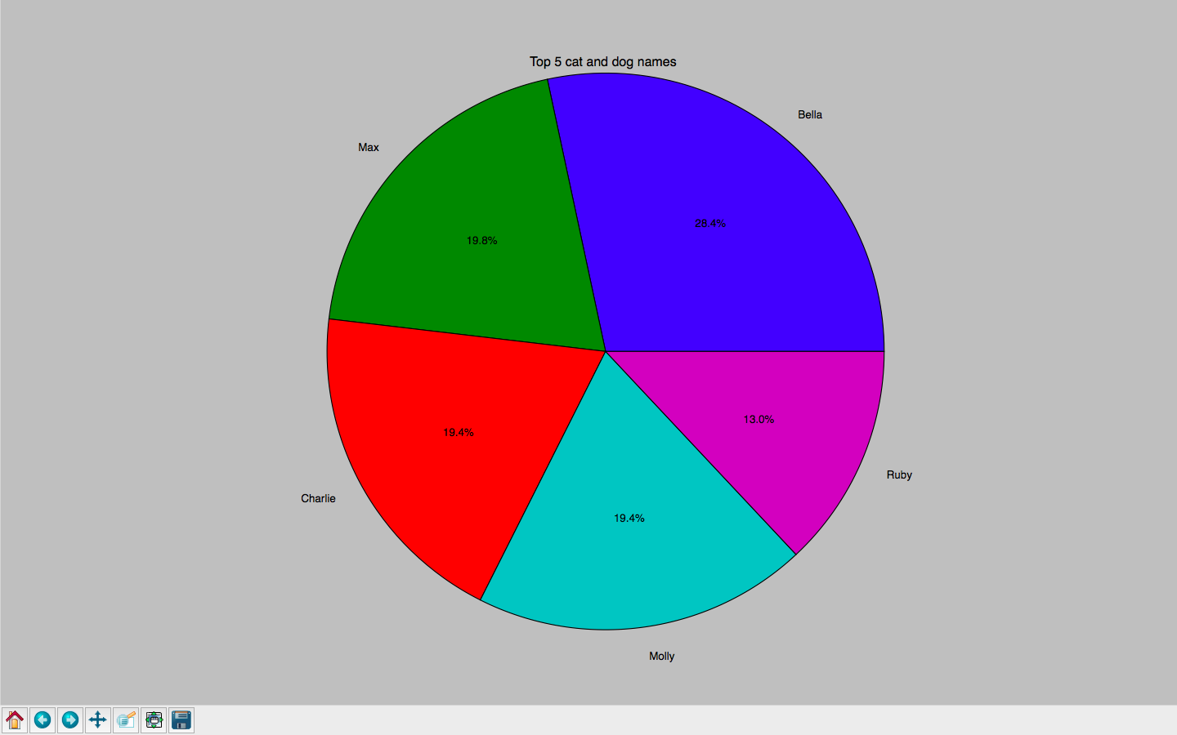

Slide 10


Slide 11
