Slide 1
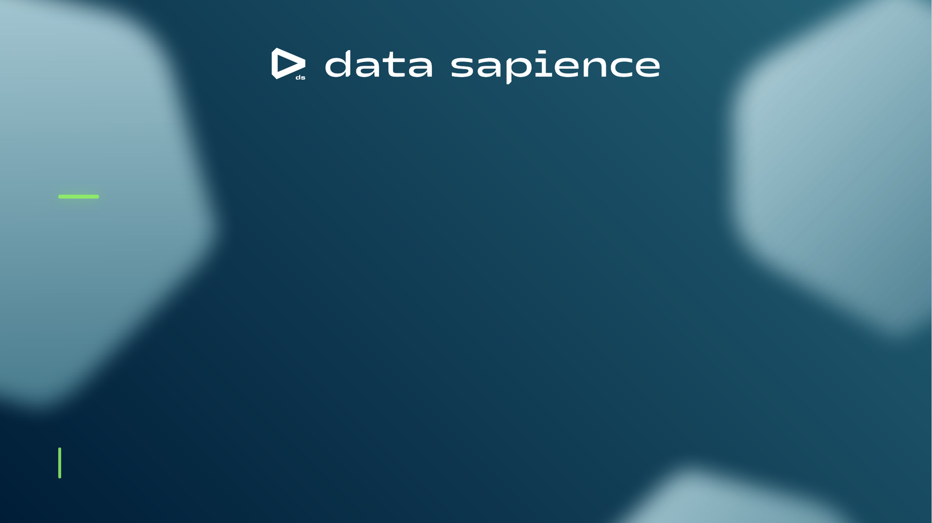
Customer Value Management in Banking
From data integration to real-time Next Best Action — a staged, data-driven path to growing customer lifetime value
MarTech & CVM transformation · reference deck

Slide 2
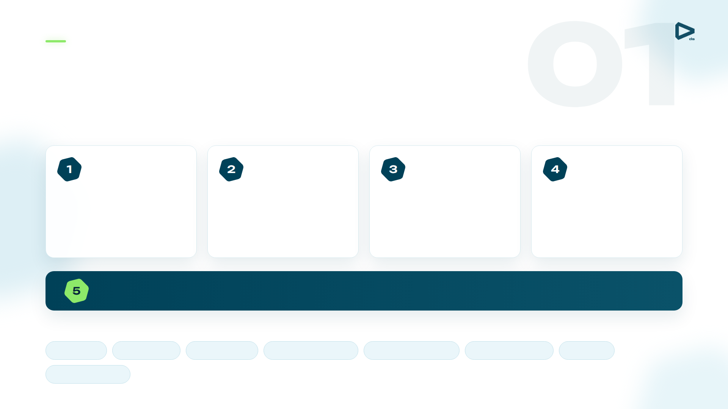
A management discipline, not a single tool
Key Points of the CVM Strategy
CVM grows customer lifetime value, product penetration and retention through data-driven decisions — built on five pillars that revolve around the customer.
Data Integration & Management
Omni-Channel Campaigns
Advanced Analytics — AI & Big Data
BI, Reporting & Test-and-Learn
Unify transactions, CRM, digital and contextual data into one customer view.
Segment by behaviour and product, then personalise across every channel.
Propensity, churn and preference models predict what each client needs next.
Dashboards and target-vs-control uplift to measure and iterate.
Customer Experience
The fifth pillar at the centre — lifecycle orchestration wraps every capability around the customer.
Customer lifecycle
Acquisition
Onboarding
Engagement
Base monetization
Proactive retention
Churn prevention
Win-back
CX improvement

Slide 3
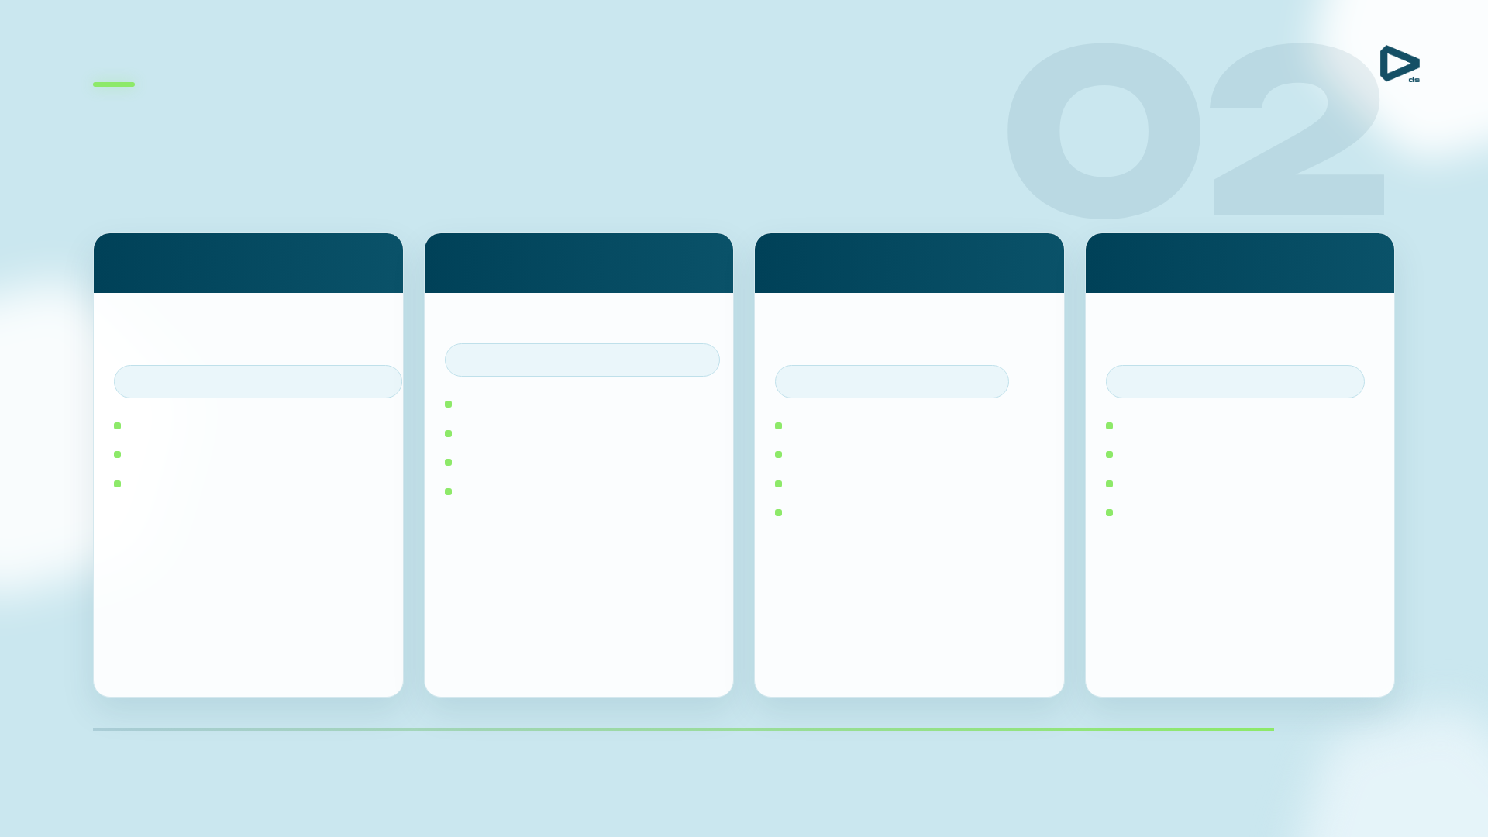
A four-year maturity path within MarTech
Baseline of CVM Transformation Stages
CVM 1.0
CVM 2.0
CVM 3.0
CVM 4.0
Year 1
Year 2
Year 3
Year 4
Experience & hypotheses
Data analytics
Real-time & Next Best Action
Data & product ecosystem
10–15 use cases · micro-segments
1–2 use cases · basic segmentation
50+ use cases · benchmarks
100+ use cases · partner offers
Master data management
Marketing showcase
App & web integration
Real-time marketing engine
3rd-party & partner data
Campaign management
ModelOps
Inbound channels
Loyalty & engagement engines
Simple outbound channels
Systematic Test & Learn
Trigger showcase
Partner APIs
CEP layer
Gamification
Maturity →

Slide 4
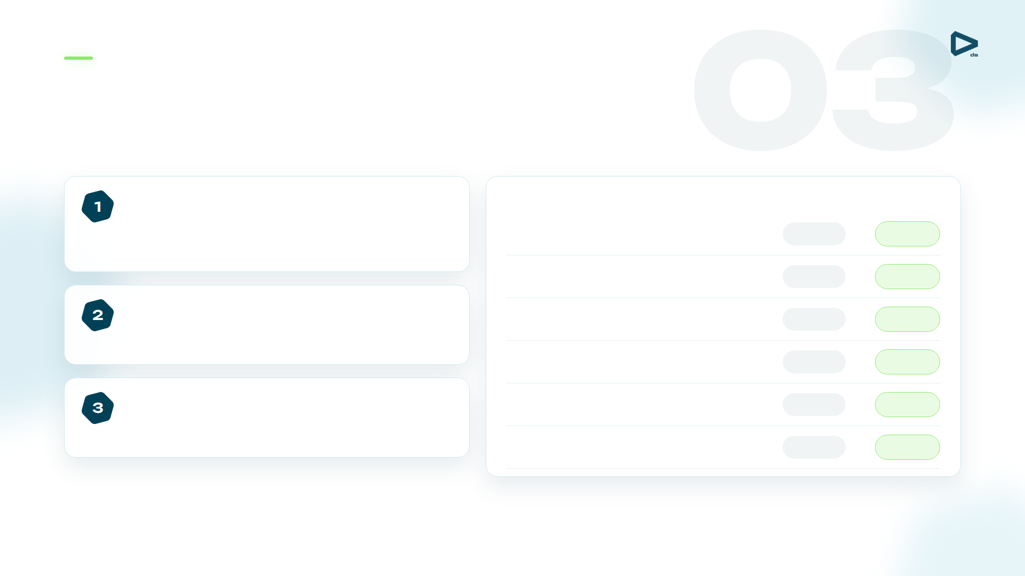
The first practical step of CVM automation
Start with Batch Campaigns & Segmentation
Single tool, central control
Before → After
Plan, segment, execute and report in one place — less manual coordination, lower time-to-market, less IT dependence.
Regular campaigns
4
→
42
Experimental campaigns / month
12
→
27
Built-in reporting
→
Operational and analytical reports are automated — fewer errors, clearer insight into what works.
Time-to-market
7 days
1 day
Delayed campaigns / month
4
→
0
Easy A/B testing
IT staff per launch
5
→
0
Campaigns become controlled experiments, not one-off activities — a continuous Test & Learn loop.
→
New campaign setup
2 days
30 min

Slide 5

Reacting to behaviour at the right moment
Omni-Channel Real-Time Interactions
Onboarding
Activation
Monetization
Cross-sell
Engagement
Retention
Reactivation
activation rate
→
→
→
→
→
→
DAU/MAU · first txn
spend · balances
product ownership
app activity
churn ↓
win-back
What real-time marketing is
Example mechanics
Marketing executed in response to current events, trends and behaviour triggers — instead of deciding once a month whom to contact, the bank reacts the moment a customer acts.
Onboarding chains
Gamification
Full-approve offers
Behaviour triggers
Win-back mechanics
app registration
process abandonment
balance threshold
Triggered the instant a customer registers, abandons a flow, nears a threshold or searches for a product.
partner location
product search
closure request

Slide 6
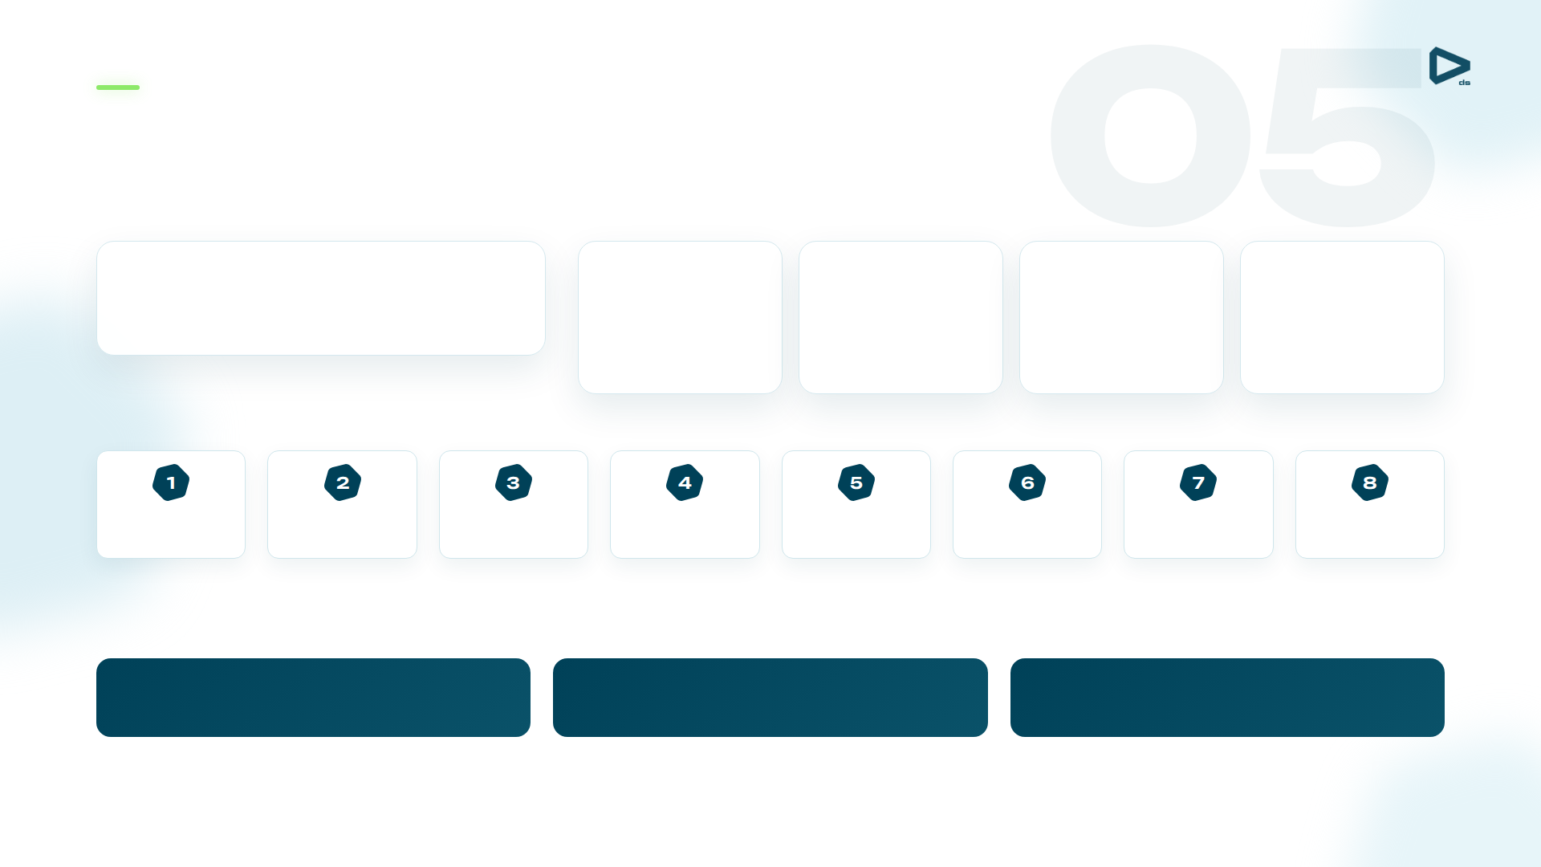
A controlled sequence of nudges, checks and triggers
Onboarding — Worked Example
Customer profile
Data sources
Tools
Channels
KPIs
Expat · 35 y.o.
Processing
Campaign management
SMS
DAU/MAU
Income $15,000 · urban area
Mobile app
Push
Activation rate
Core banking
Real-time engine
In-app
First transaction
Loyalty engine
Communication flow after card issue — each step is auto-checked
Product FAQ / landing
→
→
→
→
→
→
→
App registration
PIN setup
Balance top-up
Payment template
Cashback category
First POS payment
Partner-store payment
+10%
DAU/MAU
+25%
activation rate
+40%
first transaction

Slide 7
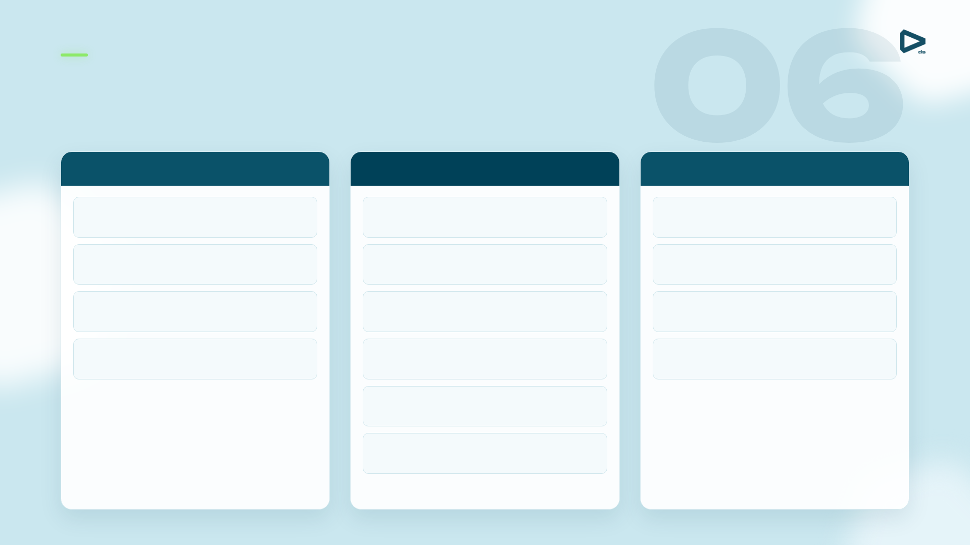
Batch, real-time, analytics and channels in one platform
Blueprint MarTech Architecture
Data Layer
CVM Layer
Delivery & CRM Layer
Sources
Data & Text Mining
Communication Hub
CRM · DWH · Web · DMP / social
Models, propensities, segments
Routes every message
MDM · Data Quality · ETL
Campaign Management
Channels
Clean, standardise, unify
Planned outbound offers
SMS · telesales · email · web/mobile · ATM/POS
Big Data storage
Event Processing Engine
CX / CJM platform
Foundation for processing
→
→
Behaviour & event triggers
Journey orchestration
Marketing Datamart
Real-Time Decision Engine
Web analytics & feedback
Customer & product profiles
Decide the next action instantly
Surveys, reactions, CEM
Marketing Optimization
Budget, capacity & contact limits
Loyalty Engine
Rewards & incentives

Slide 8
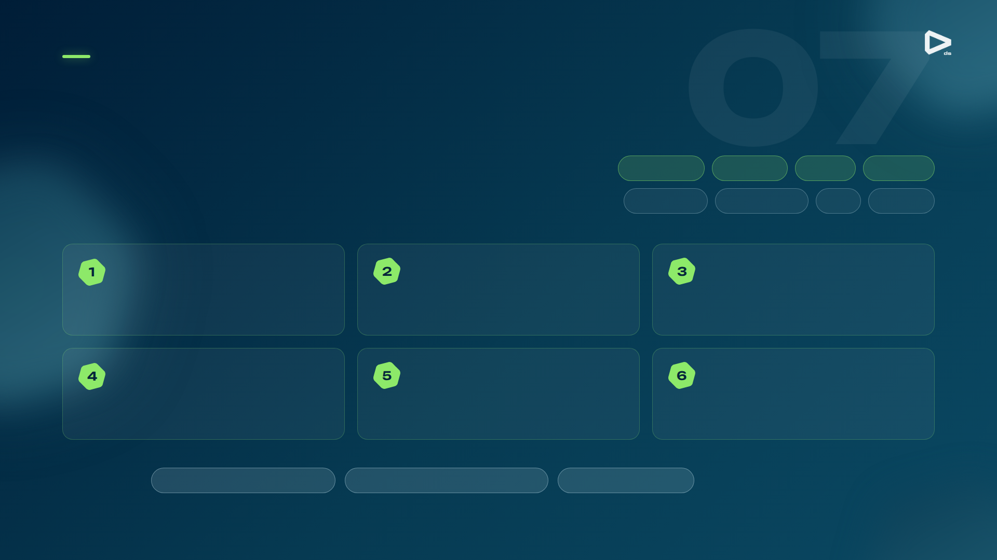
Connecting economics, operations and technology
Components of Successful CVM Transformation
Value
Revenue
Cost
Revenue drivers
=
−
Customers
Products
Usage
Lifetime
Cost to cut
Campaign
Operational
Risk
Process
Batch Campaigns & Data Marts
Real-Time & Clickstream
Advanced Analytics
More automated campaigns, regular Test & Learn, lower time-to-market.
Lift card usage and inbound conversion by reacting in real time.
Uplift, propensity and customer-agent matching models.
Marketing Optimization · NBA/NBO
Customer Experience
Process Mining
Optimise offers under budget, capacity, risk and contact limits.
Reduce churn, collect feedback, improve satisfaction.
Find bottlenecks in flows such as the application process.
Foundations
Data Management Platform
Business Intelligence / Reporting
MLOps environment
Risk integration: pre-approved loans drive cross-sell; limit management lifts volume.

Slide 9
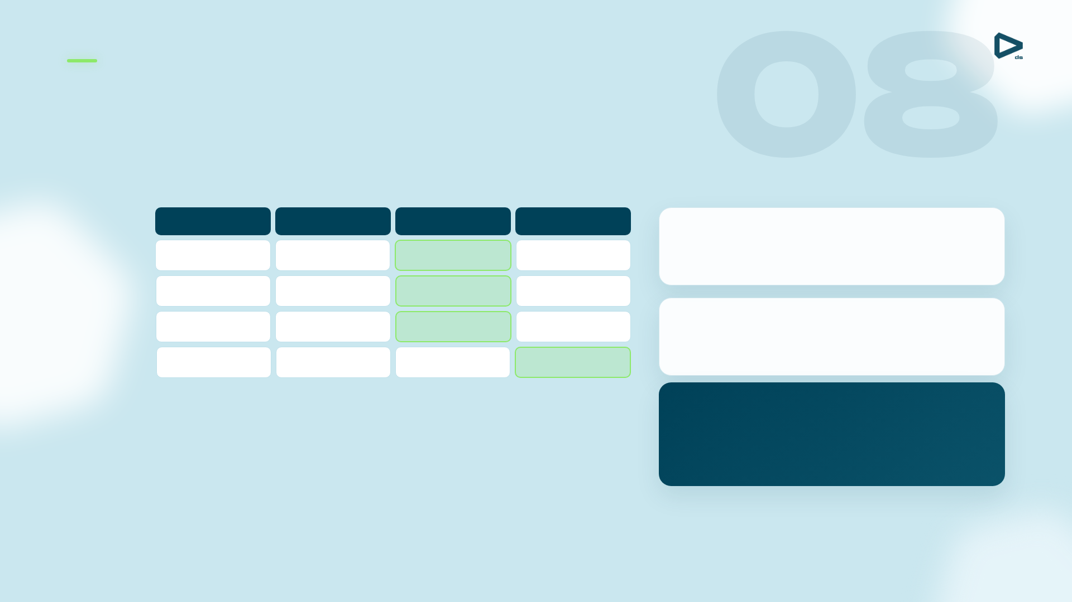
From rule-based segmentation to mathematical optimization
Marketing Optimization — NBO / NBA
Find the best balance between marketing cost and ROI: which offer, through which channel, for which customer — given all constraints.
SMS
Email
Call
Push
Revenue forecast
Customer 1
Response probability × expected margin (and LTV impact) for every customer-product-channel.
P2 · 820
P1 · 610
P3 · 940
P2 · 780
Customer 2
P3 · 540
P3 · 720
P1 · 880
P4 · 690
Customer 3
Business rules
P1 · 700
P4 · 650
P2 · 990
P1 · 730
Total budget · channel capacity · required product share · contact policy.
Customer 4
P4 · 480
P2 · 760
P4 · 620
P3 · 910
Cells = expected value per customer × product × channel. Highlighted = best allocation chosen.
Objective function
max Σ Revenue (c, p, ch)
Maximise revenue across all communications, subject to the constraints above.

Slide 10
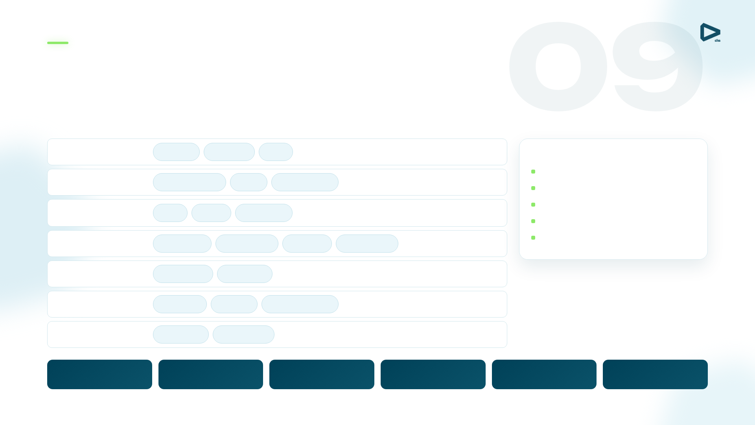
Ingestion, storage, streaming, SQL and the ML lifecycle
Open-Source Data Platform & MLOps
Data platform
UI
Jupyter
Superset
Hue
Platform operations
Cluster management
Compute
Apache Impala
Trino
Apache Spark
Metadata management
Streaming & analytics
Data catalog
Flink
Kafka
ClickHouse
Security · LDAP · Ranger
MPP & monitoring
Greenplum
Prometheus
Grafana
OpenSearch
Metastore · PostgreSQL
Orchestration
Kubernetes
OpenShift
Storage & access
S3 / MinIO
Iceberg
Trino federation
Infrastructure
Hardware
Cloud / IaaS
ModelOps / MLOps
Model management
AutoML / no-code
Training
Orchestration
Feature store
Model quality
MLflow
Data Science
Jupyter
Airflow
monitoring

Slide 11

Behaviour, risk, pricing and fulfilment in one flow
Cross-Sell — Worked Example
Customer profile
Data sources
Tools
Channels
KPIs
Mass segment · 30 y.o.
Mobile app
Campaign mgmt
SMS
Penetration
Income $7,500 · rural area
Risk engine
Real-time engine
Push
Cross-sell rate
Web / DMP
MLOps
In-app
Churn rate
Customer360
Optimization
Full-Approve mechanics
Purchase-intent trigger
→
→
→
→
Online scoring
Pricing parameterization
NBO selection
Deep link to application
web search · major purchase
PD — probability of default
by price elasticity
PTB + customer profile
pre-filled, ready to sign
Offer options
+30%
cross-sell rate
New cash loan
Loan top-up
New virtual card
Credit-limit increase
+15%
penetration
−10%
churn rate

