Slide 1
Deployment of Server-less Framework for Video Transcoding
CSCI E-90 Cloud Services Infrastructure and Computing (Fall 2019)
Terry Chau

Slide 2
The code base for this project is located here:
https://github.com/TerryChau/FINALPROJECT_E90

Slide 3
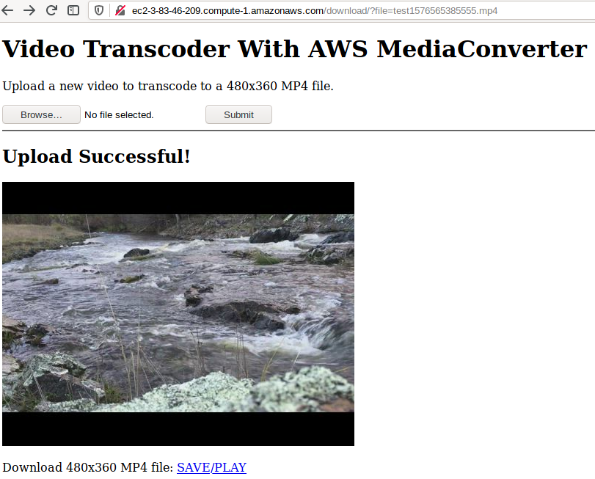
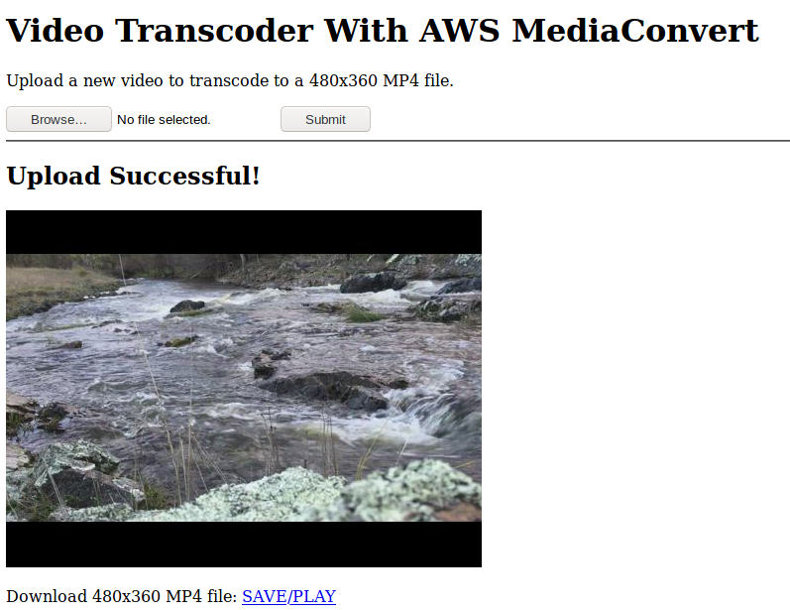

Slide 4
