Slide 1
Order Matching Engine
Terry Cheng

Slide 2
Order Concept
Order Matching Engine

Slide 3

Order Matching Engine – Order Concept

Slide 4

Order Matching Engine – Order Concept
Order

Slide 5

Order Matching Engine – Order Concept
Order
Matching

Slide 6
Orderbook
Order details
Order Matching Engine – Order Concept
Unfilled
Order
Matching

Slide 7
Orderbook
Order details
Order Matching Engine – Order Concept
Unfilled
Order
Matching

Slide 8

Orderbook
Order details
Order Matching Engine – Order Concept
Unfilled
Order
Matching
Fully Filled
Orderbook
Order details
Order / Trade

Slide 9
Orderbook
Order details
Order Matching Engine – Order Concept
Unfilled
Order
Matching
Fully Filled
Orderbook
Order details
Order / Trade

Slide 10
Orderbook
Order details
Order Matching Engine – Order Concept
Unfilled
Order
Matching
Fully Filled
Orderbook
Order details
Order / Trade

Slide 11
Orderbook
Order details
Order Matching Engine – Order Concept
Unfilled
Order / Trade
Partially Filled
Order
Matching
Orderbook
Order details
Orderbook
Order details
Fully Filled
Orderbook
Order details
Order / Trade

Slide 12
Orderbook
Order details
Order Matching Engine – Order Concept
Unfilled
Order / Trade
Partially Filled
Order
Matching
Orderbook
Order details
Orderbook
Order details
Fully Filled
Orderbook
Order details
Order / Trade

Slide 13
Orderbook
Order details
Order Matching Engine – Order Concept
Unfilled
Order / Trade
Partially Filled
Order
Matching
Orderbook
Order details
Orderbook
Order details
Fully Filled
Orderbook
Order details
Order / Trade

Slide 14
Orderbook
Order details
Order Matching Engine – Order Concept
Unfilled
Order / Trade
Partially Filled
Order
Matching
Orderbook
Order details
Orderbook
Order details
Fully Filled
Orderbook
Order details
Order / Trade

Slide 15
Orderbook
Order details
Order Matching Engine – Order Concept
Unfilled
Order / Trade
Partially Filled
Order
Matching
Orderbook
Order details
Orderbook
Order details
Fully Filled
Orderbook
Order details
Order / Trade

Slide 16
Matching Concept
Order Matching Engine

Slide 17
Order Matching Engine – Matching Concept
Redis fetch
Get order from Redis
BigDecimal operation
Trade update
Redis update
Add order to orderbook

Slide 18
Order Matching Engine – Matching Concept
Redis fetch
Get order from Redis
BigDecimal operation
Trade update
Redis update
Add order to orderbook

Slide 19
Order Matching Engine – Matching Concept
Redis fetch
Get order from Redis
BigDecimal operation
Trade update
Redis update
Add order to orderbook

Slide 20
Order Matching Engine – Matching Concept
Redis fetch
Get order from Redis
BigDecimal operation
Trade update
Redis update
Add order to orderbook

Slide 21
21
Order Matching Engine – Matching Concept
Redis fetch
Get order from Redis
BigDecimal operation
Trade update
Redis update
Add order to orderbook

Slide 22
Order Matching Engine – Matching Concept
Redis fetch
Get order from Redis
BigDecimal operation
Trade update
Redis update
Add order to orderbook

Slide 23
Order Matching Engine – Matching Concept
Redis fetch
Get order from Redis
BigDecimal operation
Trade update
Redis update
Add order to orderbook

Slide 24
Testcase
Order Matching Engine

Slide 25
Order Matching Engine – Testcase
Buy orders:
Start at 50,000 USDT, increase by 1 USDT up to 51,000 USDT.
Sell orders:
Start at 51,000 USDT, decrease by 1 USDT down to 50,000 USDT.
Order quantity:
- 1 BTC for all orders, except sell orders below 50,500 USDT are 2 BTC.

Slide 26
Order Matching Engine – Testcase
Unfilled
Fully Filled
Partially Filled
0
999
1499
1999

Slide 27
Testcase Result
Order Matching Engine

Slide 31
Notes:
1003筆開始，1003極值排除

Slide 36
Total Processing Time (s)

Slide 37
Unfilled
Fully Filled
Partially Filled
0
999
1499
1999

Slide 38
Unfilled
Fully Filled
Partially Filled
0
999
1499
1999

Slide 39
Unfilled
Fully Filled
Partially Filled
0
999
1499
1999

Slide 40
Unfilled
Fully Filled
Partially Filled
0
999
1499
1999

Slide 41
Unfilled
Fully Filled
Partially Filled
0
999
1499
1999

Slide 42
Sum
Order Matching Engine

Slide 43
Thanks for listening!
Terry Cheng

Slide 44
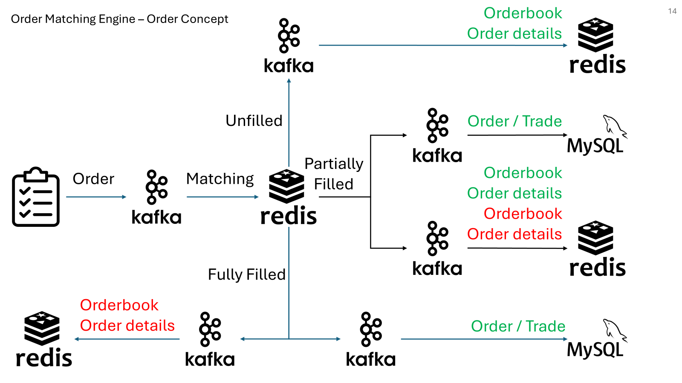
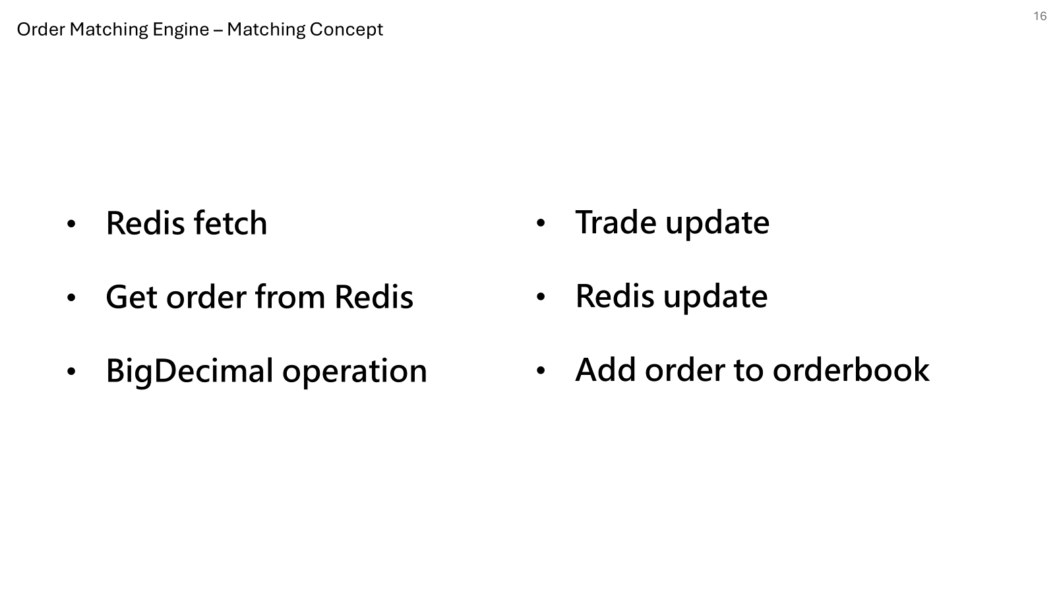
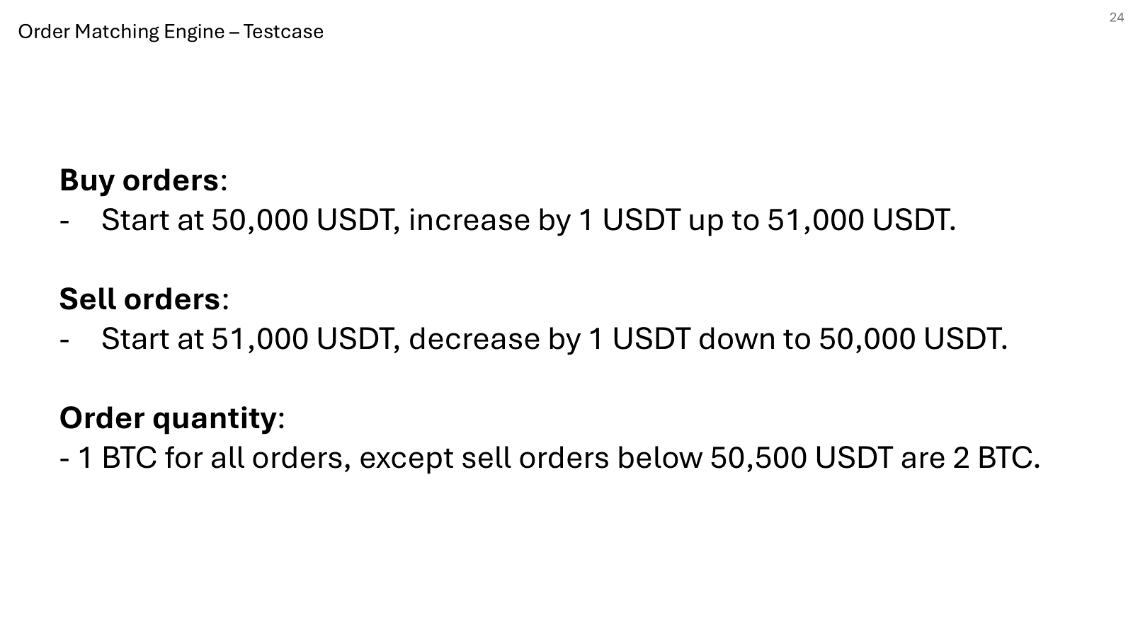
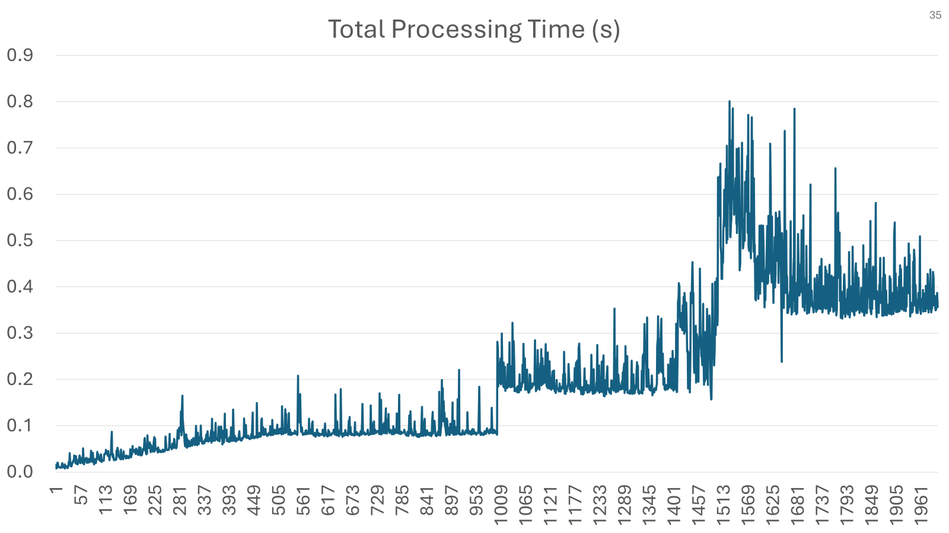
AMA

Slide 45
Orderbook
Order details
Unfilled
Order / Trade
Partially Filled
Order
Matching
Orderbook
Orderbook
Order details
Order details
Fully Filled
Orderbook
Order details
Order / Trade

Slide 46
Order Matching Engine – Matching Concept
Object creation time（totalObjectCreationTime）：
創建 Redis 的 TypedTuple 和對手訂單的相關對象。
Redis fetch time（totalRedisFetchTime）：
從 Redis 的 ZSet 中抓取對手訂單的列表（對手訂單可能是從最低或最高價格取出來的）。
Get order from Redis time（totalGetOrderFromRedisTime）：
從 Redis 中取出具體的對手訂單資訊，取得完整的訂單資料。
BigDecimal operation time（totalBigDecimalOperationTime）：
計算可交易的數量，以及比較訂單價格是否符合匹配條件。
Trade update time（totalTradeUpdateTime）：
更新交易資料，包括填充的數量，並將交易保存進資料庫（或其他系統）。
Redis update time（totalRedisUpdateTime）：
更新 Redis 中的訂單狀態，並刪除或更新對手訂單的數量，根據匹配結果將部分填充或未填充的訂單回寫到訂單簿。
Add order to orderbook time（totalAddOrderToOrderbookTime）：
如果是限價單且未完全匹配，將剩餘的訂單放回 Redis 的 ZSet 內，保留在訂單簿中等待後續匹配。
Untracked time（untrackedTime）：
處理過程中未被明確計算的其他時間，例如方法內部的邏輯處理或系統調用開銷等。
Order processing time（totalProcessingTime）：
整個訂單匹配流程所花費的總時間，包含所有已追蹤和未追蹤的時間。

