Slide 1
Order Matching Engine
Terry Cheng

Slide 2
Order Concept
Order Matching Engine

Slide 3

Order Matching Engine – Order Concept

Slide 4

Order Matching Engine – Order Concept
Order

Slide 5

Order Matching Engine – Order Concept
Order
Matching

Slide 6
Orderbook
Order details
Order Matching Engine – Order Concept
Unfilled
Order
Matching

Slide 7
Orderbook
Order details
Order Matching Engine – Order Concept
Unfilled
Order
Matching

Slide 8

Orderbook
Order details
Order Matching Engine – Order Concept
Unfilled
Order
Matching
Fully Filled
Orderbook
Order details
Order / Trade

Slide 9
Orderbook
Order details
Order Matching Engine – Order Concept
Unfilled
Order
Matching
Fully Filled
Orderbook
Order details
Order / Trade

Slide 10
Orderbook
Order details
Order Matching Engine – Order Concept
Unfilled
Order
Matching
Fully Filled
Orderbook
Order details
Order / Trade

Slide 11
Orderbook
Order details
Order Matching Engine – Order Concept
Unfilled
Order / Trade
Partially Filled
Order
Matching
Orderbook
Order details
Orderbook
Order details
Fully Filled
Orderbook
Order details
Order / Trade

Slide 12
Orderbook
Order details
Order Matching Engine – Order Concept
Unfilled
Order / Trade
Partially Filled
Order
Matching
Orderbook
Order details
Orderbook
Order details
Fully Filled
Orderbook
Order details
Order / Trade

Slide 13
Orderbook
Order details
Order Matching Engine – Order Concept
Unfilled
Order / Trade
Partially Filled
Order
Matching
Orderbook
Order details
Orderbook
Order details
Fully Filled
Orderbook
Order details
Order / Trade

Slide 14
Orderbook
Order details
Order Matching Engine – Order Concept
Unfilled
Order / Trade
Partially Filled
Order
Matching
Orderbook
Order details
Orderbook
Order details
Fully Filled
Orderbook
Order details
Order / Trade

Slide 15
Orderbook
Order details
Order Matching Engine – Order Concept
Unfilled
Order / Trade
Partially Filled
Order
Matching
Orderbook
Order details
Orderbook
Order details
Fully Filled
Orderbook
Order details
Order / Trade

Slide 16
Matching Concept
Order Matching Engine

Slide 17
Order Matching Engine – Matching Concept
Redis fetch
Get order from Redis
Trade update
Redis update
Add order to orderbook

Slide 18
Order Matching Engine – Matching Concept
Redis fetch
Get order from Redis
Trade update
Redis update
Add order to orderbook

Slide 19
Order Matching Engine – Matching Concept
Redis fetch
Get order from Redis
Trade update
Redis update
Add order to orderbook

Slide 20
Order Matching Engine – Matching Concept
Redis fetch
Get order from Redis
Trade update
Redis update
Add order to orderbook

Slide 21
Order Matching Engine – Matching Concept
Redis fetch
Get order from Redis
Trade update
Redis update
Add order to orderbook

Slide 22
Order Matching Engine – Matching Concept
Redis fetch
Get order from Redis
Trade update
Redis update
Add order to orderbook

Slide 23
Testcase
Order Matching Engine

Slide 24
Order Matching Engine – Testcase
Buy orders:
Start at 50,000 USDT, increase by 1 USDT up to 51,000 USDT.
Sell orders:
Start at 51,000 USDT, decrease by 1 USDT down to 50,000 USDT.
Order quantity:
- 1 BTC for all orders, except sell orders below 50,500 USDT are 2 BTC.

Slide 25
Order Matching Engine – Testcase
Unfilled
Fully Filled
Partially Filled
0
999
1499
1999

Slide 26
Testcase Result
Order Matching Engine

Slide 30
Notes:
1003筆開始，1003極值排除

Slide 36
Unfilled
Fully Filled
Partially Filled
0
999
1499
1999

Slide 37
Unfilled
Fully Filled
Partially Filled
0
999
1499
1999

Slide 38
Unfilled
Fully Filled
Partially Filled
0
999
1499
1999

Slide 39
Unfilled
Fully Filled
Partially Filled
0
999
1499
1999

Slide 40
Unfilled
Fully Filled
Partially Filled
0
999
1499
1999

Slide 41
Tuning
Order Matching Engine

Slide 46
Sum
Order Matching Engine

Slide 47
Thanks for listening!
Terry Cheng

Slide 48
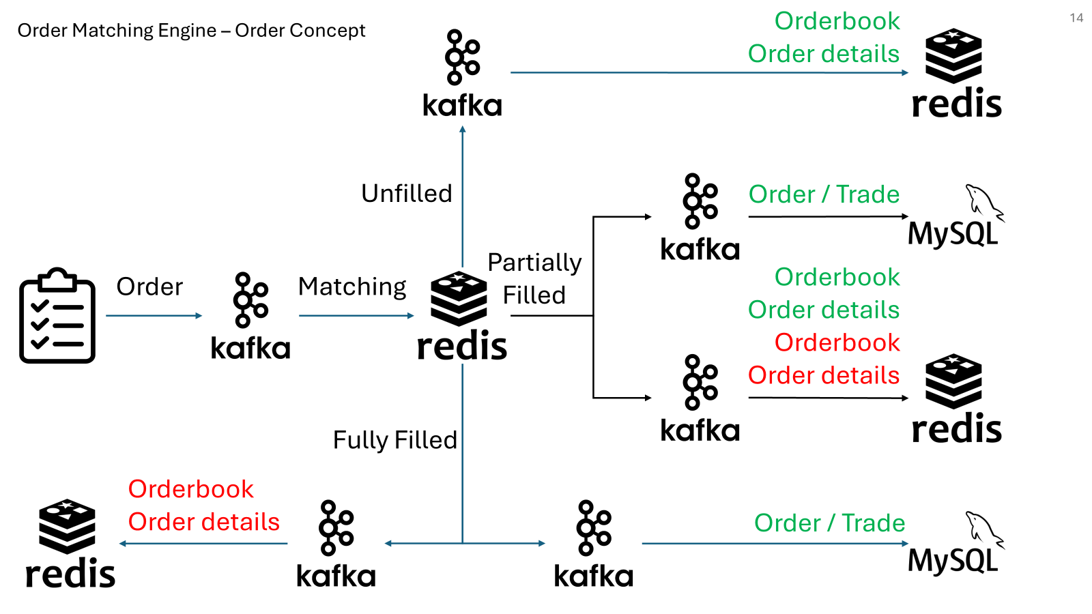
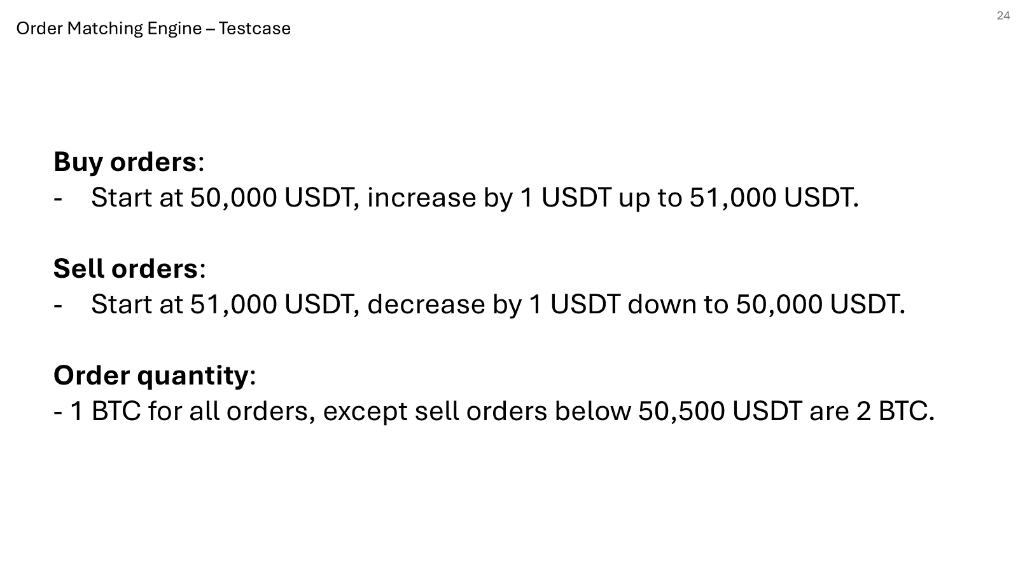
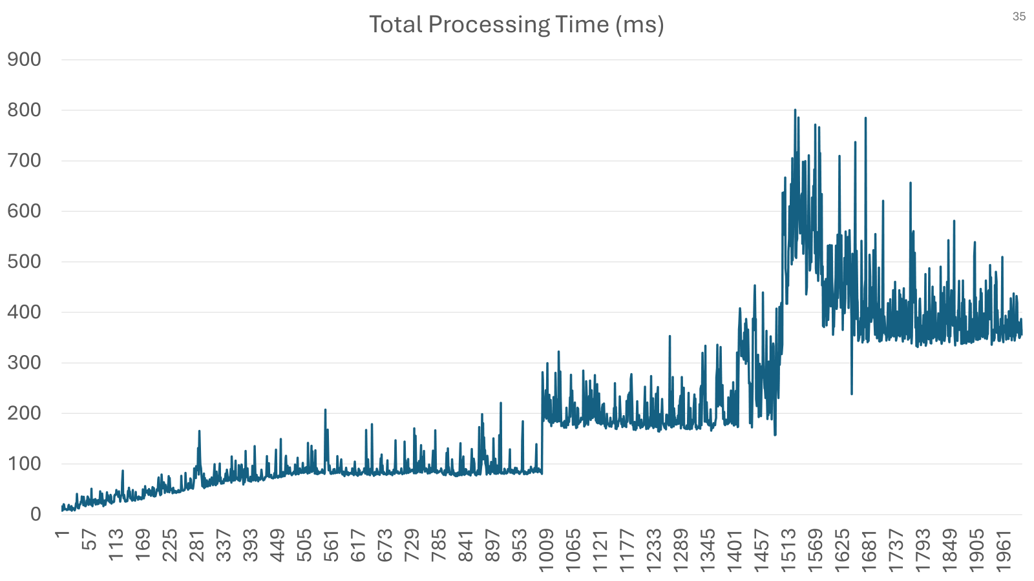
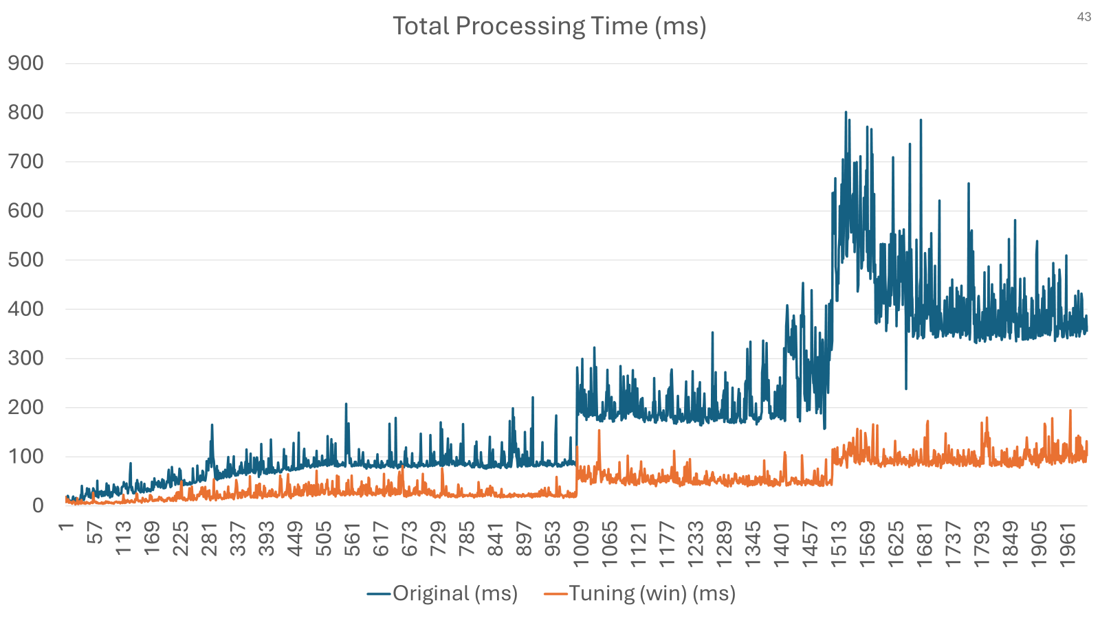
AMA

Slide 49
Orderbook
Order details
Unfilled
Order / Trade
Partially Filled
Order
Matching
Orderbook
Orderbook
Order details
Order details
Fully Filled
Orderbook
Order details
Order / Trade

Slide 50
Order Matching Engine – Matching Concept
Object creation time（totalObjectCreationTime）：
創建 Redis 的 TypedTuple 和對手訂單的相關對象。
Redis fetch time（totalRedisFetchTime）：
從 Redis 的 ZSet 中抓取對手訂單的列表（對手訂單可能是從最低或最高價格取出來的）。
Get order from Redis time（totalGetOrderFromRedisTime）：
從 Redis 中取出具體的對手訂單資訊，取得完整的訂單資料。
BigDecimal operation time（totalBigDecimalOperationTime）：
計算可交易的數量，以及比較訂單價格是否符合匹配條件。
Trade update time（totalTradeUpdateTime）：
更新交易資料，包括填充的數量，並將交易保存進資料庫（或其他系統）。
Redis update time（totalRedisUpdateTime）：
更新 Redis 中的訂單狀態，並刪除或更新對手訂單的數量，根據匹配結果將部分填充或未填充的訂單回寫到訂單簿。
Add order to orderbook time（totalAddOrderToOrderbookTime）：
如果是限價單且未完全匹配，將剩餘的訂單放回 Redis 的 ZSet 內，保留在訂單簿中等待後續匹配。
Untracked time（untrackedTime）：
處理過程中未被明確計算的其他時間，例如方法內部的邏輯處理或系統調用開銷等。
Order processing time（totalProcessingTime）：
整個訂單匹配流程所花費的總時間，包含所有已追蹤和未追蹤的時間。

