Slide 1
Dc3n
Trade Smarter
Back end
鄭翼祥 / Terry Cheng

Slide 2
Project Concept

Slide 3
Order - Create, Update, Cancel - Identity verification
Order Matching - Fairness (price-time priority) - Transaction per second (High traffic)
Data Streaming - Data calculate - Data pushing

Slide 4
Order - Create, Update, Cancel - Identity verification
Order Matching - Fairness (price-time priority) - Transaction per second (High traffic)
Data Streaming - Data calculate - Data pushing

Slide 5
Order - Create, Update, Cancel - Identity verification
Order Matching - Fairness (price-time priority) - Transaction per second (High traffic)
Data Streaming - Data calculate - Data pushing

Slide 6
Order - Create, Update, Cancel - Identity verification
Order Matching - Fairness (price-time priority) - Transaction per second (High traffic)
Data Streaming - Data calculate - Data pushing

Slide 7
Order Concept

Slide 8



Order
Matching

Slide 9
Orderbook
Order details
Unfilled
Order
Matching

Slide 10

Orderbook
Order details
Unfilled
Order
Matching
Fully Filled
Orderbook
Order details
Order / Trade

Slide 11
Orderbook
Order details
Unfilled
Order / Trade
Partially Filled
Order
Matching
Orderbook
Order details
Orderbook
Order details
Fully Filled
Orderbook
Order details
Order / Trade

Slide 12
Architecture

Slide 13











Persistent Data
Cache
Logger
DNS
Service
Load
Balance
Order
Matching
Auto
Scaling

Slide 14
Test Case

Slide 15
Unfilled
Fully Filled
Partially Filled
0
999
1499
1999

Slide 16
Unfilled
Fully Filled
Partially Filled
0
999
1499
1999

Slide 17
Tuning

Slide 20
 | POC | Tuning - 1 | Tuning – 2
Redis Search | Template | Pipeline Lua
Redis Server | Windows |  | macOS

Slide 21
 | POC | Tuning - 1 | Tuning – 2
Redis Search | Template | Pipeline Lua
Redis Server | Windows |  | macOS

Slide 22
 | POC | Tuning - 1 | Tuning – 2
Redis Search | Template | Pipeline Lua
Redis Server | Windows |  | macOS

Slide 24
 | POC | Tuning – 3 | Tuning - 4 | Tuning - 5
Data Structure | Z-set + Hash | Z-set + Hash In-Memory Z-set
Data Stream | Snapshot |  | Snapshot Delta
Decoupling | Order -> Streaming |  |  | Order Streaming

Slide 25
 | POC | Tuning – 3 | Tuning - 4 | Tuning - 5
Data Structure | Z-set + Hash | Z-set + Hash In-Memory Z-set
Data Stream | Snapshot |  | Snapshot Delta
Decoupling | Order -> Streaming |  |  | Order Streaming

Slide 26
 | POC | Tuning – 3 | Tuning - 4 | Tuning - 5
Data Structure | Z-set + Hash | Z-set + Hash In-Memory Z-set
Data Stream | Snapshot |  | Snapshot Delta
Decoupling | Order -> Streaming |  |  | Order Streaming

Slide 28
Cloud

Slide 29
Unfilled
Fully Filled
Partially Filled
0
999
1499
1999

Slide 30
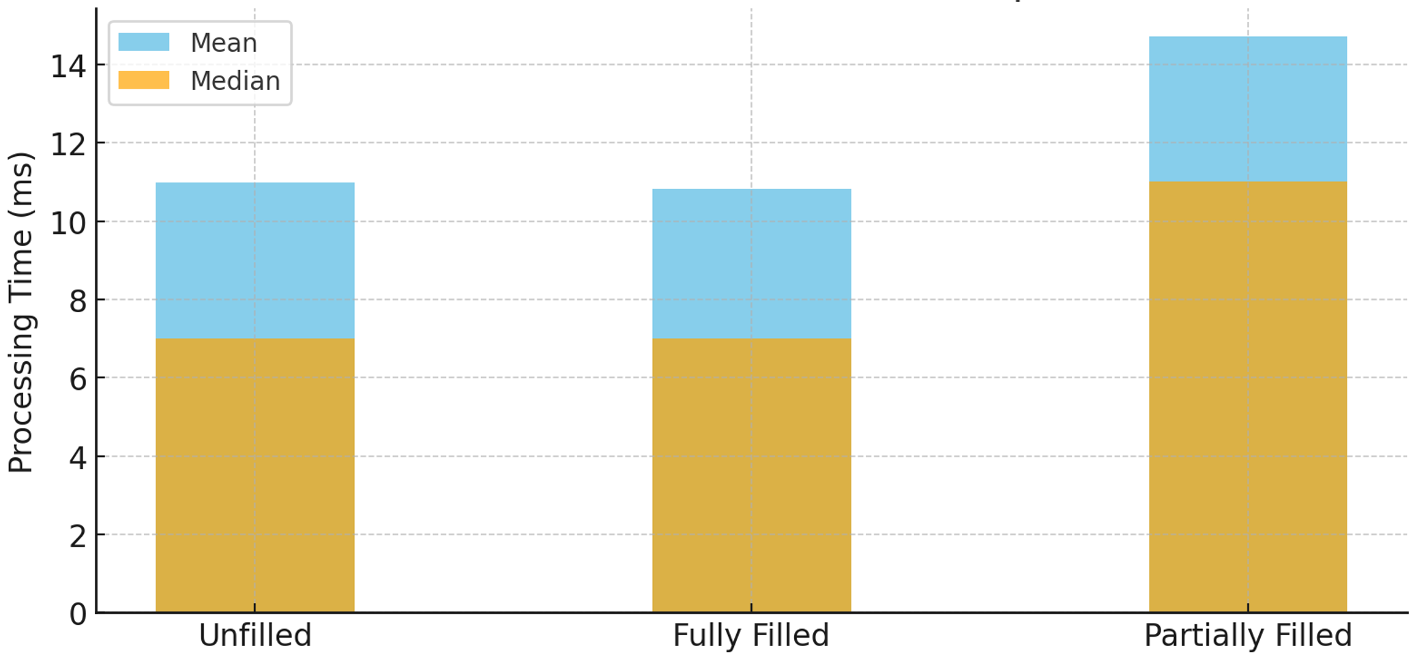
Mean and Median Comparison

Slide 31
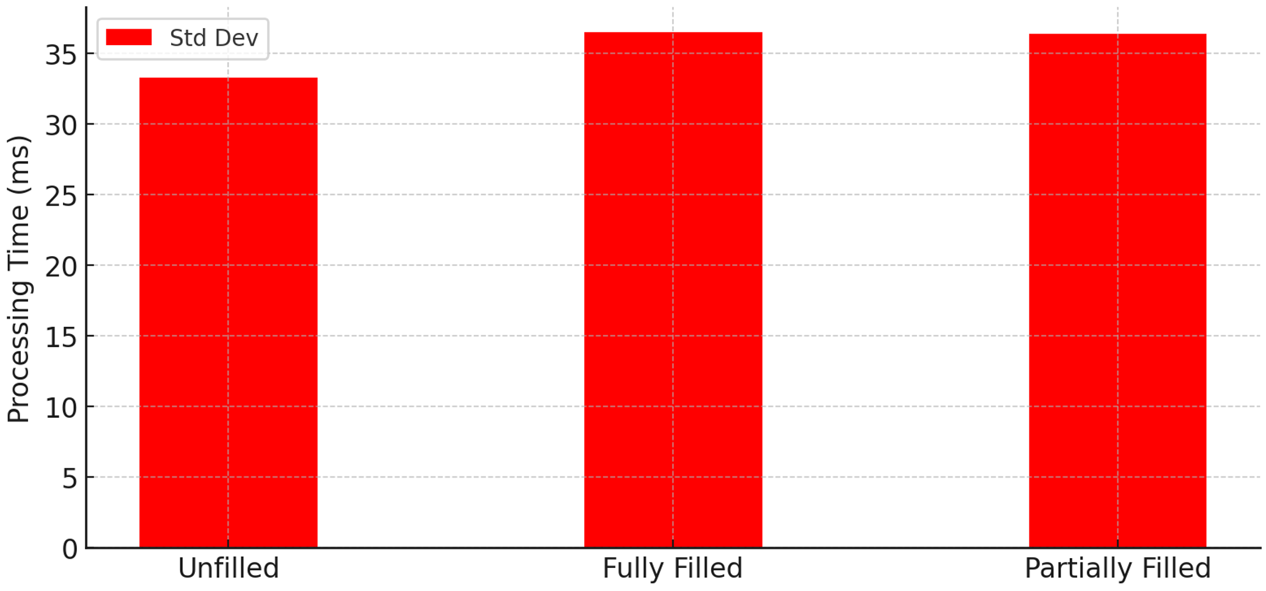
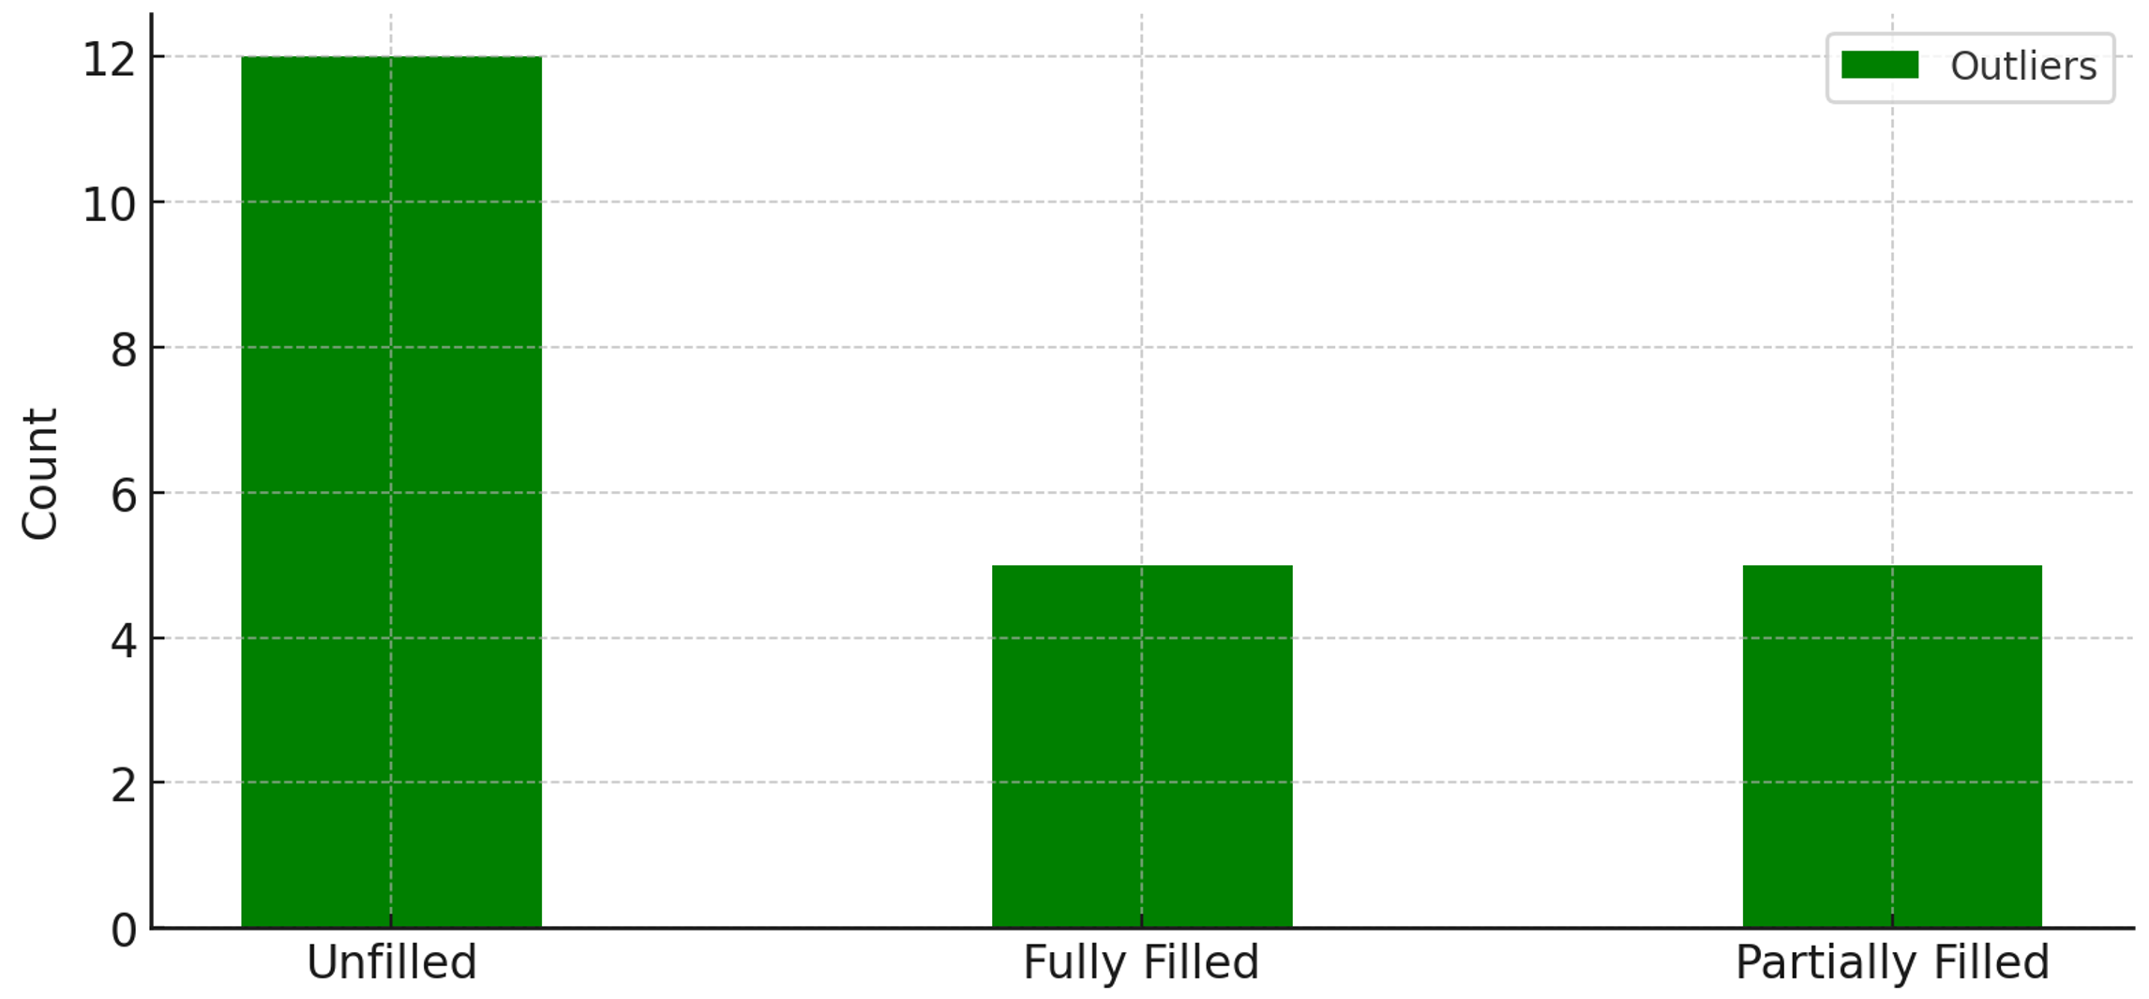
Standard Deviation
Number of Outliers

Slide 32
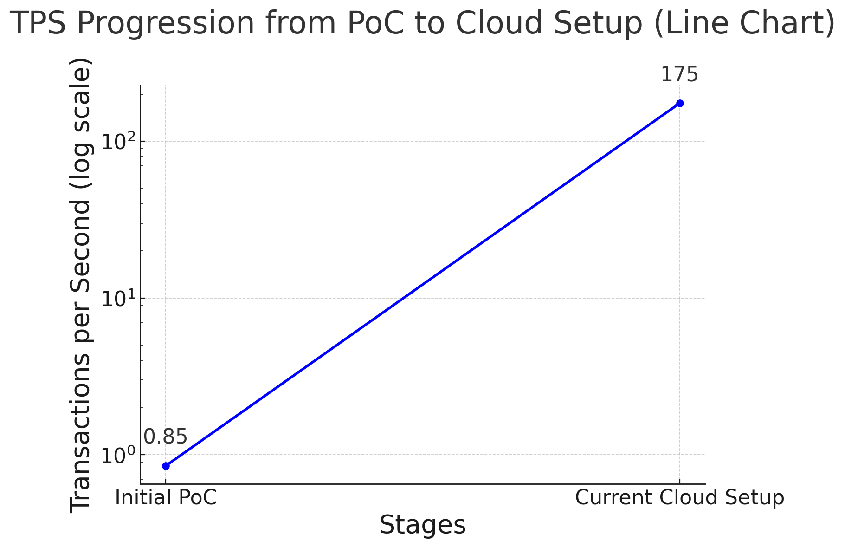

Slide 33
Conclusion

Slide 34
Speed-up
Local : 260x
Cloud : 205x

Slide 35
Future Work

Slide 36
Cluster & Data center
Decouple
Batch matching
Futures
Network

Slide 37
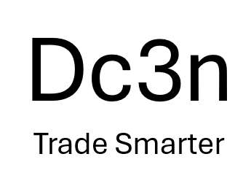
Thanks for listening
Back end
鄭翼祥 / Terry Cheng

