Slide 1
Dc3n
Trade Smarter
Back end
鄭翼祥 / Terry Cheng

Slide 2
Project Concept

Slide 3
Order - Create, Update, Cancel - Identity verification
Order Matching - Fairness (price-time priority) - Transaction per second (High traffic)
Data Streaming - Data calculate - Data pushing

Slide 4
Order - Create, Update, Cancel - Identity verification
Order Matching - Fairness (price-time priority) - Transaction per second (High traffic)
Data Streaming - Data calculate - Data pushing

Slide 5
Order - Create, Update, Cancel - Identity verification
Order Matching - Fairness (price-time priority) - Transaction per second (High traffic)
Data Streaming - Data calculate - Data pushing

Slide 6
Order - Create, Update, Cancel - Identity verification
Order Matching - Fairness (price-time priority) - Transaction per second (High traffic)
Data Streaming - Data calculate - Data pushing

Slide 7
Order Concept

Slide 8



Order
Matching

Slide 9
Orderbook
Order details
Unfilled
Order
Matching

Slide 10

Orderbook
Order details
Unfilled
Order
Matching
Fully Filled
Orderbook
Order details
Order / Trade

Slide 11
Orderbook
Order details
Unfilled
Order / Trade
Partially Filled
Order
Matching
Orderbook
Order details
Orderbook
Order details
Fully Filled
Orderbook
Order details
Order / Trade

Slide 12
Architecture

Slide 13











Persistent Data
Cache
Logger
DNS
Service
Load
Balance
Order
Matching
Auto
Scaling

Slide 14
Persistent Data
Cache
Logger
DNS
Service
Load
Balance
Order
Matching
Auto
Scaling

Slide 15
Persistent Data
Cache
Logger
DNS
Service
Load
Balance
Order
Matching
Auto
Scaling

Slide 16
Demo - 1

Slide 17
Test Case

Slide 18
Unfilled
Fully Filled
Partially Filled
0
999
1499
1999

Slide 19
Unfilled
Fully Filled
Partially Filled
0
999
1499
1999

Slide 20
Tuning

Slide 23
 | POC | Tuning - 1 | Tuning – 2
Redis Search | Template | Pipeline Lua
Redis Server | Windows |  | macOS

Slide 24
 | POC | Tuning - 1 | Tuning – 2
Redis Search | Template | Pipeline Lua
Redis Server | Windows |  | macOS

Slide 25
 | POC | Tuning - 1 | Tuning – 2
Redis Search | Template | Pipeline Lua
Redis Server | Windows |  | macOS

Slide 27
 | POC | Tuning – 3 | Tuning - 4 | Tuning - 5
Data Structure | Z-set + Hash | Z-set + Hash In-Memory Z-set
Data Stream | Snapshot |  | Snapshot Delta
Decoupling | Order -> Streaming |  |  | Order Streaming

Slide 28
 | POC | Tuning – 3 | Tuning - 4 | Tuning - 5
Data Structure | Z-set + Hash | Z-set + Hash In-Memory Z-set
Data Stream | Snapshot |  | Snapshot Delta
Decoupling | Order -> Streaming |  |  | Order Streaming

Slide 29
 | POC | Tuning – 3 | Tuning - 4 | Tuning - 5
Data Structure | Z-set + Hash | Z-set + Hash In-Memory Z-set
Data Stream | Snapshot |  | Snapshot Delta
Decoupling | Order -> Streaming |  |  | Order Streaming

Slide 31
Demo - 2

Slide 32
Cloud

Slide 33
Unfilled
Fully Filled
Partially Filled
0
999
1499
1999

Slide 34
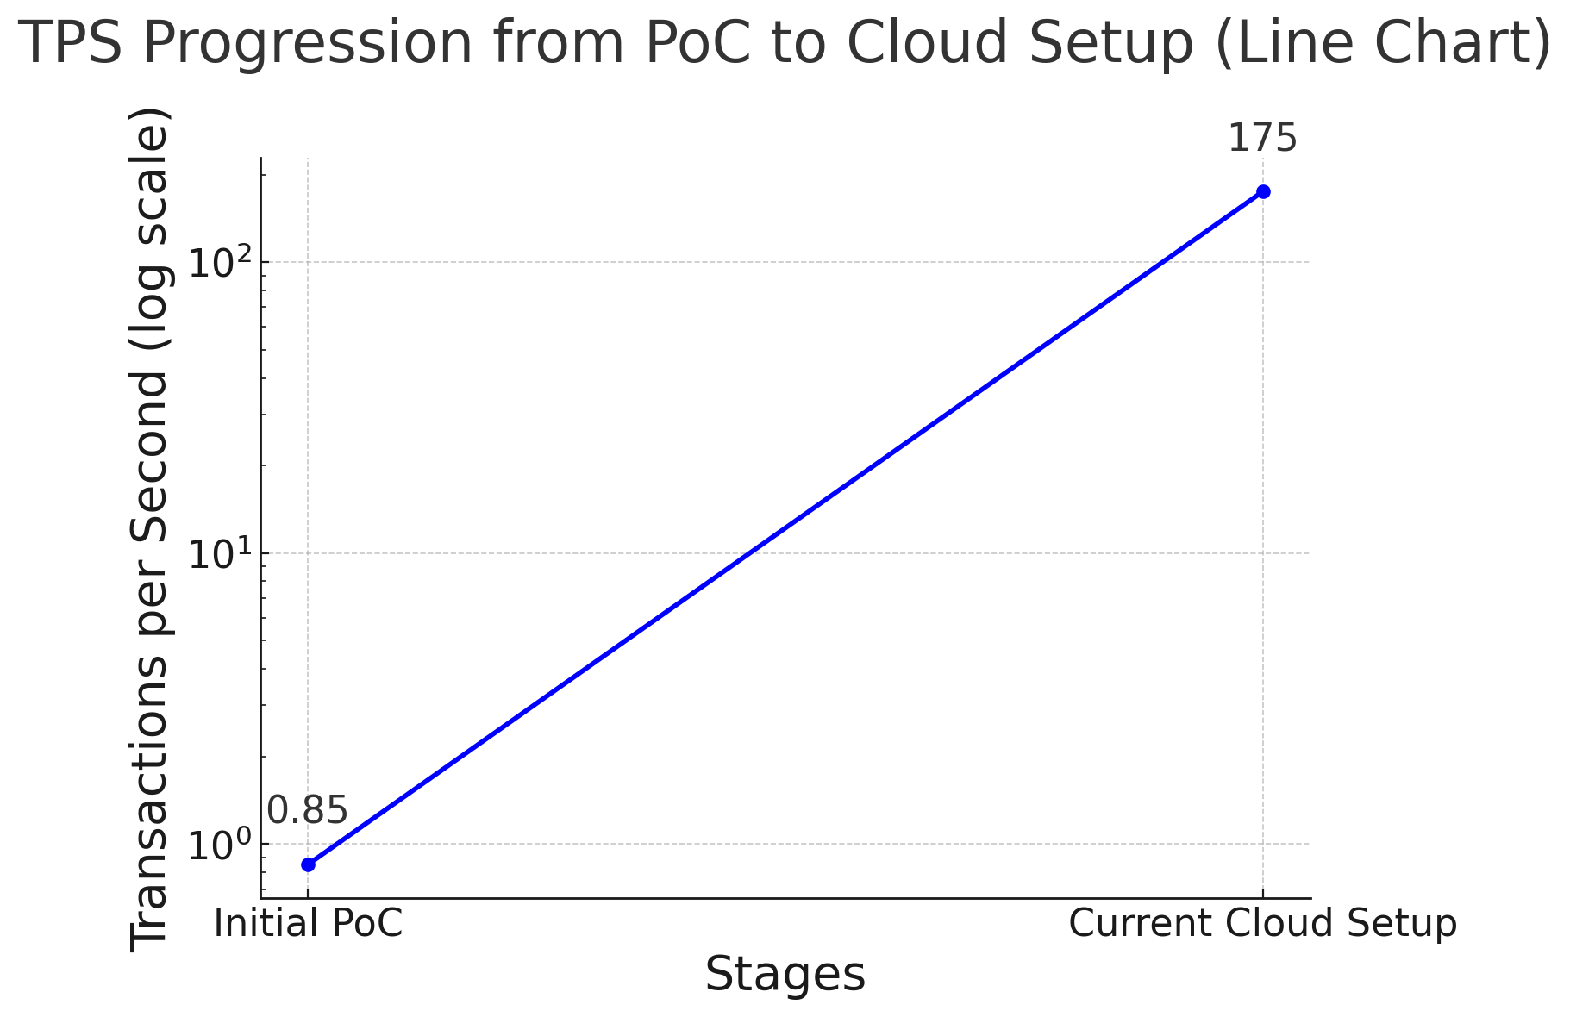

Slide 35
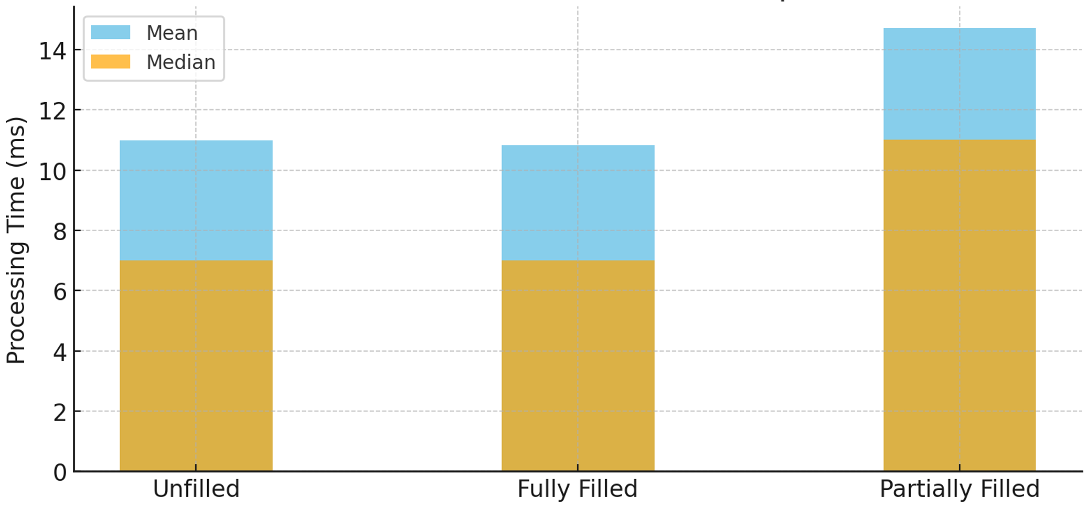
Mean and Median Comparison

Slide 36
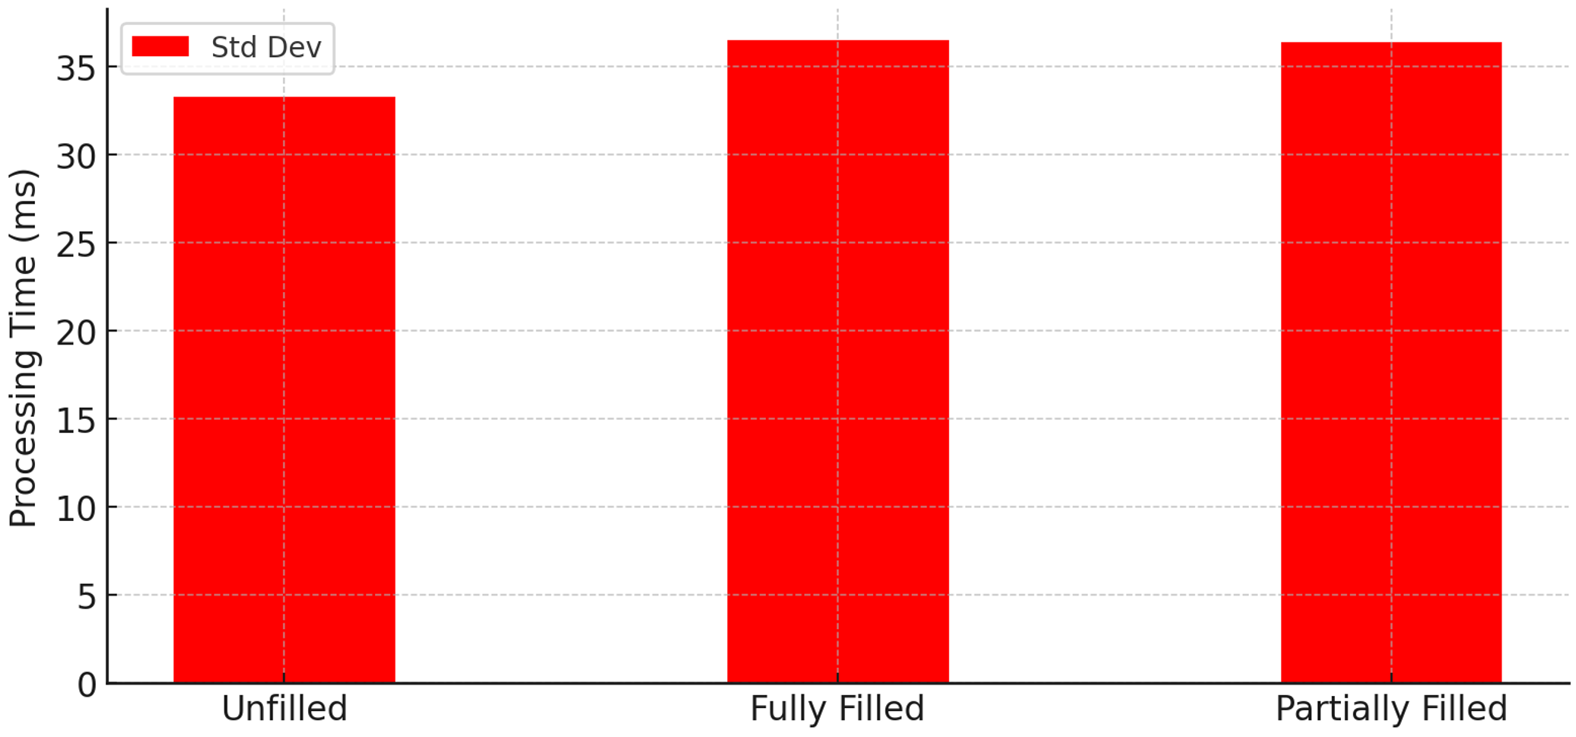
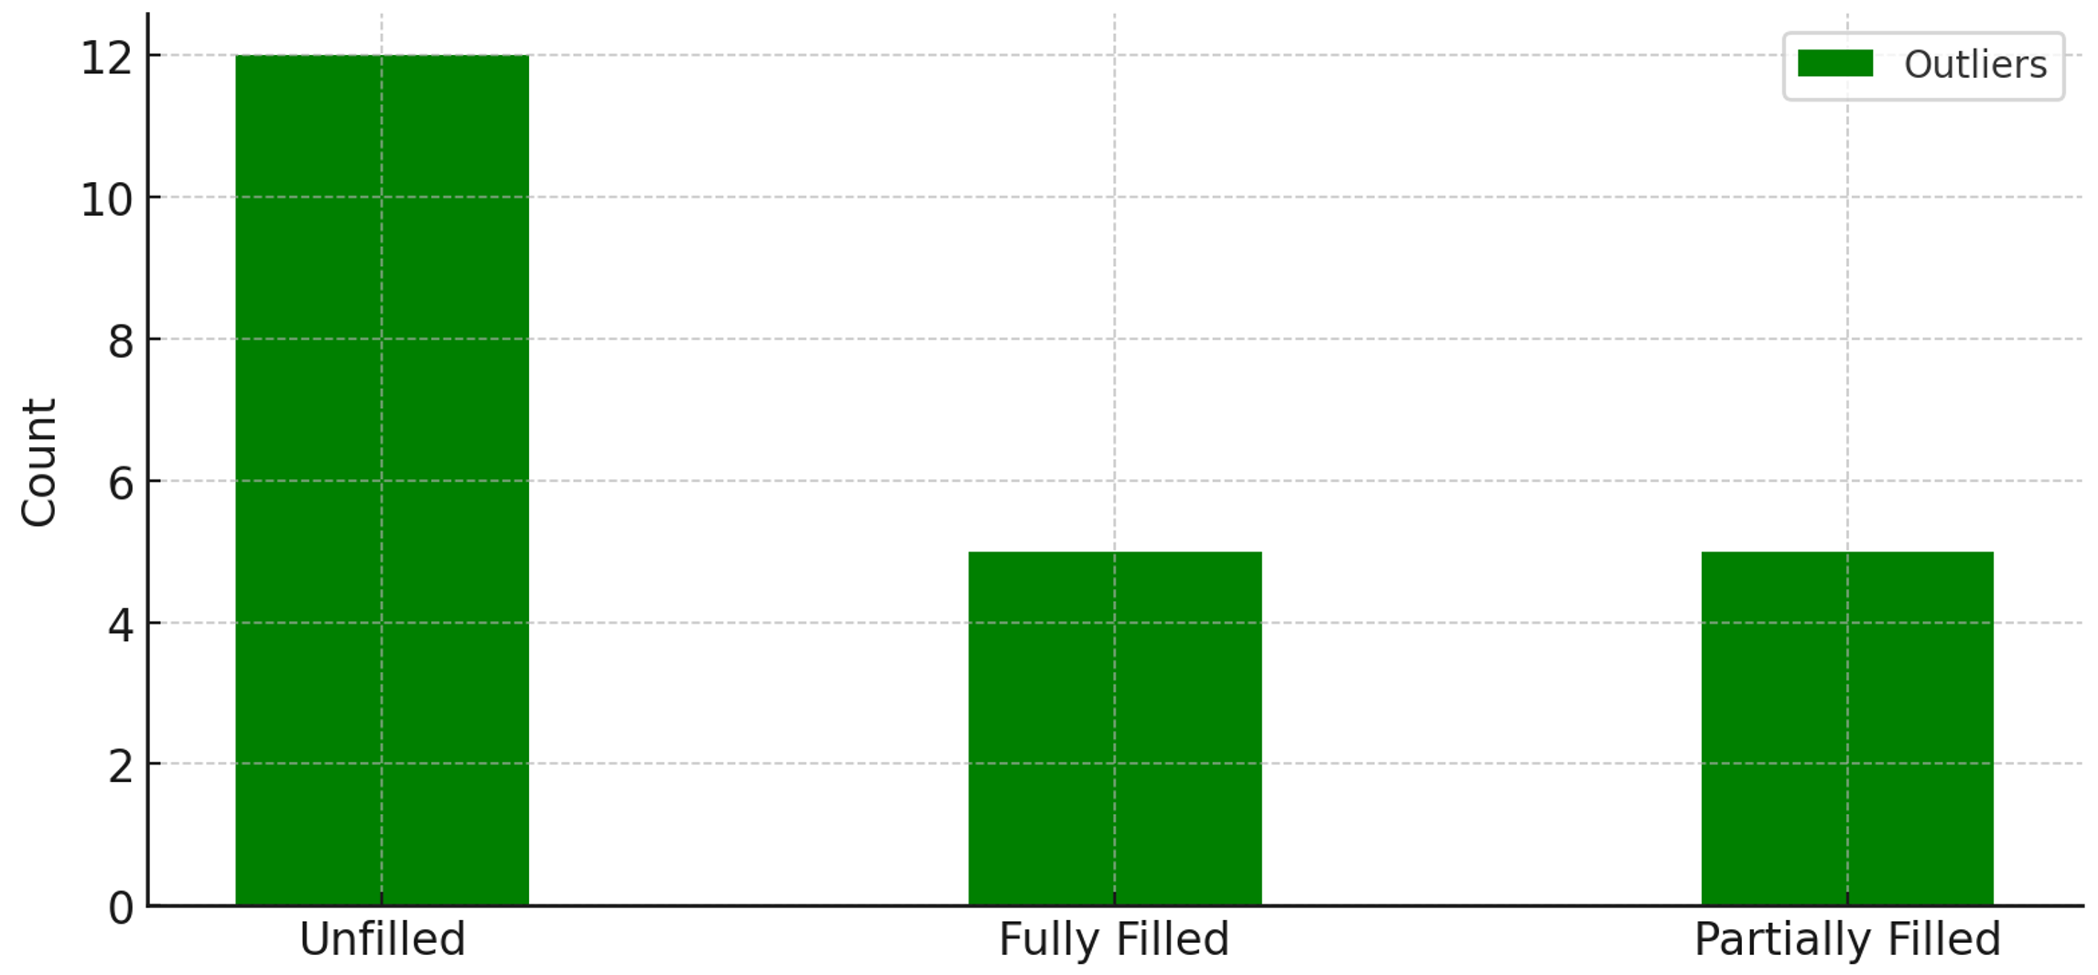
Standard Deviation
Number of Outliers

Slide 37
Conclusion

Slide 38
Speed-up
Local : 260x
Cloud : 205x

Slide 39
Future Work

Slide 40
Cluster & Data center
Decouple
Batch matching
Network

Slide 41
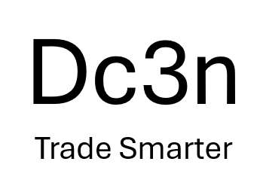
Thanks for listening
Back end
鄭翼祥 / Terry Cheng

