Slide 1
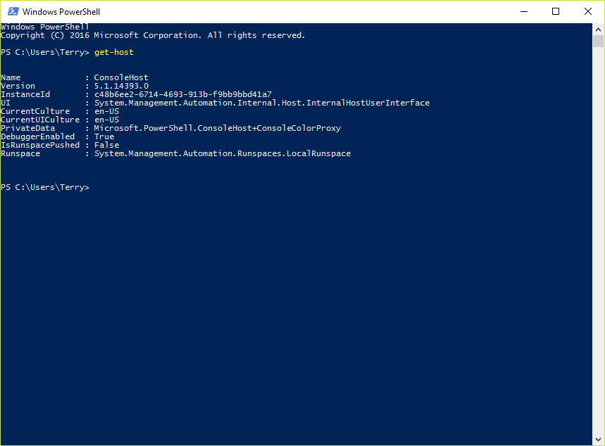
Export-ExO
By Terry E Dow
2017-01-17

Slide 2
What is it? Export-ExO
A suite of PowerShell Exchange Online Get/Export/Search command wrappers.
Suite supports not only Exchange Online (256), but also some SharePoint & SkyDrive (14), Skype for Business (19) and Unified Messaging (15) exports.
Executing computer requires the latest version of:
Microsoft Online Services Sign-in Assistant (msoidcli_v*.msi)
Windows Azure Active Directory Module for Windows PowerShell (AdministrationConfig-EN.MSI)

Slide 3
Why use it? Export-ExO
Collect Exchange Online metrics to local files.
History data can be kept longer than Office 365 online metrics (7 to 60 days).
A collection of export files over time can produce trend analysis.
Troubleshoot/recover changes to infrastructure, users and group with before and after evidence.
Support for Exchange Online message trace to local (deliverable) files.

Slide 4
Why use these command wrappers?
Support for CmdletBinding and CommonParameters (-Debug, -Verbose, -WhatIf, et al).
When Debug or Verbose is used, automatically starts/stops a transcript. Transcript file is written in the same location as the export, with the same file base name.
Export file name includes sortable data/time stamp with time zone offset in support of global aggregation or analysis. Unique export file names prevent writing over prior data.
Export file name includes name of the script and environmental information such as Forest, Domain, Exchange Organization or executing Computer name.
Support for secure remote credentials when Windows Integrated Authentication is not an option.
Each script execution’s time stamp is visible in Task Manager’s process details “Command line” column.
Exports are most often Excel compatible CSV files. Note: the export folder is highly compressible.
No hard coded folder path names, can be ran from any folder.
Supports UNC export folder for centralized data collection. Defaults to local subfolder (.\Reports) which is auto-created.
Supports single level expansion of multi-value properties, instead of native Export-CSV behavior.
Supports normalization of Exchange ByteQuantifiedSize values.
Supports emailing export file. Large export file can be zipped then emailed.
Can support “Alert Only” mode that only exports/emails unhealthy items.

Slide 5
How to use it? Export-ExO
Default CMD file (Export-ExoDaily.CMD) calls each of the scripts serially – to stay within your tenant’s PowerShell execution budget.
Little customization of the CMD file required for your tenant. Optionally supports SMTP server to email an export file if required.
Use an Azure Active Directory service account (password never expires) with Global Admin rights. The service account can be manually created or synchronized via Azure Active Directory Connector. Future improvements to Office 365 may not require Global Admin rights.
Create a scheduled task that calls the CMD file with the on-premises Active Directory service account and reference the Azure Active Directory service account.
Commands can be ran individually on demand. Most support an identity object parameter so exporting all (e.g. Get-MailboxPermission) is not required.

Slide 6
How to use it with remote credentials?
SchTasks runs in context of on-premises Active Directory service account. When accessing remote domain resources (e.g. Azure Active Directory) remote credentials are required.
SecureString encrypts with default Data Protection API (DPAPI) with a DataProtectionScope of CurrentUser and LocalMachine security tokens.
Login with the on-premises Active Directory service account on to the executing computer, open PowerShell in the script’s folder, execute the New-SecureCredentialPassword.CMD tool. When prompted, enter the remote service account password twice. An encrypted file is written.
.\SecureCredentialPassword.txt file contents sample:
01000000d08c9ddf0115d1118c7a00c04fc297eb010000007603d1100223044cbdbbb872a5cd9bc4…
This file can only be decrypted on this computer and only with the on-premises Active Directory service account credentials.
If the on-premises Active Directory and Azure Active Directory service account have the same user name, then use “–CredentialUser .” (period) to automatically use the scheduled tasks executing user’s user principal name (UPN) requiring less customization of CMD file.

Slide 7
Challenges? Export-ExO
Azure Active Directory service account may not honor PasswordNeverExpires. May require regular password change and updating of scheduled task credentials.
Set-MsolUser <UPN> -PasswordNeverExpires
Most scripts are a simple wrapper, execute Exchange Online command and export to CSV.
Some scripts required an input list. Nested commands have been built when appropriate. Each script is optimized to produce maximum output.
Few scripts run long so nested pipelining cannot be used with them. Tenant’s PowerShell execution budget will limit how long a script is allowed to run.
For example:
Get-MobileDevice … | Get-MobileDeviceStatistics … | Export-…
If Get-MobileDeviceStatistics runs long, Get-MobileDevice may timeout generating an incomplete list.
Use this instead to serialized remote commands instead of nesting:
$mobileDevices = Get-MobileDevice …
$mobileDevices | Get-MobileDeviceStatistics … | Export-…

