Slide 1
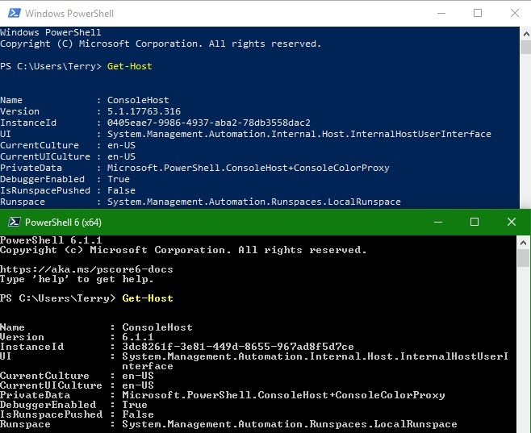
MSOfficeFindReplace
By Terry E Dow
2019-08-31
https://github.com/TerryED0618/MSOfficeFindReplace

Slide 2
Purpose of MSOfficeFindReplace
A set of PowerShell functions that performs bulk simple text replacements on Microsoft Office documents:
  Excel
  Outlook
  PowerPoint
  Word
Microsoft Office®, Microsoft Excel®, Microsoft Outlook®, Microsoft PowerPoint®, and Microsoft Word® are a registered trademarks of Microsoft Corporation.

Slide 3
Purpose of MSOfficeFindReplace
Simple text substitution only
  No wildcard support
  No regular expression [RegEx] support
Source text formatting is retained
One substitution file may be used for all operations with all documents and document types
Respective Microsoft Office document applications installation is required on executing workstation

Slide 4
What’s Inside MSOfficeFindReplace
A pair of functions for each application
  New-MS[Application]FindReplaceTextFile
    New-MSExcelFindReplaceTextFile
    New-MSOutlookFindReplaceTextFile
    New-MSPowerPointFindReplaceTextFile
    New-MSWordFindReplaceTextFile
  Update-MS[Application]FindReplaceTextDocument
    Update-MSExcelFindReplaceTextDocument
    Update-MSOutlookFindReplaceTextDocument
    Update-MSPowerPointFindReplaceTextDocument
    Update-MSWordFindReplaceMailMergeDocument
    Update-MSWordFindReplaceTextDocument

Slide 5
New-MS[Application]FindReplaceTextFile
New-MS[Application]FindReplaceTextFile is the set of functions that performs the following:
  Open one or more source documents (wildcard supported), as read only
  Applies the substitution file
  Creates one or more new resulting documents
  Closes source documents and application (as appropriate)

Slide 6
  Update-MS[Application]FindReplaceTextDocument
This set of functions updates a currently opened document
Called by respective New-MS[Application]FindReplaceTextFile function

Slide 7
Prepare Substitution File
Create a Microsoft Excel compatible CSV (Comma Separated Value) file
Microsoft Excel is not required
The CSV must have at least two column headings (case insensitive), all other columns are ignored:
  Find,Replace

Slide 8
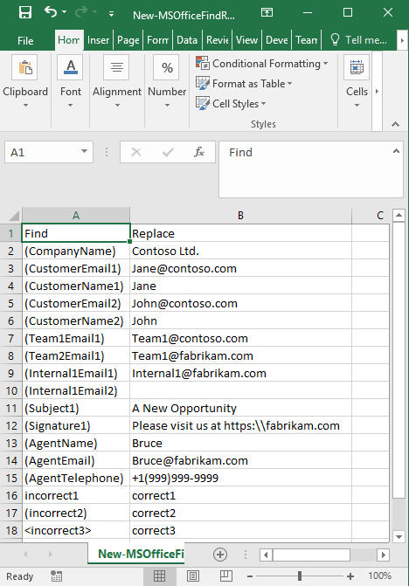
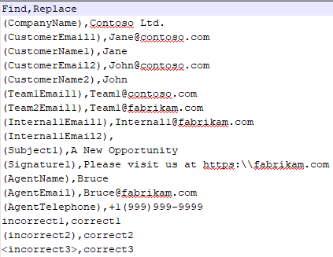
Prepare Substitution File
Example:
New-MSOfficeFindReplace-EXAMPLE.csv

Slide 9
Substitution File Limitation
Since the substitution file is simple, it is not possible to find/replace the same field from a list
  For example a “FirstName” cannot be substituted with more than one replacement value
The New-MS[Application]FindReplaceTextFile function can be used within another PowerShell script to dynamically create the substitution files from a list
See example script in this package’s .\MSOfficeFindReplace-Test folder
  New-FormEXAMPLE.cmd
  New-FormEXAMPLE.csv
  New-FormEXAMPLE.docx
  New-FormEXAMPLE.msg
  New-FormEXAMPLE.ps1

Slide 10
Prepare Microsoft Office document
Insert key words in the source Microsoft Office document
“(“ and “)” are Microsoft Word and Excel safe characters to wrap around key words to avoid unintentional matches
For example: New-MSWordFindReplaceTextFile-EXAMPLE.docx
  Dear (Greeting),
  (FirstName) we have a new opportunity we wanted to share with you.

Slide 11
Microsoft Excel Limitation
Use of parenthesis is safe as Find markers except when around a number.
  (NotANumber) – ok
  (Contains1Number) – ok
  (123N456) – ok
  (123) – not ok

Slide 12
Microsoft Outlook Limitation
Message HTMLBody is not supported
If a match is found in the HTMLBody, the message body is replaced with new text, HTML formatting is written over as Plain Text

Slide 13
New document file name options
The out file is generated by default in a subfolder called ‘.\Reports\’. The out file name is in the format of:
  <BaseName>[-<ExecutionSource>]-<date/time/timezone stamp>[-<OutFileNameTag>].<Extension>
-OutFolderPath - Specify which folder path to write the out file.
  Supports UNC and relative reference to the current folder.
  Except for UNC paths, this function will attempt to create and compress the output folder if it doesn't exist
-ExecutionSource - Specify the script's execution environment source
  Must be either; 'msExchOrganizationName', 'ForestName', 'DomainName', 'ComputerName', or an arbitrary string including '' or $NULL
    If msExchOrganizationName is requested, but there is no Microsoft Exchange organization, ForestName will be used
    If ForestName is requested, but there is no forest, DomainName will be used. The forest name is of the executing computer's domain membership
    If the DomainName is requested, but the computer is not a domain member, ComputerName is used. The domain name is of the executing computer's domain membership
  An arbitrary string can be used in the case where the Microsoft Exchange organization name, forest name or domain name is too generic (e.g. 'EMAIL', 'CORP' or 'ROOT'), or the purpose of the out file is external
  Default is msExchOrganizationName
-OutFileNameTag - Optional comment string added to the end of the output file name. If similar runs are needed use this to keep their out file names unique and meaningful
If parameter -Debug or -Verbose is specified, then a second file, a PowerShell transcript (*.LOG), is created with the same name and in the same location.

Slide 14
Result of New-MSWordReplaceTextFile
If there are no text match replacements no new file is written
An example, a new Microsoft Word document file is saved, named:
    .\Reports\MyTemplate-EXAMPLE-19991231T235959+1200.docx
If parameter -Debug or –Verbose is specified, then a second file, a PowerShell transcript (.log), is created with the same name and in the same location.
    .\Reports\MyTemplate-EXAMPLE-19991231T235959+1200.log

Slide 15
Example for New-MSWordReplaceTextFile
Example execution:
  Read source document from MS Word file:
    New-MSWordFindReplaceTextFile-EXAMPLE.docx
  Use substitution table from MS Excel compatible CSV file:
    New-MSOfficeFindReplace-EXAMPLE.csv
  New-MSWordReplaceTextFile -Path .\New-MSWordFindReplaceTextFile-EXAMPLE.docx -FindReplacePath .\New-MSOfficeFindReplace-EXAMPLE.csv

Slide 16
Example for New-MSWordReplaceTextFile Result
.\Reports\MyTemplate-EXAMPLE-19991231T235959+1200.docx:
  Dear Mr. John Doe,
  John we have a new opportunity we wanted to share with you.

Slide 17
Installing MSOfficeFindReplace on
Windows PowerShell
Install MSOfficeFindReplace module by copying the MSOfficeFindReplace folder of the this package’s .\Modules into the workstation’s $Env:PSModulePath
For a single user use:
  Copy-Item -Recurse -Path '.\Modules' -Destination "$($Env:USERPROFILE)\Documents\WindowsPowerShell\Modules"
For all users use:
  Copy-Item -Recurse -Path '.\Modules' -Destination "$($Env:ProgramFiles)\WindowsPowerShell\Modules"

Slide 18
Installing MSOfficeFindReplace on
PowerShell Core
Install MSOfficeFindReplace module by copying the MSOfficeFindReplace folder of the this package’s .\Modules into the workstation’s $Env:PSModulePath
For a single user use:
  Copy-Item -Recurse -Path '.\Modules' -Destination "$($Env:USERPROFILE)\Documents\PowerShell\Modules"
For all users use:
  Copy-Item -Recurse -Path '.\Modules' -Destination "$($Env:ProgramFiles)\PowerShell\Modules"

Slide 19
MSOfficeFindReplace Examples
Example scripts are provided in this package’s . .\MSOfficeFindReplace-Test folder
  New-FormEXAMPLE.cmd
  New-FormEXAMPLE.csv
  New-FormEXAMPLE.docx
  New-FormEXAMPLE.msg
  New-FormEXAMPLE.ps1
  New-MSExcelFindReplaceTextFile-EXAMPLE.cmd
  New-MSExcelFindReplaceTextFile-EXAMPLE.xlsx
  New-MSOfficeFindReplace-EXAMPLE.csv
  New-MSOutlookFindReplaceTextFile-EXAMPLE.cmd
  New-MSOutlookFindReplaceTextFile-EXAMPLE.msg
  New-MSPowerPointFindReplaceTextFile-EXAMPLE.cmd
  New-MSPowerPointFindReplaceTextFile-EXAMPLE.pptx
  New-MSWordFindReplaceTextFile-EXAMPLE.cmd
  New-MSWordFindReplaceTextFile-EXAMPLE.docx

