Slide 1
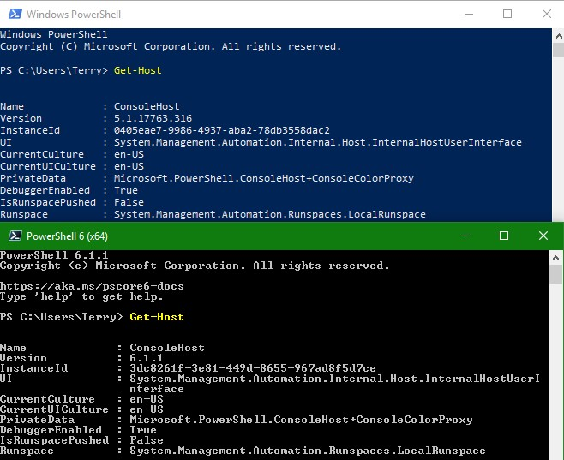
Update-MSWordReplaceText
By Terry E Dow
2019-03-02

Slide 2
Update-MSWordReplaceText
Why use Update-MSWordReplaceText?
To make multiple bulk text substitutions in a Microsoft Word document.
When to use Update-MSWordReplaceText?
Automated document generation from source MS Word template documents.

Slide 3
Output of Update-MSWordReplaceText
Opens a MS Word source document and a substitution table MS Excel compatible CSV files.
Process the whole source document executing text Find/Replace.
If there are any replacements made a new MS Word document is saved.
Source text formatting is retained.

Slide 4
Out file of Update-MSWordReplaceText options
Common Out File options
The out file is generated by default in a subfolder called '.\Reports\'. The out file name is in the format of:
<BaseName>[-<ExecutionSource>]-<date/time/timezone stamp>[-<OutFileNameTag>].<Extension>
OutFolderPath - Specify which folder path to write the out file. Supports UNC and relative reference to the current script folder. Except for UNC paths, this function will attempt to create and compress the output folder if it doesn't exist. The default is .\Reports subfolder.
ExecutionSource - Specify the script's execution environment source.
Must be either; 'msExchOrganizationName', 'ForestName', 'DomainName', 'ComputerName', or an arbitrary string including '' or $NULL.
If msExchOrganizationName is requested, but there is no Microsoft Exchange organization, ForestName will be used.
If ForestName is requested, but there is no forest, DomainName will be used. The forest name is of the executing computer's domain membership.
If the DomainName is requested, but the computer is not a domain member, ComputerName is used. The domain name is of the executing computer's domain membership.
An arbitrary string can be used in the case where the Microsoft Exchange organization name, forest name or domain name is too generic (e.g. 'EMAIL', 'CORP' or 'ROOT'), or the purpose of the out file is external.
Defaults is msExchOrganizationName.
OutFileNameTag - Optional comment string added to the end of the output file name. If similar runs are needed use this to keep their out file names unique and meaningful.
AlertOnly - When used only the invalid items are reported. The out file exists only the invalid items are found.
If parameter -Debug or -Verbose is specified, then a second file, a PowerShell transcript (*.TXT), is created with the same name and in the same location.

Slide 5
Requirements:
Microsoft Word (tested with 2016) installed.
Windows PowerShell 3 or better.
Microsoft Excel is not required.

Slide 6
Prepare MS Excel compatible CSV file
The Comma Separated Value (CSV) must have at least two column headings (case insensitive), all other columns are ignored:
Find,Replace
For example: FindReplace-EXAMPLE.csv
Find,Replace
<Greeting>,Mr. John Q. Public
<FirstName>,John

Slide 7
Prepare MS Word document
Insert key words in the template MS Word document.
“<“ and “>” are MS Word and Excel safe characters to wrap around key words to avoid unintentional matches.
For example: MyTemplate-EXAMPLE.docx
Dear <Greeting>,
<FirstName> we have a new opportunity we wanted to share with you.

Slide 8
Example for Update-MSWordReplaceText
Example execution:
Read source document from MS Word file:
MySource-EXAMPLE.docx
Use substitution table from MS Excel compatible CSV file:
FindReplace-EXAMPLE.csv
Update-MSWordReplaceText -Path .\MySource-EXAMPLE.docx
-FindReplacePath .\FindReplace-EXAMPLE.csv

Slide 9
Result of Update-MSWordReplaceText
If there are no text match replacements no file is written.
A new MS Word document file is saved, named:
.\Reports\MySource-EXAMPLE-19991231T235959+1200.docx
If parameter -Debug or –Verbose is specified, then a second file, a PowerShell transcript (.log), is created with the same name and in the same location.
.\Reports\MySource-EXAMPLE-19991231T235959+1200.log

Slide 10
Result of Update-MSWordReplaceText
.\Reports\MySource-EXAMPLE-19991231T235959+1200.docx:
Dear Mr. John Q. Public,
John we have a new opportunity we wanted to share with you.

Slide 11
Prepare for execution
Before implementing, import the required function files into the current PowerShell session.
. .\New-OutFilePathBase.ps1
. .\Update-MSWordReplaceText.ps1

Slide 12
Sample provided
Review the following files as an example:
Update-MSWordReplaceText-EXAMPLE.csv
Update-MSWordReplaceText-EXAMPLE.cmd
Update-MSWordReplaceText-EXAMPLE.docx

