Slide 1
Segmentation of CT Lung Scans
Using Image Processing Techniques
Terry Griffin
COMP.5230 Computer Vision I
Spring 2018

Slide 2
The Problem
Lung cancer remains one of the leading causes of death
Computed tomography (CT) scans are very useful for lung cancer detection
Manually analyzing these scans is difficult
Computer-aided diagnosis systems can help in efficient early detection

Slide 3


The Goal
From a CT chest scan:
1. Identify the two lungs
2. Separate the lungs into the five lobes

Slide 4
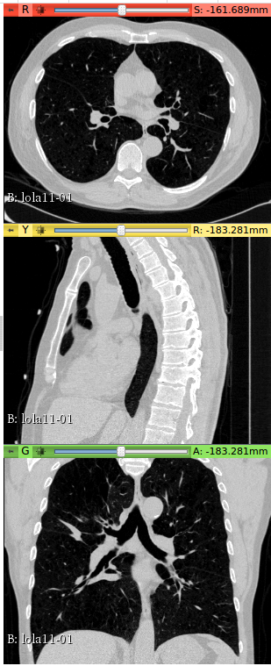
CT Scan (the Input Data)
3 Dimensional image in MetaImage format
Signed 16-bit gray scale in Hounsfield units
Three datasets
LOLA11 (55 scans)
LUNA16 (100 scans)
Tianchi (40 scans)
512x512 slices, usually 200-700 slices
Anisotropic

Slide 5
Toolkit
C++
Insight Toolkit (ITK)
Support for MetaImage format
Full support for 3D image data
Designed for working with medical images
Python for rapid prototyping and testing

Slide 6
Lung Segmentation Approach
Thresholding to remove background and separate lungs from surrounding body mass
Separate the two lung volumes
Filtering to smooth the lung boundary and fill small internal holes

Slide 7
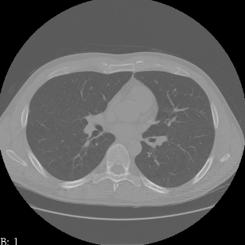
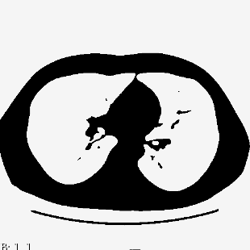
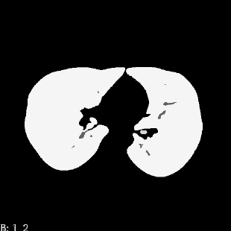
Thresholding Step
Threshold out background at -3024
Find adaptive threshold to identify lungs and body mass
Use connected component analysis to identify lungs

Slide 8
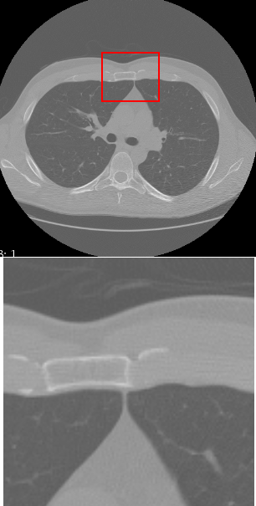
Separating the Left and Right Lung
Lungs are often very close together at a few places
Use dynamic programming to find a max cost path from bottom to top of each axial slice
If lungs are still connected in 3D, use erosion to remove connecting tissue

Slide 9
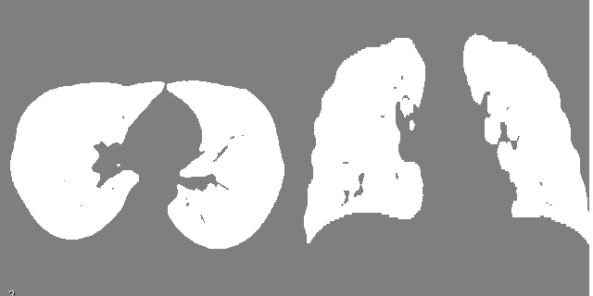

Final Smoothing Step
Use dilation and erosion to smooth boundary and fill holes

Slide 10
Evaluation
Manual checking of axial and coronal middle slices for LOLA11 and Tianchi scans
All scans were segmented correctly
Quantiative comparison with reference segmentation for LUNA16 scans

Slide 11
LUNA16 Scan Results
 | Overlap | Specificity | Sensitivity
Mean | 0.95 | 0.99 | 0.96
Min | 0.67 | 0.91 | 0.80
Max | 0.98 | 1.00 | 0.98
Std Dev | 0.04 | 0.01 | 0.02
Good overall performance
Preference for false negatives over false positives
A few lung masks had significant internal holes
False positive voxels form small ring around reference boundary

Slide 12
Attempted Lobe Segmentation Method
Identify sheet-like fissures using Eigen values of Hessian matrix
Segment blood vessels and airways and construct distance maps
Combine image data, fissure measure, and distance maps into a cost image
Use a watershed algorithm to segment a lung into the lobes
Problem:
Could not get watershed algorithm to successfully segment lobes

Slide 13
Conclusions
Lung segmentation using image processing techniques can be successful
Determining the correct set of processes and parameters is non-trivial
The parameters may depend on a particular dataset
Lobe segmentation is significantly more difficult than lung segmentation
Supposition: Deep learning may be a better approach

Slide 14
Questions

