Slide 1
Segmentation of CT Lung Scans
Using Image Processing Techniques
Terry Griffin

Slide 2
The Problem
Lung cancer remains on of the leading causes of death.
Computed tomography (CT) scans are very useful for lung cancer detection.
Manually analyzing these scans is difficult.
Computer-aided diagnosis systems can help in efficient early detection.

Slide 3
Segmentation
The segmentation problem involves separating the lung tissue from
  Blood vessels
  Air passages
  Surrounding bone and muscle
Also label the sections of the lung (lobes)

Slide 4
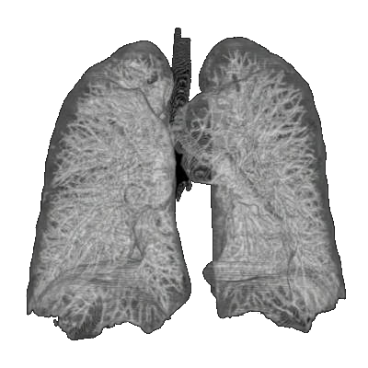
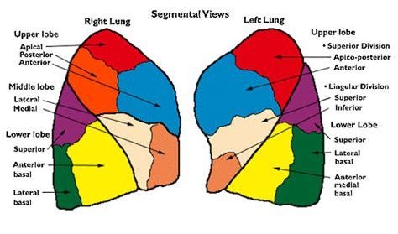
Segmentation
Go from this:
To this:

Slide 5
The Question
What are the best image processing techniques for solving the segmentation problem and what level of results can be expected?

Slide 6
The Plan
Research best known methods
Implement a system using OpenCV and C++
Evaluate the system on the LOLA11 and
LUNA16 datasets

Slide 7
Timeline
Literature search - March 17
Design and implementaton – April 14
Evaluation and documentation – May 1

Slide 8
Questions?

