Slide 1
Three Experiments on CNNs for Object Detection in Chest X-rays
Terry Griffin
COMP.5300.205 Deep Learning
Spring 2020

Slide 2
Overview
This project consists of three experiments on Convolutional Neural Networks (CNNs) used for the detection of manifestations related to Tuberculosis in X-ray images.
Reducing the number of parameters for transfer learning with grayscale images.
Comparing the performance of R-CNN, Mask R-CNN, Cascade R-CNN, and Cascade Mask R-CNN.
Using manifestation specific location information to reduce false positives.

Slide 3
1. Transfer Learning
Uses the weights from a previously trained network as a starting point.
Many projects use weights from the ImageNet challenge.
  Image classification task.
  1.2 million images.
  1,000 classes.
Fine-tune the full network or only part for the new task.
  Deep learning frameworks allow enabling or disabling of training each layer.

Slide 4
Transfer Learning for X-ray Image
Many projects use ImageNet pretrained weights.
ImageNet contains color (3 channel) images, X-rays are grayscale (1 channel).
Can we modify a model to use 1 channel input and still use the pre-trained weights?
Is the reduction in the number of parameters significant?

Slide 5
Converting a Model to Single Channel Input
Instead of expanding the grayscale image from one channel to three, we can modify the kernels to work on a single channel image:
Replace
with
where

Slide 6
Pytorch Code Model Conversion
Converting a PyTorch model from three channels to single channel input requires two changes to the first convolutional layer:
1. Set the number of input channels to 1
2. Update the parameter weights (kernels) by summing across the depth dimension and multiplying by 3.
def resnet_grayscale_model(model):
conv = model.conv1
if conv.in_channels > 1:
with torch.no_grad():
conv.in_channels = 1
conv.weight = nn.Parameter(conv.weight.sum(dim=1, keepdim=True) * 3)
def densenet_grayscale_model(model):
conv = model.features.conv0
if conv.in_channels > 1:
with torch.no_grad():
conv.in_channels = 1
conv.weight = nn.Parameter(conv.weight.sum(dim=1, keepdim=True)* 3)
Notes: Different models require custom implementation dependent code

Slide 7
Parameter Reduction
Comparison of the number of parameters for three channel and single channel models.
Some selected results:
Model | Number of Parameters for Three Channel Input | Number of Parameters for One Channel Input | Difference
ResNet18 | 11,689,512 | 11,683,240 | 0.054%
ResNet50 | 25,557,032 | 25,550,760 | 0.025%
ResNet101 | 44,549,160 | 44,542,888 | 0.014%
DenseNet121 | 7,978,856 | 7,972,584 | 0.079%
DenseNet169 | 14,149,480 | 1,4143,208 | 0.044%

Slide 8
Conclusions
The reduction in the number of parameters is insignificant.
The model implementation dependent conversion code is a weak point.

Slide 9
2. Comparing Models for Object Detection
As part of previous work a Mask R-CNN model for object detection of four TB manifestations was created.
This experiment compares the performance of four models on each of the four manifestations:
  Mask R-CNN (the previously developed model)
  R-CNN
  Cascade Mask R-CNN
  Cascade R-CNN

Slide 10
Implementation Details
Models were created using the PyTorch framework and the Detectron2 library.
The dataset for each manifestation was divided into: 80% training, 10% validation, 10% test
Each model architecture was tuned separately.
The COCO mean average precision (mAP) and average precision at a threshold of 0.50 (AP50) are used evaluation.

Slide 11
Example Results
Results for the Airspace Consolidation manifestation.
Other manifestations show similar trends between models.
Network | Backbone | mAP | AP50
R-CNN | ResNet-50 | 0.3625 | 0.7184
Mask R-CNN | ResNet-50 | 0.3313 | 0.6705
Cascade R-CNN | ResNet-50 | 0.3718 | 0.7094
Cascade Mask R-CNN | ResNet-50 | 0.3299 | 0.6785
R-CNN | ResNet-101 | 0.4002 | 0.7990
Mask R-CNN | ResNet-101 | 0.3583 | 0.7871
Cascade R-CNN | ResNet-101 | 0.3992 | 0.7882
Cascade Mask R-CNN | ResNet-101 | 0.3602 | 0.7891

Slide 12
Conclusions
R-CNN outperforms Mask R-CNN by a small amount.
  Possibly due to the easier task
Cascade versions did not show any improvement over base models.
  May be due to the limited size of the dataset

Slide 13
3. Using Location Information to Reduce False Positives
CNNs are inherently translation independent.
Some TB manifestations occur only in certain locations in the lungs.
Create a heatmap for each manifestation based on the locations in the training and validation set.
Use the heatmap as a filter in a post inference step.

Slide 14
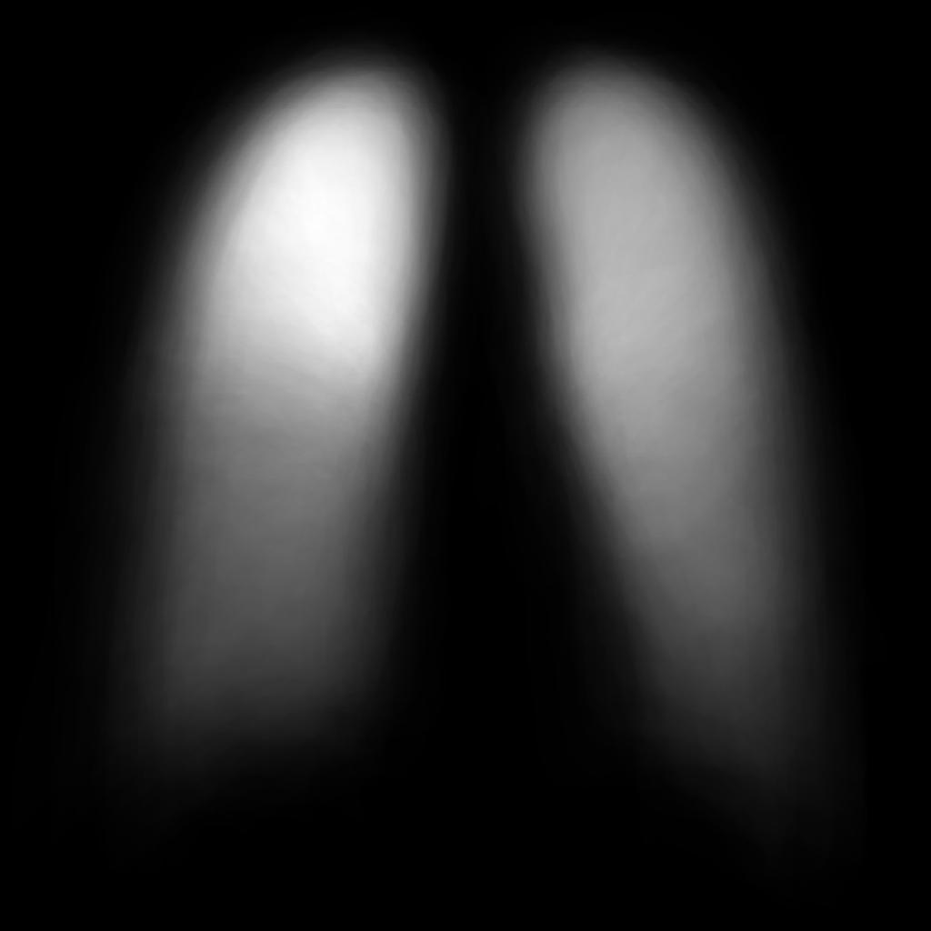
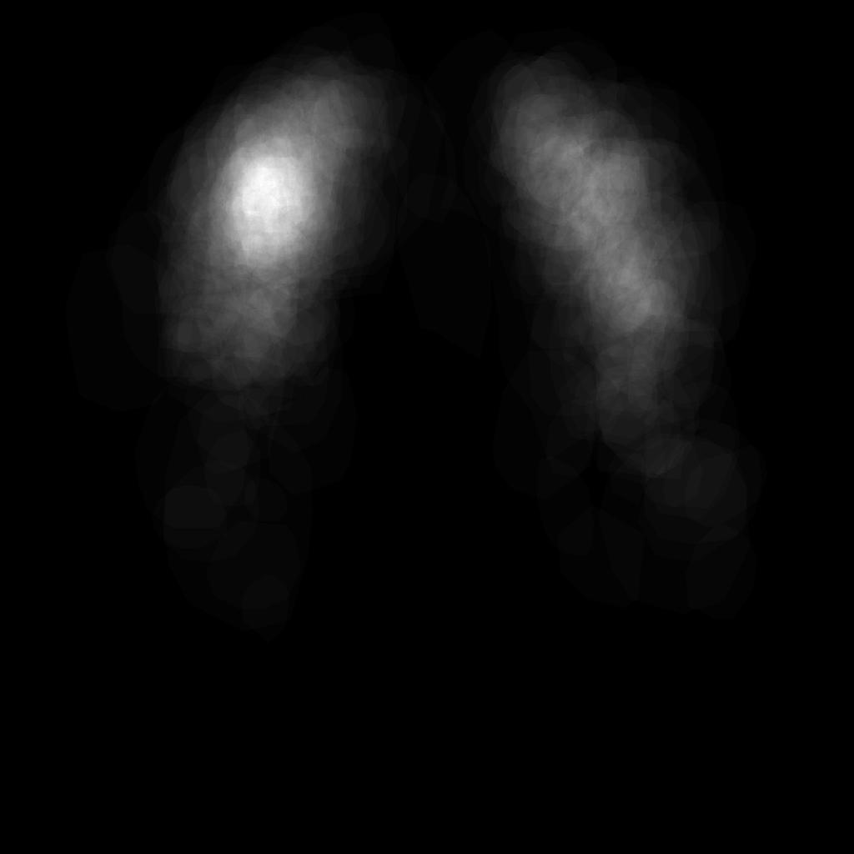
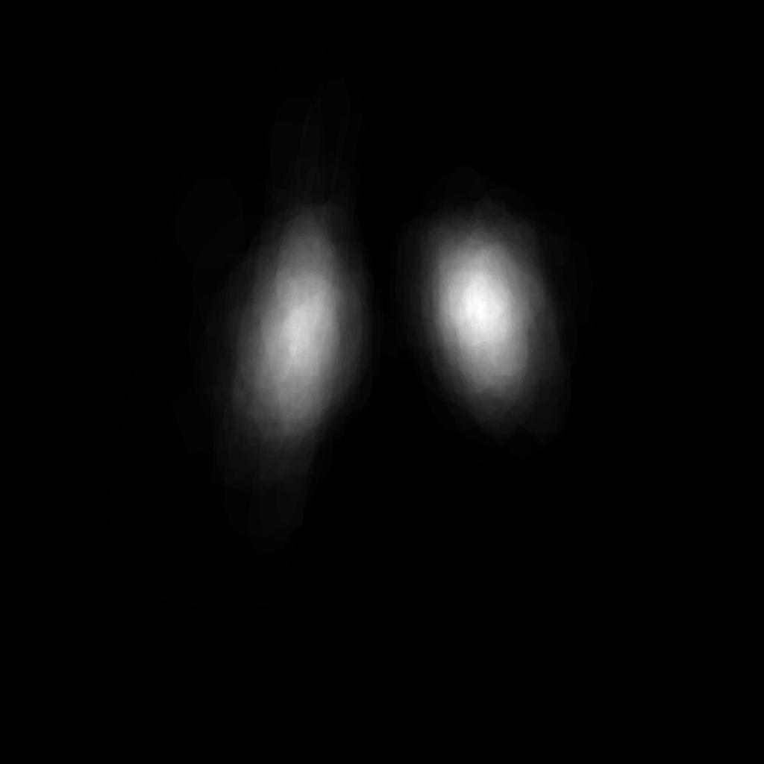
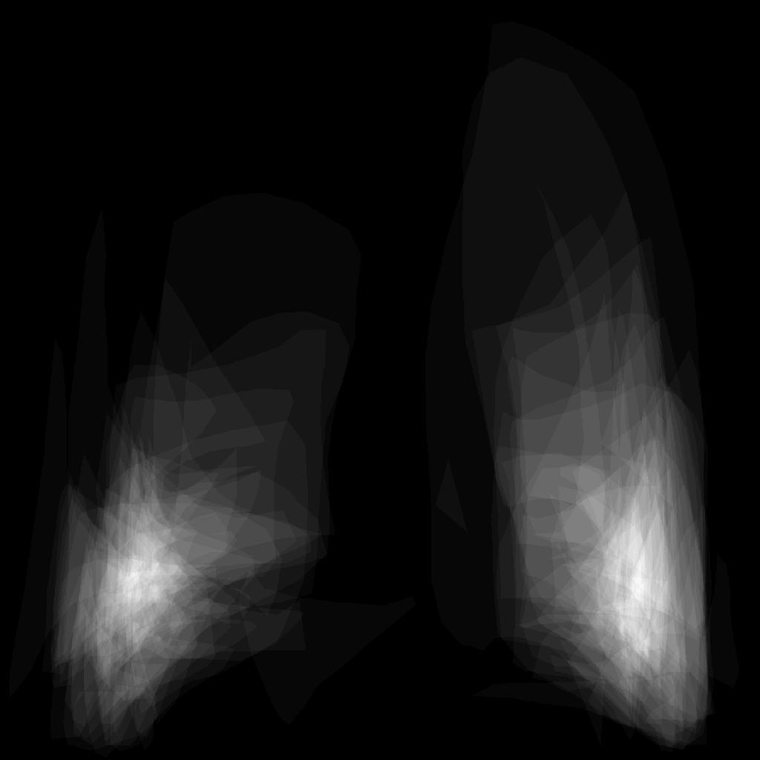
Manifestation Heatmaps
Airspace Consolidation
Cavitation
Lymphadenopathy
Pleural Effusion
Airspace consolidation and Cavitation do not show a strong relationship with location, while Lymphadenopathy and Plueral Effusion do

Slide 15
Implementation
The heatmaps were incorporated into the processing of the evaluation function.
Any instance whose bounding box on the heatmap did not contain any value above a given threshold was removed.
The evaluation function is used on the validation and test sets. The data was not fed back into the network during training (a good next step).

Slide 16
Results
No difference in performance for Airspace Consolidation and Cavitation.
No additional false negatives were created for Lymphadenopathy or Pleural Effusion.
For Lymphadenopathy 8 out of 40 false positives were removed.
For Pleural Effusion 3 out of 8 false positives were removed.

Slide 17
Questions
?

