Slide 1
Modeling of Reference Schemes
Terry Halpin
e-mail: t.halpin@live.com
/39
© 2015, T. A. Halpin

Slide 2
Contents
Introduction
Simple Reference Schemes
Compound Reference Schemes
Disjunctive Reference Schemes
Context-Dependent Reference Schemes
Conclusion
/39

Slide 3
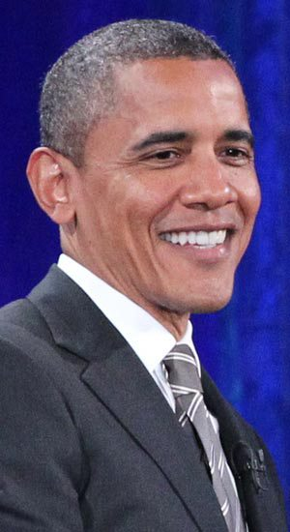
Introduction
Natural ways of referring to objects (individual things)
Ostension (pointing at the object of interest)
Linguistic expressions
Proper names
e.g. “Barack Obama”
Definite descriptions
e.g. “The (current) president of the USA”
For computerised systems, linguistic reference schemes are typically used. However, there are major differences in the way that popular data modeling and ontological modeling languages support such reference schemes.
/39

Slide 4
We now review how reference schemes are supported in:
UML (Unified Modeling Language)
Barker ER (Barker version of Entity Relationship modeling)
ORM (Object-Role Modeling)
RDB (Relational Databases)
OWL (Web Ontology Language)
Understanding the differences in how these languages support reference schemes is important for:
Modeling identification schemes within these languages
Even if we use artificial, surrogate ids as primary identifiers, we still need a natural way for humans to identify objects
Transforming models from one language to another
/39

Slide 5
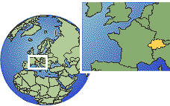


Simple Reference Schemes
Object Types in ORM
In ORM, an object is any individual thing of interest
(other than null).
An object may be:
an entity (e.g. a specific country)
a domain value (e.g. a specific country code)
a data value (e.g. the character string ‘CH’)
“≈” means “is represented by”
IATA = International
Air Transport Association
/39

Slide 6
Value Reference
ORM allows any kind of object (including a value)
to play the role of the subject in a fact reading,
e.g.
The CountryCode ‘CH’ is based on the Language named ‘Latin’.
The PersonTitle ‘Mr’ is restricted to the Gender with GenderCode ‘M’.
The EnglishWord ‘gorse’ is a post-synonym of the EnglishWord ‘furze’.
This can also be modeled directly in RDBs.
UML, ER, and OWL do not allow this directly,
so require domain values that are subjects to be artificially remodeled as entities
(e.g. see next slide).
/39

Slide 7
ORM:
Verbalization of join subset constraint:
If some Patient has some PersonTitle
that is restricted to some Gender
then that Patient is of that Gender.
UML:
/39

Slide 8
ORM:
RDB:
/39

Slide 9
Alternative ORM solution, with PersonTitle independent
(as in the UML solution shown earlier).
RDB:
/39

Slide 10
NORMA demo
/39

Slide 11
Ideally, the UI should prevent constraint violations from even occurring.
e.g. enforce the join-subset constraint by dependent drop-down lists
where the drop-down list itself is determined by the gender entry.
/39

Slide 12


Referencing an entity by relating it to a single value
In this case, an entity is identified by one of the following
an individual constant
a single attribute
a single relationship to a value
E.g. each country may be identified by its
ISO 3166 alpha-2 country code (e.g. ‘AU’ or ‘CH’)
or by its current name (e.g. ‘Australia’ or ‘Switzerland’).
Those countries with a previous name can also be
referenced by that name (e.g. ‘Ceylon’ for Sri Lanka).
In the following models, country codes provide the preferred reference scheme.
/39

Slide 13
ORM:
≡
RDB:
Barker ER:
UML:
Only ORM captures the exclusion constraint graphically.
Barker ER and UML also fail to graphically capture the uniqueness constraints
on current and previous country names.
/39

Slide 14
OWL has no standard graphic notation, but has
five textual languages that may be used to declare ontologies:
RDF/XML
OWL/XML
Manchester Syntax
Turtle
Functional Syntax
Of these, Manchester syntax is by far the most readable, so we use that.
Named individuals are identified by Internationalized Resource Identifiers (IRIs),
e.g. www.eg.org#Czech_Republic.
These may be based on actual proper names (excluding spaces),
or be surrogate IRIs.
Human-readable labels may be added using rdfs:label annotation properties.
Assuming IRIs are provided, the Country model (ignoring the exclusion constraint)
may be coded in Manchester syntax as shown on the next slide.
/39

Slide 15
DataProperty: hasCountryCode
Domain: Country
Range: xsd:string
Characteristics: Functional
DataProperty: hasCurrentCountryName
Domain: Country
Range: xsd:string
Characteristics: Functional
DataProperty: hasPreviousCountryName
Domain: Country
Range: xsd:string
Characteristics: Functional
Class: Country
SubClassOf: hasCountryCode min 1
HasKey: hasCountryCode
SubClassOf: hasCurrentCountryName min 1
HasKey: hasCurrentCountryName
HasKey: hasPreviousCountryName
The HasKey declarations
capture just the
uniqueness constraints
on the right-hand roles.
HasKey declarations are
needed to do this, because
OWL forbids data properties
(that relate entities to literals)
to be declared inverse-functional.
/39

Slide 16
Referencing an entity by relating it to a single entity
OWL allows object properties (that relate entities to entities)
to be declared inverse-functional.
In OWL, entities may be:
named individuals (identified by an IRI)
unnamed individuals (represented by blank nodes).
Hence OWL supports reference schemes that identify entities by relating them to other entities.
E.g. see the TopPolitican model on the next slide.
Here, the term “top politician” means the politician who is considered to be the head politician (e.g. a president, a prime minister) of a country.
If a country has both a president and a prime minister,
only one of these is considered the head politician.
/39

Slide 17
ORM:
RDB:
e.g. sample data
(when Julia Gillard was Oz PM)
UML:
Barker ER does not support this kind of reference scheme
(although it allows relationships as components of a primary identifier,
it does not allow a single relationship to provide the whole identifier).
OWL code (in Manchester syntax) for this example is shown on the next slide.
/39

Slide 18
DataProperty: hasCountryCode
… (see earlier code sample for details)
Class: Country
SubClassOf: hasCountryCode min 1
HasKey: hasCountryCode
ObjectProperty: headsCountry
Domain: TopPolitician
Range: Country
Characteristics: Functional, InverseFunctional
ObjectProperty: wasBornInCountry
Domain: TopPolitician
Range: Country
Characteristics: Functional
Class: TopPolitician
SubClassOf: headsCountry min 1
SubClassOf: wasBornInCountry min 1
/39

Slide 19

The first row of the RDB table records the fact that
the top politician who heads Australia (country code = ‘AU’)
was born in the United Kingdom (country code = ‘GB’).
We can record this without knowing the name of the politician (Julia Gillard).
In OWL, this fact may be coded using blank node ids for unnamed individuals.
Individual: _:p1
Facts: headsCountry _:c1, wasBornInCountry _:c2
Individual: _:c1
Facts: hasCountryCode "AU"
Individual: _:c2
Facts: hasCountryCode "GB"
/39

Slide 20
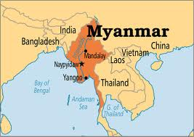
OWL individuals may be named (with one or more IRIs) or be unnamed.
Class: Country
HasKey: hasCountryCode
Individual: Myanmar
Facts: hasCountryCode "MM"
Individual: Burma
Facts: hasCountryCode "MM"
Individual: Burma
SameAs: Myanmar
/39

Slide 21
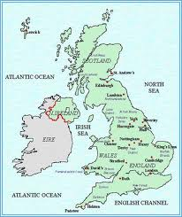
Class: Country
HasKey: hasCountryCode
Individual: JuliaGillard
Facts: wasBornInCountry _:c1
Individual: _:c1
Facts: hasCountryCode "GB"
Individual: TheUK
Facts: hasCountryCode "GB"
Will an OWL reasoner now infer the following?
Individual: JuliaGillard
Facts: wasBornInCountry TheUK
No! HasKey declarations apply only to named individuals
(unlike InverseFunctional declarations).
OWL allows that there could be many unnamed individuals that have the country code “GB”, not just the named individual TheUK.
/39

Slide 22
Typical databases adopt closed world semantics, and treat declarations such as “Each person was born in some country” as constraints, so an update attempt to record a person without his/her birth country will be rejected.
In contrast, OWL adopts open world semantics, and treats many declarations
simply as propositions, not as constraints.
e.g.
ObjectProperty: wasBornInCountry
Domain: Person
Range: Country
Characteristics: Functional
Class: Person
SubClassOf: wasBornInCountry min 1
The OWL code declares that each person was born in exactly one country,
but it does not require that we know which country a recorded person is born in.
So care is required when mapping between data modeling approaches and OWL. Some recent proposals have made to extend OWL to cater properly for constraints (see references [7] and [22] in the first Selected Resources paper).
/39

Slide 23
Compound Reference Schemes
A composite reference scheme for an entity identifies it using a combination of two or more attributes or relationships, e.g.
ORM:
RDB:
/39

Slide 24
Barker ER:
The composite uniqueness constraint on x and y coordinate pairs is lost.
UML:
Again, the composite uniqueness constraint on x and y coordinate pairs is lost.
OCL code could be added, but OCL is often difficult for domain experts to validate.
/39

Slide 25
In OWL, the unary isWindowed predicate is replaced by a binary data property
that maps Room to Boolean.
The rest of the schema may be coded in a similar way to that discussed earlier.
The reference predicates are coded as HasKey properties (see below), but these are effective only if meaningful IRIs (or additional labels) are supplied (e.g. “Room3-205” for Room 205 in Building3).
Class: Building
HasKey: hasBuildingNr
HasKey: hasXcoordinate, hasYcoordinate
Class: Room
HasKey: isInBuilding, hasRoomNr
/39

Slide 26
Disjunctive Reference Schemes
Join Semantics for External Uniqueness Constraints
r1 P1
r2 P1
r3 P2
r4 P2
This external uniqueness constraint
has inner join semantics
P1
P1 left outer join P2
r1 r2
r3 r4
P2
inner join:
r4 name
All roles (named or unnamed) may be referenced by their roleId.
Role names are optional in ORM,
but within the same predicate, role names must be distinct.
Hence, named roles may also be referenced by the combination of their name and predicate.
/39

Slide 27
This external uniqueness constraint
has outer join semantics
(with the added proviso that
nulls are treated as actual values)
}
violates
constraint
C4 Mechanics ?
All courses may be referenced by their courseCode.
Some courses might not offered by a department (e.g. a course by a visitor),
but courses offered by the same department must have distinct titles.
Each course may also be referenced by exactly one of the following patterns:
courseTitle and its department
courseTitle where the course has no department
/39

Slide 28
Reference schemes involving a disjunction of two or more patterns
are known as disjunctive reference schemes.
External uniqueness constraints with outer join semantics
may be used for the preferred reference scheme. In this case, a double-bar is used.
If at least one referencing relationship is optional for its entity type,
an external uniqueness constraint with inner join semantics
cannot be used for the preferred reference scheme
since it can be used to reference only some instances of the entity type.
/39

Slide 29
The general, weakest pattern allowed
for disjunctive reference (n > 1).
If used for preferred reference, use a double-bar.
∀y₁..y_{n} ∃^{0..1}x (xR₁y₁ & … & xR_{n}y_{n})
&
∀y ∃^{0..1}x [xR₁y & ~∃z(xR₂z … ∨ xR_{n}z)]
& …
& ∀y₁..y_{n-1} ∃^{0..1}x (xR₁y₁ & … & xR_{n-1}y_{n-1} & ~∃z xR_{n}z )
Inner join part.
The outer join part
covers all patterns where
1 or more components is
absent.
E.g.
∀ct:CourseTitle,d:Department ∃^{0..1}c:Course (c hasCourseTitle ct & c isOfferedBy d)
& ∀ct:CourseTitle ∃^{0..1}c:Course [c hasCourseTitle ct & ~∃d:Department c isOfferedBy d]
/39

Slide 30
An example of the weakest disjunctive reference pattern
used for secondary reference of non-origin points on a Cartesian plane.
/39

Slide 31
Simplified version of a model for botanical naming.
Some plant kinds are identified purely by their genus, e.g. Agrostis.
Some are identified by combining genus and species name, e.g. Acacia interior.
Others are identified by combining genus, species name and infraspecies (itself identified by combining rank and infraname), e.g. Eucalyptus fibrosa ssp. nubila.
/39

Slide 32

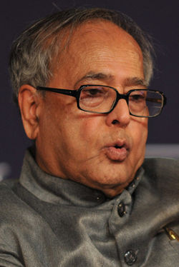
A uniqueness constraint with a double-bar, one bar of which is solid and one dotted, may be used to reference just some instances of the relevant entity type.
A disjunctive reference scheme for the entity type may then be provided by two or more such partial, preferred reference relationships, e.g.
Unlike our earlier example, this allows a
country to have two top politicians, e.g.
The TopPolitican who is prime minister of India
The TopPolitican who president of India
Narendra Modi
Pranab Mukerjee
/39

Slide 33
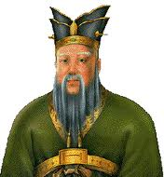

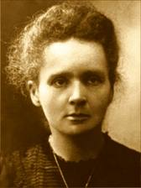
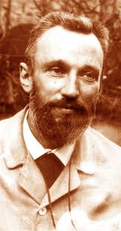
In this example,
some famous persons may be identified by
just a popular name, e.g. ‘Confucius’
(instead of ‘Kong Qui’).
Some may be identified by just their family name, e.g. ‘Einstein’
Others may be identified by
combining their family name with a given name,
e.g. ‘Marie Curie’,
‘Pierre Curie’
/39

Slide 34
Disjunctive reference schemes can be mapped from ORM to RDB schemas,
but are not supported in the graphical notation of Barker ER or UML.
HasKey properties in OWL have inner join semantics,
so cases like this can be coded in OWL,
along with the usual limitations discussed
for HasKey properties discussed earlier.
Disjunctive reference with outer join semantics
can be implemented in OWL but some remodeling is typically required,
e.g. to create a partition of relevant subclasses, e.g.
/39

Slide 35
Context-Dependent Reference Schemes
In a context-dependent reference scheme,
the preferred identifier for an entity varies according to its context.
ORM supports this by allowing subtypes to introduce new preferred reference schemes used within the scope of their immediate fact types
(displayed by a dashed subtyping link), e.g.
/39

Slide 36
Mapping of context-dependent reference schemes from ORM to RDBs is discussed in Halpin & Morgan, 2008 (pp. 519-521).
Barker ER and UML have no direct support for this notion.
However, UML’s implicit use of oids for class instances provides support for global identifiers.
OWL allows multiple IRIs for the same entity, and use of the owl:sameAs predicate to equate individuals.
This can be used to provide basic support for context-dependent reference.
/39

Slide 37
Conclusion
Reference Scheme Support | ORM | RDB | Barker ER | UML | OWL
simple, primary | Yes | Yes | Yes, except for entity-to-entity | Yes | Yes, with limitations
simple, secondary | Yes | Yes | No | No | Yes, with limitations
compound, primary | Yes | Yes | Yes | Yes | Yes, with limitations
compound, secondary | Yes | Yes | No | No | Yes, with limitations
disjunctive | Yes | Yes | No | No | Yes, but remodeling is sometimes needed
context-dependent | Yes | Yes | No | Partly | Partly
Future research plans include extending the NORMA tool with full support for the new disjunctive reference cases (including automated verbalization) and automated mapping between ORM, RDB, ER, UML, OWL and datalog.
/39

Slide 38
Selected References
Halpin, T. 2013, ‘Modeling of Reference Schemes’,
BPMDS 2013 and EMMSAD 2013, eds. I. Bider et al. LNBIP 147,
Springer-Verlag, Berlin Heidelberg, pp. 308–323.
Halpin, T. 2015, ‘Modeling of Linguistic Reference Schemes’,
Int. Jnl. of Inf. Sys. Modeling and Design, (to be published), IGI Global.
Halpin, T. 2015, Object-Role Modeling Fundamentals, Technics Publications.
Halpin, T. & Morgan, T. 2008, Information Modeling and Relational Databases,
2nd edn, Morgan Kaufmann.
Halpin, T. 2010, ‘Object-Role Modeling: Principles and Benefits’,
Int. Jnl. of Inf. Sys. Modeling and Design, Vol. 1 (1), IGI Global.
/39

Slide 39
Relevant Websites
www.BRcommunity.com -- Business Rules Journal
www.orm.net -- My website
www.ORMFoundation.org -- ORM Foundation, and download
site for NORMA program + Labs
www.ORMsolutions.com -- browser-based model viewer, printer, …
/39

